Slide 1
Building Lean Systems
Based on the Book- Lean Supply Chain Using the Theory of Constraints
M.M. Srinivasan
Nothing focuses the mind better than the constant sight of a competitor who wants to wipe you off the map.
Wayne Calloway

Slide 2
Lean Production
Produce when needed. Match supply with demand. Deliver products quickly to the customer without large inventory.
Reduce Setup Times, to make it possible to switch from one product to the next easily.
When switching from one product to the next is not time consuming and is not costly, then instead of large batch sized you can produce in small batch sizes. Small Q.
Flexible Cross Trained Workers to be able to handle a variety of tasks on different parts of the process and on different products.
Large batch sizes are not good. We produce in large batch sizes because setup time is high. Large batches → large work-in-progress and finished goods (WIP&FG) inventories.
With plenty of WIP to buffer any production delays, defects found on the shop floor do not generate a sense of urgency to fix the problem, so it does not occur again. Worse, quality problems often escape unnoticed until after the product is sold.

Slide 3
Lean Production
Smooth Flow. Not too many up and downs, small batch sizes
Pull vs. Push System. Pull: Produce only what is needed and when it is needed, rather than in anticipation of a demand. Push: Produce and add to inventory.
Super Market. Each process is a supermarket for the succeeding process. Each production station arrayed its diverse output for the downstream station to pull when needed. Each process would produce to replenish only the items that the downstream process has consumed.
Eliminate waste (non-value-adding activities and resources).
Kanban. Limit the inventory of raw material, work-in-progress, and finished good.
Kaizen. Continuous improvement –
Ford had offered his customers cars in only one color to reduce changeover times. This was due to long changeover times. General Motors brought variety to stage.

Slide 4
Lean Production
The Japanese refused to accept changeover times (Setup Times) as a constraint. They focused relentlessly on Reducing Setup Times. They were enabled to provide variety without large lots.
Close Relationship with Supplies. A limited number of suppliers, certified supplier.
Operational Information are Transparent and Available to Suppliers. Suppliers need transparent access to production data to know when the next o order may arrive. If suppliers are left in the dark about when the next delivery request would come, they built up finished goods inventory so as to better respond to requests – this is contradictory to being lean throughout the supply chain.
Components should not be produced before they are needed. They should be made Just In Time.
Every step in the supply chain had to work in harmony to produce when a product is needed, not a single moment before. This philosophy never intend to have the supplier maintain a stock of finished goods to supply material just in time.

Slide 5
Lessons Learned
A close relationships with the suppliers is required. Long-term contracts are needed. Components cannot be sourced from multiple vendors mainly based on price.
Simply adopting tools and techniques piecemeal does not lead to a lasting lean competitive edge. Without a complete understanding of the core principles of lean thinking, there is considerable potential for doing more harm than good.
For instance, lean emphasizes eliminating waste - any activity that absorbs resources but creates no value. If the enterprise has not fully understood the core concepts of lean, waste-removal activities could lead it down the wrong path.
We may think when non-value-adding activities are eliminated, the enterprise will become more efficient through workforce reduction. Nothing could be further from the truth. When lean is viewed as a cost-cutting initiative or an opportunity to reduce the workforce, employees will naturally resist it, leading to eventual migration back to the old way of doing things.

Slide 6
Lessons Learned
On the other hand, if it is made clear that freed-up resources would be productively deployed elsewhere, implementation efforts would have a much better chance of success. Freeing up resources for productive deployment elsewhere is at the very core of lean thinking.
Lean is a growth strategy ➔ uncovering additional capacity ➔ deployed for further growth ➔ the money that enterprises do not have to spend now.
Eliminate muda (waste). Eliminate any activity that creates no value
Lean is a way to do more & more with less & less
  Less effort, less equipment, less time, and less space;
  While coming closer and closer to providing customers exactly what they want
Reduce inventory, changeover (setup) time, Waiting line, additional move & Transport

Slide 7
SEVEN Deadly Sources of Muda (waste)
Overproduction
Inventories
Transportation
Delays
Defective products
Processing
Motion

Slide 8
Enable Flow: River Analogy
A "river and rocks" analogy likens the water level to the inventory level in a facility. A higher water level hides potential blemishes in the process. As the water level is lowered, these problems surface, forcing management to correct. The key is to resist to reduce the inventory level too quickly. Lower the water level a little, break apart the exposed rocks (obstacles), and then lower the water level once again.
Scrap
Capacity Imbalances
Large Setup Times
Unreliable Suppliers

Slide 9
The Read Cost of Inventory
Has cost
  Physical carrying costs – we need storage and human resources.
  Financial costs (Opportunity Cost) – We could have invested our capital elsewhere and benefit from it. In the LFT Game financial cost is 10% of the cost of goods.
Has risk of obsolescence
  Due to change in customer preferences, and due to technological changes.
Hides problems
  Even if we produce low quality product, there is enough inventory downstream.
  Untrustworthy suppliers, machine breakdowns, long changeover times, too much scrap do not show up.
  Long flow time, Feedback loop is long. not-uniform operations.

Slide 10
The Lean System
As attempts are made to reduce inventory levels, other major elements that should be in place are
  Reliable Processes
  Preventive Maintenance Systems
  Cross-trained Workers
  Setup Reduction Programs
  Reliable Suppliers.
  Partnership With Supplies, Production (Operation) Schedule Visibility
If these are not already present in a factory, putting them in place takes time-it cannot happen overnight. The Japanese spent bout 20 years perfecting the system before the US automakers observed TPS.

Slide 11
The Lean System
For the boat to move faster, all the oars should be in the water at the same time.
  Balance the flow across the supply chain
  Have all processes working at the same rate
Having some resources working faster than others will pile up inventory. Making sure all resources respond to pull signals ensures a smooth flow of products across the enterprise, or the supply chain.

Slide 12
The important lean thinking tools to promote flow
5s
Flow Chart the Process
Value-Added and Non-Value Added Activities
Takt Time
Average Labor Content- Minimum Required Manpower
Mixed Model Scheduling
One Piece Flow
Cellular Layout
Standard Work
Pull Replenishment: Placing a Cap on WIP
Point-of-Use Material Storage
Mistake Proofing and Method Sheets
Continuous Improvement and the Pursuit of Perfection

Slide 13
5S: A systematic process for organizing the workplace
Japanese | Definition | English | Example
Seiri | Tidiness. Throw Away Rubbish. | Sorting | Items are classified as Necessary, Unnecessary (disposed of immediately), Red tag (auctioned for anyone to claim as necessary). No claim → discarded
Seiton | Organization. Retrieve in 30-seconds | Storing | Arrange items in order so that they can be picked up easily. Visual information about what & how much should be stored in a spot. Tools are hung on boards, with a silhouette (shadow box) of the tool painted. Drawers have Styrofoam cutouts of the items to be stored.
Seiso | Cleanliness. keeping the area clean, and organized. | Sanitizing | Individual Responsibility. Not just sweeping the floor and cleaning up leaks and spills. Checks for malfunctioning machinery or loose parts on machines. If machines are kept clean, oil leaks will be discovered before a equipment failure. If aisles are clean, accidents are minimized, etc.
Seiketsu | Neatness. | Standardizing | Standards by which personnel must measure and maintain personal and environmental "cleanliness." What the normal condition should be. How an abnormal condition should be corrected. Visual management; by color-coding and standardization of colors for easier identification of problems. Personnel are trained to detect such problems using one or more of their five senses and to correct them immediately.
Shitsuke | Discipline | Sustaining | Do 5S Activities Daily and continually

Slide 14

Identify Value & Non-Value Added Activities
Value added; An activity that adds value to the product in the eyes of the customer. Non-Value added: any thing else.
Identifying and reducing NVA activities is key to streamlining a process.
The Value added ratio. Total VA time divided by the total process time. While the it depends on the industry, a ratio of 10% is suggested. It is 1.8% in the next flow chart. It indicates the amount of waste and opportunities for lean efforts to remove waste.
Process flow chart ➔ captures the logical sequence of activities ➔ to eliminate NVA activities.
Spaghetti diagram ➔ depicts the physical movement of products ➔ the extent of travel, and back-tracking. To come out with a better layout.
The process flow chart should be drawn after 5S. If before, lack of attention to simple housekeeping activities may obfuscate some of the NVA activities. For instance, the operators could be taking more time to change tooling simply because they cannot find the tools, and that may be reflected in the time standards set for tool changeover.

Slide 15
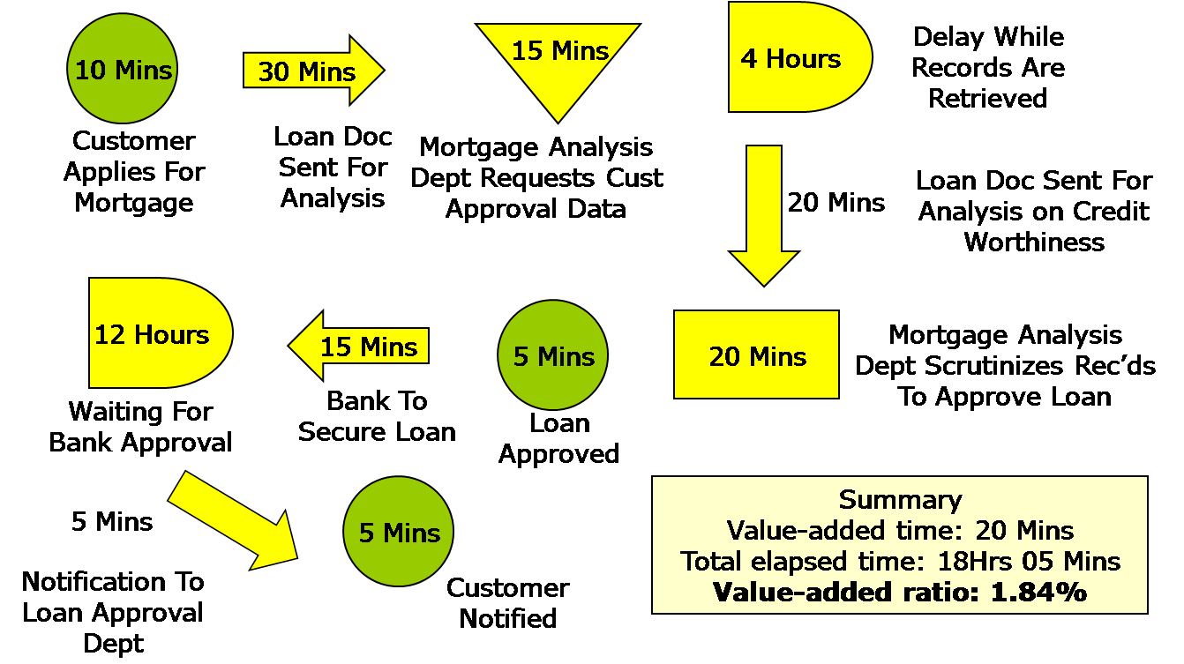
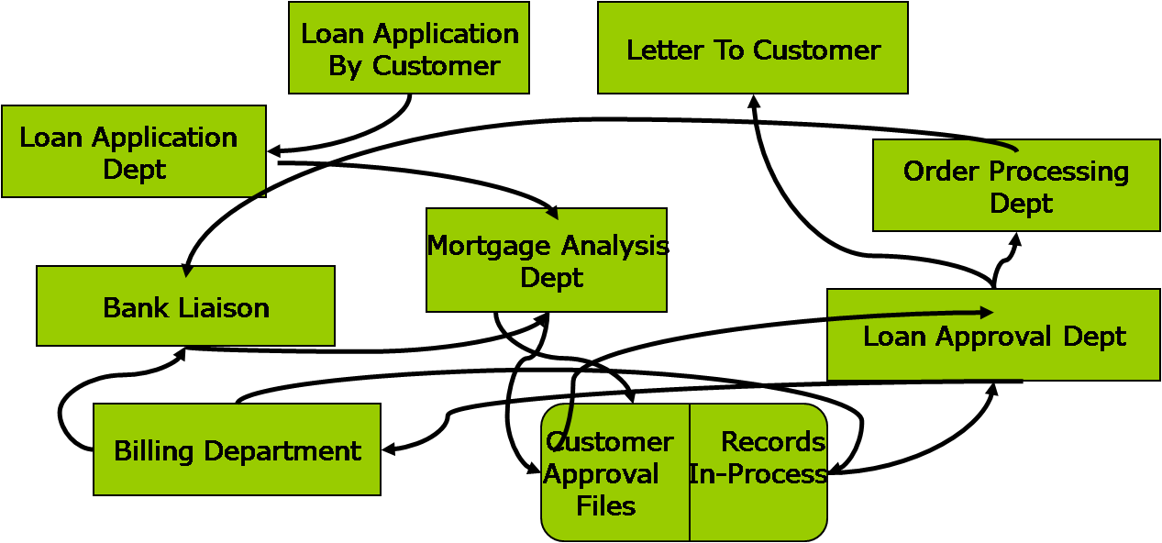
Process Flow Chart and Spaghetti Diagram

Slide 16
Origin of Takt Time
German engineers helped Japan build aircrafts in 30s. Takt is a German word for a musical meter. Customer demand dictated the pace of operations on the shop-floor.
Takt Time links the customer demand (external) to production resources (internal) .
Demand is 20 policies/day. Available time is 400 minutes/day. Compute the takt time.
$$\text{Takt} \text{Time}=\frac{\text{Available} \text{Time} \text{per} \text{Period}}{\text{Demand} \text{per} \text{Period}}$$
$\text{Takt} \text{Time}=\frac{\text{Available} \text{Time} \text{per} \text{Period}}{\text{Demand} \text{per} \text{Period}}$ = $\frac{\text{400}}{\text{20}}$ = 20 minutes
There are four sub-processes; Distribution (data gathering/ data entry, Underwriting (risk analysis), Rating (computing the premium), and Policy writing

Slide 17
Load Balancing?
An operator can not be overloaded. Apply time studies to lower the time or breakdown the task.
Loading each operator close to 100 percent may lead to infinite queue if the workload is highly variable (negative).
Keep operators loaded close to 100% to motivate them to find creative ways to reduce their cycle time to takt time (positive).
If the operators are underutilized, work expands to fill the time available (negative).
takt time goes down when demand increases. Then some operator may become overloaded.
Subdivide tasks more finely, to load each operator close takt time. However, that would uniformly underutilize each operator.
A better alternative is to have the first two operators loaded with tasks that add up to the takt time, leaving the third under-loaded.

Slide 18
Takt Time is a Measure of External Demand
The third operator could help if the others fall behind. S/he could be located at the end of the cell to perform material handling.

Slide 19
Takt Time is a Measure of External Demand
If each operator is paced to takt time, over production will be automatically limited. Limiting overproduction prevents frequent stops and starts that inhibit a smooth flow.
It's best to buffer variation with capacity, not inventory.
It is incorrect stating that a machine has a takt time of five minutes. Takt time is a measure of external demand; it has nothing to do with machine capacity. Takt is the time that we have (market oriented) to produce a flow unit, not the time we need (capacity oriented).
Enterprise should match its (internal) resources to meet the (external) customer demand.
Takt time applies better to a flow shop, may not be very relevant in job shop, but still useful to determine the number of operators.
Takt time could be reevaluated if the demand exceeds the set production rate for 5 consecutive days (Run Test). Distinguish between noise and real trends.
  If we change it too frequently ➔ Chaos
  If it is not flexible, and we cannot change it ➔ Missed opportunities, Inventory buildup

Slide 20
Internal vs. External Takt Time
Takt Time allows to smooth external demand variation
130
Demand
Production
Run 2
120
Run 1
110
100
90
80
0
5
10
15
20
25
30
Day

Slide 21
Average Labor Content
Average labor content is the minimum number of workers to sustain operations.
Demand percentages for Hungama, Inc., Tasks
 | RUNS | RAPS | RAINS | RERUNS
Jobs/Day | 4 | 12 | 6 | 18
% of Total | 10% | 30% | 15% | 45%
Operation times for Hungama, Inc. in (Minutes)
 | RUNS | RAPS | RAINS | RERUNS
Distribution | 58 | 50 | 44 | 28
Underwriting | 43 | 40 | 23 | 19
Rating | 72 | 65 | 68 | 75
Policy writing | 67 | 0 | 55 | 50
Total Labor | 240 | 155 | 190 | 172
Available time per day is 400 mins. Demand is 40 per day.
$$\text{Takt} \text{Time}=\frac{\text{Availab}\text{le} \text{Time}}{\text{Demand}}=\frac{\text{400}}{\text{40}}=10 \text{minutes}$$

Slide 22
Average Labor Content
Average labor content = 0.10 (240) + 0.30 (155) + 0.15 (190) + 0.45(172) = 176.4 min
ALC for Distribution = (0.10 x 58) + (0.30 x 50) + (0.15 x 44) + (0.45 x 28) = 40 minutes.
Since Takt time is 10 min, the minimum number of operators allocated to Distribution task will be 4. (40/10 = 4)

Slide 23
Practice: Pleasant Valley Health Clinic
The Pleasant Valley Health Clinic treats patients with respiratory illnesses. It classifies patients according to four different types of respiratory problems (commonly referred to as Diagnostic Related Groups, or DRGs): Bronchiolitis (BRO), Pneumonia (PNE), Pharyngitis (PHA) and Sinusitis (SIN). The average number of patients treated per day are summarized below. The clinic works two shifts, from 7:00 am to 3 pm and from 3 pm to 11 pm. During a shift, the staff are provided a half hour lunch break and two rest breaks of 15 minutes each.
Each patient typically requires 4 process steps: Check-In (includes weigh-in, blood pressure check, etc.), Evaluation (by a physician), Testing (X-Rays, administering of respiratory instruments like Pulse Oximeters, etc.), and Assessment (diagnosis and future scheduling). The average task time for each process (in minutes) is given below:

Slide 24
Pleasant Valley Health Clinic: Task Durations
Tasks 1, 3, and 4 are typically handled by RNs. Task 2 is handled by a physician. For simplicity, we assume that the arrival rates of patients are constant through both shifts. Average Work Content = 80.87 minutes. Daily demand; BRO: 15, PNE: 24, PHA: 25, SIN: 36. A total of 100.
Time available in a day: 2 shift @ 8 hrs less 0.5 (lunch) - 0.5 (2 breaks) = 14 hours = 840 minutes
Takt time = Time Available / Daily Demand = 840/100 = 8.40 minutes / request
Min. # of RNs required = 80.87/8.4 = 9.627 ➔ 10

Slide 25

Takt Time for Pleasant Valley Health Clinic
Average Work Content = 80.87 minutes.
Daily demand; BRO: 15, PNE: 24, PHA: 25, SIN: 36. A total of 100.
Time available in a day: 2 shift @ 8 hrs less 0.5 (lunch) - 0.5 (2 breaks) = 14 hours = 840 minutes
Takt time = Time Available / Daily Demand
= 840/100 = 8.40 minutes / reques
Min. # of RNs required = 80.87/8.4 = 9.627 ➔ 10

