Slide 1
Throughput Analysis
Multi-Product Flow
Ardavan Asef-Vaziri

Slide 2
Lean Operations
Providing greater value for customers
Eliminating waste and non-value-added activities
  Waste on Flow Units- longer flow time
  Waste on Resources- lost of capacity
These will lead to ⇓cost (⇑efficiency), ⇑quality, ⇓flow time (quick response time, ⇓days of supply), and ⇑flexibility.

Slide 3
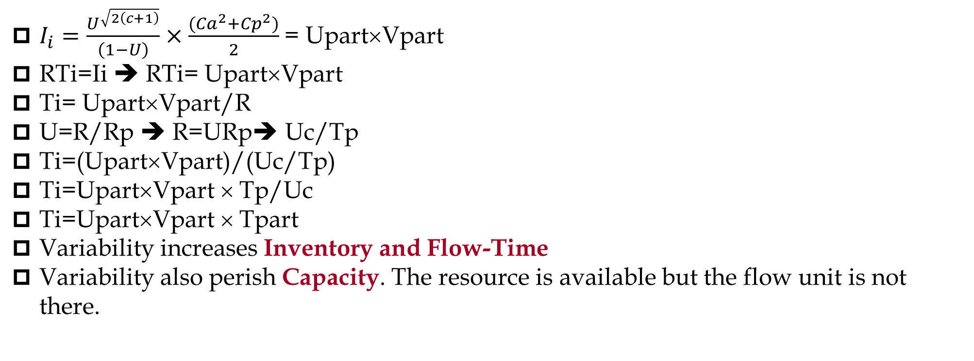
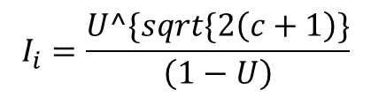
Reduce Variability
$I_{i}=\frac{U^{\sqrt{2\left(c+1\right)}}}{\left(1−U\right)}×\frac{{(Ca}^{2}{+Cp}^{2})}{2}$ = Upart×Vpart
RTi=Ii ➔ RTi= Upart×Vpart
Ti= Upart×Vpart/R
U=R/Rp ➔ R=URp➔ Uc/Tp
Ti=(Upart×Vpart)/(Uc/Tp)
Ti=Upart×Vpart × Tp/Uc
Ti=Upart×Vpart × Tpart
Variability increases Inventory and Flow-Time
Variability also perish Capacity. The resource is available but the flow unit is not there.
$$I_{i}=\frac{U^\{sqrt\{2\left(c+1\right)\}}{\left(1−U\right)}$$

Slide 4
Reduce Setup Time/Cost
The Japanese refused to accept changeover times (Setup Times) as a constraint. They focused relentlessly on Reducing Setup Times and Cross Trained Workers. They were enabled to provide variety without large lots.
Large Setup time leads to large batches.
It is against the principle of smooth flow as claimed by Henry Ford.
Large Batches increases Inventory & Flow-time.
Separate External Parts and Internal Parts
Do Internal parts in parallel.
Short setup time makes it possible to switch from one product to the next easily.
When switching from one product to the next is not time consuming and is not costly, then we can produce in small batches.

Slide 5
Batch Size Reduction- One Piece Flow
Wait-to-Batch time & Wait-in-Batch time is short- leading to all the benefits of low inventory and short flow time
Better Quality since small batches do not hide defective items
Short Information turn-around time
Easy material handling – small batches
Several operations can be close to each others – perhaps in a U-Shape cell since there is room for small batches
Responsiveness & flexibility to change.
Large batches → large work-in-progress and finished goods (WIP&FG) inventories.
With plenty of WIP to buffer any production delays, defects found on the shop floor do not generate a sense of urgency to fix the problem, so it does not occur again. Worse, quality problems often escape unnoticed until after the product is sold.

Slide 6
Flexible Resources
ord had offered his customers cars in only one color to reduce changeover times. This was due to long changeover times. General Motors brought variety to stage.
General Purpose & Multi-Purpose Machines.
Cross Trained Workers
Dong more than one task on a machine or by one person- reduces material handling (transportation).
Flexible Cross Trained Workers to be able to handle a variety of tasks on different parts of the process and on different products.

Slide 7
Cellular Layout
General Purpose & Multi-Purpose Machines.
Cross Trained Workers
Dong more than one task on a machine or by one person- reduces material handling (transportation).
Flexible as takt time changes, allows add/subtract work force, allows combing duties.
A mixture of job shop and flow shop for producing a family of product with somehow similar set of required operations.
Reduces movement and facilitates 1 piece flow
Improves visibility, operators can see each others
Motivates team-work.
U shape most common, also T, Z, L shape, and loop.

Slide 8
Lean Production
Smooth Flow. Not too many up and downs, level flow, small batch sizes.
Pull vs. Push System. Pull: Produce only what is needed and when it is needed, rather than in anticipation of a demand. Push: Produce and add to inventory.
Supermarket. Each process is a supermarket for the succeeding process. Each production station arrayed its diverse output for the downstream station to pull when needed. Each process would produce to replenish only the items that the downstream process has consumed.
Kanban. Limit the inventory of raw material, work-in-progress, and finished good.
Kaizen. Continuous improvement –

Slide 9
Lean Production
Close Relationship with Supplies. A limited number of suppliers, certified supplier.
Operational Information are Transparent and Available to Suppliers. Suppliers need transparent access to production data to know when the next o order may arrive. If suppliers are left in the dark about when the next delivery request would come, they built up finished goods inventory so as to better respond to requests – this is contradictory to being lean throughout the supply chain.
Every step in the supply chain had to work in harmony to produce when a product is needed, not a single moment before. This philosophy never intend to have the supplier maintain a stock of finished goods to supply material just in time.
Components should not be produced before they are needed (Push). They should be made Just In Time (Pull).

Slide 10
Lean Production
A close relationships with the suppliers is required. Long-term contracts are needed. Components cannot be sourced from multiple suppliers mainly based on price.
Simply adopting tools and techniques piecemeal does not lead to a lasting lean competitive edge. Without a complete understanding of the core principles of lean thinking, there is considerable potential for doing more harm than good.
We may think when non-value-adding activities are eliminated, the enterprise will become more efficient through workforce reduction. Nothing could be further from the truth. When lean is viewed as a cost-cutting initiative or an opportunity to reduce the workforce, employees will naturally resist it, leading to eventual migration back to the old way of doing things.
On the other hand, if it is made clear that freed-up resources would be productively deployed elsewhere, implementation efforts would have a much better chance of success. Freeing up resources for productive deployment elsewhere is at the very core of lean thinking.

Slide 11
Lean Production
Lean is a growth strategy ➔ uncovering additional capacity ➔ deployed for further growth ➔ the money that enterprises do not have to spend now.
Eliminate muda (waste). Eliminate any activity that creates no value
Lean is a way to do more & more with less & less
  Less effort, less equipment, less time, and less space;
  While coming closer and closer to providing customers exactly what they want
Reduce inventory, changeover (setup) time, Waiting line, additional move & Transport
Seven Deadly Source of Muda (Waste): Overproduction, Inventories, Transportation, Delays, Defective products, Processing (when not needed), Motion (when not needed)

Slide 12
Enable Flow: River Analogy
A River and Rocks analogy likens the water level to the inventory level in a facility. A higher water level hides potential blemishes in the process. As the water level is lowered, these problems surface, forcing management to correct. The key is to resist to reduce the inventory level too quickly. Lower the water level a little, break apart the exposed rocks (obstacles), and then lower the water level once again.
Scrap
Capacity Imbalances
Large Setup Times
Unreliable Suppliers

Slide 13
The Lean System
As attempts are made to reduce inventory levels, other major elements that should be in place are: Setup Time Reduction, Cross-Trained Workers
Reliable Processes, Preventive Maintenance Systems, Reliable Suppliers.
Partnership With Supplies, Production (Operation) Schedule Visibility
For the boat to move faster, all the oars should be in the water at the same time.
  Balance the flow across the supply chain
  Have all processes working at the same rate
Having some resources working faster than others will pile up inventory. Making sure all resources respond to pull signals ensures a smooth flow of products across the enterprise, or the supply chain.

Slide 14
The Read Cost of Inventory
Has cost
  Physical carrying costs – we need storage and human resources.
  Financial costs (Opportunity Cost) – We could have invested our capital elsewhere and benefit from it. In the LFT Game financial cost is 10% of the cost of goods.
Has risk of obsolescence
  Due to change in customer preferences, and due to technological changes.
Hides problems
  Even if we produce low quality product, there is enough inventory downstream.
  Untrustworthy suppliers, machine breakdowns, long changeover times, too much scrap do not show up.
  Long flow time, Feedback loop is long. not-uniform operations.

Slide 15

Identify Value & Non-Value Added Activities
Value added; An activity that adds value to the product in the eyes of the customer. Non-Value added: any thing else.
Identifying and reducing NVA activities is key to streamlining a process.
The Value Added ratio. Total VA time divided by the total process time. While the it depends on the industry, a ratio of 10% is suggested. It is 1.8% in the next flow chart. It indicates the amount of waste and opportunities for lean efforts to remove waste.

Slide 16
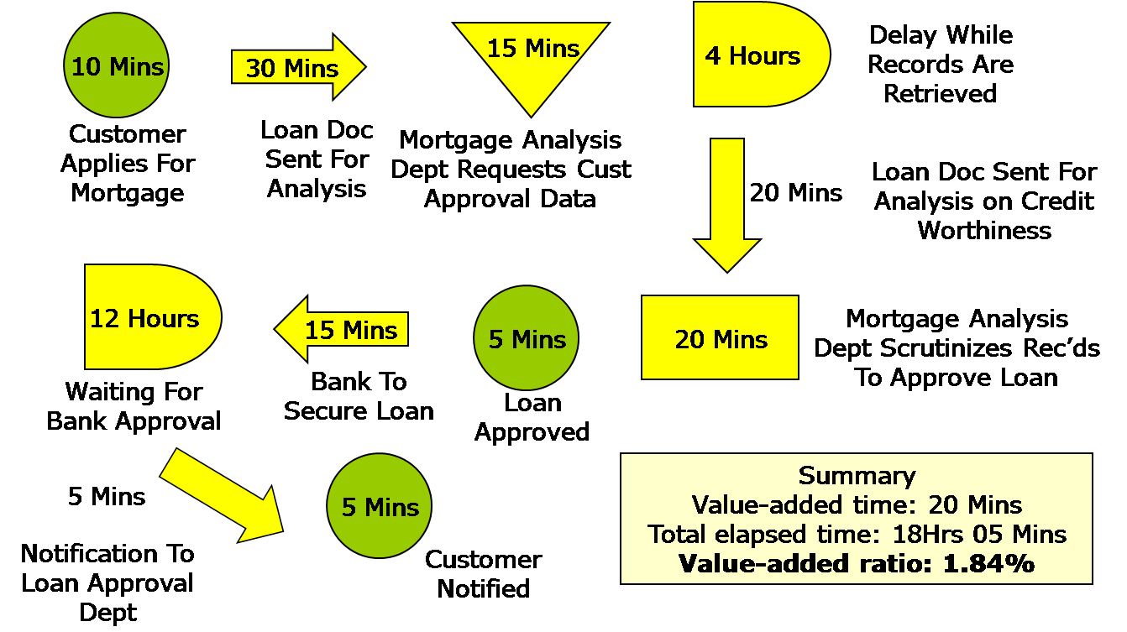
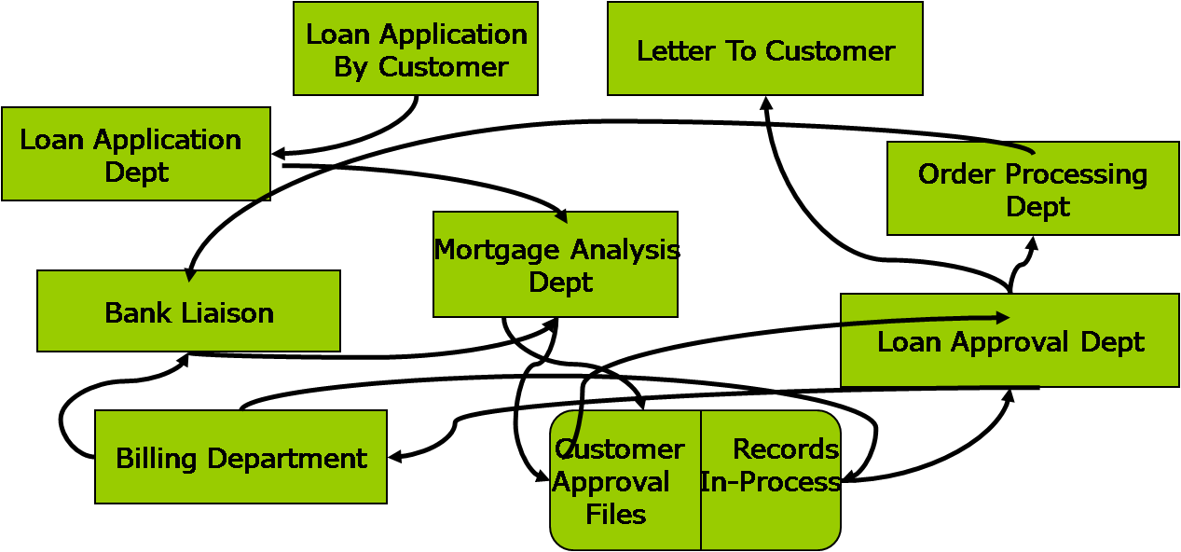
Process Flow Chart and Spaghetti Diagram
Spaghetti Diagram ➔ depicts the physical movement of products ➔ the extent of travel, and back-tracking. To come out with a better layout.
Process Flow Chart ➔ captures the logical sequence of activities ➔ to eliminate NVA activities.

Slide 17
Mixed-Model Scheduling and Small Batch Production
In a perfect world, when the customer pulls a product from the final station, a signal is generated on each upstream resource to produce exactly what is pulled.
In the real world, changeover time, material availability, or operator availability motivates large batch production.
When inventory goes up, flow time goes up.
Produce products at the same rate at which customer demands are made.
In a lean system, products flow smoothly through the enterprise with no delays

Slide 18
Mixed-Model Scheduling and Small Batch Production
Mixed-model scheduling
  Evenly distributing the production of different products over a period of time
  Changeover or setup times must be small
  Small batching in the presence of setup times
  Cross Trained Workers for Flexibility
Demand per hour A(3), B(2), and C(1).
10 min/part assembly time. 10 hrs/day, 5d/week.
Batch size is one week of demand; A(150), B(100), C(50).
Instead of receiving products every hour, the customer will receive them once a week. The average inventory is 75 As, 50 Bs, and 25 Cs.

Slide 19
Mixed Model Scheduling Example
If production per hour was A(3), B(2), C(1), the finished goods inventory would be negligible because production would match hourly demand.
A pattern of AAABBC is a good hourly schedule, it could be more finely sequenced as follows: ABACAB.
Production in large batches
  uneven workload
  uneven demand for output of the previous station
  production is not synchronized with demand.
Mixed-model production:
  smooth work-load
  smooth demand for output of the previous station
  Allows production to match customer demand.

