Slide 1
Building Lean Systems
Based on the Book- Lean Supply Chain Using the Theory of Constraints
M.M. Srinivasan
Nothing focuses the mind better than the constant sight of a competitor who wants to wipe you off the map.
Wayne Calloway

Slide 2
Stop Here
Stop Here
Stop Here
Stop Here

Slide 3
The important lean thinking tools to promote flow
5s
Flow Chart the Process
Value-Added and Non-Value Added Activities
Takt Time
Average Labor Content- Minimum Required Manpower
Mixed Model Scheduling
One Piece Flow
Cellular Layout
Standard Work
Pull Replenishment: Placing a Cap on WIP
Point-of-Use Material Storage
Mistake Proofing and Method Sheets
Continuous Improvement and the Pursuit of Perfection

Slide 4
5S: A systematic Process for Organizing the Workplace
Japanese | Definition | English | Example
Seiri | Tidiness. Throw Away Rubbish. | Sorting | Items are classified as Necessary, Unnecessary (disposed of immediately), Red tag (auctioned for anyone to claim as necessary). No claim → discarded
Seiton | Organization. Retrieve in 30-seconds | Storing | Arrange items in order so that they can be picked up easily. Visual information about what & how much should be stored in a spot. Tools are hung on boards, with a silhouette (shadow box) of the tool painted. Drawers have Styrofoam cutouts of the items to be stored.
Seiso | Cleanliness. keeping the area clean, and organized. | Sanitizing | Individual Responsibility. Not just sweeping the floor and cleaning up leaks and spills. Checks for malfunctioning machinery or loose parts on machines. If machines are kept clean, oil leaks will be discovered before a equipment failure. If aisles are clean, accidents are minimized, etc.
Seiketsu | Neatness. | Standardizing | Standards by which personnel must measure and maintain personal and environmental "cleanliness." What the normal condition should be. How an abnormal condition should be corrected. Visual management; by color-coding and standardization of colors for easier identification of problems. Personnel are trained to detect such problems using one or more of their five senses and to correct them immediately.
Shitsuke | Discipline | Sustaining | Do 5S Activities Daily and continually

Slide 5
Origin of Takt Time
German engineers helped Japan build aircrafts in 30s. Takt is a German word for a musical meter. Customer demand dictated the pace of operations on the shop-floor.
Takt Time links the customer demand (external) to production resources (internal) .
Demand is 20 policies/day. Available time is 400 minutes/day. Compute the takt time.
$$\text{Takt} \text{Time}=\frac{\text{Available} \text{Time} \text{per} \text{Period}}{\text{Demand} \text{per} \text{Period}}$$
$\text{Takt} \text{Time}=\frac{\text{Available} \text{Time} \text{per} \text{Period}}{\text{Demand} \text{per} \text{Period}}$ = $\frac{\text{400}}{\text{20}}$ = 20 minutes
There are four sub-processes; Distribution (data gathering/ data entry, Underwriting (risk analysis), Rating (computing the premium), and Policy writing

Slide 6
Load Balancing?
An operator can not be overloaded. Apply time studies to lower the time or breakdown the task.
Loading each operator close to 100 percent may lead to infinite queue if the workload is highly variable (negative).
Keep operators loaded close to 100% to motivate them to find creative ways to reduce their cycle time to takt time (positive).
If the operators are underutilized, work expands to fill the time available (negative).
takt time goes down when demand increases. Then some operator may become overloaded.
Subdivide tasks more finely, to load each operator close takt time. However, that would uniformly underutilize each operator.
A better alternative is to have the first two operators loaded with tasks that add up to the takt time, leaving the third under-loaded.

Slide 7
Takt Time is a Measure of External Demand
The third operator could help if the others fall behind. S/he could be located at the end of the cell to perform material handling.

Slide 8
Takt Time is a Measure of External Demand
If each operator is paced to takt time, over production will be automatically limited. Limiting overproduction prevents frequent stops and starts that inhibit a smooth flow.
It's best to buffer variation with capacity, not inventory.
It is incorrect stating that a machine has a takt time of five minutes. Takt time is a measure of external demand; it has nothing to do with machine capacity. Takt is the time that we have (market oriented) to produce a flow unit, not the time we need (capacity oriented).
Enterprise should match its (internal) resources to meet the (external) customer demand.
Takt time applies better to a flow shop, may not be very relevant in job shop, but still useful to determine the number of operators.
Takt time could be reevaluated if the demand exceeds the set production rate for 5 consecutive days (Run Test). Distinguish between noise and real trends.
  If we change it too frequently ➔ Chaos
  If it is not flexible, and we cannot change it ➔ Missed opportunities, Inventory buildup

Slide 9
Internal vs. External Takt Time
Takt Time allows to smooth external demand variation
130
Demand
Production
Run 2
120
Run 1
110
100
90
80
0
5
10
15
20
25
30
Day

Slide 10
Average Labor Content
Average labor content is the minimum number of workers to sustain operations.
Demand percentages for Hungama, Inc., Tasks
 | RUNS | RAPS | RAINS | RERUNS
Jobs/Day | 4 | 12 | 6 | 18
% of Total | 10% | 30% | 15% | 45%
Operation times for Hungama, Inc. in (Minutes)
 | RUNS | RAPS | RAINS | RERUNS
Distribution | 58 | 50 | 44 | 28
Underwriting | 43 | 40 | 23 | 19
Rating | 72 | 65 | 68 | 75
Policy writing | 67 | 0 | 55 | 50
Total Labor | 240 | 155 | 190 | 172
Available time per day is 400 mins. Demand is 40 per day.
$$\text{Takt} \text{Time}=\frac{\text{Availab}\text{le} \text{Time}}{\text{Demand}}=\frac{\text{400}}{\text{40}}=10 \text{minutes}$$

Slide 11
Average Labor Content
Average labor content = 0.10 (240) + 0.30 (155) + 0.15 (190) + 0.45(172) = 176.4 min
ALC for Distribution = (0.10 x 58) + (0.30 x 50) + (0.15 x 44) + (0.45 x 28) = 40 minutes.
Since Takt time is 10 min, the minimum number of operators allocated to Distribution task will be 4. (40/10 = 4)

Slide 12
Practice: Pleasant Valley Health Clinic
The Pleasant Valley Health Clinic treats patients with respiratory illnesses. It classifies patients according to four different types of respiratory problems (commonly referred to as Diagnostic Related Groups, or DRGs): Bronchiolitis (BRO), Pneumonia (PNE), Pharyngitis (PHA) and Sinusitis (SIN). The average number of patients treated per day are summarized below. The clinic works two shifts, from 7:00 am to 3 pm and from 3 pm to 11 pm. During a shift, the staff are provided a half hour lunch break and two rest breaks of 15 minutes each.
Each patient typically requires 4 process steps: Check-In (includes weigh-in, blood pressure check, etc.), Evaluation (by a physician), Testing (X-Rays, administering of respiratory instruments like Pulse Oximeters, etc.), and Assessment (diagnosis and future scheduling). The average task time for each process (in minutes) is given below:

Slide 13
Pleasant Valley Health Clinic: Task Durations
Tasks 1, 3, and 4 are typically handled by RNs. Task 2 is handled by a physician. For simplicity, we assume that the arrival rates of patients are constant through both shifts. Average Work Content = 80.87 minutes. Daily demand; BRO: 15, PNE: 24, PHA: 25, SIN: 36. A total of 100.
Time available in a day: 2 shift @ 8 hrs less 0.5 (lunch) - 0.5 (2 breaks) = 14 hours = 840 minutes
Takt time = Time Available / Daily Demand = 840/100 = 8.40 minutes / request
Min. # of RNs required = 80.87/8.4 = 9.627 ➔ 10

Slide 14

Takt Time for Pleasant Valley Health Clinic
Average Work Content = 80.87 minutes.
Daily demand; BRO: 15, PNE: 24, PHA: 25, SIN: 36. A total of 100.
Time available in a day: 2 shift @ 8 hrs less 0.5 (lunch) - 0.5 (2 breaks) = 14 hours = 840 minutes
Takt time = Time Available / Daily Demand
= 840/100 = 8.40 minutes/request
Min. # of RNs required = 80.87/8.4 = 9.627 ➔ 10

Slide 15
Mixed Model Sequence for Volpens
Smallest possible sequence length = 1/0.09 = 11.11
Choose a 11 unit sequence; adjust every two cycles.
Note: A mixed model sequence is used to intentionally
vary work content and component requirements.

Slide 16
Mixed Model Sequence For Volpens
Seq. #
Model Desc.
Seq. #
Model Desc.
1
Blue Pen
18
Blue Shell
2
Red Pen
19
Red Pen
3
Blue Pen
20
Yellow Pen
4
Red Shell
21
Blue Pen
5
Blue Pen
22
Yellow Shell
6
Yellow Pen
23
Blue Pen
7
Blue Shell
24
Red Pen
8
Red Pen
25
Blue Pen
9
Yellow Pen
26
Red Shell
10
Blue Pen
27
Blue Pen
11
Yellow Shell
28
Yellow Pen
12
Blue Pen
29
Blue Shell
13
Red Pen
30
Red Pen
14
Blue Pen
31
Yellow Pen
15
Red Shell
32
Blue Pen
16
Blue Pen
33
Yellow Shell
17
Red Pen
34
Red Shell

Slide 17
One Piece Flow
Process 1
Process 4
60 units
60 units
Process 2
60 units
Process 3
60 units
Reduce lead time by reducing WIP
Move products between workstations
Average lead time = WIP/Throughput
What is the average lead time for the system above, if throughput is 100/week?
2.4 weeks

Slide 18

One Piece Flow
Process 1
Process 2
Process 3
Process 4
What is the average lead time for this system?
1 unit
1 unit
1 unit
1 unit
One piece could mean a pallet, a box etc.
Is not practical in every situation
One-piece flow may require relocation of the people/equipment.
A process layout (grouping operations by function) must be replaced by a product layout (arranging operations in the order of flow.)

Slide 19
Batch Process For Volpens, Ltd.
Cap Assy
Pen Assy
WIP
WIP
Label
Press
Peel&
Stick
Production
Scheduler
Test, Pack
& Ship
Inspect
Raw
Materials
Material Flow
Information Flow
Finished
Goods

Slide 20
Takt Time for Volpens, Ltd.
Monthly Demand =
No. of days per month = 16
Daily Demand =
Avail. Time/Day =
Takt Time =
68

Slide 21
Manpower requirements for Volpens Ltd.
Pessimistic times for the current activities
  Cap Assembly: 25 seconds
  Pen Assembly: 17 seconds for pens, 5 seconds for shells
  Label Making: 28 seconds
  Peel & Stick: 16 seconds
  Test,Pack,Ship: 15 seconds

Slide 22
Manpower requirements for Volpens Ltd.
Note that activities 3, 4, 5 are not performed for shells. Also, activity 2 is minimal for shells. The only activity done, for all items, is cap assembly.
The time for activity 3 includes an allowance for changing coils; excluding this allowance, a pessimistic time will be 23 seconds. Use this number for your calculations.

Slide 23
Minimum Manpower Required for Volpens, Ltd.
Monthly Demand for Pens = 48
Monthly Demand for Shells = 20
Total Monthly Demand = 68
Percentage Demand for Pens =
Percentage Demand for Shells =

Slide 24
Minimum Manpower Required for Volpens, Ltd.
  Activity Pens ( %) Shells ( %) Ave.Time/Unit
  Cap Assembly
  Pen Assembly
  Label Making
  Peel & Stick
  Test,Pack,Ship
  _____________
  Total Labor Content per Unit:
  Takt Time per Unit:
  Minimum Manpower Required =

Slide 25
Mixed Model Sequence for Volpens
Smallest possible sequence length = 1/0.09 = 11.11
Choose a 11 unit sequence; adjust every two cycles.
Note: A mixed model sequence is used to intentionally
vary work content and component requirements.

Slide 26
Mixed Model Sequence For Volpens
Seq. #
Model Desc.
Seq. #
Model Desc.
1
Blue Pen
18
Blue Shell
2
Red Pen
19
Red Pen
3
Blue Pen
20
Yellow Pen
4
Red Shell
21
Blue Pen
5
Blue Pen
22
Yellow Shell
6
Yellow Pen
23
Blue Pen
7
Blue Shell
24
Red Pen
8
Red Pen
25
Blue Pen
9
Yellow Pen
26
Red Shell
10
Blue Pen
27
Blue Pen
11
Yellow Shell
28
Yellow Pen
12
Blue Pen
29
Blue Shell
13
Red Pen
30
Red Pen
14
Blue Pen
31
Yellow Pen
15
Red Shell
32
Blue Pen
16
Blue Pen
33
Yellow Shell
17
Red Pen
34
Red Shell

Slide 27
Mixed Model Assembly Schedule for Volpens
Family: Pens
Week 3
Week 4
Week 5
Week 6
Blue Pen & Case PCB1
7
5
7
5
Red Pen & Case PCR2
4
3
4
3
Yellow
Pen&Case PCY3
2
3
2
3
Totals
13
11
13
11
Family: Shells
Week 3
Week 4
Week 5
Week 6
Blue Shell SB1
1
2
1
2
Red Shell SR2
2
2
2
2
Yellow Shell SY3
1
2
1
2
Totals
4
6
4
6

Slide 28
Mixed Model Scheduling: Lean Loading For Caps
Units
Workload
on Operators

Slide 29
Mixed Model Scheduling: Purchase Orders For Caps
Units
Units
Units

Slide 30
Implementing Mixed-Model Scheduling:
The Load-Leveling (Heijunka) Box
Part
8:00
8:15
8:30
8:45
9:00
9:15
9:30
9:45
10:00

Slide 31
Cellular Layout
A mixture of job shop and flow shop for producing a family of product with somehow similar set of required operations.
Reduces movement and facilitates 1 piece flow
Improves visibility, operators can see each others
Motivates team work.
Creates Cross-Trained work force.
Flexible as takt time changes, allows add/subtract work force, allows combing duties.
U shape most common, also T, Z, L shape, and loop.

Slide 32
Standard Work
Clear specification of how tasks should be performed.
The best sequence using the best combination of resources.
Fully documented, and all operators must follow. The operators should be involved in defining standard work. That way, they will improvement efforts in the future.
Consistency
  Fair output rates are established. Everyone is judged by the same standards.
  Improves safety. Also useful when training new employees.
  Leads to continuous improvement dues to collaboration of the work force.
Not against creativity; but every operator follow the best practices. The best practice may be a moving target; work force may come up with a better standard work.
Standard work is a set of tasks allocated to an operator, so standard work will also change when the takt time or the model mix changes.
The goals are to give each operator an amount of work less than or equal to the takt time while creating a compact footprint for each operator.

Slide 33
Pull Replenishment
Contain inventory usually using kanban (signal).
Transferred production responsibility to operators instead of a centralized scheduler to push in advance.
Downstream operator signal (kanban) upstream when parts are needed.
Requirements
  Repetitive demand and short lead times.
  Availability of components to produce when the visual signal is generated.
First step: how much inventory to buffer the downstream operator from the upstream operator.

Slide 34
In-process Kanban
Two types: In-process kanbans and Material kanbans.
In-process kanbans when the operations are close to each others. The upstream is triggered by a visual signal. A physical location will specify the maximum inventory that the upstream operator can place.
Stop production if the in-process kanban is full.
Paint a rectangle on the floor between the two operations where the parts should be placed.
If there are multiple part types, each might have a different color code. Each location or container has a number indicating the WIP inventory limit.

Slide 35
Material Kanbans
A production facility may use them to signal a replenishment of material from a supermarket or warehouse (a withdrawal kanban), another production facility (a production kanban), or a supplier (a supplier kanban). A production kanban is used in place of an in-process kanban if the upstream and downstream processes are far apart with no visibility.
The replenishment signals are usually transmitted either through a card or an electronic signal. Each card requests that a specific number of items be replenished.

Slide 36
How Kanbans Work: An Example
Inbound Buffer
Outbound Buffer
Inbound Buffer
Outbound Buffer
WS1
WS2
Supplier Kanban
Production Kanban
Withdrawal Kanban

Slide 37
Kanban Calculations
Number of kanbans =
# of cards required for system to work
Number of Kanbans =
D x (1 + SF) x KCT
+1
Kanban Size
D = Average Demand
SF = Safety Factor
KCT = Kanban Cycle Time (in terms of demand period)
(time for material to be replenished once a signal has been received)

Slide 38
Kanban Calculations: An Example
Parts per product
Model # of Parts of Z
A 1
B 3
C 2
Daily demand per product
Model Demand
A 21
B 16
C 32
KCT = Replenishment Time = 0.25 day
SF = Safety Factor = 0.10
K = Kanban Size = 15

Slide 39
The Formula
The formula assumes that the signal to replenish a container of parts is triggered when the container becomes empty.
Two unknown values: (1) the number of kanban cards (2) the kanban size.
kanban size is determined in consultation with the supplier, or the upstream facility or the supermarket based on a variety of factors, such as standard container sizes or ergonomic issues.
The formula is used to determine the number of cards in circulation.
Some enterprises use a two-bin system of replenishment: they start with two kanban cards and use the formula to determine kanban size. If the number is unsatisfactory, the number of cards is increased by one and the computation is repeated until a satisfactory kanban size is determined.
There needs to be a minimum of two cards because there should always be one container at the workstation for the operator to pull parts from.
Withdrawal kanban signals are typically generated from a production facility that keeps materials at point of use.

Slide 40
Pull System
Create a pull for products across the value stream.
Pull scheduling
  Build only to demand
    Build to Takt Time
  Concept of Kanbans: A Cap on WIP
    Stop working if your output buffer is full.

Slide 41
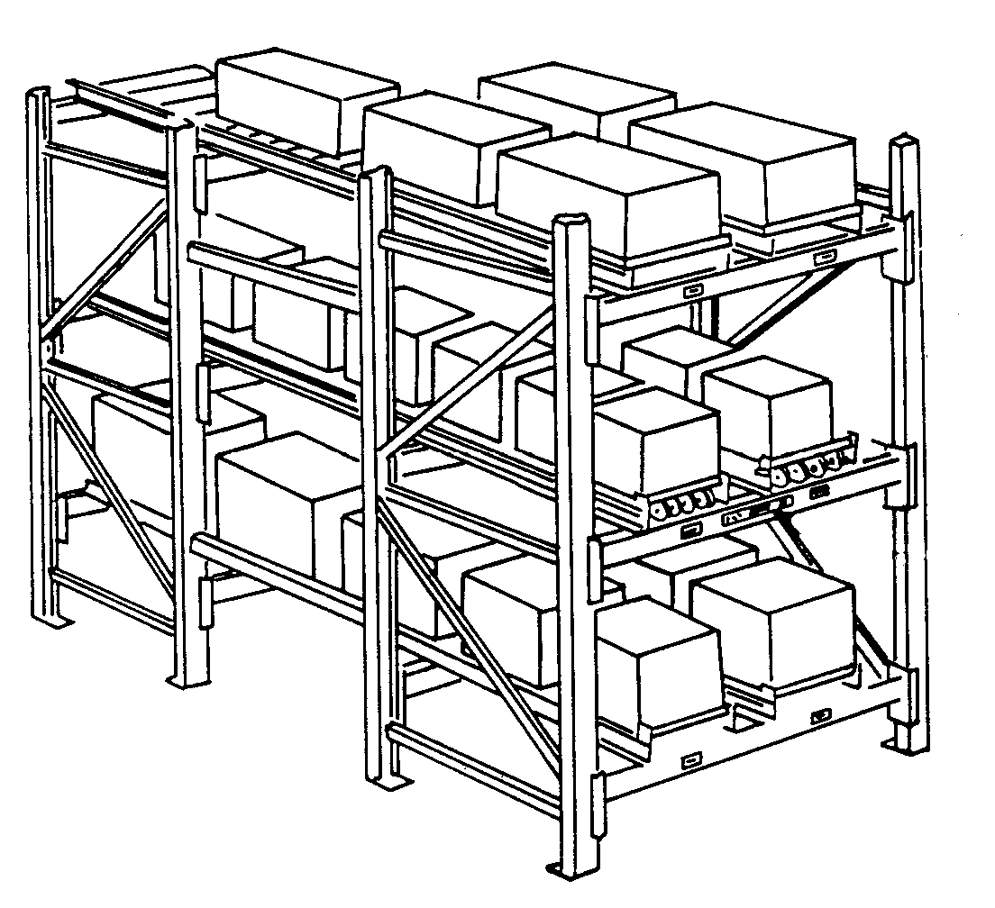
Point-Of-Use Material Storage
The upstream process or external supplier, based on a kanban signal, delivers the material direct to the point of use, than to a central warehouse.
The materials are often stored on flow-through racks just outside the cell.
Flow-through racks, like wending machines, are storage locations with shelves that can be replenished from the back and consumed from the front. FIFO usage and replenishment from outside the cell.
For material that cannot be stored at point of use, supermarkets (nearby storage locations) are often used in place of centralized storage.
Parts used by several cells are delivered to a supermarket once a day, and are pulled out in hourly quantities depending on which cell is active.
Notes:
Like the soda refrigerators in gas stations

Slide 42
Total Productive Maintenance (TPS)
Systematic execution of maintenance by all employees.
Total productive maintenance (TPM) is an equipment management strategy. Originally developed in 1970 to support TPS and it evolved from the TQM (Deming and Juran).
The original TQM concepts were modified to fit or work well in the maintenance environment,.
The goal: increase capacity, decrease variation, increase employee morale and job satisfaction.
TPM resembles TQM in a number of ways, and the similarities are not coincidental.
Notes:
Toyota…

Slide 43
Maintenance Classifications
Traditionally, maintenance can be classified as
  Corrective waits until a failure occurs, then remedies it as quickly as possible; a sensor failing in an automobile.
  Preventive aims at maintaining equipment at regular intervals to keep an otherwise troublesome failure mode at bay; changing the oil for an automobile.
  Predictive examines vital signs displayed by equipment, to determine the health of the equipment; analyze car engine wear using instruments like vibration analyzers.
  Proactive analyzes why defects occur in an equipment, and then designs the problem out of the machine.
Notes:
Toyota…

Slide 44
TPM
TPM emphasizes the importance of people and joint effort by production and maintenance staff.
It is continuous improvement philosophy.
It is a vital part of any lean implementation. Because there is a natural tendency for people to follow the "if it ain't broke don't fix it" philosophy.

Slide 45
Mistake Proofing and Method Sheets
Mistake proofing (poka yoke). Combined with other lean tools, tries to build 100% quality built into both process and product. The three-prong electrical plug: There is only one way you can plug it in.
Techniques to prevent defects from being passed on to the next process.
Quality checks are built into operations and equipment, using sensors to detect errors and stop the process as needed. Autonomation; Automation with human touch).
Method sheets are visual instructions (drawings and pictures) located at a workstation that show how a job must be done, the quality checks necessary, and the tools to be used. They are understandable by even new operators
Notes:
Fast food restaurants

Slide 46
Continuous Improvement and the Pursuit of Perfection
Complacency is the toughest challenge in any lean transformation. Lean is not a one-time effort; is an ongoing journey that requires a sustained effort at continuous improvement.
Transformation to lean is not accomplished by simply applying a few techniques; it is a whole new way of looking at the operations of the enterprise.
Continuously reexamine processes to take out waste and non-value-added activities if enterprises are to see significant improvement in financial performance.
It is necessary that enterprises constantly initiate kaizen events that promote continuous improvements.
At the same time, there is a need to promote kaikaku, the radical redesign of processes and methods geared for achieving breakthroughs in performance and growth.
Once a kaikaku step is applied, kaizen becomes a powerful follow up drive to perfect the processes and methods and to continue to adapt to stay relevant.

Slide 47
Continuous Improvement and the Pursuit of Perfection
The sequential application of a kaikaku step followed by a series of kaizen events results in performance improvements that effectively match the S-curve model for enterprise grow containing jumps and gradual progresses.
Applying lean thinking and implementing tools to create flow result in a fundamental change in the way the enterprise thinks about its operations. Employees soon realize there is no end to the pursuit of perfection-to reducing effort, time, space, cost, and mistakes in the process of producing and delivering a product.
When products flow faster through the enterprise, they expose hidden waste in the value stream. The harder the pull, the more obstacles are revealed and the more easily they can be removed.
While lean implementations must have commitment and support from top management, shop floor personnel are also critical to their success. Many enterprises have initiated their lean efforts from the bottom up.

Slide 48
Continuous Improvement and the Pursuit of Perfection
Continuous improvement (kaizen) events play a vital role in getting employees engaged in the lean journey, and that pays dividends. Managers at all levels became lean thinkers and change agents.
A truly lean enterprise makes it much easier for everyone-shop floor employees, supervisors, lean champions, subcontractors, and first-tier suppliers-to discover better ways to create value.
Because feedback loops are significantly shortened, there is faster feedback to employees, providing a more conducive environment for them to pursue perfection
Whenever an individual or a business decides that success has been attained, progress stops.
Lean is a journey-a continuous journey that requires sustained effort to maintain momentum.

Slide 49
Summary
Once there is a sharpened awareness among employees of the waste present in the system, there will be a concerted effort to maintain the momentum to reduce it if the right incentives are provided.
All types of manufacturing, distribution, software development, or financial services.
Important points that enterprises should keep in mind when embarking on a lean journey are these:
While the goal of lean has often been identified as the removal of waste, removing muda is just a means to an end. The real goal of lean is to reduce lead time. Lean is all about lead-time reduction and creating flow.
Some of the more important steps that enterprises can take to create flow are takt time, standard work, pull replenishment, and 5S. All of them readily apply in a service setting as well.
Enterprises that embark on the lean journey typically start by identifying a product family they can apply lean principles to.

Slide 50
Summary
Steps like 5S and takt time are often misunderstood or misused. For instance, the fifth step in the 5S program, Sustain, is vital for maintaining momentum. Once a 5S program is put in place, some enterprises neglect this step. Again, lean is a journey-one that really never ends.
Lean thinking must be applied to all the processes in the enterprise that work on the selected product family. The idea is not to simply lean out some of the process steps and create a few islands of excellence.
While some waste may be removed in creating such islands, the products flowing out of them will end up waiting elsewhere in the enterprise, usually queuing up in front of the constraint resources.
Finally, the lean supply chain is the ultimate goal. It is the responsibility of the lean enterprise to collaborate with upstream and downstream supply chain members to success­fully streamline the supply chain.

