Slide 1
Building Lean Systems
Nothing focuses the mind better than the constant sight of a competitor who wants to wipe you off the map.
Wayne Calloway

Slide 2
In 1980, Japan became the world's leading producer of automobiles, producing just over 11/38.6 million units. Slipping to second for the first time since taking the lead from in 1904, US produced just over 8 million.
Japanese auto manufacturers had produced 0.07/9.2 million vehicles in 1955. Who could have predicted that just 25 years later the Japanese auto industry would produce 3 million vehicles more than their U.S. and remain the world's leading auto manufacturer for the next 15 years? Japan maintained its stature as the world's largest auto manufacturing until 1995. Today, recent mergers and acquisitions by the big three automakers make comparisons less meaningful.
Japan's rise to its preeminent position was fueled by its application of lean-thinking principles. It is a widely accepted notion that these principles originated in Japan. What is not widely known is the fact that a number of these principles were created in the US .

Slide 3
CRAFT PRODUCTION: The first auto manufacturers in the world were French. In 1889, Rene Panhard and Emil Levassor, partners in a woodworking machinery business, obtained a license from Daimler to build engines for automobiles. They built the first car in 1890, but because they saw no future in this business, they granted Armand Peugeot the right to use Daimler engines in self-propeled vehicles. Peugeot made five cars in 1891 and 29 in 1892. These cars were built using the craft production technique; no two cars were alike.
By 1905, less than 15 years after Panhard and Levassor built their first car, hundreds of enterprises in Europe and the U.S. were producing cars in small volumes using craft production tech­niques. But by then craft production techniques for cars were heading for extinction due to the pioneering efforts of the celebrated "father of mass production," Henry Ford.

Slide 4
Henry Ford and the Origin of Mass Production: The title of the first mass producer belonged to Ransom E. Olds. However, Ford changed the way the world would perceive manufacturing. He introduced the concepts of flow and throughput velocity in automobile manufacturing. To create flow, he instituted the well-known moving assembly line in the Highland Park plant that built the Model T automobile. The moving line reduced assembly time for automobiles from 12 worker-hours down to about 1.5, and realized production of 1,000 cars a day in 1914.
Ford's goal was to reduce waste in any form-not just within the factory walls. He reduced waste and leveraged flow across the entire supply chain. He claimed: "Our production cycle is about 81 hours from the mine to the finished machine in the freight car.
Removing waste from every step in the process allowed him to slash production costs. Price of automobile droped from $1,000 to $260. The sharp increases in productivity that accompanied these innovations kept inflationary pressures down and led to periods of "benign deflation.“

Slide 5
This happened despite the fact that existing supply chains consisted of independent, inflexible enterprises that somehow managed to deliver products to customers. Not all of Henry Ford's contributions to management were beneficial. He paid excessive attention to manufacturing details, often disregarding important decisions that cost the enterprise thousands of dollars. He equated throughput velocity with product uniformity by insisting on a standard model with a single color. Because of Henry Ford's managerial style, combined with his strategy to produce only a single model, the Ford company lost market share to General Motors between the 1920s and World War II.
Under the leadership of Alfred P. Sloan, GM was taking advantage of a shift it perceived in the buying patterns of the American consumer by introducing a new model every year. While Ford continued to turn out the same model year after year, GM's Chevrolet division introduced the annual model change. In 1921, Ford had 55 percent of the U.S. market; by 1927 its market share was less than 15 percent.

Slide 6
Besides Henry Ford's many contributions to mass production, he was also the inspiration for many of the concepts and tools used in the Toyota Production System. However, it was Sloan who ultimately took mass production techniques to new heights. Sloan succeeded where Ford did not by devising an organization suitable for a mass production system, putting in place a management system for controlling the multiple-enterprise conglomerate that GM had become. By the time Sloan retired in 1946, GM was the biggest enterprise in the world.
It is little wonder that when Fortune chose the "businessman of the century" in its 1999 issue, Sloan made it to the final four. The winner, however, was Henry Ford.
The three decades after World War II were the glory days of the American automobile industry. The economy in Europe, the only major threat to U.S. industry, was just beginning its long recovery from the devastating effects of the war, so foreign competition was minimal.

Slide 7
The domestic economy was flourishing as the U.S. Government poured money into rebuilding infrastructure. Mass production techniques and vertical integration were key factors that established the dominance of the "Big Three" U.S. automakers, as well as U.S. manufacturing in general.
Mass production proved extremely effective. It delivered growth at an extraordinary rate. The U.S. industry flourished well into the 1960s. A time when demand far outstripped supply, this period was perceived as a "golden era" for V.S. industry. However, it was actually a problematic period in a number of ways.
The High Cost of Complacency: The Big Three automakers had effectively become a cartel led by GM. But cartels, like their more integrated cousins, monopolies, tend to become inefficient and ineffective because they can afford to be. Although the U.S. automobile industry had led the world in innovation at the turn of the 20th century, innovation started to take a back seat in the U.S. after the war.

Slide 8
The automatic transmission, introduced in the 1940 Oldsmobile models, was the last major U.S. innovation. While an abundance of new popular features was promoted with each new model, there was little to distinguish cars made in the 1960s from those made in the 1950s.
The misapplication of mass production techniques compounded these problems. Conceived in Henry Ford's heyday as a way to deliver products quickly to the customer, the mass production system had over time morphed into a batch production system in which the accepted mode of operation was to use economies of scale. Cars were built in large batches, resulting in large work-in­process (WIP) and finished goods inventories.
This did not worry automakers because demand still exceeded supply in the absence of serious foreign competition. The desire to achieve scale economies drove even low-volume manufacturing enterprises, such as aircraft engine manufacturers, to produce in large batches. Large-lot production soon became the most distinguishing feature of mass production.

Slide 9
Building products in large lots in anticipation of customer demand may have worked satisfactorily in the production-centric era, but it had serious consequences. For instance, with plenty of WIP to buffer any production delays, defects found on the shop floor did not generate a sense of urgency to fix the problem so it did not occur again. Worse, quality problems often escaped unnoticed until after the product was sold. Consumers suffered from poor quality because cars were often riddled with defects and needed frequent repairs. In short, the U.S. auto industry was badly in need of a shake-up. It got it in the 1970s when the oil crisis hit. Gas guzzlers suddenly lost their appeal and soon the world's largest market was clamoring for smaller, fuel­efficient cars. This opened the door for imports from Japan, which filled the bill, accelerating the decline of U.S. dominance in automobile manufacturing.

Slide 10
The Toyota Production System: In 1960s, Japanese manufacturers. dedicated themselves to building compact and subcompact cars with excellent fuel economy. They succeeded in producing those vehicles at low cost by adopting the just-in-time (JIT) production management philosophy and system. The JIT management system, invented by the Toyota Motor Corporation, owes its conception and evolution to two individuals, Kiichiro Toyoda and Taiichi Ohno; the latter is widely acknowledged as the creator of the Toyota Production System (TPS).
Inspired by Henry Ford's book, Today and Tomorrow, Kiichiro
Toyoda had formulated as early as 1936 a clear mental picture of the production system he wanted. The basic idea was to produce only what was needed on a given day to initiate a production run only when it was needed, rather than in anticipation of a demand. He initiated this idea in the automobile department he had started within his father's enterprise, the Toyoda Automatic Loom Works.

Slide 11
Slips were passed around indicating the number of parts to be made or processed that day. This was the origin of the kan-ban method of production that became the basis for the JIT system. Toyoda began convincing suppliers to cooperate with his JIT system. He also changed the traditional physical layout of the plant so that machine tools were organized in a flow line. That made the supply line shorter so parts could get into the assembly process sooner.
In 1950, Kiichiro Toyoda's cousin, Eiji Toyoda, toured Ford Motor Company. An important process he learned about during the trip was the Ford suggestion system. Eiji Toyoda instituted the concept and it became to be one of the major building blocks of continuous improvement (kaizen).
On his return to Japan, he sought the help of Taiichi Ohno to produce cars in small batches more efficiently than the big U.S. enterprises were able to.

Slide 12
Ohno was an ardent admirer of Ford and credits his contributions to TPS to two main concepts. The first concept, the moving assembly line, he had found in Henry Ford's book Today and Tomorrow. The second concept was the supermarket operations he saw on a visit to the United States in 1956 that provided stores with a continuous supply of merchandise.
Ohno set up a pull system in which each production process became a supermarket for the succeeding process: Each process would produce to replenish only the items that the downstream process had used.
Like Ford, Ohno emphasized waste reduction. Ohno's contention was that waste is so prevalent that we do not eliminate it because we learn to live with or work around it. He modified Ford's ideas to reflect modern market demands. Ford had offered his customers cars in only one color to reduce changeover times between paint colors. Subsequent efforts to introduce product variety into U.S. car industry offerings were hampered by those large changeover times for products as well as paint colors.

Slide 13
This apparent inflexibility had become a corporate millstone for U.S. auto makers. The Japanese refused to accept changeover times as a constraint. Instead, they focused relentlessly on reducing changeover times, and they did so. This made it possible for them to provide product variety without having to produce large lots. The Toyota production system is the antithesis of large-lot production, not mass production. Japanese autos were now highly competitive against the U.S. and other foreign cars, both in quality and cost.
Lessons Learned: The brief journey back in time showed that a number of elements in the Toyota Production System- kaizen, flow, pull production, and waste elimination-were inspired by Henry Ford. At the same time, the journey also revealed the dangers of complacency and the critical need for enterprises to avoid adopting tools and techniques in a piecemeal manner. JIT, for instance, emphasizes working with kanbans and minimal inventories, but just trying to reduce inventories without considering other factors can have serious consequences because the system is now much more vulnerable to disruptions.

Slide 15
A "river and rocks" analogy likens the water level to the inventory level in a facility. A higher water level hides potential blemishes in the process, such as unreliable suppliers, scrap loss, and machine breakdowns.
As the water (inventory) level is low­ered, these problems surface, forcing management to correct the defects. The key is to resist the temptation to reduce the inventory level too quickly. Rather, the idea is to lower the water level a little, break apart the exposed rocks (obstacles), and then lower the water level once again.

Slide 16
Enable Flow
Scrap
Capacity Imbalances
Large Setup Times
Unreliable Suppliers

Slide 17
Even as attempts are made to reduce inventory levels, other major elements that should be in place are reliable processes, preventive maintenance systems, cross-trained workers, setup reduction programs, and reliable suppliers. If these are not already present in a factory, putting them in place takes time-it cannot happen overnight. The Japanese spent close to 20 years perfecting the system before the U.S. automakers observed TPS in action.

Slide 18
The Japanese management system was also built on partnering arrangements that had mutual benefits for both the automakers and their suppliers. Not only were suppliers given ample visibility on the automakers' assembly schedules but these schedules were adhered to fairly stringently. That made it easier for the suppliers to plan their own production schedules and deliver supplies in a timely manner without having to hold a large finished goods inventory.

Slide 19
In their anxiety to adopt Japanese practices, the U.S. automakers attempted to implement JIT techniques in the 1980s. They studied the TPS and identified a number of TPS tools they believed they could transplant into their factories. In their enthusiasm to catch up with the Japanese competition, they attempted to implement JIT tools too quickly, in a piecemeal fashion. They first tried to drastically reduce their inventory of automobile components. At the same time, they asked suppliers to deliver components just when they were needed.

Slide 20
However, they did not first ensure that their own internal processes were reliable. Because they were not, the automakers were unable to give suppliers clear visibility on their production schedules. Left in the dark about when the next delivery request would come, suppliers built up finished goods inventory so as to better respond to requests from the automakers for JIT supplies. Invariably, the suppliers ended up building the wrong products. Furthermore, relationships with the suppliers at that time were (and in too many cases, still are) adversarial.

Slide 21
There were no long-term contracts and components were generally sourced from multiple vendors selected based on price, quality, and delivery, though mainly on price. These factors made the position of suppliers even more tenuous.
U.S. manufacturers probably misunderstood the intended meaning of JIT. The JIT philosophy articulated by Kiichiro Toyoda merely stated that components for an automobile should not be produced before they were needed but should instead be made Just In Time.

Slide 22
The implication was that every step in the supply chain had to work in harmony to produce when a product was needed, not a single moment before. This philosophy never intended, for instance, to have the supplier maintain a stock of finished goods to supply material just in time.
Simply adopting tools and techniques piecemeal does not lead to a lasting competitive edge. On the contrary, without a complete understanding of the core concepts and principles of lean thinking, there is considerable potential for doing more harm than good.
For instance, lean thinking emphasizes eliminating muda or wastelO-specifically, any activity that absorbs resources but creates no value. If the enterprise has not fully understood the core concepts of lean operations, waste-removal activities could lead it down the wrong path.
Conventional wisdom may suggest that when non-value-adding activities are eliminated, the enterprise has an opportunity to become more efficient through workforce reduction. Nothing could be further from the truth. When lean implementation is viewed as a cost-cutting initiative or an opportunity to reduce the workforce, employees will naturally resist it, leading to eventual migration back to the old way of doing things. On the other hand, if it is made clear that freed-up resources would be productively deployed elsewhere, implementation efforts would have a much better chance of success. Freeing up resources for productive deployment elsewhere is at the very core of lean thinking.

Slide 23

The goal of lean thinking
Eliminate muda (waste)
  Eliminate any activity that creates no value
A way to do more & more with less & less
  Less effort, less equipment, less time, and less space;
  While coming closer and closer to providing customers exactly what they want

Slide 24
The Muda in Batch & Queue Operations
Move
Queue
Set up
Value
Added
Work
Move

Slide 25
SEVEN deadly sources of Muda
Overproduction
Inventories
Transportation
Delays
Defective products
Processing
Motion

Slide 26
The Muda in Volpens, Ltd.
Production Scheduling
Stores Parts Picking
Material Handling
Label Press Changeovers
Quality Control
Stores Management
Materials Management
MRP Production Order Generation

Slide 27
Agenda
Lean Thinking
5 S
Flow Charts
Takt Time
Average Labor Content
Mixed Model Scheduling
One Piece Flow
Cellular Layout
Standard Work
Pull Replenishment
Point-Of-Use Material Storage
Mistake Proofing and Method sheets
Continuous Improvement and the Pursuit of Perfection

Slide 28
The Toyota Production System (TPS) & JIT
The Toyota Production System (TPS) & JIT
  Kan-Ban
  Layout of The Plant
  Kaizen
  Moving Assembly Line
  Supermarket Operations
  Waste Reduction
The Outcome
  JIT ➔ Every step should work in harmony

Slide 29
Enabling Flow: Process Steps
Flow Chart the Process
Do 5S and TPM
Identify value- and non-value added activities
Evaluate Takt time
Labor content & minimum manning requirements
Mixed model sequence
Cell design: “One-piece flow”
Pull Execution: Placing a cap on WIP

Slide 30
5 S: A systematic process for organizing the workplace
Japanese | Definition | English | Example
Seiri | Tidiness | Sorting | Throw Away Rubbish
Seiton | Organization | Storing | 30-Sec Doc Retrieval
Seiso | Cleanliness | Sanitizing | Individual Responsibility
Seiketsu | Neatness | Standardizing | Clear Written Instructions
Shitsuke | Discipline | Sustaining | Do 5S Activities Daily

Slide 31
Process flow chart: Logical sequence of activities
Mortgage Application
10 Mins
4 Hours
Delay While Records Are Retrieved
30 Mins
15 Mins
Customer Applies For Mortgage
Loan Doc Sent For Analysis
Mortgage Analysis Dept Requests Cust Approval Data
Loan Doc Sent For Analysis on Credit Worthiness
20 Mins
12 Hours
15 Mins
5 Mins
20 Mins
Mortgage Analysis Dept Scrutinizes Rec’ds To Approve Loan
Waiting For Bank Approval
Bank To Secure Loan
Loan Approved
5 Mins
Summary
Value-added time: 20 Mins
Total elapsed time: 18Hrs 05 Mins
Value-added ratio: 1.84%
5 Mins
Notification To Loan Approval Dept
Customer Notified

Slide 32
Spaghetti diagram: Physical movement of products
Loan Application
By Customer
Letter To Customer
Loan Application
Dept
Order Processing
Dept
Mortgage Analysis
Dept
Bank Liaison
Loan Approval Dept
Billing Department
Customer Records
Approval In-Process
Files

Slide 33

Identify Value & Non-Value Added Activities
Value added activity:
  An activity that adds value to the product in the eyes of the customer.
Non-Value added activity:
  An activity that moves the product without doing anything to transform it.
  Time to prepare for production.
  Paperwork for purposes of tracking or costing.

Slide 34

Takt Time
Takt Time: The concept of linking production capacity to customer demand
  Takt time is used to represent customer demand. It is expressed in terms of the time available to make one unit to keep pace with customer demand.

Slide 35

Takt Time: Example
Hungama Insurance Co. Demand is 20 policies/day. Net avialablity is 400 minutes/day.
There are four sub-processes
  Data gathering / data entry (distribution)
  Risk analysis (underwriting)
  Computing the premium (rating)
  Policy writing

Slide 36
Takt Time: Hungama Co.
Enterprise should match its (internal) resources to meet the (external) customer demand.
Takt Time = 20 min.
14
22
6
12

Slide 37
Takt Time: Hungama Co
One of the main uses of takt time calculation is to match internal resources to external demand.
Load chart helps determine whether work is assigned equitably and whether anyone is overloaded.
Reviewing the previous chart, a number of inefficiencies can be observed.
Load Leveling can be used to resolve this issue.

Slide 38
Takt Time: Hungama Inc.
Enterprise should match its (internal) resources to meet the (external) customer demand.
19
17
18

Slide 39
Takt Time: Advantages
Limits overproduction
Therefore, stabilizes the system
  Preventing frequent stops which inhibit smooth flow
Working with takt time heightens awareness to
  Output rates
  Potential problems in achieving these goals
Operators can be immediately notified if takt time is not met
  Providing an opportunity to fix the problem

Slide 40
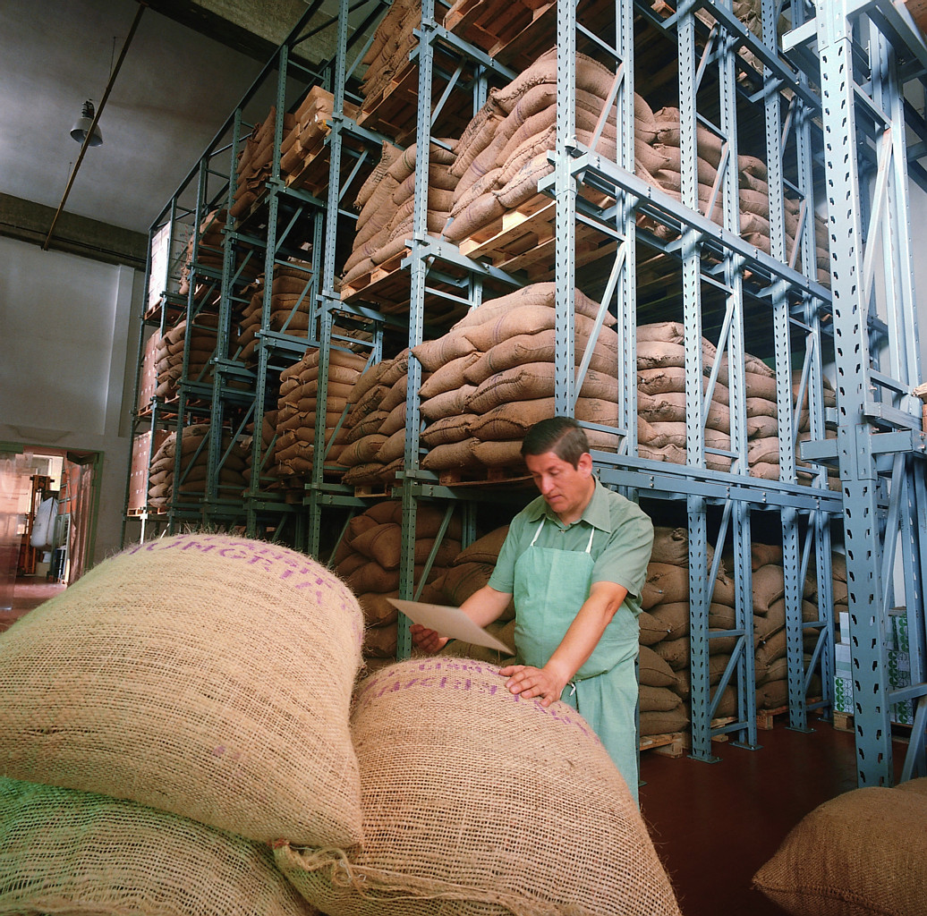
Takt Time: Frequency of Change
How often should takt time be changed?
Depends on Industry
Too Frequent = Chaos
If the enterprise is not flexible, opportunities could be lost, and could result in:
  Missed opportunities
  Inventory buildup

Slide 41
Takt Time: Frequency of Change
Key is to distinguish between “noisy” data and real trends.
Takt time could be reevaluated if the demand exceeds the set production rate for 5 consecutive days (Run Test).
At Dell ➔ Assembly takt time is 15 secs per computer. It is accomplished through (capacity) running multiple assembly lines

Slide 42
Internal vs. External Takt Time
130
Demand
Production
Run 2
120
Run 1
110
100
90
80
0
5
10
15
20
25
30
Day
Takt Time allows to smooth external demand variation

Slide 43
Takt Time: Summary
Takt time is used to represent customer demand. It is expressed in terms of the time available to make one unit to keep pace with customer demand.
Primary purpose of calculating takt time is to match external demand with internal capacity.
Takt time should only be adjusted when it is clear that customer demand has changed, not based on temporary noise.

Slide 44
Average Labor Content
Average labor content is the minimum number of workers to sustain operations.
Demand percentages for Hungama, Inc., Tasks
 | RUNS | RAPS | RAINS | RERUNS
Jobs/Day | 4 | 12 | 6 | 18
% of Total | 10% | 30% | 15% | 45%
Operation times for Hungama, Inc. in (Minutes)
 | RUNS | RAPS | RAINS | RERUNS
Distribution | 58 | 50 | 44 | 28
Underwriting | 43 | 40 | 23 | 19
Rating | 72 | 65 | 68 | 75
Policy writing | 67 | 0 | 55 | 50
Total Labor | 240 | 155 | 190 | 172

Slide 45
Average Labor Content
Average labor content = 0.10 (240) + 0.30 (155) + 0.15 (190) + 0.45(172) = 176.4 min

Slide 46
Average Labor Content
ALC for Distribution = (0.10 x 58) + (0.30 x 50) + (0.15 x 44) + (0.45 x 28) = 40 minutes.
Since Takt time is 10 min, the minimum number of operators allocated to Distribution task will be 4. (40/10 = 4)

Slide 47
Practice: Pleasant Valley Health Clinic
The Pleasant Valley Health Clinic treats patients with respiratory illnesses. It classifies patients according to four different types of respiratory problems (commonly referred to as Diagnostic Related Groups, or DRGs): Bronchiolitis (BRO), Pneumonia (PNE), Pharyngitis (PHA) and Sinusitis (SIN). The average number of patients treated per day are summarized below. The clinic works two shifts, from 7:00 am to 3 pm and from 3 pm to 11 pm. During a shift, the staff are provided a half hour lunch break and two rest breaks of 15 minutes each.
Average # Patients per Day
 | BRO | PNE | PHA | SIN
Patients / Day | 15 | 24 | 25 | 36

Slide 48
Practice: Pleasant Valley Health Clinic: Task Durations
Each patient typically requires 4 process steps: Check-In (includes weigh-in, blood pressure check, etc.), Evaluation (by a physician), Testing (X-Rays, administering of respiratory instruments like Pulse Oximeters, etc.), and Assessment (diagnosis and future scheduling). The average task time for each process (in minutes) is given below:
 | BRO | PNE | PHA | SIN
Check-In | 30 min. | 30 min. | 30 min. | 30 min.
Evaluation | 20 min. | 15 min. | 10 min. | 12 min.
Testing | 45 min. | 40 min. | 15 min. | 15 min.
Assessment | 15 min. | 15 min. | 10 min. | 10 min.
Work Content | 110 min. | 100 min. | 65 min. | 67 min.

Slide 49
Practice: Pleasant Valley Health Clinic: Task Execution
NOTE: In this clinic, tasks 1, 3, and 4 are typically handled by Licensed Practitioners (LPNs) and Registered Nurses (RNs). Task 2 is handled by a physician. For simplicity, in this exercise we will assume that all tasks are administered by RNs. For simplicity, again, we will assume that the arrival rates of patients are constant through both shifts.

Slide 50

Practice: Takt Time for Pleasant Valley Health Clinic
Step 1: Determine the daily demand
BRO: 15; PNE: 24;
PHA: 25; SIN: 36
Step 2: Determine Time available in a day:
2 shift @ 8 hrs less 0.5 (lunch) - 0.5 (2 breaks)
= 14 hours = 840 minutes
Step 3: Takt time = Time Available / Daily Demand
= 840/(15+24+25+36)
= 8.40 minutes / request

Slide 51
Practice: Resource (Staff) Requirement for Pleasant Valley Health Clinic
For Pleasant Valley Health Clinic, determine:
1. The average work content (“labor content”).
2. Minimum number of RNs required using the average total work content and the takt time for given demand (“minimum manning”).
3. If the percent demand for each request type remained unchanged, but the total daily demand increased to 120 patients, how would the answers to 1 and 2 change?

Slide 53
Practice: Pleasant Valley Health Clinic
Average Work Content = 80.87 minutes
Takt Time = 8.4 minutes
Min. # of RNs required = 80.87/8.4
= 9.627 ➔ 10

Slide 54
Mixed-Model Scheduling and Small Batch Production
Why do enterprises use batch production?
  Economies of scale
  Changeover constraints
  Material and manpower availability
What are the disadvantages?
  Large-lot sends ripple effect
  Quality control

Slide 55
Mixed-Model Scheduling and Small Batch Production – Cont’d
Mixed-model scheduling (heijunka)
  Evenly distributing the production of different products over a period of time
Changeover or setup times must be small
Small batching in the presence of setup times

Slide 56
Mixed-Model Scheduling and Small Batch Production
Why do enterprises use batch production?
  Economies of scale
  Changeover constraints
  Material and manpower availability
What are the disadvantages?
  Large-lot sends ripple effect
  Quality control

Slide 57
Batch Process For Volpens, Ltd.
Cap Assy
Pen Assy
WIP
WIP
Label
Press
Peel&
Stick
Production
Scheduler
Test, Pack
& Ship
Inspect
Raw
Materials
Material Flow
Information Flow
Finished
Goods

Slide 58
Mixed Model Sequence for Volpens
Smallest possible sequence length = 1/0.09 = 11.11
Choose a 11 unit sequence; adjust every two cycles.
Note: A mixed model sequence is used to intentionally
vary work content and component requirements.

Slide 59
Mixed Model Sequence For Volpens
Seq. #
Model Desc.
Seq. #
Model Desc.
1
Blue Pen
18
Blue Shell
2
Red Pen
19
Red Pen
3
Blue Pen
20
Yellow Pen
4
Red Shell
21
Blue Pen
5
Blue Pen
22
Yellow Shell
6
Yellow Pen
23
Blue Pen
7
Blue Shell
24
Red Pen
8
Red Pen
25
Blue Pen
9
Yellow Pen
26
Red Shell
10
Blue Pen
27
Blue Pen
11
Yellow Shell
28
Yellow Pen
12
Blue Pen
29
Blue Shell
13
Red Pen
30
Red Pen
14
Blue Pen
31
Yellow Pen
15
Red Shell
32
Blue Pen
16
Blue Pen
33
Yellow Shell
17
Red Pen
34
Red Shell

Slide 60
Implementing Mixed-Model Scheduling:
The Load-Leveling (Heijunka) Box
Part
8:00
8:15
8:30
8:45
9:00
9:15
9:30
9:45
10:00

Slide 61
Parts Supply and Withdrawal Using the Spiderman Nasser – Case of Streamlined: Chapter 7
Production
Kanban
Daily
Orders
160
160
Withdrawal
Kanban
Upstream
Presses
Parts
Supermarket
Mixed-Model
Build Schedule
Load Leveling
(Heijunka)
Finishing
Cells

Slide 62
One-Piece Flow
Flow time is proportional to WIP.
Little’s Law:
  Flow Time = WIP/production rate;
  or “WIP to Ship”

Slide 63
One Piece Flow
Process 1
Process 4
60 units
60 units
Process 2
60 units
Process 3
60 units
Goal:
Reduce lead time by reducing WIP
Move products between workstations
Average lead time = WIP/Throughput
What is the average lead time for the system above, if throughput is 100/week?
Ans: 2.4 weeks

Slide 64

One Piece Flow
Process 1
Process 2
Process 3
Process 4
What is the average lead time for this system?
One piece could mean a pallet, a box etc.
Is not practical in every situation
1 unit
1 unit
1 unit
1 unit

Slide 65
One Piece Flow and Layout
One-piece flow may require relocation of the people/equipment.
A process layout (grouping operations by function) must be replaced by a product layout (arranging operations in the order of flow.)

Slide 66
Cellular Layout
Standard Work
Operator
Tasks
1
2
3
1
7
8
2
6
3
4
5
1
8
7
Flow-through racks
for materials
2
6
3
4
5

Slide 67
Cellular Layout
Goal:
  facilitate 1 piece flow
  reduce movement
  reduce processing
  improve visibility
  allow operators to flex between operations
  permit material replenishment from outside the cell
Consecutive operations are located in proximity
Cells are often arranged in a U-shape, T-shape or serpentine shape.

Slide 68
Standard Work
Clear specifications
Documented process
A moving target
Results
Promote consistency
Continuous improvement
Improves safety
Easier to measure performance

Slide 69
Flow: Kanban system and visual controls
A simple and visual system.
Transfers ownership back to shop floor.
Each kanban (part) has its own replenishment process.
Improvements come one part or one supplier at a time.

Slide 70
Pull Replenishment
Kanbans
  Relatively repetitive demand
  Short lead times
  Components must be available
In-process kanban
Material kanban

Slide 71
KANBAN : A Visual Signal
Two basic types of Kanban Signals:
1. In-Process Kanban ~ a visual signal to pace the movement of products in a flow manufacturing process
2. Material Kanban ~ a visual signal to replenish materials consumed in a lean production process
KANBAN CARD ID: 0
Production
Unit of Lot
PRINT DATE:
3/16/95
*0*
LOTSIZE NUMBER:
1 of 4
PART NO: 12-00327-09
REF. DRAWING NO.:
dw1234
12-00327-09
PART NAME:
MODULE 69NT
KANBAN QUANTITY: 3
REVISION NO.:
dr987
*3*
CONTAINER TYPE: BOX
Supply Point: Supply B
*Supply B*
USAGE POINT: USAGE C
Notes:
NOTE 1
*USAGE C*

Slide 72
Kanban Types
Withdrawal Kanbans
Production Kanbans
Supplier Kanbans
blue
red
green

Slide 73
How Kanbans Work: An Example
Inbound Buffer
Outbound Buffer
Inbound Buffer
Outbound Buffer
WS 1
WS 2
Production Kanban
Withdrawal Kanban
Supplier Kanban

Slide 74
Kanban Calculations
Number of kanbans =
# of cards required for system to work
Number of Kanbans =
D x (1 + SF) x KCT
+1
Kanban Size
D = Average Demand
SF = Safety Factor
KCT = Kanban Cycle Time
(time for material to be replenished once a signal has been received)

Slide 75
Kanban Calculations: An Example
Number of kanbans required for part Z.
Product Z used for models A, B and C as follows:
Model # of Parts of Z
A 1
B 3
C 2
Daily rate at capacity, D:
Model D
A 21
B 16
C 32
KCT = Replenishment Time (fraction of days) = 0.25
SF = Safety Factor = 0.10
K = Kanban Size = 15
Number of
Kanbans
[(21 x 1) + (16 x 3) + (32 x 2)] x 0.25 x (1 + 0.10)
15
+ 1
=
36.58
15
+ 1 = 2.44 + 1 = 4
=

Slide 76
Lean Thinking: Pull
Create a pull for products across the value stream.
Pull scheduling
  Build only to demand
    Build to Takt Time
  Concept of Kanbans: A Cap on WIP
    “Stop working if your output buffer is full.”

Slide 77
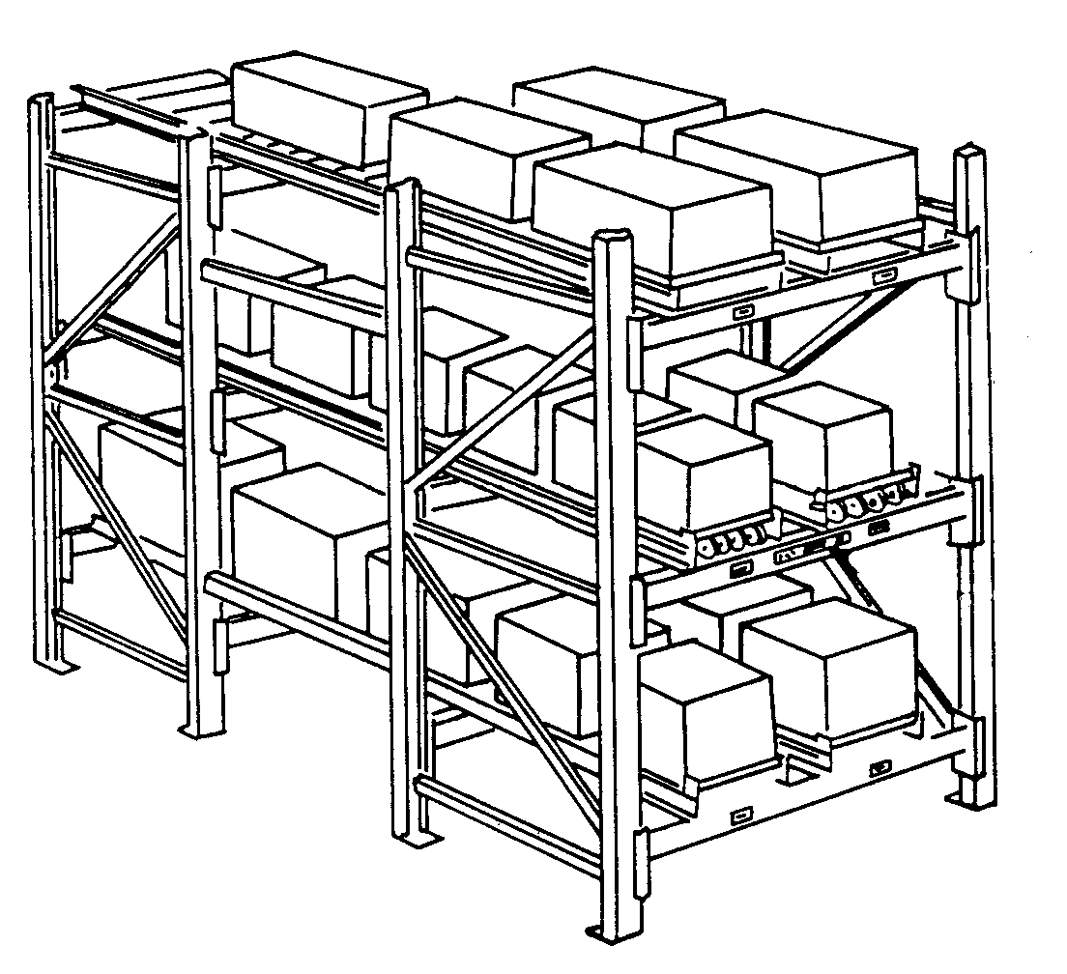
Point-Of-Use Material Storage
Store locally
  Flow through racks
Use “supermarkets” for temporary storage
Advantages
  Conserves FIFO
  Can be filled from outside the cell
Notes:
Like the soda refrigerators in gas stations

Slide 78
Total Productive Maintenance
Equipment management strategy
Systematic execution of maintenance by all employees
Maintenance is as important as any other part of the process (separate but integral)
Notes:
Toyota…

Slide 79
Mistake Proofing and Method Sheets
Mistake Proofing (Poka-Yoke)
  Finding techniques to prevent defects from passing to the next process
  Ensures quality in both product and process
Method Sheets
  Clear visual instructions that show each step
  Should be understandable by even new operators
Notes:
Fast food restaurants

Slide 80
Continuous Improvement and the Pursuit of Perfection
Continuous effort
Implementing such tools result in fundamental change in thinking
Employees become aware of the the pursuit
“Whenever an individual or business thinks that success has been attained, progress stops.”

Slide 81
Batch Process For Volpens, Ltd.
Cap Assy
Pen Assy
WIP
WIP
Label
Press
Peel&
Stick
Production
Scheduler
Test, Pack
& Ship
Inspect
Raw
Materials
Material Flow
Information Flow
Finished
Goods

Slide 82
Takt Time for Volpens, Ltd.
Monthly Demand =
No. of days per month = 16
Daily Demand =
Avail. Time/Day =
Takt Time =
68

Slide 83
Manpower requirements for Volpens Ltd.
Pessimistic times for the current activities
  Cap Assembly: 25 seconds
  Pen Assembly: 17 seconds for pens, 5 seconds for shells
  Label Making: 28 seconds
  Peel & Stick: 16 seconds
  Test,Pack,Ship: 15 seconds

Slide 84
Manpower requirements for Volpens Ltd.
Note that activities 3, 4, 5 are not performed for shells. Also, activity 2 is minimal for shells. The only activity done, for all items, is cap assembly.
The time for activity 3 includes an allowance for changing coils; excluding this allowance, a pessimistic time will be 23 seconds. Use this number for your calculations.

Slide 85
Minimum Manpower Required for Volpens, Ltd.
Monthly Demand for Pens = 48
Monthly Demand for Shells = 20
Total Monthly Demand = 68
Percentage Demand for Pens =
Percentage Demand for Shells =

Slide 86
Minimum Manpower Required for Volpens, Ltd.
  Activity Pens ( %) Shells ( %) Ave.Time/Unit
  Cap Assembly
  Pen Assembly
  Label Making
  Peel & Stick
  Test,Pack,Ship
  _____________
  Total Labor Content per Unit:
  Takt Time per Unit:
  Minimum Manpower Required =

Slide 87
Mixed Model Sequence for Volpens
Smallest possible sequence length = 1/0.09 = 11.11
Choose a 11 unit sequence; adjust every two cycles.
Note: A mixed model sequence is used to intentionally
vary work content and component requirements.

Slide 88
Mixed Model Sequence For Volpens
Seq. #
Model Desc.
Seq. #
Model Desc.
1
Blue Pen
18
Blue Shell
2
Red Pen
19
Red Pen
3
Blue Pen
20
Yellow Pen
4
Red Shell
21
Blue Pen
5
Blue Pen
22
Yellow Shell
6
Yellow Pen
23
Blue Pen
7
Blue Shell
24
Red Pen
8
Red Pen
25
Blue Pen
9
Yellow Pen
26
Red Shell
10
Blue Pen
27
Blue Pen
11
Yellow Shell
28
Yellow Pen
12
Blue Pen
29
Blue Shell
13
Red Pen
30
Red Pen
14
Blue Pen
31
Yellow Pen
15
Red Shell
32
Blue Pen
16
Blue Pen
33
Yellow Shell
17
Red Pen
34
Red Shell

Slide 89
Mixed Model Assembly Schedule for Volpens
Family: Pens
Week 3
Week 4
Week 5
Week 6
Blue Pen & Case PCB1
7
5
7
5
Red Pen & Case PCR2
4
3
4
3
Yellow
Pen&Case PCY3
2
3
2
3
Totals
13
11
13
11
Family: Shells
Week 3
Week 4
Week 5
Week 6
Blue Shell SB1
1
2
1
2
Red Shell SR2
2
2
2
2
Yellow Shell SY3
1
2
1
2
Totals
4
6
4
6

Slide 90
Mixed Model Scheduling: Lean Loading For Caps
Units
Workload
on Operators

Slide 91
Mixed Model Scheduling: Purchase Orders For Caps
Units
Units
Units

Slide 92
Implementing Mixed-Model Scheduling:
The Load-Leveling (Heijunka) Box
Part
8:00
8:15
8:30
8:45
9:00
9:15
9:30
9:45
10:00

