Slide 1
Breck-Even Analysis
Multiple Alternatives

Slide 2
BEA for Multiple Alternatives
Break-even analysis for multiple alternatives:
Such an analysis is implemented to compare cases such as
A Simple technology
An Intermediate technology
An Advanced technology
General purpose machines
Multi-purpose machines
Special purpose machines
Low F high V
In between
High F Low V
In general, when we move from a simple technology to an advanced technology; F↑ ➔ V↓

Slide 3
BEA for Multiple Alternatives
Flow-Shop
Batch
Job-Shop
Q1
Q2

Slide 4
Example 2
Management should decide whether to make a part at house or outsource it. Outsource at $10 per unit.
To make it at house; two processes: Advanced and Intermediate
(1) At house with intermediate process
Fixed Cost: $10,000/year
Variable Cost: $8 per unit
(2) At house with advanced process.
Fixed Cost: $34,000/year
Variable Cost: $5 per unit
Prepare a table to summarize your recommendations.
Demand Recommendation
R ≤ ? ?
? ≤ R ≤ ? ?
? ≤ R ?

Slide 5
Example 2. BEA for Multiple Alternatives
Manufacture II
Manufacture I
Outsource
Q1
Q2

Slide 6
Example 2. Outsource vs. Manufacturing I
100000
90000
80000
70000
60000
10000+8Q=10Q
2Q=10000
50000
40000
10,000+8Q
30000
20000
10Q
10000
1000
2000
3000
4000
5000
6000
7000
8000
9000
10000
Q=5000

Slide 7
Example 2. Manufacturing I vs. Manufacturing II
100000
90000
80000
70000
60000
10000+8Q=34000+5Q
3Q=24000
50000
34,000+5Q
40000
30000
10,000+8Q
20000
10000
1000
2000
3000
4000
5000
6000
7000
8000
9000
10000
Q=8000

Slide 8
Example 2. Executive Summary
We summarize our recommendations as
Demand Recommendation
R ≤ 5000 Buy
5000 ≤ R ≤ 8000 Manufacture Alternative I
8000 ≤ R Manufacture Alternative II
On the boundary points, in practice, we need more information

Slide 9
Example 3. BEA for Multiple Alternatives
Three alternatives
1) Job-Shop
Total Fixed Cost F = $10,000,
Variable cost V = $10 per unit
2) Group-Shop
Total Fixed Cost F = $60,000,
Variable cost V = $5 per unit
3) Flow-Shop
Total Fixed Cost F = $150,000,
Variable cost V = $2 per unit
Tell me what to do: In terms of the range of demand and the preferred choice…

Slide 10
Example 3. BEA for Multiple Alternatives
Flow-Shop
Group-Shop
Job-Shop
Q1
Q2

Slide 11
Example 3. BEA, Job-Shop vs. Batch Processing
Group-Shop
Job-Shop
Q1

Slide 12
Example 3. BEA, Job-Shop vs. Batch Processing
F₁=10000 V₁=10
F₂=60000 V₂=5
Break-even of 1 and 2
F₁+ V₁ Q = F₂+ V₂ Q
10000+10Q = 60000 + 5Q
Q =

Slide 13
Example 3. Batch Processing vs. Flow Shop
Flow-Shop
Group-Shop
Q2

Slide 14
Example 3. Batch Processing vs. Flow Shop
F₂=60000 V₂=5
F₃=150000 V₃=2
Break-even of 2 and 3
F₂+ V₂ Q = F₃+ V₃ Q
60000 + 5Q = 150000+2Q
Q =

Slide 15
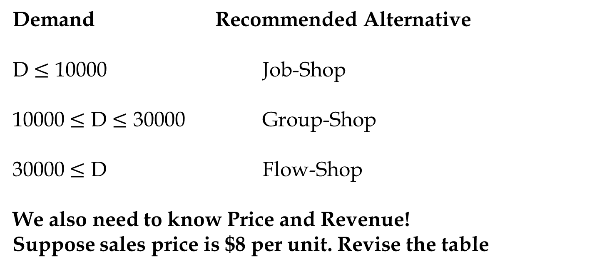
Recommendations to Management and Marketing
Demand Recommended Alternative
D $≤$ 10000 Job-Shop
10000 $≤$ D $≤$ 30000 Group-Shop
30000 $≤$ D Flow-Shop
We also need to know Price and Revenue!
Suppose sales price is $8 per unit. Revise the table

Slide 16
Recommendations to Management and Marketing
Alternative 1 has a variable cost of $10>$8 will never use it
Alternative 2 has a variable cost of $5<$8
Alternative 3 has a variable cost of $2<$8
As we saw before, Alternatives 2 and 3 break even at 30,000
If demand is greater than 30,000, we use alternative 3.
Now we can compute the break-even point of Alternative 2.
Can you analyze the situation before solving the problem?
If the break-even point for alternative 2 is X and is greater than 30,000, then we never use Alternative 2 since beyond a demand of 30,000, Alternative 3 is always preferred to Alternative 2.
D < X Do nothing
D> X Alternative 3
Lets see where is the BEP of alternative 2
F+VQ = PQ
60,000+5Q=8Q ➔ Q= 20,000.

Slide 17
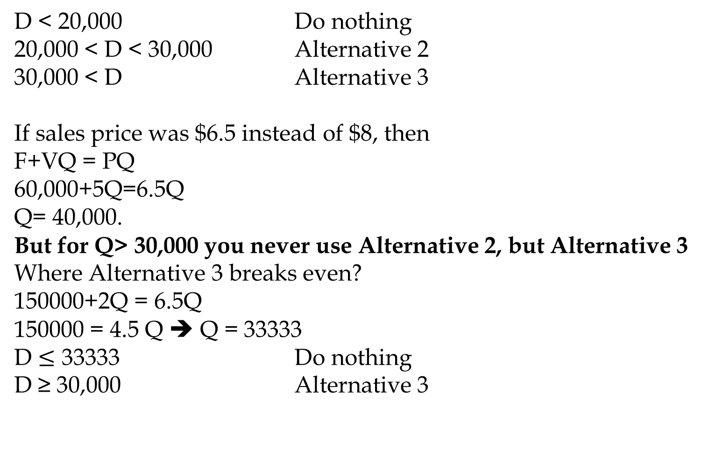
Recommendations to Management and Marketing
D < 20,000 Do nothing
20,000 < D < 30,000 Alternative 2
30,000 < D Alternative 3
If sales price was $6.5 instead of $8, then
F+VQ = PQ
60,000+5Q=6.5Q
Q= 40,000.
But for Q> 30,000 you never use Alternative 2, but Alternative 3
Where Alternative 3 breaks even?
150000+2Q = 6.5Q
150000 = 4.5 Q ➔ Q = 33333
D $≤$ 33333 Do nothing
D ≥ 30,000 Alternative 3

Slide 18
Example 4. BEP for the Three Global Locations
You’re considering a new manufacturing plant in the sites at the suburb of one of the three candidate locations of:
Bristol (England), Taranto (Italy), or Essen (Germany).
Total Fixed costs (costs of human and capital resources) per year and variable costs (costs of inputs) per case of product is given below
Bristol (England) F = $300000, V = $18
Essen (Germany): F = $600000, V = $12
Taranto (Italy): F = $900000, V = $9

Slide 19
Example 3. BEA for Multiple Alternatives
Taranto
Essen
Bristol
Q1
Q2

Slide 20
Example 3. BEA for Multiple Alternatives
Taranto
Essen
Bristol
Q1
Q2

Slide 21
Example 4. BEP for the Three Global Locations
1. At what level of demand a site at Bristol suburb is preferred?
Bristol Total Costs = 300000+18Q
Essen Total Costs = 600000+12Q
300000+18Q = 600000+12Q
6Q = 300,000
Q = 50,000
2. At what level of demand is a site at Essen suburb preferred?
Essen Total Costs = 600000+12Q
Taranto Total Costs = 900000+9Q
600000+12Q = 900000+9Q
3Q = 300,000
Q = 100,0000
Essen is preferred for 100,000≥ Q ≥ 50,000

Slide 22
Example 3. BEA for Multiple Alternatives
Taranto
Essen
Bristol
50000
100000

Slide 23
Example 4. BEP for the Three Global Locations
3. At what level of demand a site at Taranto suburb is preferred?
More than 100,000
4. Suppose sales price is equal to the average of the variable costs at Bristol and Essen. At what level of demand is a site at Bristol suburb preferred?
Never
6. Given the same assumption as (4). At what level of demand a site at Essen suburb is preferred?
P = (18+12)/2 = 15
Total Essen cost = 600,000 + 12Q
PQ = F + VQ
15Q = 600,000 + 12Q
3Q = 600,000
Q = 200,000
Never. Why???

Slide 24
Example 5. BEP for the Three Global Locations
Why
At Q = 100,000 Taranto dominates Essen
5. Given the same assumption as (4). At what level of demand is a site at Taranto suburb preferred?
P = (18+12)/2 = 15
Taranto Total cost = 900,000 + 9Q
PQ = F + VQ
15Q = 900,000 + 9Q
6Q = 900,000
Q = 150,000
P =15
D ≤ 150000 No Where
D ≥ 150,000 Taranto

Slide 25
Example 5. BEP for the Three Global Locations
7. Suppose sales price is $20. At what level of demand a site at Essen suburb is preferred?
Essen Total cost = 600,000 + 12Q
20Q = 600,000+12Q
Q = 75000
From 75000 to ??
At what level of demand a site at Essen is preferred?
At 100,000 Essen and Taranto Break Even – After that Taranto denominates
From 75,000 to 100,000
P= 20
75,000 ≤ D ≤ 100000 Essen
D ≥ 100,000 Taranto

Slide 26
Financial Throughput and Fixed Operating Costs
We define financial throughput as the rate at which the enterprise generates money. By selling one unit of product we generate P dollars, at the same time we incur V dollars pure variable cost. Pure variable cost is the cost directly related to the production of one additional unit - such as raw material. It does not include sunk costs such as salary, rent, and depreciation. Since we produce and sell Q units per unit of time. The financial throughput is Q(P-V).
Fixed Operating Expenses (F) include all costs not directly related to production of one additional unit. That includes costs such as human and capital resources.
Throughput Profit Multiplier = % Changes in Profit divided by % Changes in Throughput
1% change in the throughput leads to TPM% change in the profit

Slide 27
Financial Throughput and Fixed Operating Costs
Suppose fixed cost F = $180,000 per month. Sales price per unit P = 22, and variable cost per unit V = 2. In July, the process throughput was 10,000 units. A process improvement increased throughput in August by 2% to 10,200 units without any increase in the fixed cost. Compute throughput profit multiplier.
July: Financial Throughput = 10000(22-2) = 200000
Fixed cost F = 180,000
Profit = 200000-180000 = $20,000
In August throughput increased by 2% to 10200
August: Financial Throughput of the additional 200 units = 200(22-2) = 4,000
We have already covered our fixed costs, the $4000 directly goes to profit.

Slide 28
Throughput Profit Multiplier (TPM)
% Change in Throughput = 2%
% change in profit = 4000/20000 = 20%
Throughput Profit Multiplier (TPM) = 20%/2% = 10
1% throughput improvement ➔ 10% profit improvement

Slide 29
A Viable Vision – Eliyahu Goldratt
A Viable Vision (Goldratt): What if we decide to have todays total revenue as tomorrows total profit.
In our example, Financial Throughput in July was Q1(P-V) = 10,000(22-2). In order to have your profit equal this amount we need to produce Q2 units such that:
Q2(P-V) – F = Q1(P)
Q2(20) -180,000 = 10,000(22)
Q2(20) = 40,000
Q2 = 20,000
In order to have your todays total revenue as tomorrows total profit. We only need to double our throughput. Our sales, our current revenue becomes our tomorrows profit.

Slide 30
Example 5
A manager has the option of purchasing 1, 2 or 3 machines.
The capacity of each machine is 300 units.
Fixed costs are as follows:
Number of Machines Fixed cost Total Capacity
1 $9,600 1-300
2 $15,000 301-600
3 $20,000 601-900
Variable cost is $10 per unit, and the sales price of product is $40 per unit.
Tell management what to do!

Slide 31
Example 5. BEP Recommendations
Prepare an executive summary similar the following:
R<= ? ➔ ?
?<R<=? ➔ ?
R>? ➔ ?
Now it is up to the Marketing Department to provide an Executive Summary regarding the demand.

Slide 32
BEP: One Machine
The beak-even point for 1 machine is 320
But one machine can not produce more than 300
Demand <= 300 ➔ No Production
Otherwise ➔ Consider two machines
40000
35000
30000
40Q
25000
20000
15000
9600+10Q
9600 + 10Q = 40Q
9600= 30Q
10000
5000
320
100
200
300
400
500
600
700
800
900
1000

Slide 33
BEP: Two Machine
The beak-even point for 2 machine is 500
Demand <= 500 ➔ No Production
Otherwise ➔ Two machines and consider 3 machines
40000
35000
30000
40Q
25000
20000
15000+10Q
15000
15000 + 10Q = 40Q
15000= 30Q
10000
5000
500
100
200
300
400
500
600
700
800
900
1000

Slide 34
BEP: Three Machine
The beak-even point for 3 machine is 667
Demand <= 667 ➔ Produce up to 600 using 2 machine
Otherwise ➔ 3 machines
40000
40Q
35000
30000
25000
20000
20000+10Q
15000
20000 + 10Q = 40Q
20000= 30Q
10000
5000
667
100
200
300
400
500
600
700
800
900
1000

Slide 35
BEP for the Three Alternatives and Recommendations
Prepare an executive summary similar the following:
R<= 500 ➔ Do nothing
500 <R<=667 ➔ Buy two machines and produce 500< Q<= 600
Q>667 ➔ Buy three machines and produce 667<R<=900
Now it is up to the Marketing Department to provide an Executive Summary regarding the demand.
Please Think again!.
We have made a mistake.

Slide 36
BEP: Two Machine- Revisited
TC = 15000 + 10(600)
TC = 21000
TR = 40(600) = 24000
Profit = 24000-21000 = 3000
40000
35000
30000
40Q
25000
}
20000
15000+10Q
You do not switch to 3 machines unless you make 3000 profit
15000
10000
5000
600
100
200
300
400
500
600
700
800
900
1000

Slide 37
From Wrong to Right Recommendations
Q<= 500 ➔ Do-Nothing
500<Q<=667 ➔ Buy two machines and produce 500<Q<= 600
Q>667 ➔ Buy three machines and produce 667<Q<=900
At Q = 667 you make 0 profit with 3 machines
20000 + 10Q = 40Q
20000= 30Q
Q = 667
20000 + 10Q +3000= 40Q
23000= 30Q
Q = 767

Slide 38
Executive Summary
Q<= 500 ➔ Do-Nothing
500<Q<=767 ➔ Buy two machines and produce 500<Q<= 600
Q>767 ➔ Buy three machines and produce 767<Q<=900
Now it is to Marketing Department to provide executive summary regarding the demand

Slide 39
Example 5- At Your Own Will
You are the production manager and are given the option to purchase either 1, 2 or 3 machines. Each machine has a capacity of 500 units. Fixed costs are as follows:
Number of Machines Fixed cost Total Capacity
1 $19,200 1- 500
2 $30,000 501-1000
3 $40,000 1001-1500
Variable cost is $35 per unit, and the sales price of product is $69 per unit.
Determine the best option!

Slide 40
BEP for the Three Alternatives and Recommendations
Prepare an executive summary similar the following:
R<= ? ➔ ?
?<R<=? ➔ ?
R>? ➔ ?

Slide 41
BEA Simulation

Slide 42
Back to Example1 - Simulation
$1000,000 average total yearly fixed costs ($800,000-$1,200,000).
$200 average per unit variable costs ($180-$220).
$400 average per unit sale price ($350-$450)
Sales 4000-6000
.

Slide 44
