Slide 1
Breack-Even Analysis
The Very Basic Model

Slide 2


Break-Even Analysis
&
Profit Margin Multiplier
Ardavan Asef-Vaziri

Slide 3
Seven Principles of Supply Chain Management
Operation costs are divided into 2 main groups:
  Fixed costs – Costs of Human and Capital Resources
  wages, benefits, depreciation, rent, property tax and insurance.
  the total fixed cost is fixed throughout the year. No matter if we produce one unit or one million units. It does not depend on the production level.
  fixed cost per unit of production is variable.
Variable costs – Costs of Inputs
  raw material, packaging material, supplies, production water and power.
  The total variable costs depend on the volume of production. The higher the production level, the higher the total variable costs.
  variable cost per unit of production is fixed.

Slide 4
Five Elements of the Process View
Process
Management
Information
structure
Network of
Activities and Buffers
Inputs
(natural or processed resources, parts and components, energy, data, customers, cash, etc.)
Outputs
Goods
Services
Flow Unit
Human & Capital
Fixed
Variable
Resources

Slide 5
Total Fixed Cost and Fixed Cost per Unit of Product
Total fixed cost
(F)
Fixed cost per unit of product
(F/Q)
Production volume (Q)
Production volume (Q)

Slide 6
Variable Cost per Unit and Total Variable Costs
Variable costs
Per unit of product
Total Variable costs
(VQ)
(V)
Production volume (Q)
Production volume (Q)

Slide 7
Diminishing Marginal Return
Variable costs
Output
Per unit of product
(V)
Input
Production volume
(Q)

Slide 8
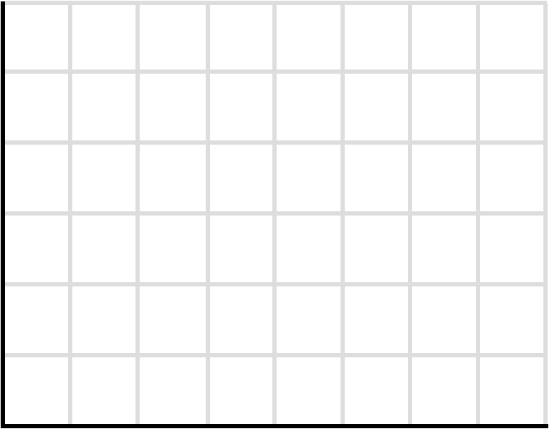
Economy of Scall & Diseconomy of Scale
Economies of scale
  Labor specialization
  Managerial specialization
  Efficient capital
  -------------
Diseconomies of scale
  Control and coordination problems
  Communication problems
  Worker alienation
  Shirking
  Dinosaur Effect
ATC-5
ATC-1
ATC-2
ATC-4
Average Total Costs Per Output
ATC-3
Long-Run ATC
Output
Control
Size

Slide 9
Total Costs TC = F+VQ
Total cost = F+VQ
Total Costs in $ (TC)
Total variable cost (VQ)
Total Fixed cost (F)
0
Volume of Production and Sales in units (Q)

Slide 10
Total Revenue
It is assumed that the price of the product is fixed, and we sell whatever we produce.
Total sales revenue depends on the production level.
The higher the production, the higher the total sales revenue.

Slide 11
Break-Even Computations
Profit
Total cost = F+VQ
Total Costs or Revenue in $ (TC)
Loss
Total Revenue (PQ)
Break-Even Point
Volume of Production and Sales in units (Q)

Slide 12
BEP-Example
$1000,000 total yearly fixed costs.
$200 per unit variable costs
$400 per unit sale price
TR = TC
400Q= 1000,000+200Q
(400-200)Q= 1000,000
Q= 5000
Q_{BEP}=5000
If our market research indicates that the present demand is > 5,000, then this manufacturing system is economically feasible.

Slide 13
Financial Throughput and Fixed Operating Costs
We define financial throughput as the rate at which the enterprise generates money. By selling one unit of product we generate P dollars, at the same time we incur V dollars pure variable cost. Pure variable cost is the cost directly related to the production of one additional unit - such as raw material. It does not include sunk costs such as salary, rent, and depreciation. Since we produce and sell Q units per unit of time. The financial throughput is Q(P-V).
Fixed Operating Expenses (F) include all costs not directly related to production of one additional unit. That includes costs such as human and capital resources.
Throughput Profit Multiplier = % Changes in Profit divided by % Changes in Throughput
1% change in the throughput leads to TPM% change in the profit

Slide 14
Financial Throughput and Fixed Operating Costs
Fixed cost F = $180,000 per month. Sales price per unit P = 22, and variable cost per unit V = 2. In July, the process throughput was 10,000 units. A process improvement increased throughput in August by 2% to 10,200 units without any increase in the fixed cost. Compute throughput profit multiplier.
July: Financial Throughput = 10000(22-2) = 200000
Fixed cost F = 180,000
Profit = 200000-180000 = $20,000
In August throughput increased by 2% to 10200
August: Financial Throughput of the additional 200 units = 200(22-2) = 4,000
We have already covered our fixed costs, the $4000 directly goes to profit.
July Profit was 20,000, in August it increased by 4,000
4000/20000 = 20%
2%⇑Sales ➔ 20%⇑Profit.
1%⇑Sales ➔ 10%⇑Profit. That is Throughput Profit Multiplier.

Slide 15
A Viable Vision – Eliyahu Goldratt
A Viable Vision (Goldratt): What if we decide to have today's total revenue as tomorrow's total profit.
In our example, Financial Throughput in July was Q1(P-V) = 10,000(22-2). In order to have your profit equal this amount we need to produce Q2 units such that:
Q2(P-V) – F = Q1(P)
Q2(20) -180,000 = 10,000(22)
Q2(20) = 40,000
Q2 = 20,000
In order to have your today's total revenue as tomorrow's total profit. We only need to double our throughput. Our sales, our current revenue becomes our tomorrow's profit.

Slide 16
Break-Even Analysis - Math-Quiz (A)
C(Q) =48 +3Q
P=11
Fixed cost is 48 since it has no relation with Q
Variable cost is 3 because for one unit increase in Q the cost will go up by 3
Total cost of making 18 pies
C(18) = 48+3(18) = 102
Total cost of making 19 pies instead of 18
102+3=105
Total Revenue = Total Cost
PQ=48+3Q ➔ 11Q=48+3Q ➔ 8Q=48 ➔ Q=6
Profit = Total Cost ➔ Total Revenue = Total Cost + Total Cost
11Q=2(48+3Q) ➔ 11Q=96+6Q
5Q=96 ➔ Q=19.2

Slide 17
Throughput Profit Multiplier
Suppose we produce 10 units. What % increase in production and sales is needed to double the profit? That is what percentage increase in sales leads to 100% increase in profit. Q= 10
TC= F+VQ = 48+3Q = 48+3(10) = 78
TR= PQ=11(10) = 110
TP= TR-TC = 110-78 = 32
To increase profit by 100% we need to make 2(32) =64
TR-TC= 64
11Q-(48+3Q) = 64 ➔ 11Q-3Q = 64+48 ➔ 8Q = 112 ➔ Q= 14
14/10= 1.4 ➔ 140% ➔ 40% increase
40% increase in sales leads to 100% increase in profit.
Throughput Profit Multiplier = %Profit_Change/%Sales_Change

Slide 18
Throughput Profit Multiplier -Second Example
Fixed Cost = F = $120,000.
Variable Cost = V = $20.
Sales Price = P = $30.
Contribution Margin = P=V = 30-20 = 10 to recover F and Produce Profit.
We are making $10,000 profit.
How many units do we produce (assume Production = Sales).
TR = PQ.
TC = F +VQ.
TP = TR-TC = PQ-(F-VQ) = (P-V)Q-F.
10,000 = 10Q-120,000.
10Q= 130,000 ➔ Q = 13,000.
Suppose sales is =increased by 10%. By what % will profit increase.
Sales = 13,000+0.1(130,000) = 143,000.

Slide 19
Throughput Profit Multiplier- Second Example
TP = TR-TC = PQ-(F-VQ) = (P-V)Q-F
TP = 10(14,300)-120,000
TP= 143,000-120,000= 23,000
Original profit was 10,000
Sales increased by 10%
Profit went from 10,000 to 23,000
That is 13,000 increase
13,000 compared to 10,000 is 130% increase.
10%Sales⇑ leads to 130%Profit⇑
That is Throughput Profit Multiplier

Slide 20
A Viable Vision- Goldratt
By what % should we increase production (production = sales) to make our profit 5 years from now equal to our current sales.
Current sales quantity = Q1= 13,000
Current sales revenue = TR= PQ = 30(13,000) = 390,000
Profit 5 years from now = 390,000
Our current profit is only 10,000
Therefore want to have (390000-10,000)/10,000= 38 we want to increase out profit 38 times.
TP=TR-TC
TP=PQ2-(F-VQ2) = (P-V)Q2-F
390,000= (30-20)Q2-120,000 ➔ 10Q2=510,000 ➔ Q2=51,000
(Q2-Q1)/Q1 = (51,000-13,000)/13,000 =2.92 = under 3 times.
Increase sales by 3 times, your profit will increase by 38 times

