Slide 1
Linear Programing
Introduction
Ardavan Asef-Vaziri

Slide 2
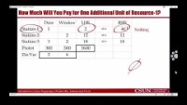

Slide 3


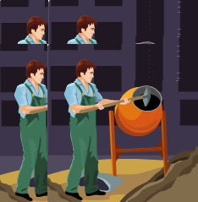

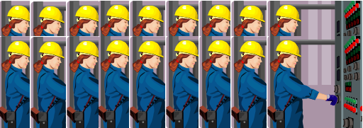
Door and Window
Two products (Product1 and Product2) and three resources (Resource1, Resource2, Resource3).
Contribution Margin of product 1 and Product2 are $300 and $500, respectively.
Product1 needs 1 hour of Resource1, nothing of Resource2, and 3 hours of resource3. Product2 needs nothing from Resource1, 2 hours of Resource2, and 2 hours of resource3.
Available hours of resources 1, 2, 3 are 4, 12, 18, respectively.
Formulate the Problem
Solve the problem using solver in excel

Slide 4
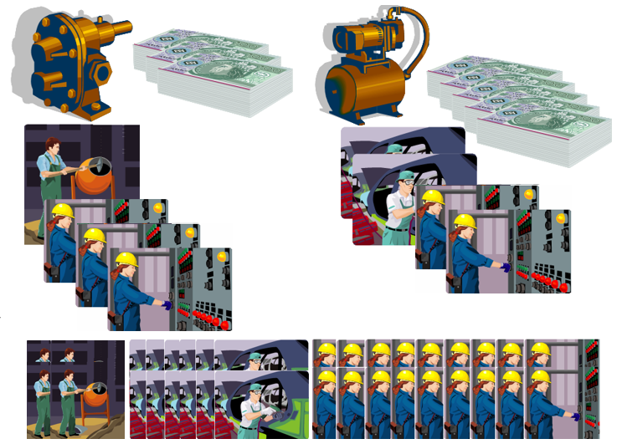
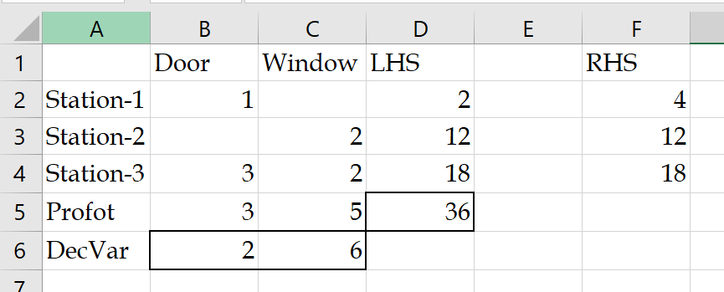
Formulation
Decision Variables
X1: Volume of Product 1
X2: Volume of Product 2
Objective Function
Z = 300X1 +500X2
Constraints
Resource 1
X1 ≤ 4
Resource 2
2X2 ≤ 12
Resource 3
3X1+ 2X2 ≤ 18
Nonnegativity
X1≥ 0, X2≥ 0

Slide 5
How Much Will You Pay for One Additional Unit of Resource-1?
Nothing

Slide 6
How Much Will You Pay for One Additional Unit of Resource-2?
Door
Window
LHS
RHS
Station-1
1
1.667
<=
4
Station-2
2
13
<=
13
Up to $150
Station-3
3
2
18
<=
18
Profit
300
500
3750
DecVar
1.667
6.5
Real numbers like 1.667 for product-1 and 6.5 for product-2 are OK.
We may assume in 3 days we produce 3(1.667) = 5 units of product-1 and in two days produce 2(6.5) = 13 units of product-2.

Slide 7
Solver Optimal Solution
Up to $100

Slide 8
Assumptions of Linear Programming
Real numbers: we can produce decimals of products, like 1.667, 6.5, 2.33, etc.
Linear: All components in the formulation are formed by a constant multiplied by a variable, like 2X1. No square, no square root, no power, no log, etc.
Deterministic: We know the parameters of the model, such as profit and consumption rates, and the availability of resources.
Multiplicativity: If one unit of a Product consumes 2 units of a Resource, then X1 units of this product need 2X1 units of the Resource - the same for the profit and all other components of the model.
Additivity: If X1 units of product-1 require 2X1 units of a Resource, and X2 units of product-2 require 3X2 units of the same Resource, then for X1 units of Product-1 and X2 units of Product-2, we need 2X1+3X2 units of this Resource - the same for the profit and all other components of the model.
If we have 3 products, any combination of three numbers is a Solution. A Feasible Solution satisfies all constraints. An Optimal Solution is the best among all Feasible solutions.

Slide 9
Infeasible, Feasible, Optimal
Given the following problem
  Maximize Z = 3x1 + 5x2
  Subject to: the following constraints
      x1 ≤ 4
      2x2 ≤ 12
      3x1 + 2x2 ≤ 18
x1, x2 ≥ 0
What combination of x1 and x2 could be the optimal solution?
    A) x1 = 4, x2 = 4
    B) x1 = -3, x2 = 6
    C) x1 = 3, x2 = 4
    D) x1 = 0, x2 = 7
    E) x1 = 2, x2 = 6
Infeasible; Violates Constraint 3
Infeasible; Violates nonnegativity
Feasible; z = 3×3+ 5×4 = 29
Infeasible; Violates Constraint 2
Feasible; z = 3×2+ 5×6 = 36 and Optimal

Slide 10
Practice - The Lego Production Problem
You have a set of Legos
8 small bricks
6 large bricks
These are your “raw materials”.
You have to produce tables and chairs out of these Legos. These are your “products”.
How many chairs and how many tables do you produce?
Les assume X1 as the number of chairs and X2 as the number of tables we produce
Weekly supply of raw materials
8 Small Bricks
6 Large Bricks
Products
Chair
Profit = 15 cents per Chair
Table
Profit = 20 cents per Table

Slide 11
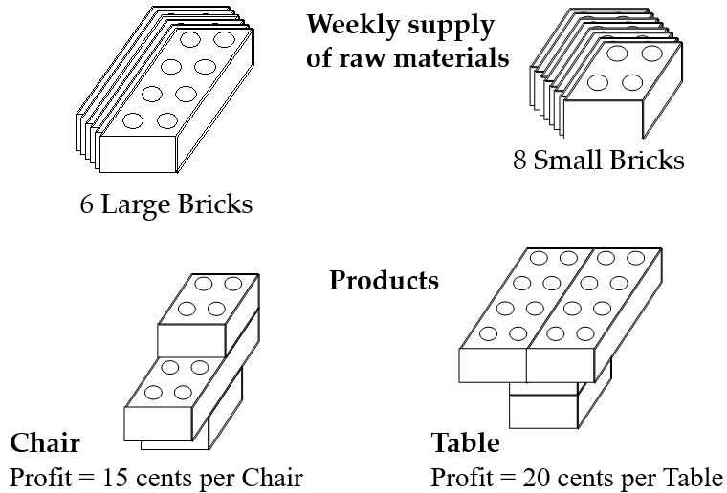
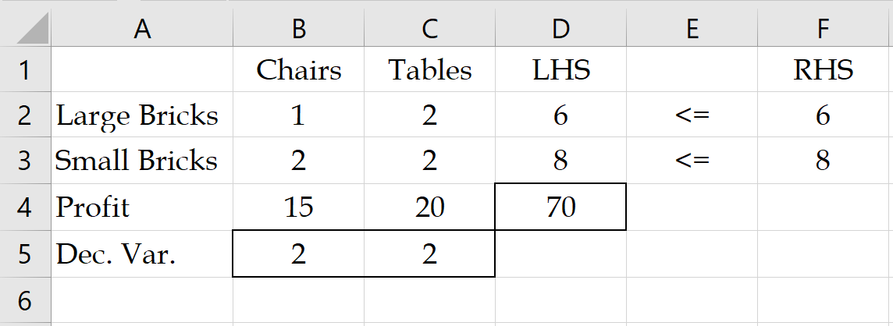
Mathematical Formulation
X1 is the number of Chairs
X2 is the number of Tables
Large brick constraint
X1+2X2 ≤ 6
Small brick constraint
2X1+2X2 ≤ 8
Objective function is
Maximize 15X1+20 X2
X1 ≥ 0
X2 ≥ 0

