Slide 1

Normal Distribution & Re-Order Point (ROP)

Slide 2
Uniform, Normal, Exponential

Slide 3

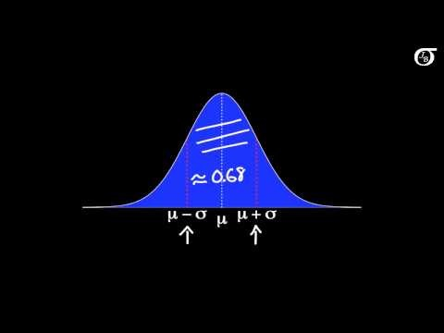
Normal Probability Distribution
https://www.youtube.com/watch?v=iYiOVISWXS4

Slide 4
Normal Probability Distribution
The Normal probability distribution is the most applied distribution in the real world. Weight of people, test scores, life of a light bulb, number of votes in an election follow Normal Distribution. Normal distribution is symmetric; skewness = 0.
Mean, median and mode, are on each others and are at the highest point. Normal distributions is defined by its mean μ and its standard deviation σ . ➔ X~ N(μ, σ ).
The mean can be any numerical value: negative, zero, or positive.
The standard deviation determines the width of the curve: larger values result in wider, flatter curves.

Slide 5
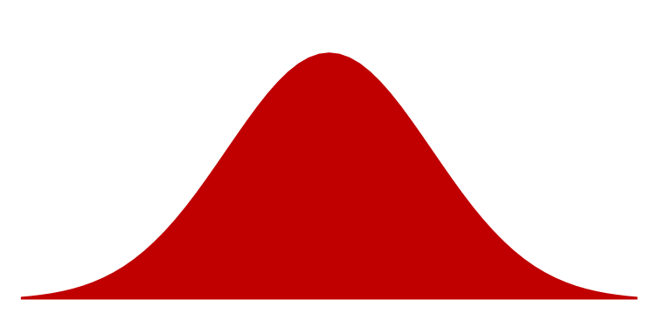
Normal Probability Distribution
Probabilities for the normal random variable are given by areas under the curve. The total area under the curve is 1 (0.5 to the left of the mean and 0.5 to the right).
99.72%
Chebyshev Theorem
At least 1-1/k² between μ+kσ
K= 1 ➔ not defined
K= 2 ➔ 1-1/4 = 0.75
K= 3 ➔ 1-1/9 = 0.89
95.44%
68.26%
x
μ – 3σ
μ – 1σ
μ
μ + 1σ
μ + 3σ
μ – 2σ
μ + 2σ

Slide 6
Standard Normal Probability Distribution
A random variable is standardized x➔ z first by subtracting µ. x- µ ≥ 0, the random variable is greater than or equal to the mean.
X- µ ≤ 0, the random variable is less than or equal to the mean.
Therefore, half a way to standard normal is to see if the random variable is greater than or less than average.
The second step is how much greater or less than, but not in absolute term. In terms of the number of standard deviations.
z= (x- µ)/σ
The letter z is used to designate the standard normal random variable.
We can think of z as a measure of the number of standard
deviations x is from μ.
σ = 1
z
0

Slide 7
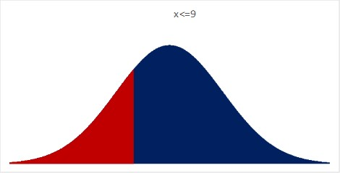
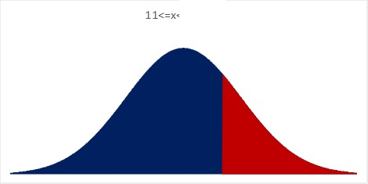
Normal Probability Distribution
In October 2012, Apple introduced a much smaller variant of the Apple iPad, known as the iPad Mini. Assume that battery life of the iPad Mini is normally distributed with mean od 10 and standard deviation of 1.5 hours.
a) What is the probability that the battery life for an iPad Mini will be 9 hours or less?
=NORM.DIST(X,μ,σ,1)
= NORM.DIST(9,10,1.5,1)
=0.25249
b) What is the probability that the battery life for an iPad Mini will be at least 11 hours?
=1-NORM.DIST(X,μ,σ,1) =
0.25249 =1-NORM.DIST(11,10,1.5,1)

Slide 8
Normal Probability Distribution
What is the probability that the battery life for an iPad Mini will be between 9.5 and 11.5 hours?
=NORM.DIST(X,μ,σ,1))
= NORM.DIST(11.5,10,1.5,1)
= 0.8413447
=NORM.DIST(X,μ,σ,1)
= NORM.DIST(9.5,10,1.5,1)
= 0.3694413
0.4719

Slide 9
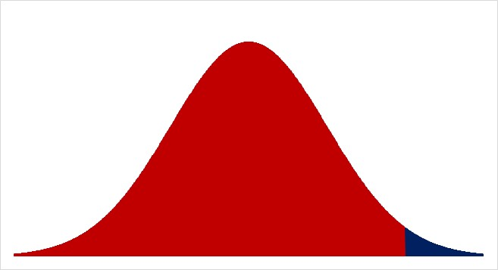

Normal Probability Distribution
What is the probability that the battery life for an iPad Mini will be between 11 and 13 hours?
=NORM.DIST(X,μ,σ,1) = NORM.DIST(13,10,1.5,1)
= 0.9772499
=NORM.DIST(X,μ,σ,1) = NORM.DIST(11,10,1.5,1)
= 0.7475075
0.22974

Slide 10
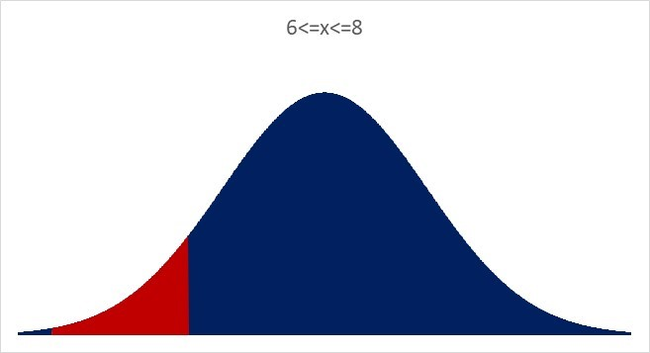
Normal Probability Distribution
What is the probability that the battery life for an iPad Mini will be between 8 and 6 hours?
=NORM.DIST(X,μ,σ,1) = NORM.DIST(8,10,1.5,1)
= 0.0912112
=NORM.DIST(X,μ,σ,1)
= NORM.DIST(6,10,1.5,1)
= 0.0038304
0.08738

Slide 11
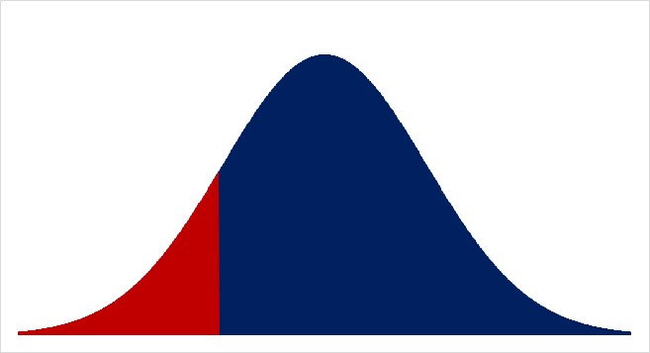
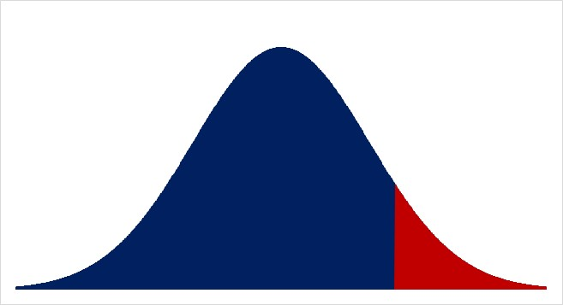
Normal Probability Distribution
The bottom 15% of the batteries live at most for how many hours?
=NORM.INV(0.15,10,1.5) = 8.44535
The top 10% of the batteries live at least for how many hours?
=NORM.INV(1-0.1,10,1.5) = 11.9223

Slide 12
ROP; total demand during lead time is variable
a) If average demand during the lead time (from the time that we place and order till we receive it) is 200 and standard deviation of demand during lead time is 25. Compute Re-Order Point (ROP) at 90% service level. Compute safety stock.
Service level
Risk of a
stockout
Probability of
no stockout
ROP
Quantity
Average
demand
Safety stock

Slide 13
Safety Stock and ROP
LTD = 200, σ_{LTD} = 25, SL=90%,
If ROP=200, there is 50% probability of stockout.
Service Level = 50%
Risk= 50%
232.0388 =NORM.INV(0.9,200,25)
By adding a safety stock of 32.04
Service Level = 90%
Risk= 10%
ROP = Average Demand + Isafety
ROP = LTD+Isafety
Isafety = ROP –LTD

Slide 14
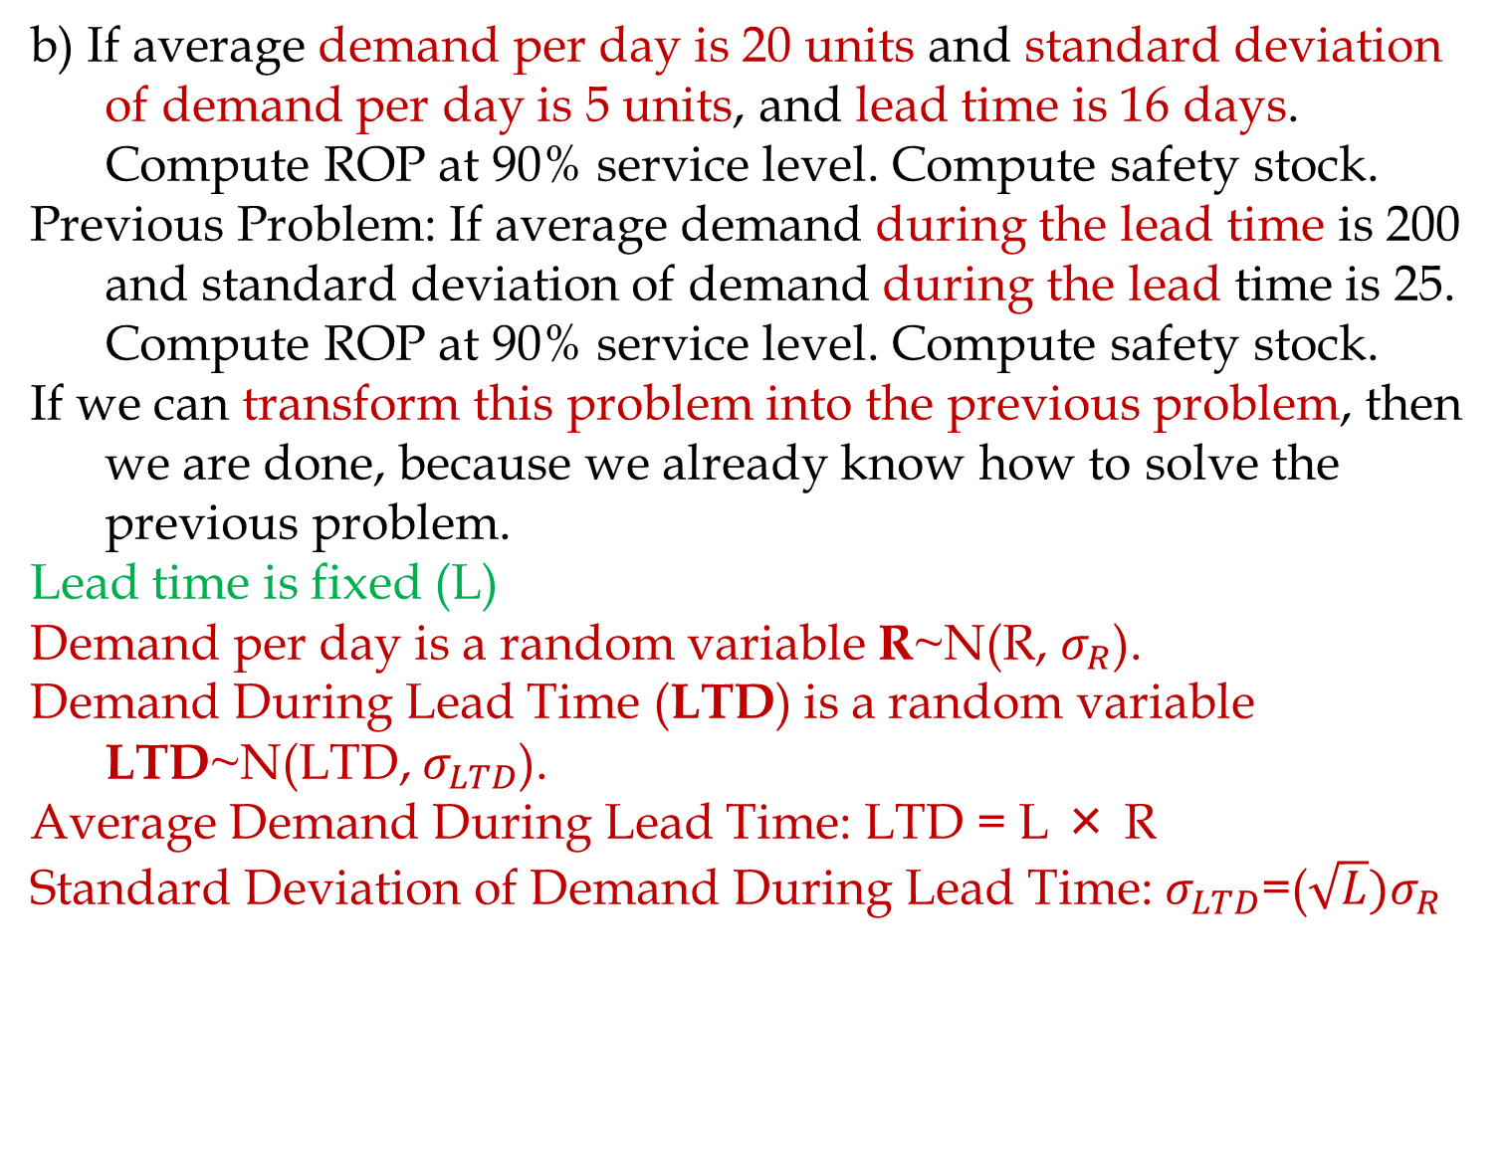
ROP; Variable R, Fixed L
b) If average demand per day is 20 units and standard deviation of demand per day is 5 units, and lead time is 16 days. Compute ROP at 90% service level. Compute safety stock.
Previous Problem: If average demand during the lead time is 200 and standard deviation of demand during the lead time is 25. Compute ROP at 90% service level. Compute safety stock.
If we can transform this problem into the previous problem, then we are done, because we already know how to solve the previous problem.
Lead time is fixed (L)
Demand per day is a random variable R~N(R, $σ_{R}$).
Demand During Lead Time (LTD) is a random variable LTD~N(LTD, $σ_{LTD}$).
Average Demand During Lead Time: LTD = L × R
Standard Deviation of Demand During Lead Time: $σ_{LTD}$=($\sqrt{L}{)σ}_{R}$

Slide 15
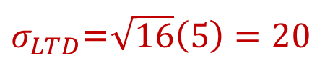
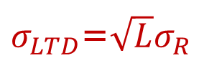
μ and σ of demand per period and fixed L
If demand is variable and Lead time is fixed
L: Lead Time = 16 days
R: Demand per day
R: Average daily demand =20
σ_{R}: Standard deviation of daily demand =5
LTD: Average Demand During Lead Time
LTD = L × R = 16 × 20 = 320
σ_{LTD}: Standard deviation of demand during lead time
$σ_{LTD}$=$\sqrt{L}σ_{R}$
$σ_{LTD}$=$\sqrt{16}\left(5\right)=20$

Slide 16
Now It is Transformed
The Problem originally was: If average demand per day is 20 units and standard deviation of demand is 5 per day, and lead time is 16 days. Compute ROP at 90% service level. Compute safety stock.
We transformed it to: The average demand during the lead time is 320 and the standard deviation of demand during the lead time is 20. Compute ROP at 90% service level. Compute safety stock.
Which is the same as the previous problem: If average demand during the lead time is 200 and standard deviation of demand during lead time is 25. Compute ROP at 90% service level. Compute safety stock.

Slide 17
ROP; Variable R, Fixed L
LTD = 320, σ_{LTD} = 20, SL=90%.
ROP = 345.631 =NORM.INV(0.9,320,20)
Isafety = 346-320= 26

Slide 18
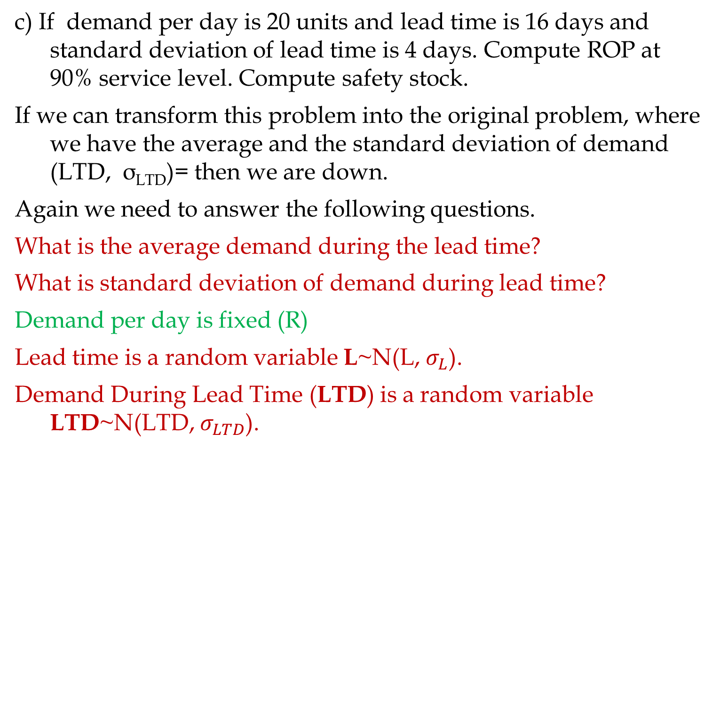
ROP; Variable R, Fixed L
c) If demand per day is 20 units and lead time is 16 days and standard deviation of lead time is 4 days. Compute ROP at 90% service level. Compute safety stock.
If we can transform this problem into the original problem, where we have the average and the standard deviation of demand (LTD, σ_{LTD})= then we are down.
Again we need to answer the following questions.
What is the average demand during the lead time?
What is standard deviation of demand during lead time?
Demand per day is fixed (R)
Lead time is a random variable L~N(L, $σ_{L}$).
Demand During Lead Time (LTD) is a random variable LTD~N(LTD, $σ_{LTD}$).

Slide 19
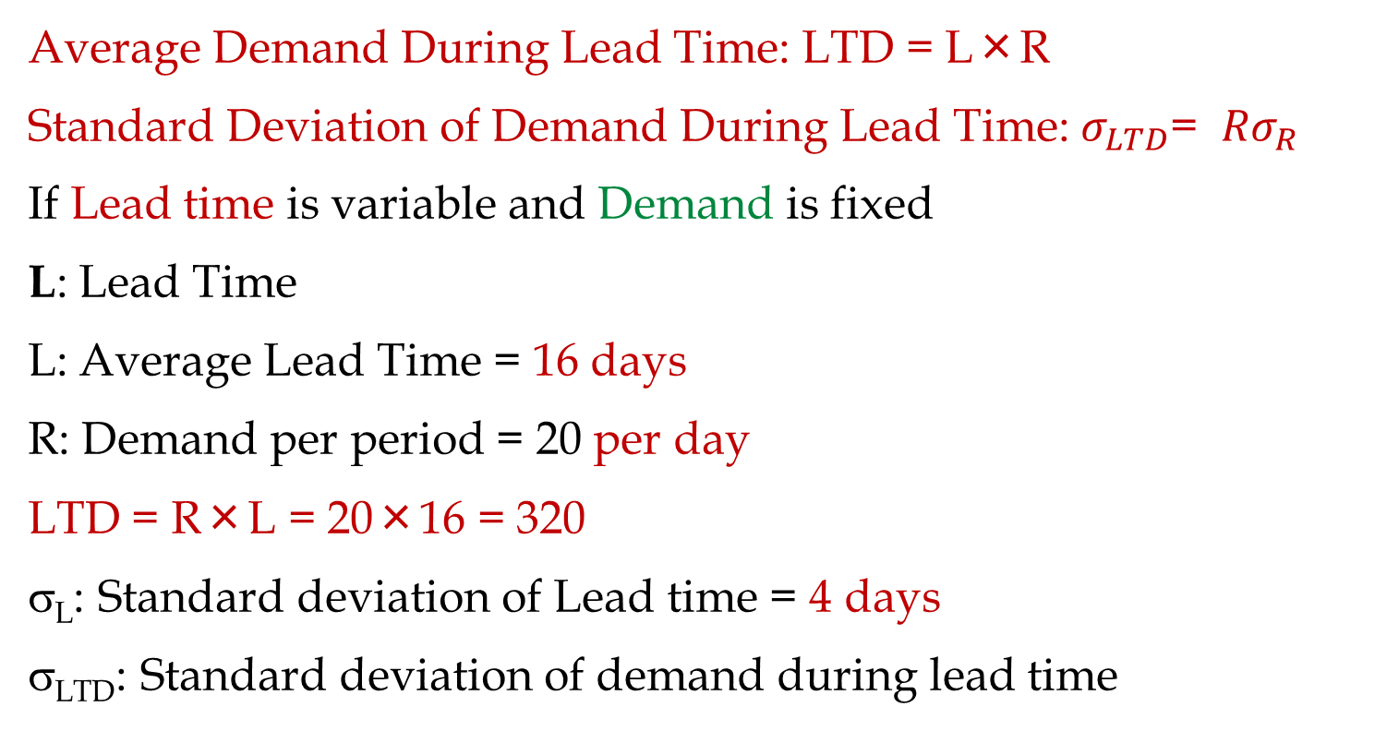
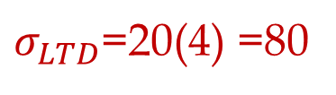
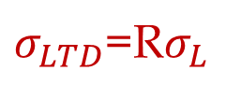
ROP; Variable R, Fixed R
Average Demand During Lead Time: LTD = L×R
Standard Deviation of Demand During Lead Time: $σ_{LTD}$= ${Rσ}_{R}$
If Lead time is variable and Demand is fixed
L: Lead Time
L: Average Lead Time = 16 days
R: Demand per period = 20 per day
LTD = R×L = 20×16 = 320
σ_{L}: Standard deviation of Lead time = 4 days
σ_{LTD}: Standard deviation of demand during lead time
$σ_{LTD}$=R$σ_{L}$
$σ_{LTD}$=20(4) =80

Slide 20
μ and σ of L and Fixed R
LDT = 320, σ_{LTD} = 80, SL = 90%
ROP = 422.5241 =NORM.INV(0.9,320,80)
Isafety = 423-320 ≈ 103

Slide 21
Comparing the two problems
Average demand per day is 10 units and standard deviation of demand per day is 3 units. The lead time is 5 days
Demand per day is 10 units. The average lead time is 3 days and standard deviation of lead time is 1 days.
Click on the graph below, then hit delete button several times

Slide 22
Given Safety Inventory Compute Service Level
Average lead time demand is 20,000 units. Standard deviation of lead time demand is 5,000 units. Each time the inventory level drops to 24,000 units, we order a 14-day supply of 28,000 units. Suppose holding cost is $2 per unit per year.
LTD = 20,000, σ_{LTD} = 5,000, ROP = 24,000, H=$2, R = 2,000 / day, Q or EOQ = 28,000.
a) Compute the service level.
SL= 0.788145 =NORM.DIST(24000,20000,5000,1)
In 78.81 % of the order cycles, the warehouse will not have a stockout. Risk = 100-78.81 = 21.19%.

Slide 23
Given Safety Inventory Compute Service Level
b) Compute the cycle inventory, and average inventory.
At reorder point we order 28,000 units.
Icycle = Q/2 = 28,000/2 = 14,000
Isafety = 4,000
Average Inventory = I = Icycle + Isafety =14,000 + 4,000 = 18000.
c) Compute the total holding costs per year.
H(Average Inventory) = H(I) = 2 × 18,000 = 36,000/year
d) Compute the average flow time.
R = 2,000 / day, I = 18,000
RT = I ➔2000T = 18,000
T = 9
9 days

Slide 24
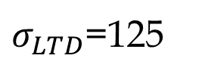
Problem 7.1
MassPC Inc. produces a 4-week supply of its PC Pal model when stock on hand drops to 525 units. It takes 1 week to produce a batch. Orders average 400 units per week, and standard deviation of demand forecast is 125 units. Compute the risk of stockout.
ROP =
1 week
400/week
$σ_{LTD}$=125
Q =
4(400)
525
L =
LTD =
0.841345 =NORM.DIST(525,400,125,1)
b) Compute Isafety for 80%, 90%, 95%, 99% service levels.

Slide 25
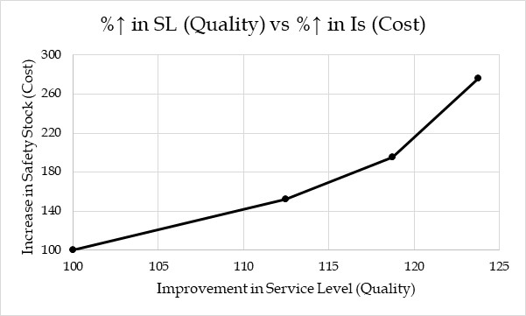
Problem 7.1
Selecting service level and safety inventory level is an important strategic decision.
A firm may choose high quality service in terms of product availability. Or
The firm may choose to be a low cost supplier by holding down inventory costs. In either case, it is positioning itself along the quality vs. cost trade-off curve.
This graph is a perfect example to show how a strategic position could be operationalized.

Slide 26
Additional Problems
Not Needed

Slide 27
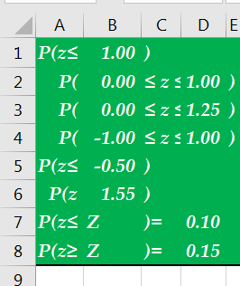
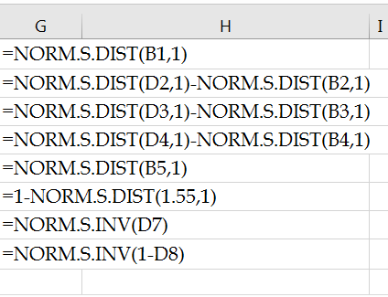
Standard Normal Distribution in Excel
Standard normal probability distribution, z, has a mean of 0 and a standard deviation of 1.
Given z find cumulative probability =NORM.S.DIS(x,1)
Given cumulative probability find z = NORM.S.INV(probability)

Slide 28
Service Level, Fill Rate
Within 100 time intervals, stockouts occur in 20.
Service Level = 80/100 = 80%.
Probability of stock-out = 20%.
Risk = # of stockout intervals/ Total # of intervals
Service Level = 1- (# of stockout intervals/ Total # of intervals)
Suppose that in each time interval in which a stockout occurred, the number of units by which we were short.
Suppose that cumulative demand during the 100 time intervals was 15,000 units and the total number of units short in the 20 intervals with stockouts was 1,500 units.
Fill rate = (15,000-1,500)/15,000 = 13,500/15,000 = 90%.
Fill Rate = Expected Sales / Expected Demand
Fill Rate = (1- Expected Stockout )/ Expected Demand

Slide 29
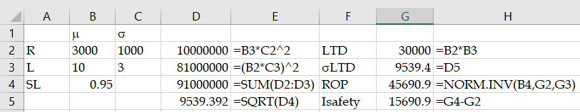

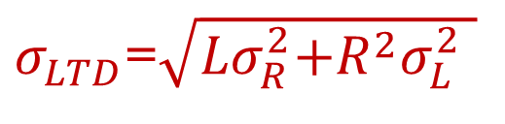
Both Lead Time and Demand are Variable
$σ_{LTD}$=$\sqrt{{Lσ}_{R}^{2}\text{+}R^{2}σ_{L}^{2} }$
$LTD=LR$
Lead time has mean of 10 days and a stddev of 3 days. Demand per day has a mean of 3000 and stddev of 1000. How much safety inventory is needed in order to provide a 95% service level?
R: Average demand rate= 3000 units
σ_{R}: Standard deviation of demand = 1000 units
L: Average lead time = 10 days
σ_{L}: Standard deviation of the lead time = 2 days

Slide 30
More Practice on the Same Concepts
Average demand of a product is 50 tons per week. Standard deviation of the weekly demand is 3 tons. Lead time is 2 weeks. Assume that the management is willing to accept a risk no more that 10%. L= 2 weeks, R= 50 tons per week, σ_{R} = 3 tons per week.
LTD = L×R = 2(50) = 100
σ_{LTD} =(√L) σ_{R} =(√2) 3 = 4.24
ROP =NORM.INV(0.9,100,4.24) = 105.43 ≈ 106
Isafety = ROP – LTD = 106-100 = 6

Slide 31
More Practice on the Same Concepts
Demand of sand is fixed and is 50 tons per week. The average lead time is 2 weeks. Standard deviation of lead time is 0.5 week. Under a risk of no more that 10%, compute ROP and Isafety.
Acceptable risk; 10%. R: 50 tons, L = 2 weeks, σ_{L} = 0.5 week.
LTD = L×R = 2(50) = 100
σ_{LTD} = R σ_{L} = 50 ×0.5 = 25
ROP = NORM.INV(0.9,100,25) = 132.04 ≈133
I safety = 133-100 =33

Slide 32
Service Level, Fill Rate
Within 100 time intervals, stockouts occur in 20.
Service Level = 80/100 = 80%.
Probability of stock-out = 20%.
Risk = # of stockout intervals/ Total # of intervals
Service Level = 1- (# of stockout intervals/ Total # of intervals)
Suppose that in each time interval in which a stockout occurred, the number of units by which we were short.
Suppose that cumulative demand during the 100 time intervals was 15,000 units and the total number of units short in the 20 intervals with stockouts was 1,500 units.
Fill rate = (15,000-1,500)/15,000 = 13,500/15,000 = 90%.
Fill Rate = Expected Sales / Expected Demand
Fill Rate = (1- Expected Stockout )/ Expected Demand

Slide 33
Given x (or z) Find the Probability
When the stock of the oil in an oil change station drops to 20 gallons, an order is placed. The demand during lead time (till we receive the order) in gallons is x~N(15, 6). What is the probability that demand during lead-time will exceed 20 gallons (what is probability of stockout)?
P(x ≥ 20) = ?
How far are we from mean? 20-15 = 5
How many standard devotions? (20-15)/6 = 5/6 standard deviations to right.
That is z =5/6 = 0.83.
0.7967
0.2023
1 - 0.7977
0.83
z
0

Slide 34
Standard Normal Probability Distribution
If the manager of Pep Zone wants the probability of a stockout during replenishment lead-time to be no more than .05, what should the reorder point be?
=NORM.S.INV(0.95)=1.465
1.465 standard deviation
=1.465(6) = 9.87 ≈ 10
0.95
0.05
z
0
z_{.05}
A reorder point of 25 gallons will place the probability
of a stockout during lead-times at (slightly less than) .05

Slide 35
Standard Normal Probability Distribution
By raising the reorder point from 20 gallons to 25 gallons on hand, the probability of a stockout decreases from 0.20 to .05.
This is a significant decrease in the chance of being out of stock and unable to meet a customer’s desire to make a purchase.
Instead of NORM.S.XX We can directly use NORM.X function.
=NORM.DIST(20,15,6,1)
=0.797671619
P(x≥20) =1-0.797671619
P(x ≥X1)=0.05
=NORM.INV(0.95,15,6)
= 24.869122

Slide 36
Reorder Point
If average demand during the lead time is 200 and standard deviation of demand during lead time is 25. At what level of inventory we should order such that with 90% confidence we will not have stockout.
=NORM.S.INV(0.9) = 1.2816
We need to go 1.2816 away from average
1.2816(25) ≈ 32
To right
200+32 = 232
We can also use NORM. function directly
=NORM.INV(0.9,200,25) = 232.0388

