Slide 1
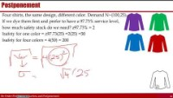
Re-Order-Point and Centralization
Re-Order-Point and Centralization

Slide 2
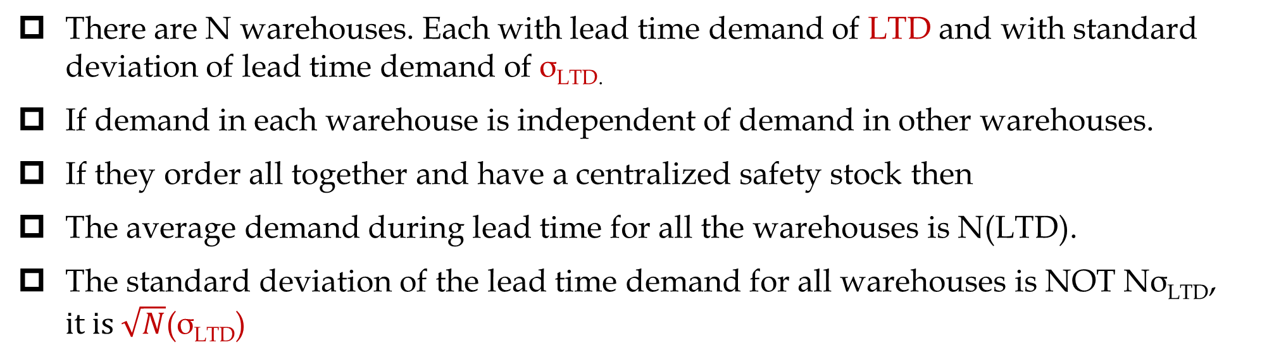
Centralization and ROP
There are N warehouses. Each with lead time demand of LTD and with standard deviation of lead time demand of σ_{LTD.}
If demand in each warehouse is independent of demand in other warehouses.
If they order all together and have a centralized safety stock then
The average demand during lead time for all the warehouses is N(LTD).
The standard deviation of the lead time demand for all warehouses is NOT Nσ_{LTD}, $it is \sqrt{N}$(σ_{LTD})

Slide 3

Centralization and ROP
Warehouse A
Warehouse B
SL = 95%
Isafety each = 1.65(10)
Isafety each = 16.5
Isafety all = 33
Demand N(80,10)
Demand N(80,10)
Warehouse A
Warehouse B
SL = 95%
Isafety all = 1.65(14.14)
Isafety all = 23.3
Demand N(160,$\sqrt{200}$)=N(160,14.14)

Slide 4
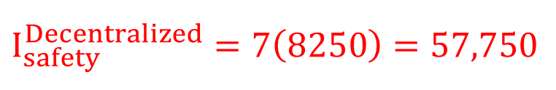
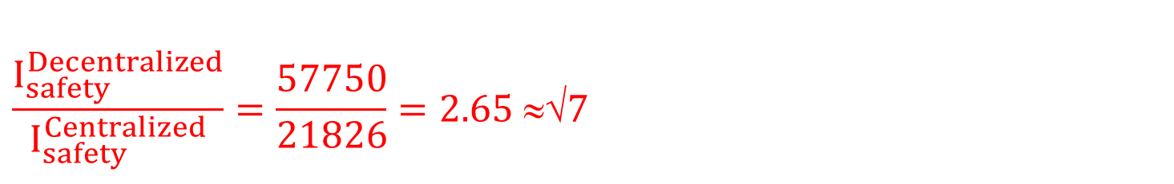
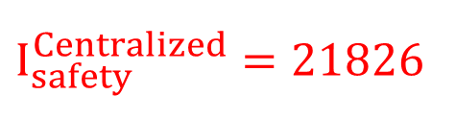
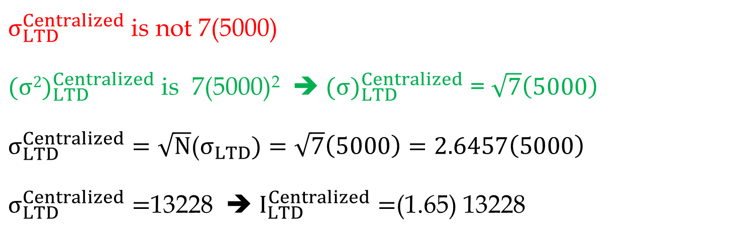
Independent Lead time Demands at N Locations
GE lighting with 7 warehouses. LTD for each warehouse has mean of 20,000 units and StdDev of 5,000 units and. Compute total Isafety at SL= 95% service level for centralized and decentralized systems.
I_{safety} = 1.65×5000= 8250
$$I_{safety}^{Decentralized}=7\left(8250\right)=57,750$$
$σ_{LTD}^{Centralized}$ is not 7(5000)
${(σ2)}_{LTD}^{Centralized}$ is 7(5000)² ➔ ${(σ)}_{LTD}^{Centralized}$ = $\sqrt{7}\left(5000\right)$
$σ_{LTD}^{Centralized}=\sqrt{N}$($σ_{LTD})=\sqrt{7}\left(5000\right)=2.6457\left(5000\right)$
$σ_{LTD}^{Centralized}=$13228 ➔ $I_{LTD}^{Centralized}=$(1.65) 13228
$$I_{safety}^{Centralized}=21826$$
$$\frac{I_{safety}^{Decentralized}}{I_{safety}^{Centralized}}=\frac{57750}{21826}=2.65 ≈√7$$

Slide 5
Centralization & Postponement
Epson produces printers for sale in Europe in its Taiwan factory. Printers sold in different countries differ in terms of the power outlet as well as the language manuals. Currently Epson assembles and packs printers for sale in individual countries. Weekly demand in different countries is normally distributed with mean and standard deviation as shown in table:
Assume demand in different countries to be independent. Given that the lead time from the Taiwan factory is six weeks, how much safety inventory does Epson require in Europe if it targets 96% probability of no stock out (CSL)?
R = Read From Table, for example for France it is 30,000. L=6 for all.
LTD_{France} = 6(30000)=180,000
σ_{LTDFrance} = SQRT(6)7500 = 2.44949(7500)= 18371
Z96% = 1.7507
Is= Z96%(σ_{LTDFrance})= 1.7507(18371) = 32182

Slide 6
Centralization
Epson decides to build a central DC in Europe. It will ship base printers (without power supply) to the DC. When an order is received, the DC will assemble power supplies, add manuals, and ship the printers to the appropriate country. The printers are still to be manufactured in Taiwan with the same lead-time. How much safety inventory can Epson expect to save as a result if it still targets 96% CSL?

Slide 7
Independent Lead Time Demands at N Locations
In Inventory; Centralization leads to reduction in
  EOQ, and therefore Icycle
  Isafety
  Average inventory
  Flow time
In Waiting Line; Centralization , or Polling, leads to (i) flow time reduction and (ii) throughput improvement.
If centralization reduces inventory, why doesn’t everybody do it?
  Less understanding of customer needs
  Less understanding of cultural, linguistics, and regulatory barriers
  Longer response time
  Higher shipping cost – which may lead to higher prices
These disadvantages may reduce the demand.

Slide 8
Principle of Aggregation and polling Inventory
Inventory benefits ➔ due to principle of aggregation.
Statistics: standard deviation of sum of random variables is less than the sum of the individual standard deviations.
Physical consolidation is not essential, as long as available inventory is shared among various locations ➔ Polling Inventory
  Virtual Centralization
  Specialization – one warehouse carries the majority of Isafety for all warehouses
  Component Commonality – a single motor in several models of a car factory
  Delayed Differentiation – a shirt in 4 model and 9 colors
  Product Substitution – a better available product for a less expensive stocked out

Slide 9
Lessons Learned
Levers for Reducing Safety Inventory
Reduce demand variability through improved forecasting
Reduce replenishment lead time
Reduce variability in replenishment lead time
poll safety inventory for multiple locations or products
Postpone product-differentiation processing until closer to the point of actual demand
Use common components
Exploit product substitution

Slide 10
Virtual Centralization
Virtual Centralization: inventory polling is facilitated using information regarding availability of goods and subsequent transshipment between locations.
Location A
Exceeds Available stock
Location B
Less than Available stock
1. Information about product demand and availability must be available at both locations
2. Shipping the product from one location to a customer at another location must be fast and cost effective
Polling is achieved by keeping the inventories at decentralized locations.

Slide 11
Component Commonality
We discussed aggregating demand across various geographic locations, either physical or virtual
Aggregating demand across various products has the same benefits.
Computer manufacturers: offer a wide range of models, but few components are used across all product lines.
Replace Make-to-stock with make Make-to-Order
Commonality + MTO:
Commonality: Safety inventory of the common components much less than safety inventory of unique components stored separately.
MTO: Inventory cost is computed in terms of WIP cost not in terms of finished good cost (which is higher).

Slide 12
Postponement (Delayed Differentiation)
Forecasting Characteristic: Forecasts further into the future tends to be less accurate than those of more imminent events.
Since shorter-range forecasts are more accurate, operational decisions will be more effective if supply is postponed closer to the point of actual demand.
Two Alternative processes (each activity takes one week)
  Alternative A: (1) Coloring the fabric, (2) assembling T-shirts
  Alternative B: (1) Assembling T-shirts, (2) coloring the fabric
No changes in flow time. Alternative B postponed the color difference until one week closer to the time of sale. Takes advantage of the forecasting characteristic: short-Range forecast more accurate.

Slide 13
Postponement (Delayed Differentiation)
Two advantages: Taking advantage of two demand forecasting characteristics
  Commonality Advantage: At week 0; Instead of forecast for each individual item, we forecast for aggregates item – uncolored T-shirt. Forecast for aggregate demand is more accurate than forecast for individual item. It is easier to more accurately forecast total demand for different colored T-shirts for next week than the week after the next.
  Postponement Advantage: Instead of forecasting for each individual items two weeks ahead, we do it at week 1. Shorter rang forecasts are more accurate. It is easier to more accurately forecast demand for different colored T-shirts for next week than the week after the next.

Slide 14


Example of process postponement - Benetton
A world leader in knitwear
Massive volume, many stores
Many small stores with limited storage
March: Final designs for a collection
March-July: Store owners place orders
July: Production starts based on first 10% of orders
August-December: Store adjust orders (colors)
January: Primary collection hit stores

Slide 15
Benetton - Old and New Manufacturing Process
Spin or Purchase Yarn
Spin or Purchase Yarn
Dye Yarn
Manufacture Garment Parts
Finish Yarn
Join Parts
Dye Garment
This step is
postponed
Manufacture Garment Parts
Join Parts
Finish Garment

Slide 16




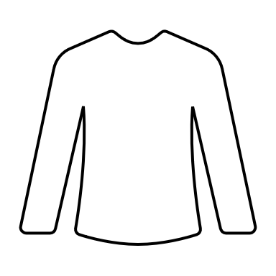
Postponement
Four shirts, the same design, different color. Demand N~(100,25).
If we dye them first and prefer to have a 97.73% service level,
how much safety stock do we need? z97.73% = 2
Isafety for one color = z97.73(25) =2(25) =50
Isafety for four colors = 4(50) = 200
What if we have a high-speed dyeing machine and could postpone dyeing the uncolored fabric to when the demand comes with the same service level?
Standard Deviation of Demand for 4 colors = SQRT(4)(25) =50
Isafety for 4 colors = z97.73(50) =2(50) =100
100/200; that is 50% improvement in safety stock cost

Slide 17
Value of Postponement
100 different paint colors, R = 30/week, σ_{R} = 10, CSL = 0.95
Isafety_OneProduct = z0.95(10) = 1.65(10)= 16.5
Isafety_100Products Without Postponement = 100(16.5)= 1650
Standard deviation of demand of 100 products = SQRT(100)*10 =100
Isafety_100Products With Postponement = z0.95(100) = 1.65(100) = 165
1650 is reduced to 165. That is 10 times or SQRT(100)

Slide 18
Postponement
The larger the ratio of the larger to smaller number, the higher the saving in safety Inventory
Suppose we have 100% right information about the market in the second phase and fulfill the orders to precision as long as we are not out of stock

