Slide 1
Managing Flow Variability: Safety Inventory
Forecasts Depend on: (a) Historical Data and (b) Market Intelligence.
Demand Forecasts and Forecast Errors
Safety Inventory and Service Level
Optimal Service Level – The Newsvendor Problem
Demand and Lead Time Variability
Pooling Efficiency through Centralization and Aggregation
Shortening the Forecast Horizon
Levers for Reducing Safety Inventory
Notes:
........................................................................................................................................................................................................................................ ........................................................................................................................................................................................................................................
........................................................................................................................................................................................................................................ ........................................................................................................................................................................................................................................
........................................................................................................................................................................................................................................ ........................................................................................................................................................................................................................................
........................................................................................................................................................................................................................................ ........................................................................................................................................................................................................................................
........................................................................................................................................................................................................................................ ........................................................................................................................................................................................................................................
........................................................................................................................................................................................................................................ ........................................................................................................................................................................................................................................
........................................................................................................................................................................................................................................ ........................................................................................................................................................................................................................................
........................................................................................................................................................................................................................................ ........................................................................................................................................................................................................................................
........................................................................................................................................................................................................................................

Slide 2
Four Characteristics of Forecasts
Forecasts are usually (always) inaccurate (wrong). Because of random noise.
Forecasts should be accompanied by a measure of forecast error. A measure of forecast error (standard deviation) quantifies the manager’s degree of confidence in the forecast.
Aggregate forecasts are more accurate than individual forecasts. Aggregate forecasts reduce the amount of variability – relative to the aggregate mean demand. StdDev of sum of two variables is less than sum of StdDev of the two variables.
Long-range forecasts are less accurate than short-range forecasts. Forecasts further into the future tends to be less accurate than those of more imminent events. As time passes, we get better information, and make better prediction.

Slide 3
Service Level and Fill Rate
Within 200 time intervals, stockouts occur in 20.
Probability of Stockout =
# of stockout intervals/Total # of intervals = 20/200 = 0.1
Risk = Probability of stockout = 0.1 = 10%
Service Level = 1-Risk = 1=0.1 = 0.9 = 90%.
Suppose that cumulative demand during the 200 time intervals was 25,000 units and the total number of units short in the 20 intervals with stockouts was 4,000 units.
Fill rate = (25,000-4,000)/25,000 = 21,000/25,000 = 84%.
Fill Rate = Expected Sales / Expected Demand
Expected stockout = Expected Demand – Expected Sales

Slide 4
μ and σ of Demand During Lead Time
Demand during lead time has an average of 50 tons. Standard deviation of demand during lead time is 5 tons. Acceptable risk is no more than 5%. Find the re-order point.
Service level = 1-risk of stockout = 1-0.05 = 0.95.
Find the z value such that the probability of a standard normal variable being less than or equal to z is 0.95.

Slide 5
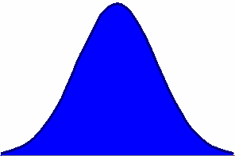

Forecasts should be accompanied by a measure of forecast error
Forecast and a Measure of Forecast Error

Slide 6
Demand During Lead Time
Inventory
Demand during LT
Lead Time
Time

Slide 7
ROP when Demand During Lead Time is Fixed
LT

Slide 8
Demand During Lead Time is Variable
LT

Slide 9
Demand During Lead Time is Variable
Inventory
Time

Slide 10
Safety Stock
Quantity
A large demand
during lead time
Average demand
during lead time
ROP
Safety stock reduces risk of
stockout during lead time
Safety stock
LT
Time

Slide 11
Safety Stock
Quantity
ROP
LT
Time

Slide 12
Re-Order Point: ROP
Demand during lead time has Normal distribution.
If we order when the inventory on hand is equal to the average demand during the lead time;
then there is 50% chance that the demand during lead time is less than our inventory.
However, there is also 50% chance that the demand during lead time is greater than our inventory, and we will be out of stock for a while.
We usually do not like 50% probability of stock out
We can accept some risk of being out of stock, but we usually like a risk of less than 50%.

Slide 13
Safety Stock and ROP
Service level
Risk of a
stockout
Probability of
no stockout
ROP
Quantity
Average
demand
Safety
stock
0
z
z-scale
Each Normal variable x is associated with a standard Normal Variable z
x is Normal (Average x , Standard Deviation x) ➔ z is Normal (0,1)

Slide 14
z Values
Service level
Risk of a
stockout
Probability of
no stockout
ROP
Quantity
Average
demand
Safety
stock
0
z
z-scale
There is a table for z which tells us
Given any probability of not exceeding z. What is the value of z
Given any value for z. What is the probability of not exceeding z

Slide 15

z Value using Table
Go to normal table, look inside the table. Find a probability close to 0.95. Read its z from the corresponding row and column.
Given a 95% SL
95% Probability
Normal table
0.05
z
Second digit
after decimal
The table will give you z
Up to the first digit
after
decimal
1.6
Probability
Z = 1.65

Slide 16
The standard Normal Distribution F(z)
F(z) = Prob( N(0,1) < z)
F(z)
0
z
Risk Service level z value
0.1 0.9 1.28
0.05 0.95 1.65
0.01 0.99 2.33

Slide 17
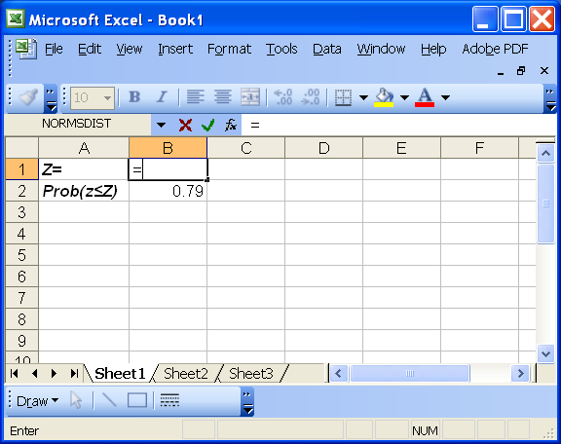
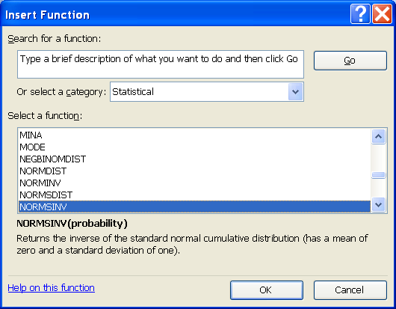
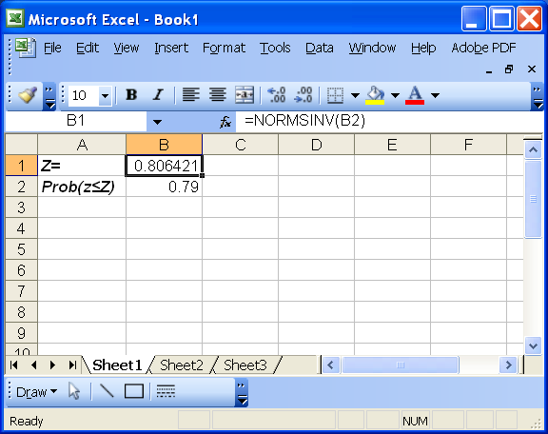
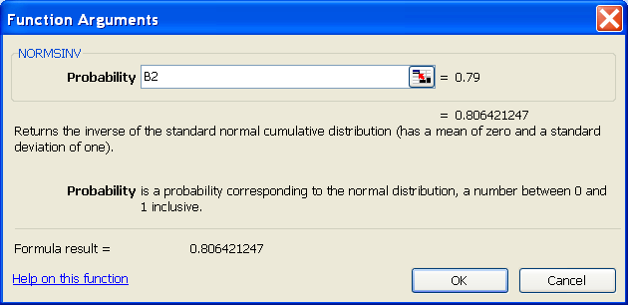
Excel: Given Probability, Compute z

Slide 18
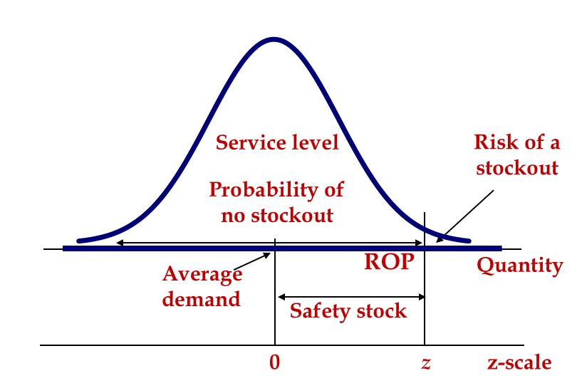
Relationship between z and Normal Variable x
z = (x-Average x)/(Standard Deviation of x)
x = Average x +z (Standard Deviation of x)
LTD = Average lead time demand
σ_{LTD} = Standard deviation of lead time demand
ROP = LTD + zσ_{LTD}
ROP = LTD + Isafety

Slide 19
Demand During Lead Time is Variable N(μ,σ)
Demand of sand during lead time has an average of 50 tons.
Standard deviation of demand during lead time is 5 tons
Assuming that the management is willing to accept a risk no more that 5%. Compute safety stock.
LTD = 50, σ_{LTD} = 5
Risk = 5%, SL = 95% ➔ z = 1.65
Isafety = zσ_{LTD}
Isafety = 1.65 (5) = 8.3
ROP = LTD + Isafety
ROP = 50 + 1.65(5) = 58.3
Risk Service level z value
0.1 0.9 1.28
0.05 0.95 1.65
0.01 0.99 2.33
  When Service level increases
  Risk decreases
  z increases
  Isafety increases

Slide 20
Example 2; total demand during lead time is variable
Average Demand of sand during lead time is 75 units.
Standard deviation of demand during lead time is 10 units.
Under a risk of no more that 10%, compute SL, Isafety, ROP.
What is the Service Level?
Service level = 1-risk of stockout = 1-0.1 = 0.9
What is the corresponding z value?
SL (90%) ➔ Probability of 90% ➔ z = 1.28
Compute the safety stock?
Isafety = zσ_{LTD} = 1.28(10) = 12.8
ROP = LTD + Isafety
ROP = 75 + 12.8 = 87.8

Slide 21
Service Level for a given ROP Example
Compute the service level at GE Lighting’s warehouse,
LTD = 20,000, σ_{LTD} = 5,000, and ROP = 24,000
ROP = LTD + Isafety
24000 = 20000 + Isafety ➔ Isafety = 4,000
Isafety = z σ_{LTD}
4000 = z(5000)
z = 4,000 / 5,000 = 0.8
SL= Prob (Z ≤ 0.8) from Normal Table

Slide 22
Given z, Find the Probability
Table returns probability
0.00
z
Second digit
after decimal
Up to the first digit
after
decimal
Given z
0.8
Probability
z = 0.8
Probability = 0.7881
Service Level (SL) = 0.7881

Slide 23
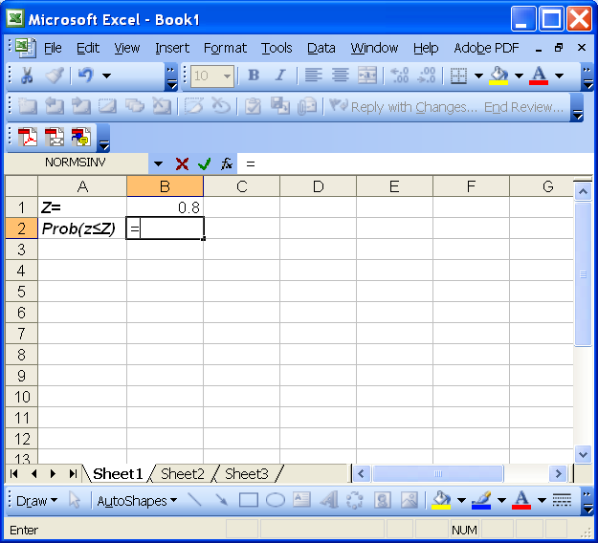
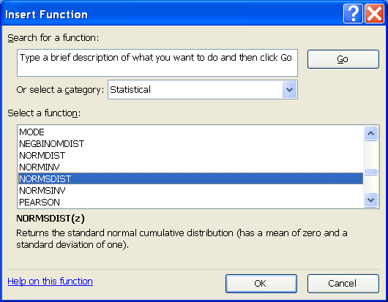
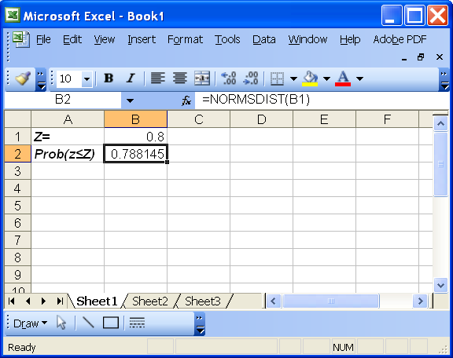
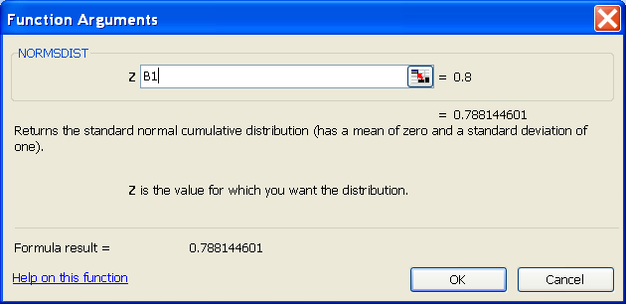
Excel: Given z, Compute Probability

Slide 24
Service Level for a given ROP
SL = Prob (LTD ≤ ROP)
LTD is normally distributed
LTD = N(LTD, σ_{LTD} )
ROP = LTD + Isafety
ROP = LTD + zσ_{LTD}
The recording does not cover the last 3 lines of this slide.
Isafety = z σ_{LTD}
z = Isafety /σ_{LTD}
Then we go to table and find the probability

