Slide 1
Service Level - For the Last Order for the Last 50 Days
What is the Re-Order Point
We have already computed the standard deviation of the accepted daily demand which is 6.4 for the first 24 days. But standard deviation goes down when WIP gets close to Max-WIP. As we can see, the standard deviation in the first 14 days is 5.47, while it is for days 11-24 is 2.8. Assume the standard deviation of the daily demand is σ_{R} = 5. You need to recompute it throughout the game- especially for the last order.
Standard deviation of the demand during the lead time during the game differs from that of the end of the game. We will discuss the end of the game later.
During the game, we have a lead time of L= 9 days ➔ σLTD = SQRT(9)*5=15.
Demand per day R=16, Lead Time = 9 days. Lead time demand =LTD = L*R=9(16)=144
LTD ~ N(144, 15)
To compute ROP, we need to compute the service level.
Service level during the game differs from the required service level in the very last 50 days.

Slide 2

CSL For Continuously Stocked Item With & Without Lost Sales
CSL* (Without Lost Sale) $=1−\frac{HQ}{DCu}$
CSL* (With Lost Sale) = $1−\frac{HQ}{DCu+HQ}$

Slide 3
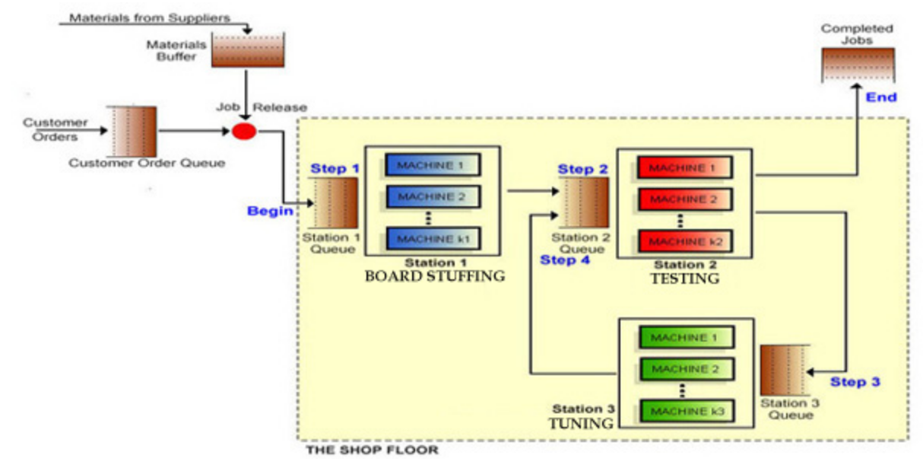
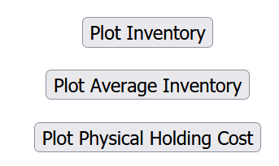
Inventory Profiles, Good & Bad Decisions

Slide 4
ROP - When We have Access to the Game
We first discuss the service level at the end of the game.
Suppose we are on $1000 contract. What service level should we choose?
What is the underage cost (Cu)?
If a contract is available but we cannot deliver it, we don’t earn $1000.
We would have spent $600 on the 60 kits required for each contract.
Cu=$1000-$600=$400. However, we do not loose this profit because we earn it in the next cycle. Since each cycle is 19.5 ≈ 20 days, and interest rate that we do not earn is 10%. Therefore, underage cost Cu = 0.1(20/365)(400) = 2.2.
What is the overage cost (Co)?
If we order kits for one extra contract, and we do not use it in this cycle, we use it in the next cycle. But we have 20% financial and storage cost per carrying the 60 kits ($600) of a contract for one year. Therefore, overerage cost Co = 0.2(20/365)(600) = 6.6
SL* = 2.2/(2.2+6.6) = 0.25

Slide 5
ROP - When We have Access to the Game
We first discuss the service level during the game. Suppose we want to make out
Suppose we are on $1000 contract. What service level should we choose?
What is the underage cost (Cu)?
If a contract is available but we cannot deliver it, we don’t earn $1000.
We would have spent $600 on the 60 kits required for each contract.
Cu=$1000-$600=$400. However, we do not loose this profit because we earn it in the next cycle. Since each cycle is 19.5 ≈ 20 days, and interest rate that we do not earn is 10%. Therefore, underage cost Cu = 0.1(20/365)(400) = 2.2.
What is the overage cost (Co)?
If we order kits for one extra contract, and we do not use it in this cycle, we use it in the next cycle. But we have 20% financial and storage cost per carrying the 60 kits ($600) of a contract for one year. Therefore, overerage cost Co = 0.2(20/365)(600) = 6.6
SL* = 2.2/(2.2+6.6) = 0.25

Slide 6
Service Level - For the Last Order for the Last 50 Days
NORM.S.INV(0.25) = -0.67 standard deviation of lead time demand to the right.
That is 0.67 to the left
We have already assumed the standard deviation of daily demand. Suppose it is σ_{R} = 5.
Standard deviation of the demand during the lead time during the game differs from that of the end of the game.
During the game, we have a lead time of 9 days. Therefore, σLTD = SQRT(9)*5=15.
Is = -0.67 (15)=-10
Demand per day R=16, Lead Time = 9 days. Lead time demand =LTD = L*R=9(16)=144
LTD ~ N(144, 15)
ROP=144-10=134 orders ➔ ROP = 176 orders x 60 kits/order = 10560 kits.
We place an order Q= 18720 kits when inventory reaches ROP=10560 kits.
But we have ignores one important component in Cu.
We did not discussed since it needs a knowledge beyond the mathematical content of our course. But we need to take it into account.

Slide 7
Service Level - For the Last Order for the Last 50 Days
What if shortage of kits lead to delay in the delivery of contract. A delay may reduce the revenue of a contract from 1000 to 0. That is a huge increase in Cu.
Therefore, throughout the game, but not in the very last 50 days of the game, apply a large service level, say 3 standard deviations to the right- which is about %99 service level. Then monitor the inventory level, if you think you carry extra inventory, instead of three standard deviations, you may chose two or even one standard deviation.
But the situation is entirely different in the very last 50 days of the game.
We place an order Q= 18720 kits when inventory reaches the kits required for 144+3*15 orders. That is 60(189)= 11340 kits.

Slide 8
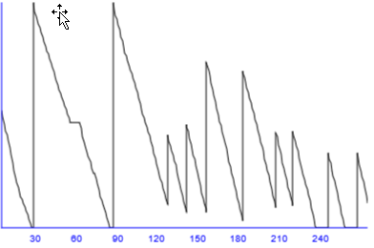
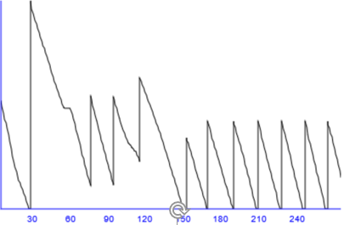

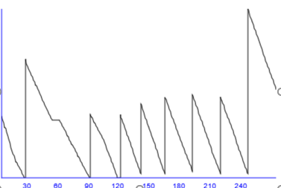
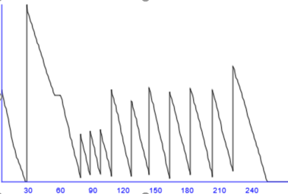
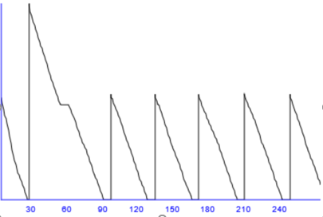
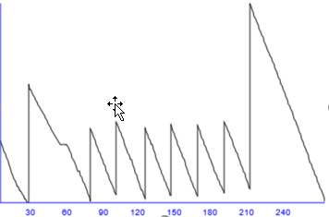
The Last 50 Days; Inventory

Slide 9
Service Level - For the Last Order for the Last 50 Days
What is L and what is σ_{LTD} a few hours before when we will be disabled of making any changes.
Suppose it is a little before 8 PM a day before the end of the game. The 218 days of the game ends at 1 PM tomorrow. The game then runs for 50 more days, but it takes a second for computer to do all the computations. Therefore, at 1:01 PM you can see your final standing.
Now it is a little before 8 PM the day before, and we have 17 hours (days) to the last 50 days. Therefore, the game has 50+17 days to run. L=67.
Demand per day = R=16
Demand in 67 days =LTD = L*R = 67(16) = 1072
Standard deviation of daily demand = σ_{R}=5
Standard deviation of demand for 67 days of demand = σ_{LTD}= SQRT(67)*5 40.9 ≈ 41
LTD=N~(1072, 41)
What are Cu and Co?

Slide 10
Service Level - For the Last Order for the Last 50 Days
If a contract is there but the kits are not, you could have spent $600 and have earned $1000. Cu = $400.
If kits for a contract are there but contract is not, you have no use for them, and at the end of the game their value is 0. Cu = $600.
SL*=$400/($400+600) = 0.4
NORM.S.INV(0.396739) = -0.253 standard deviation of lead time demand to the right.
That is -0.253347103 to the left
Is = -0.253347103 (41)=-10.38 ≈ -10
LTD=N~(1072, 41)
Q= 1072-10= 1062

Slide 11
Service Level - For the Last Order for the Last 50 Days
Should we order the kits required for 1062 contracts?
Should we order 63720 kits?
No.
Why
We need to check how much inventory we have. Suppose we have 6000 kits which is enough for 100 contracts.
Set your new order quantity 63720-6000= 57720 kits, then quickly set your ROP to more than 6000 kits to make sure that you trigger that materials order immediately.

