Slide 1
Re-Order Point
ROP
You may first watch the following 8-minutes lecture on
Normal Distribution
to refresh your mind.
Ardavan Asef-Vaziri

Slide 2
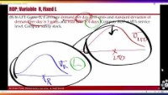
https://youtu.be/re6f_Gc02Gs

Slide 3
Four Characteristics of Forecasts
Forecasts are usually (always) inaccurate (wrong). Because of random noise.
Forecasts should be accompanied by a measure of forecast error. A measure of forecast error (standard deviation) quantifies the manager’s degree of confidence in the forecast.
Aggregate forecasts are more accurate than individual forecasts. Aggregate forecasts reduce the amount of variability – relative to the aggregate mean demand. StdDev of sum of two variables is less than sum of StdDev of the two variables.
Long-range forecasts are less accurate than short-range forecasts. Forecasts further into the future tends to be less accurate than those of more imminent events. As time passes, we get better information, and make better prediction.

Slide 4
Demand During Lead Time
Inventory
Average Demand during LT
Lead Time
Time

Slide 5
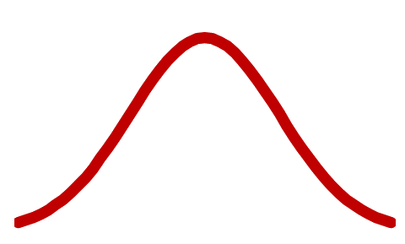
Demand During Lead Time
Inventory
ROP= LTD
Average Demand during LT
Lead Time
Time

Slide 6
Demand During Lead Time
Inventory
Average Demand during LT
LTD
ROP=LTD+Is
Lead Time
Time
Is

Slide 7
ROP; total demand during lead time is variable
(A) Suppose in LFT-Game-II the average demand during the lead time (from the time that we place and order till we receive it) is 40 units, and standard deviation of demand during lead time is 6. Compute Re-Order Point (ROP) at 95% service level. Compute safety stock.
Service level
Risk of a
stockout
Probability of
no stockout
ROP
Quantity
Average
demand
Safety stock

Slide 8
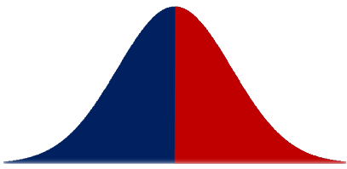
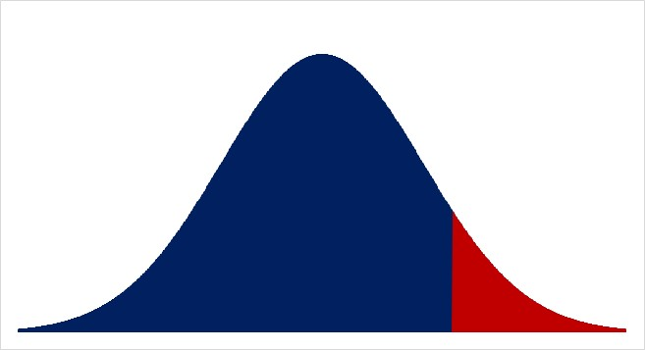
Safety Stock and ROP
LTD = 40, σ_{LTD} = 6, SL=95%,
If ROP=40, there is 50% probability of stockout.
Service Level = 50%
Risk= 50%
ROP = NORM.INV(0.95,40,6) = 49.87
Re-Order Point = Average Demand + Safety Stock
ROP = LTD+Isafety
Isafety = ROP –LTD
By adding a safety stock of
49.87 – 40 = 9.87
Service Level (SL) 50% ➔ 95%
Risk from 50% ➔ 5%
Round up 49.87 to 50.
SL=NORM.DIST(50,40,6,1) = 95.22%

Slide 9
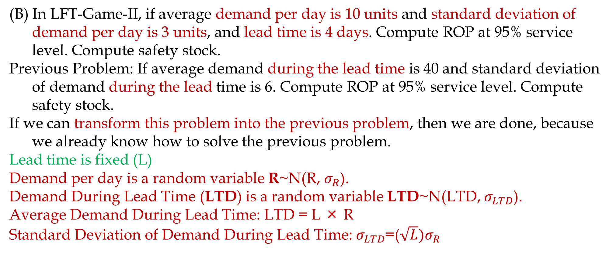
ROP; Variable R, Fixed L
(B) In LFT-Game-II, if average demand per day is 10 units and standard deviation of demand per day is 3 units, and lead time is 4 days. Compute ROP at 95% service level. Compute safety stock.
Previous Problem: If average demand during the lead time is 40 and standard deviation of demand during the lead time is 6. Compute ROP at 95% service level. Compute safety stock.
If we can transform this problem into the previous problem, then we are done, because we already know how to solve the previous problem.
Lead time is fixed (L)
Demand per day is a random variable R~N(R, $σ_{R}$).
Demand During Lead Time (LTD) is a random variable LTD~N(LTD, $σ_{LTD}$).
Average Demand During Lead Time: LTD = L × R
Standard Deviation of Demand During Lead Time: $σ_{LTD}$=($\sqrt{L}{)σ}_{R}$

Slide 10
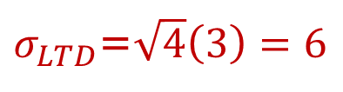
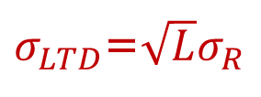
μ and σ of demand per period and fixed L
If demand is variable and Lead time is fixed
L: Lead Time = 4 days
R: Demand per day
R: Average daily demand =10
σ_{R}: Standard deviation of daily demand =3
LTD: Average Demand During Lead Time
LTD = L × R = 4 × 10 = 40
σ_{LTD}: Standard deviation of demand during lead time
$σ_{LTD}$=$\sqrt{L}σ_{R}$
$σ_{LTD}$=$\sqrt{4}\left(3\right)=6$

Slide 11
Now It is Transformed
The Problem originally was: If average demand per day is 10 units and standard deviation of demand is 3 per day, and lead time is 4 days. Compute ROP at 95% service level. Compute safety stock.
We transformed it to: The average demand during the lead time is 40 and the standard deviation of demand during the lead time is 6. Compute ROP at 95% service level. Compute safety stock.
Which is the same as the previous problem: If average demand during the lead time is 40 and standard deviation of demand during lead time is 6. Compute ROP at 95% service level. Compute safety stock.
In order not to repeat the same computations, lets change the problem to the following.
If average demand per day is 10 units and standard deviation of demand is 3 per day, and lead time is 9 days. Compute ROP at 90% service level. Compute safety stock.

Slide 12
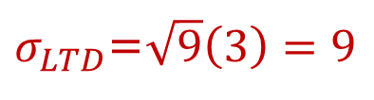
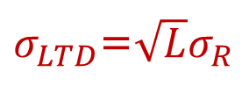
ROP; Variable L, Fixed R
L: Lead Time = 9 days
R: Average daily demand =10
σ_{R}: Standard deviation of daily demand =3
LTD: Average Demand During Lead Time
LTD = L × R = 9× 10 = 90
σ_{LTD}: Standard deviation of demand during lead time
$σ_{LTD}$=$\sqrt{L}σ_{R}$
$σ_{LTD}$=$\sqrt{9}\left(3\right)=9$
ROP =NORM.INV(0.9,90,9) = 101.53
Isafety = 101.53-90 = 11.53 ➔ Roundup 11.53 to 12
ROP = 102
SL=NORM.DIST(102 ,90,9,1) = 90.88%

Slide 13
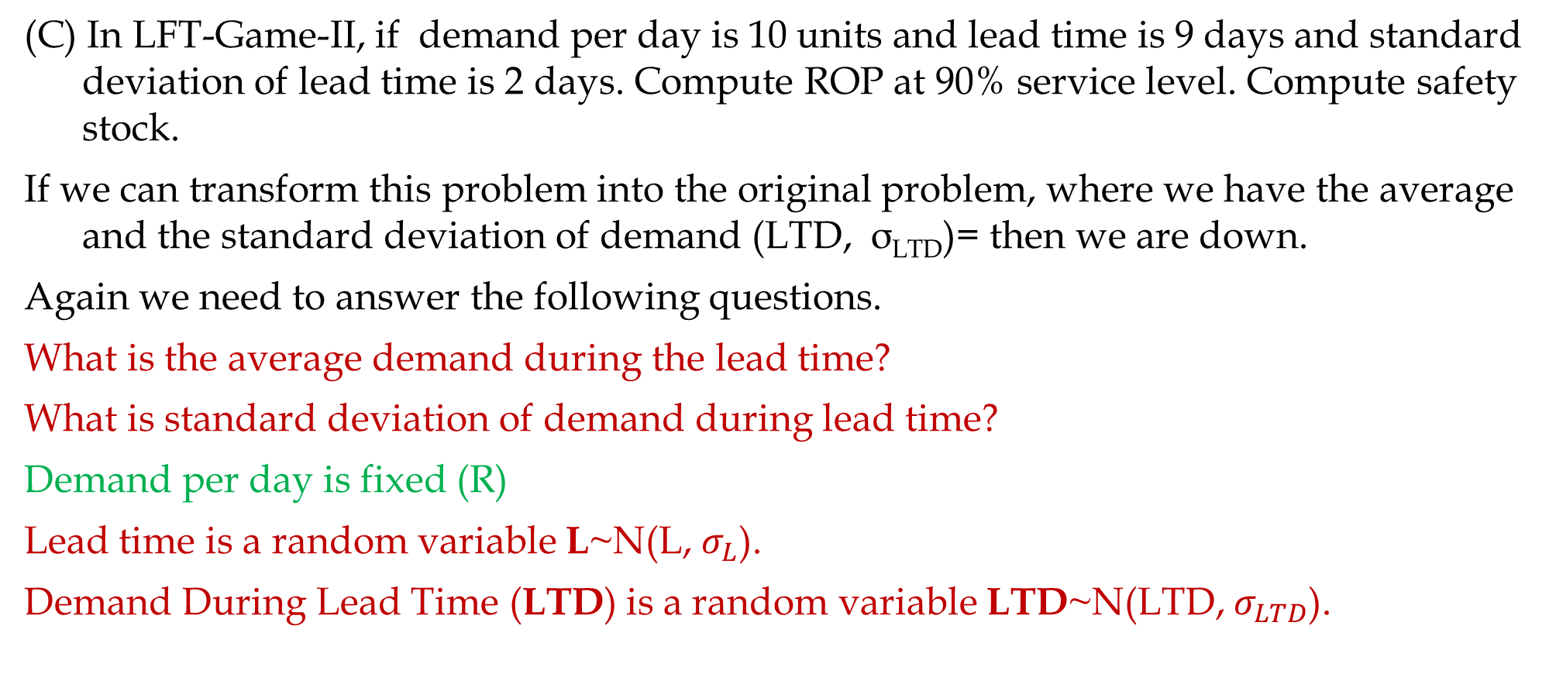
ROP; Variable L, Fixed R
(C) In LFT-Game-II, if demand per day is 10 units and lead time is 9 days and standard deviation of lead time is 2 days. Compute ROP at 90% service level. Compute safety stock.
If we can transform this problem into the original problem, where we have the average and the standard deviation of demand (LTD, σ_{LTD})= then we are down.
Again we need to answer the following questions.
What is the average demand during the lead time?
What is standard deviation of demand during lead time?
Demand per day is fixed (R)
Lead time is a random variable L~N(L, $σ_{L}$).
Demand During Lead Time (LTD) is a random variable LTD~N(LTD, $σ_{LTD}$).

Slide 14
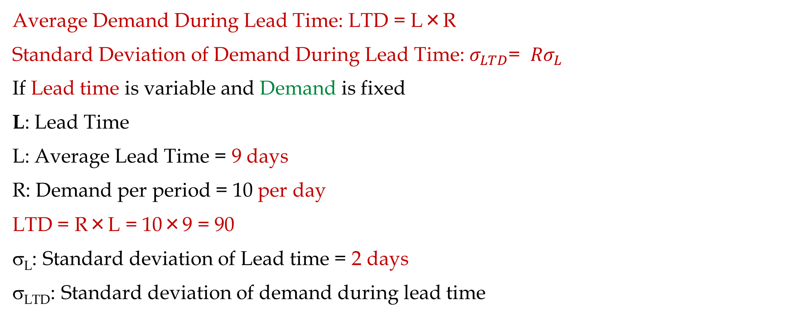
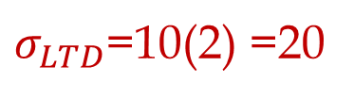
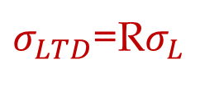
ROP; Variable L, Fixed R
Average Demand During Lead Time: LTD = L×R
Standard Deviation of Demand During Lead Time: $σ_{LTD}$= ${Rσ}_{L}$
If Lead time is variable and Demand is fixed
L: Lead Time
L: Average Lead Time = 9 days
R: Demand per period = 10 per day
LTD = R×L = 10×9 = 90
σ_{L}: Standard deviation of Lead time = 2 days
σ_{LTD}: Standard deviation of demand during lead time
$σ_{LTD}$=R$σ_{L}$
$σ_{LTD}$=10(2) =20
ROP =NORM.INV(0.9,90,20) = 115.63 ≈ 116
Isafety = 116-90 = 26

Slide 15
Comparing the Nature of the two problems
Problem (B)- Blue. Average demand per day is 10 units and standard deviation of demand per day is 3 units. The lead time is 5 days
Problem (C) -Red. Demand per day is 10 units. The average lead time is 5 days and standard deviation of lead time is 1.5 days.
Click on the graph below, then hit delete button several times to see the differences in the two situations.

Slide 16
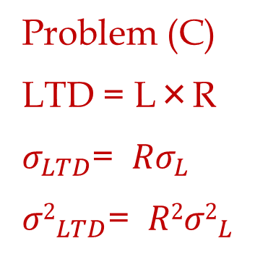
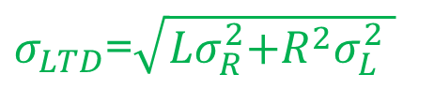
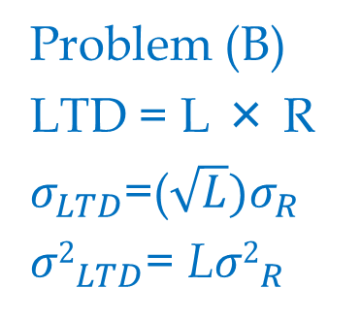

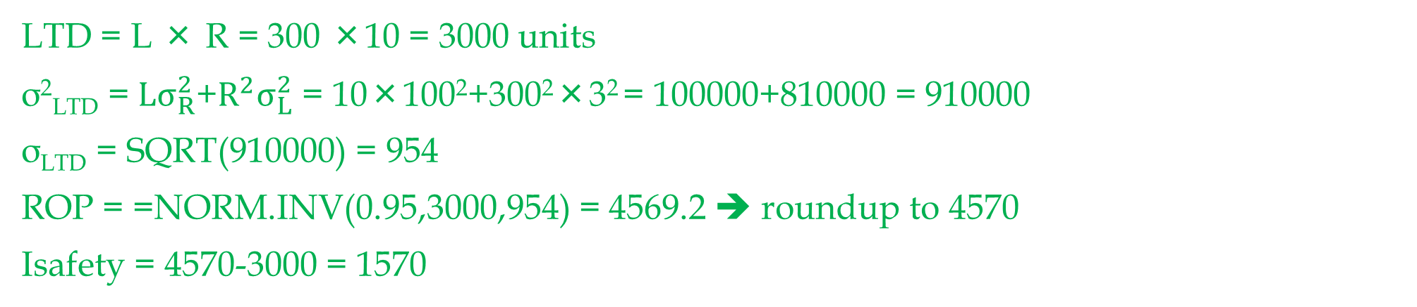



Both Lead Time and Demand are Variable
(D) Lead time has mean of 10 days and a StdDev of 3 days. Demand per day has a mean of 300 and StdDev of 100. How much safety inventory is needed in order to provide a 95% service level?
Problem (C)
LTD = L×R
$σ_{LTD}$= ${Rσ}_{L}$
${σ2}_{LTD}$= ${R2σ2}_{L}$
R = 300 units
σ_{R} = 100 units
L = 10 days
σ_{L} = 3 days
Problem (B)
LTD = L × R
$σ_{LTD}$=($\sqrt{L}{)σ}_{R}$
${σ2}_{LTD}$= L${σ2}_{R}$
Problem (D)
LTD = L×R
$$\text{+}$$
$σ_{LTD}$=$\sqrt{{Lσ}_{R}^{2}\text{+}R^{2}σ_{L}^{2} }$
${σ2}_{LTD}$=
L${σ2}_{R}$
$${R2σ2}_{L}$$
LTD = L × R = 300 ×10 = 3000 units
σ²_{LTD} = ${Lσ}_{R}^{2}\text{+}R^{2}σ_{L}^{2} \text{= 10}\text{×}\text{100}\text{2}\text{+}\text{3}\text{00}\text{2}\text{×}\text{3}\text{2}$= 100000+810000 = 910000
σ_{LTD} = SQRT(910000) = 954
ROP = =NORM.INV(0.95,3000,954) = 4569.2 ➔ roundup to 4570
Isafety = 4570-3000 = 1570

Slide 17
Given Safety Inventory Compute Service Level
The average lead time demand in LFT-Game-II is 140 units. Standard deviation of lead time demand is 40 units. Each time the inventory level drops to 187 units, we order a 15-day demand of 300 units. Suppose holding cost is $60 per unit per year.
LTD = 140, σ_{LTD} = 40, ROP = 187, H=$60, R = 20/day, Q or EOQ = 300.
a) Compute the service level.
SL=NORM.DIST(187,140,40,1) = 0.88
In 88 % of the order cycles, the warehouse will not have a stockout. Risk = 100-88 = 12%.
b) Compute the cycle inventory.
At reorder point we order 300 units.
Icycle = Q/2 = 300/2 = 150
c) Compute the average inventory. Icycle+Isafety
Isafety = ROP-LTD = 187-140 = 47

Slide 18
On Average, Safety Stock is always there
LTD
ROP= +
Isafety
L

Slide 19
Given Safety Inventory Compute Service Level
At reorder point we order 300 units.
Icycle = Q/2 = 300/2 = 150
Isafety = 47
Average Inventory = I = Icycle + Isafety =150+47= 197.
d) Compute the total holding costs per year.
H(Average Inventory) = H(I) = 60 × 197 = $11820/year
e) Compute the average flow time.
R = 20 / day, I = 197
RT = I ➔20T = 197
T = 9.85 days

Slide 20
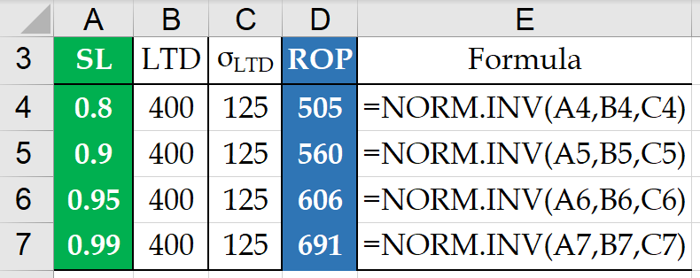
Service Level vs Safety Stock
MassPC Inc. produces a 4-week supply of its PC Pal model when stock on hand drops to 525 units. It takes 1 week to produce a batch. Orders average 400 units per week, and standard deviation of demand forecast is 125 units. Compute the risk of stockout.
ROP =
1 week
400/week
$σ_{LTD}$=125
Q =
4(400)
525
L =
LTD =
0.841345 =NORM.DIST(525,400,125,1) ➔ Risk = 1-0.841345
b) Compute Isafety for 80%, 90%, 95%, 99% service levels.

Slide 21
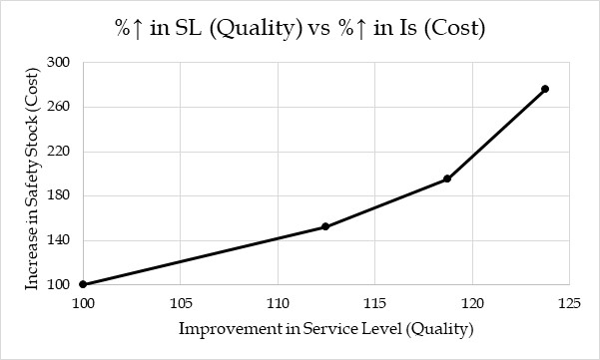
Efficient Frontier- Service vs. Cost
Selecting service level and safety inventory level is an important strategic decision. A firm may choose high quality service in terms of product availability. Or The firm may choose to be a low cost supplier by holding down inventory costs. In either case, it is positioning itself along the quality vs. cost trade-off curve.
This graph is a perfect example to show how a strategic position could be operationalized.

