Slide 1
Cycle Service Level & and Fill Rate
Ardavan Asef-Vaziri

Slide 2
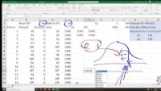

Lead Time, Re-Order Point, Cycle Service Level, and Fill Rate
Parts of the slides of this lectures were prepared over my teaching lifetime based on the material that I have learned from the following book
Ardavan Asef-Vaziri

Slide 3
Service Level vs Fill Rate-Example-1. Uniform Distribution
Order Lead Time: time from placing an order to receiving it.
Cycle Service Level (CSL): probability of fulfilling the demand.
Fill Rate (FR): proportion of the demand filled.
Suppose demand during lead time has a uniform distribution [1, 10].
Suppose you have 8 units. Compute SL and FR.
FR is always higher than SL.

Slide 4
Normal Random Number Generator

Slide 5
Service Level vs Fill Rate - Normal Distribution Demand
Demand has Normal distribution N~100, 20. Suppose you have Q units. Simulate 1000 periods. Report SL & FR for Q=140, Q=100, Q=....
Right click to open the file. Ctrl~ to see the formulas. Ctrl~ again to go back to normal view.
https://youtu.be/7RurbY9b-mY
Expected Loss= σ^2NORM.DIST(Q,μ,σ,0)-(Q-μ)*(1-NORM.DIST(Q,μ, σ,1))

Slide 6
Single Period Ordering
Underage Cost, Overage Cost, Order Quantity, Service Level, Fill Rate, Lost Sales, and Leftover
Ardavan Asef-Vaziri

Slide 7
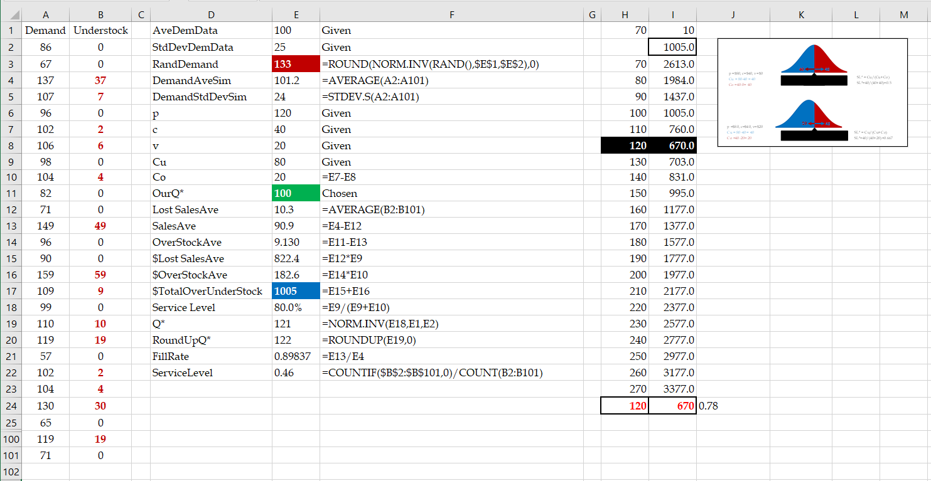
Single Period Ordering. Overage Cost, Underage Cost, and Order Quantity

Slide 8
The News Vendor Problem
Swell Productions is sponsoring an outdoor conclave for owners of collectible and classic Fords. The concession stand in the T-Bird area will sell clothing such as official Thunderbird racing jerseys. Suppose sales price is $80 per jersey, purchase cost is $40, and unsold jerseys are returned to the manufacturer for $20 per unit. Suppose the probability of jerseys sales quantities is Normally distributed with mean of 100 and standard deviation of 25. How many Jerseys Swell Production orders?
p: sale price; c: purchase cost; s: salvage value
Underage Cost: What we loose if demand is there but we do not have the product?
It depends on all costs involved. In this specific example,
Cu= p-c
Overage Cost: What we loose if we do have the product but demand is not there?
It depends on all costs involved. In this specific example,
Cu= c-v

Slide 9
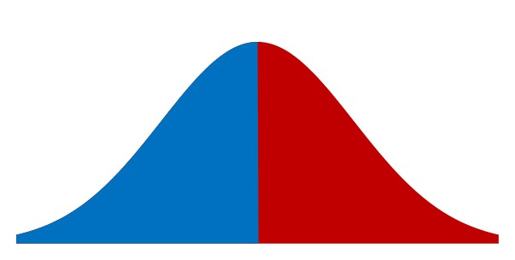
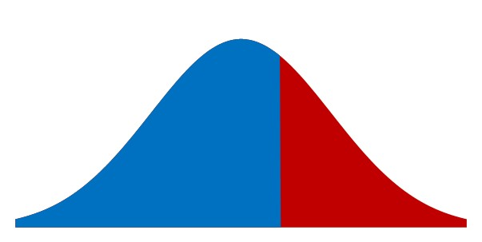
Overage Cost vs. Underage Cost
Cu: Underage Cost
Cu = 80-40 = 40
Co: Overage Cost
If Co was also 40
40
40
SL* =Blue/(Blue+Red) = Cu/(Cu+Co)
SL*= 40/(40+40) =0.5
Given a 66.67% SL
66.67% Probability
Cu: Underage Cost
Cu = 80-40 = 40
SL* =Blue/(Blue+Red)
Co: Overage Cost
Co = 40-20 = 20
20
40
Compute x

Slide 10
Optimal Service Level
CSL*: optimal cycle service level or simply optimal service level is a probability and is
SL* = Cu/(Cu+Co) = 1/(1+Co/Cu)
SL* = Cu/(Cu+Co) = P(LTD ≤ ROP)
SL* = 40/(40+20)
SL* = 2/3 = 0.67
µ: mean demand; σ: standard deviation of demand, Q*: optimal order quantity
Q= NORM.INV(SL*, µ, σ)
ROP= NORMINV(2/3,100,25) = 110.7682 ≈111
New SL = NORM.DIST(111,100,25,1) = 0.670031446

Slide 11
Example-2. Salvage Value
Demand for a product in the upcoming period is normally distributed with mean of 4000 and standard deviation of 1000.
Where is the optimal service level? How much do you order?
Sales Price = $30. Purchase cost = $10.
Salvage value (return or sell the product for this price) = $6.
Goodwill cost (present value of the long term dammage to our reputation per unit of product due to being out of stock) = $1.
LTD ~ N(4000,1000)
Overage Cost = Marginal Cost = Co = 10-6 = 4
Underage Cost = Marginal Benefit = 30-10 +1 = 21
SL*= Cu/(Cu+Co) = SL*= 21/25 = 0.84
ROP = Q = NORMINV(0.84,4000,1000) 4994.457883≈ 4995
New SL = NORM.DIST(4995,4000,1000,1) = 0.8401 ➔Risk = 15.99%

Slide 12
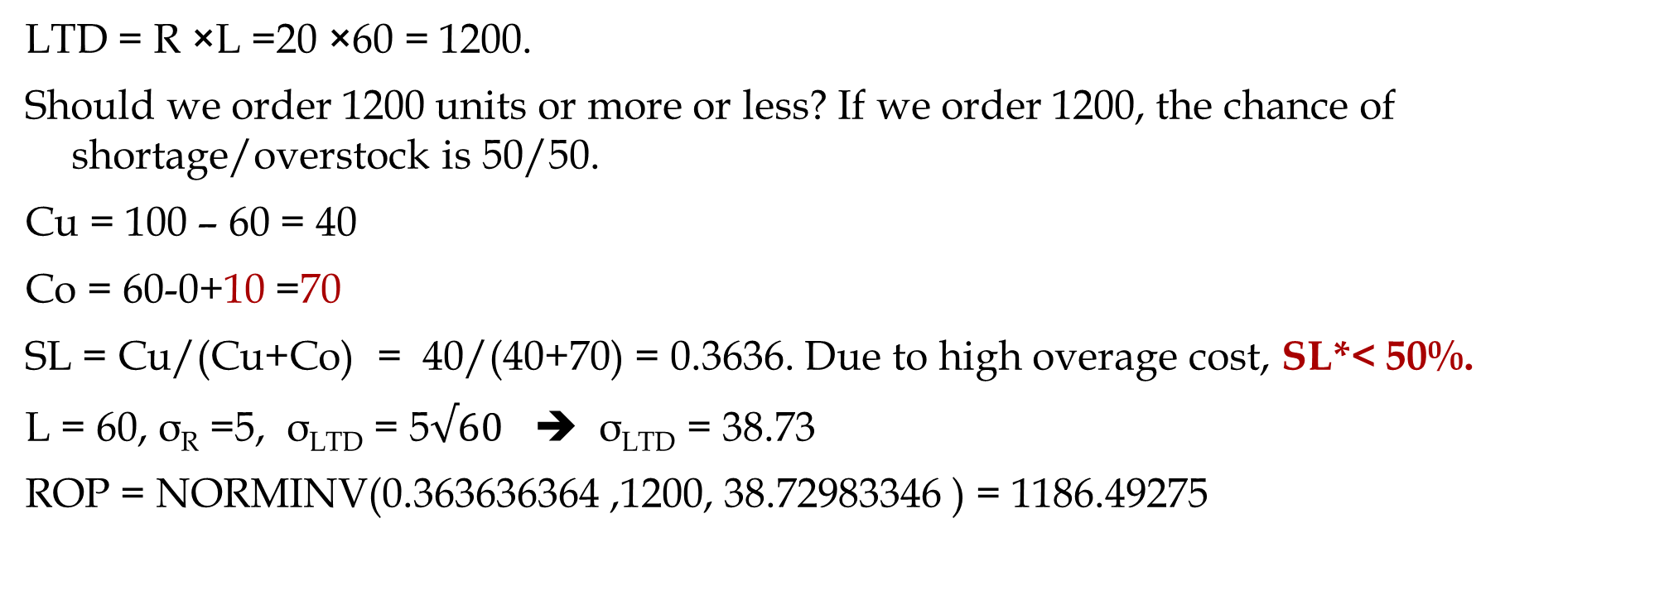
Example-3. Recycling Cost
Daily demand for your product R~N(R,σ_{R} ) = N(20, 5). Sales price is $100 per unit of product. You have decided to close this business line in 60 days. Your supplier has also decided to close the line immediately but has agreed to provide your last order at a cost of $60 per unit. Any unsold product will be disposed at cost of $10 per unit due to EPA regulations. How many units do you order
LTD = R ×L =20 ×60 = 1200.
Should we order 1200 units or more or less? If we order 1200, the chance of shortage/overstock is 50/50.
Cu = 100 – 60 = 40
Co = 60-0+10 =70
SL = Cu/(Cu+Co) = 40/(40+70) = 0.3636. Due to high overage cost, SL*< 50%.
L = 60, σ_{R} =5, σ_{LTD} = 5$√60$ ➔ σ_{LTD} = 38.73
ROP = NORMINV(0.363636364 ,1200, 38.72983346 ) = 1186.49275

Slide 13
Periodic Review Policy
Daily demand for a product has an average of R=20, and a standard deviation of σ_{R}=8 units. The review period is T= 35 days, and lead time is L= 14 days. Service level is SL*=99%.
At the beginning of the review period there are 200 units in inventory.
How many units should be ordered?
Average demand between two orders = D(T+L)=20(35+14)= 980
Standard Deviation of demand between two orders σ_{(T+L)} =SQRT(35+16)(8) =56
Z(99%)=NORM.S.INV(0.99) = 2.326348 ≈ 2.33 standard deviation added to average.
2.33(56) = 130.48 ≈ 131
Q=980+131=1111
1111/20=55.55 days of demand

Slide 14
Postponement
Ardavan Asef-Vaziri

Slide 15


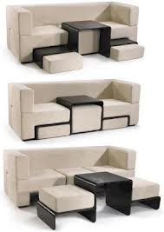
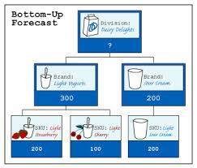
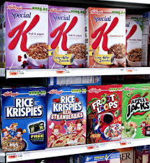
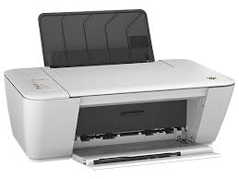
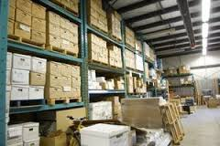
Mass Customization- Making Personalized Products on a Large Scale
Reduces scrapped or obsolete inventory, increases customer service
May require new processes or product design with associated cost
Enables the use of aggregate forecasts
Enables the delay of detailed forecasts

Slide 16
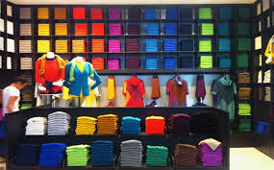
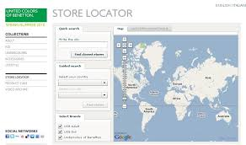
Benetton - Old and New Processes
Spin or Purchase Yarn
Spin or Purchase Yarn
Dye Yarn
Manufacture Garment Parts
Finish Yarn
Join Parts
Dye Garment
This step is
postponed
Manufacture Garment Parts
Join Parts
Finish Garment
Delay product differentiation or customization until closer to the time the product is sold. Have common components in the supply chain for most of the push phase. Move product differentiation as close to the pull phase of the supply chain as possible
Inventories in the supply chain are mostly aggregate

Slide 17


Example of postponement implementation
Produce 150 of each color ahead of time
Produce 300 which can be dyed after demand is observed

Slide 18
Value of Postponement
36 products, 36 different colors, R = 100/week, σ_{R} = 25, L = 4 weeks, SL = 97.7249868%
Average Demand During Lead time (no-postponement) = LTD= 4*100=400
Standard deviation of demand during Lead time (no-postponement) = σ_{LTD} = SQRT(L)σ_{R} = SQRT(4)*25= 50
ROP-for-each (no-postponement) =NORM.INV(0.977249868,400,50) = 500
Isafety-for-each (no-postponement) = 500-400=100
Isafety-for-all (no-postponement) = 36*100= 3600
Average 36 Products in 4 weeks = 36*100*4= 14400
StdDev 36 Products (postponement) = SQRT(36)*25=150
StdDev 36 Products in 4 weeks (postponement) = SQRT(4)*150=300
ROP for all (postponement) =NORM.INV(97.7249868%,14400,300) = 15000
Isafety-for-all (postponement) =15000-14400=600
Isafety-for-all (postponement) = 600 vs Isafety-for-all (no-postponement) = 3600
=

Slide 19


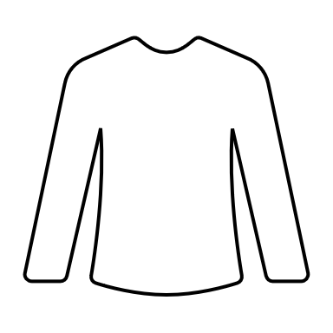
Postponement
Four shirts, the same design, different color. Demand N~(100,25).
If we dye them first and prefer to have a 95% service level,
how much safety stock do we need?
Q for one color =NORM.INV(0.95,100,25) = 141.12
Isafety for one color = 141.12 -100 = 41.12
Isafety for one colors =4(41.12) = 164.48
What if we have a high-speed dyeing machine and could postpone dyeing the uncolored fabric to when the demand comes with the same service level?
Average Demand for all colors = 4(100) =400
Standard Deviation of Demand for all colors = SQRT(4)(25) =50
=NORM.INV(0.95,400,50) = 482.24 ➔ Isafety 482.24-400 = 82. 24
82. 24/ 164.48 or 50% improvement

Slide 20

Postponement

Slide 21
Postponement
The larger the ratio of the larger to smaller number, the higher the saving in Safety Inventory
Npw Suppose we have 100% right information about the market in the second phase and fullfill the orders to precision as lond as we are not out of stock

Slide 22
Simulation

Slide 23
Simulation

Slide 24
Lower Safety Inventory & Higher Fill Rate

Slide 25
Excel Computations

Slide 26
N locations, at each location identical mean demand d, normally distributed with standard deviation σ, lead time L=1, continuous review
Each location has safety stock σz
Total safety stock Nσz
If inventory is centralized, standard deviation at the centralized warehouse is
Total safety stock

Slide 27
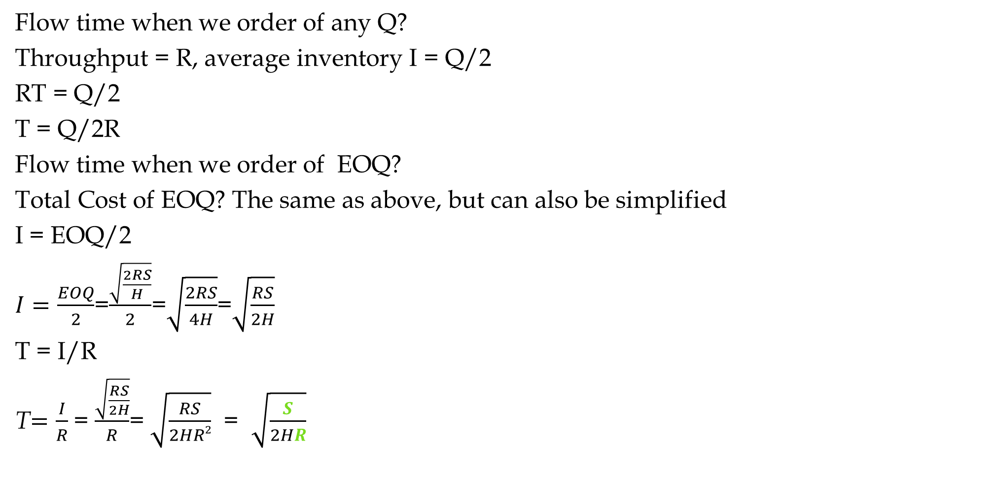
Formula Proof for Flow Time Under EOQ
Flow time when we order of any Q?
Throughput = R, average inventory I = Q/2
RT = Q/2
T = Q/2R
Flow time when we order of EOQ?
Total Cost of EOQ? The same as above, but can also be simplified
I = EOQ/2
$I=\frac{EOQ}{2}$=$\frac{\sqrt{\frac{2RS}{H}}}{2}$=$\sqrt{\frac{2RS}{4H}}$=$\sqrt{\frac{RS}{2H}}$
T = I/R
T$=\frac{I}{R}$ = $\frac{\sqrt{\frac{RS}{2H}}}{R}$= $\sqrt{\frac{RS}{2HR2}}$ = $\sqrt{\frac{S}{2HR}}$

Slide 28

Formula Proof for Total Cost of EOQ
Total cost of any Q?
TC_{Q} = SR/Q + HQ/2
Total Cost of EOQ? The same as above, but can also be simplified
${TC}_{EOQ}=\frac{SR}{\sqrt{\frac{2RS}{H}}}$ +$\frac{H\sqrt{\frac{2RS}{H}}}{2}$ =
${TC}_{EOQ}=2\frac{H\sqrt{\frac{2RS}{H}}}{2}$=$H\sqrt{\frac{2RS}{H}}$=$\sqrt{\frac{H^{2}2RS}{H}}$=$\sqrt{2RSH}$
${TC}_{EOQ}$=$\sqrt{2RSH}$

Slide 29
Plaining for a Coming Period
Marketing’s forecast for sales is 3200 units.

Slide 30
The Newsvendor Problem
Characteristics of Newsvendor problem:
Making a Single Decision on quantity Q to sell in selling period
The demand during the selling period is not certain.
The decision must be made before the actual demand is observed.
Once the decision is made, it cannot be changed.
Both leftover inventory and shortage are costly
The goal is to find the optimal quantity Q* that maximizes the expected profit.
Applications?
Perishable Product (e.g., food, flowers), Seasonal products (Christmas trees, seasonal clothing), Revenue Management (Airlines and hotels), Capacity Investment, …

Slide 31
What is a demand model?
A demand model specifies what demand outcomes are possible and the probability of these outcomes.
Traditional distributions from statistics can be used as demand models:
  e.g., the Normal, Gamma, Poisson distributions

Slide 32
The density function tells you the probability of a particular outcome occurring.
  e.g. the probability demand will be exactly 5 units.
The distribution function tells you the probability the outcome will be a particular value or smaller.
  e.g. the probability demand will be 5 or fewer units.
Both can be used to describe a demand model, but we will most often work with distribution functions.
Density functions can take all kinds of shapes (they don’t always have to look like a bell curve).
Distribution functions always start low and increase towards 1.0

Slide 33
Density & Distribution Function
f(x) vs F(x)
NORM.DIST(x,mean,stddev,0) vs NORM.DIST(x,mean,stddev,1)
ϕ (x) vs φ(x)

Slide 34
Solution
CSL= 0.99;
Using Excel, z = NORMSINV(0.99) = 2.326
Order quantity q = d(T+L) + z σ_{LTD} - I
Order quantity q = 20(30+16) + 2.326*47.5 - 200 ≈ 830 -> 41.5 days of demand
Average inventory carried = ?
Notes:
22

Slide 35
Example with fill rate
In above example, what if performance measure is fill rate of 99%?
Using the formula for z or table, given fill rate FR and coefficient of variation, z = 0.5
Order quantity q = d(T+L) + z σ_{LTD} - I
Order quantity q = 20(30+16) + 0.5*47.5 - 200 ≈ 744 -> 37 days of demand
Average inventory carried?
Notes:
22

Slide 36
Service Level vs Fill Rate

Slide 37
What fill rate (FR) can you achieve with your current safety stock?
Good approximation formula for determining item fill rate given:
z value
mean demand μ and standard deviation σ
demand distribution is normal
provided z > 0 or desired fill rate > 50%,
used to calculate coefficient of variation cv= σ/μ

Slide 38
How does demand variability impact service level?
CSL and fill rate (FR(z,cv)) for different scenarios
For CSL=90% and cv=0.1, FR=99.5%; when cv=0.5, FR=97.5%; when cv=5, FR=76%

Slide 39
Using the earlier equation and working backwards, we can determine the safety stock necessary for achieving a desired fill rate,
z can be obtained by solving a quadratic equation in z
We first need to find cv!

Slide 40
Example: Let us consider the same setting as before except that the service level requirement now is fill rate of 99%.
Optimal order quantity = 600
Given desired fill rate of 99%, the desired z is
where FR = 0.99, μ = 320, σ = 16 for lead time demand.
r = d*L + z*σ_{LTD} = 20*16 + 0.5*16 ≈ 328 -> 16.5 days of demand
Safety stock = 0.5*16 ≈ 8 -> ½ day of demand
σ_{LTD} = σ_{d}*√L = 4* √16 = 16
Notes:
21

Slide 41
How does the desired service level impact the required inventory level?
6
5
Based on
67% forecast accuracy
30 day replenishment lead-time
no supply uncertainty
4
3
Safety Stock (Weeks)
2
1
0
88%
90%
92%
94%
96%
98%
100%
Based on
67% forecast accuracy
30 day replenishment LT
no supply uncertainty
Fill rate (up to 99.99%)

Slide 43
Expected Loss, Expected Sales & Expected Leftover

Slide 44
Expected Loss, Expected Sales & Expected Leftover

Slide 45
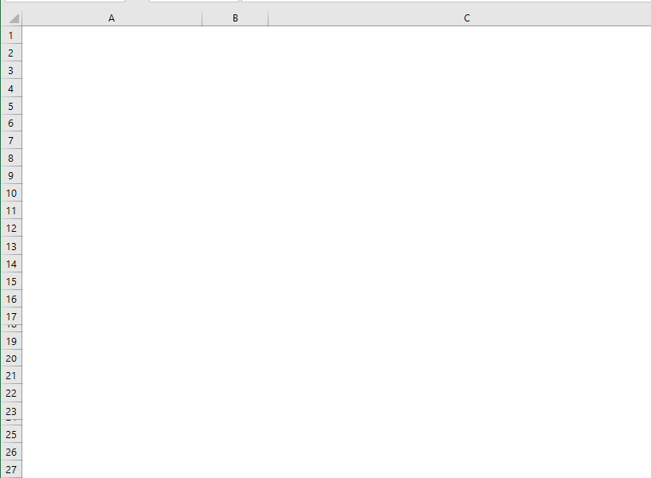
More Metrics- Excel Implementation

Slide 46
Fill Rate Always Exceeds Service Level

Slide 47
Service Level vs Fill Rate

Slide 48
Customer Service level –csl vs. fill rate

Slide 49
How to evaluate our customer service level?
Which measure to select?
Does it measure what we really want?
How does it impact inventory?
How do we set target customer service levels?
Fill rate
Pros: More directly related to a measure of shipped quantity relative to demand.
Cons: It is more complicated to implement a safety stock calculation.
Did we consider product substitution?

Slide 50
Safety stock level for different cv, CSL and FR (µ = 100, L=1)
cv | 98% |  | 99% |  | 99.9%
 | CSL | FR | CSL | FR | CSL | FR
0.10 | 20.5 | 6 | 23.3 | 10 | 30.9 | 20
0.25 | 51.3 | 26 | 58.2 | 34 | 77.3 | 57
0.50 | 102.7 | 68 | 116.3 | 83 | 154.5 | 126
1.00 | 205.4 | 166 | 232.6 | 194 | 309.0 | 273
5.00 | 1027.0 | 1134 | 1163.0 | 1252 | 1545.0 | 1600
99% fill rate is typically equivalent to 90%-95% CSL (for cv up to 0.3).
99% CSL is estimated at 99.985% fill rate (for cv=0.2) .
This may not seem a lot different, but it increases safety stock by 50%.

