Slide 1
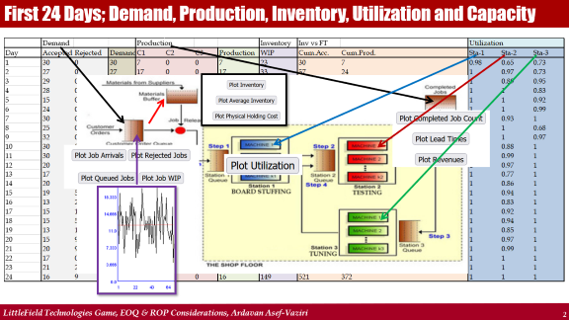
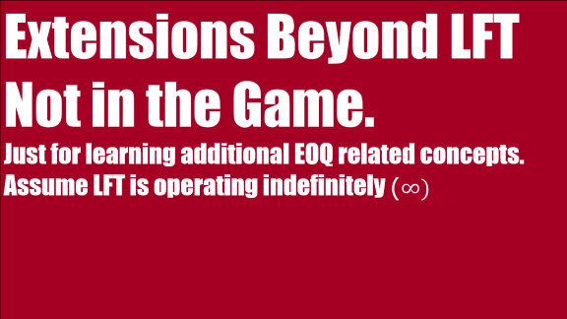
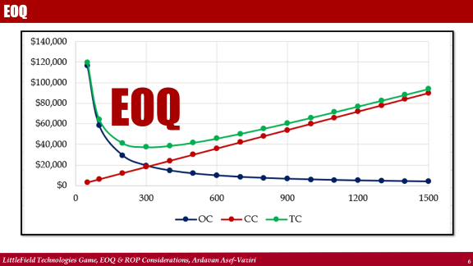
Ardavan Asef-Vaziri

Slide 2
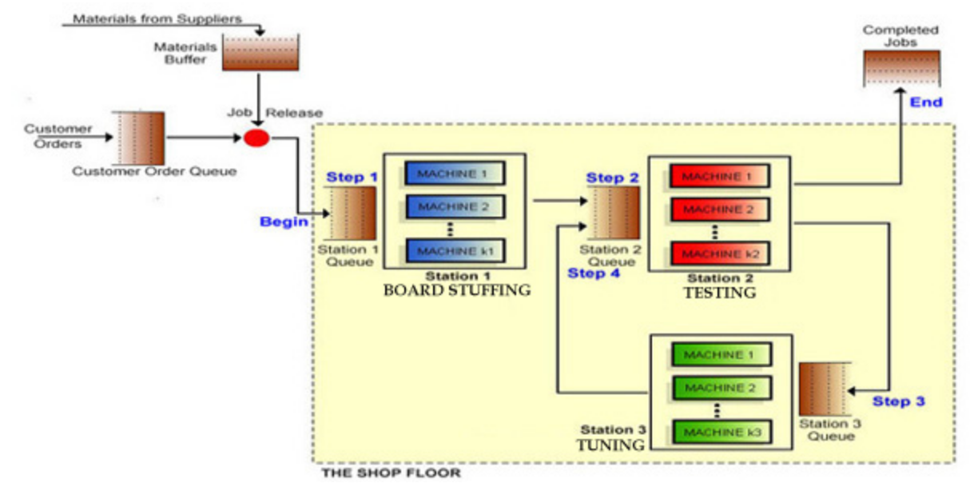
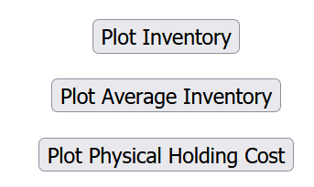
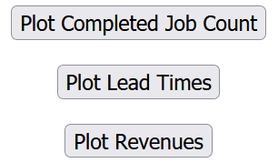
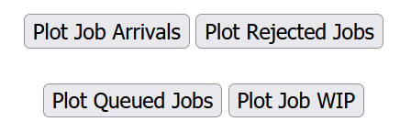

First 24 Days; Demand, Production, Inventory, Utilization and Capacity

Slide 3
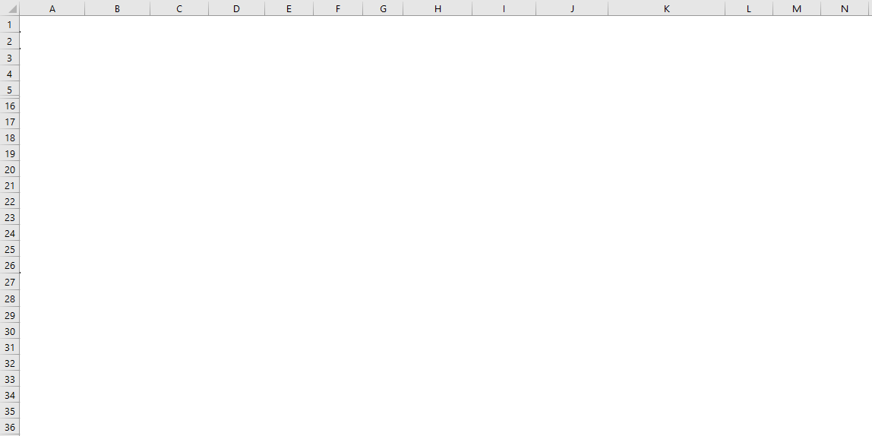
The First 24 Days; Demand, Accepted Demand, Production, and Inventory

Slide 4
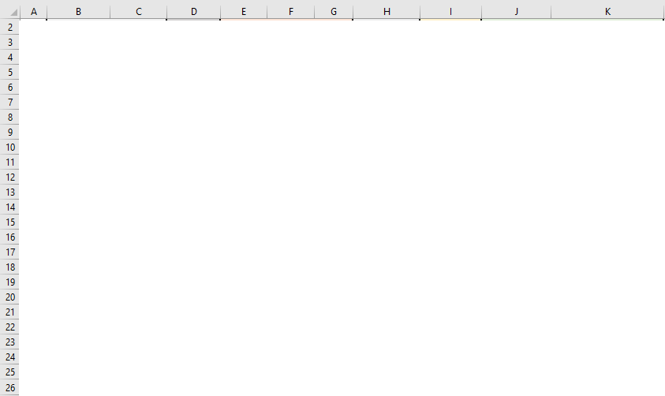
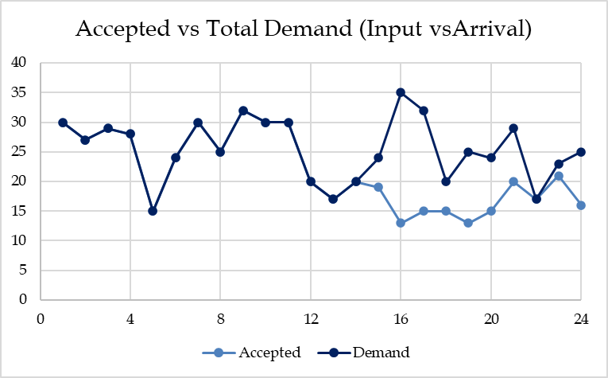
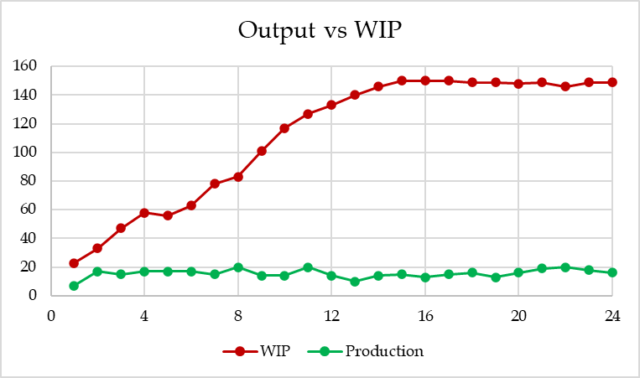
The First 24 Days; Demand, Accepted Demand, Production, and Inventory

Slide 5
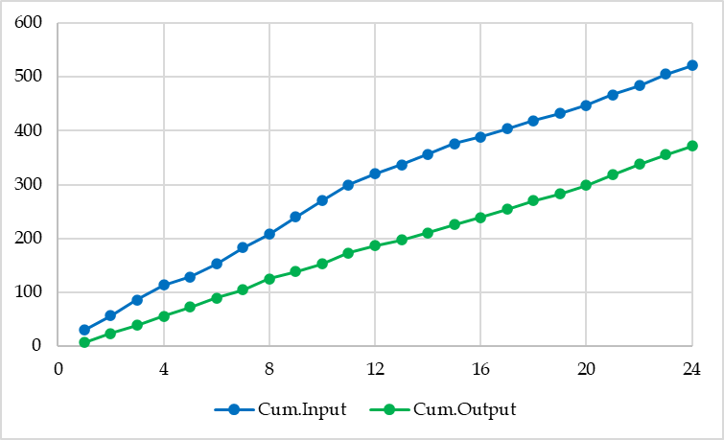
Input, Output, Inventory, and Flow Time
I
T

Slide 6
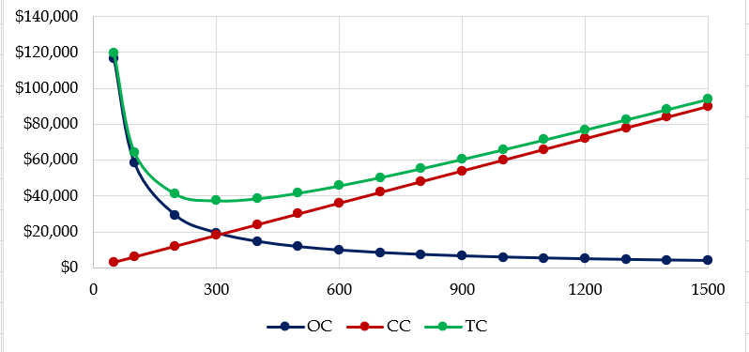
EOQ
EOQ

Slide 7
Inventory Decisions in LittleField Technologies
R and D are used interchangeably in our EOQ (Economic Order Quantity) models.
D is demand, and R is throughput. We assume R = D ➔ Everything produced is sold.
Note that only part of the actual demand enters our system when we do not allow all the demand (arrival) to come (due to a Max-WIP). That is the accepted demand or input.
For the first 24 days, the average daily output was 15.5. We round it to 16 per day. (You need to work with the actual game data throughout the game and not round the numbers.)
We need 60 kits for each contract at $10 per kit. That is the purchase price of C=$600 per unit of product. While the demand is probabilistic and moves up and down around the average, to use the EOQ model, we need to assume that the demand is deterministic and R = D = 16 until we increase the capacity or there is a change in demand.
The kits are used at a steady rate of 16(60) = 960 per day, and a year is 365 days. That is 5475 products or 350400 kits per year.

Slide 8
Inventory Decisions in LittleField Technologies
We have 10% capital cost (interests) and 10% physical storage cost during the game. That is a total of h=20% per dollar invested in inventory per year, or H=hC=0.20($600) = $120 per product per year.
The ordering cost is S=$1000 per order.
How much should we order each time to minimize our total annual inventory ( ordering and carrying) costs?

Slide 9
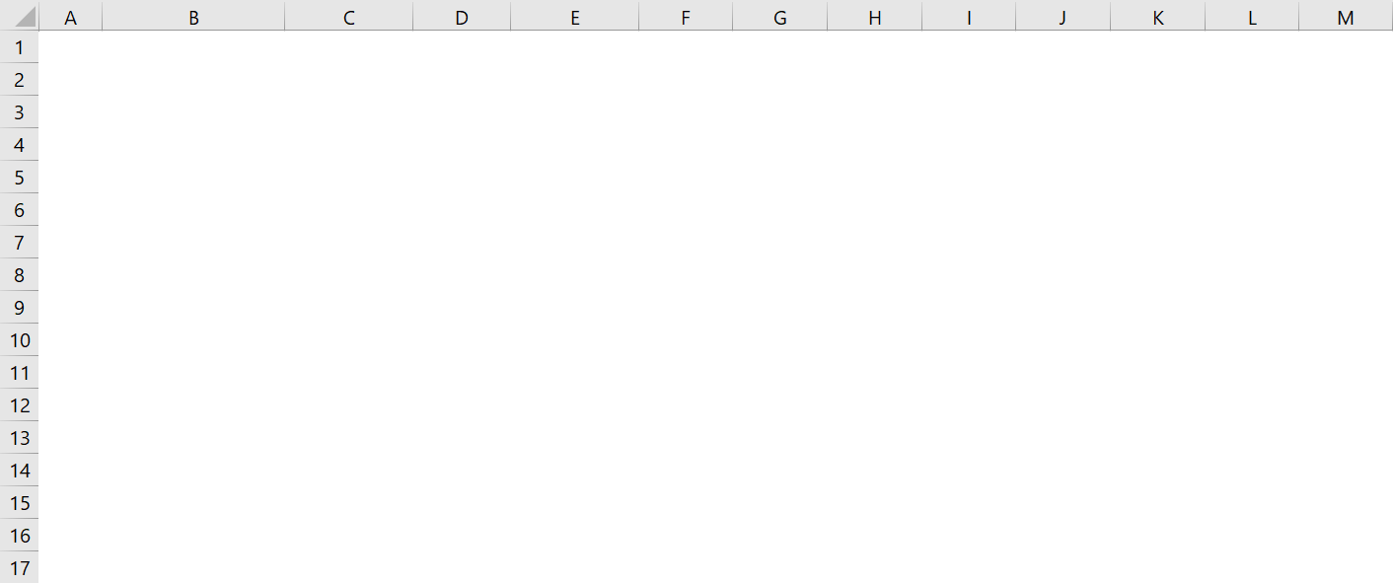
Number of Orders & Ordering Costs
D = R = (16)(365) = 5475 contracts per year or D = R = 60(5475) = 350400 kits per year.
H = 0.2($10) = $2 per kit per year, or H = $10*0.20(60) = $120 per contract per year.
S = $1000 per order. Ordering Quantity = Q.
# of orders per year = D/Q = 5475/Q.
OC = SD/Q = 1000(5480)/Q

Slide 10
Average Inventory & Carrying Cost
At the start of the cycle, we have the order size of Q units. At the end of the cycle, we have 0. Average inventory = (Q+0)/2 = Q/2 units.
Q/2 is also called cycle inventory.
Quantity
Time
In each cycle, we have Q/2 inventory ➔ In all cycles, we have Q/2 inventory.
Throughout the year, we have Q/2 inventory.
Cost of carrying (holding) one unit of inventory for one year = H $ per unit per year.
Total Holding Costs (Total Carrying Costs) = CC = HQ/2 $ per year.

Slide 11
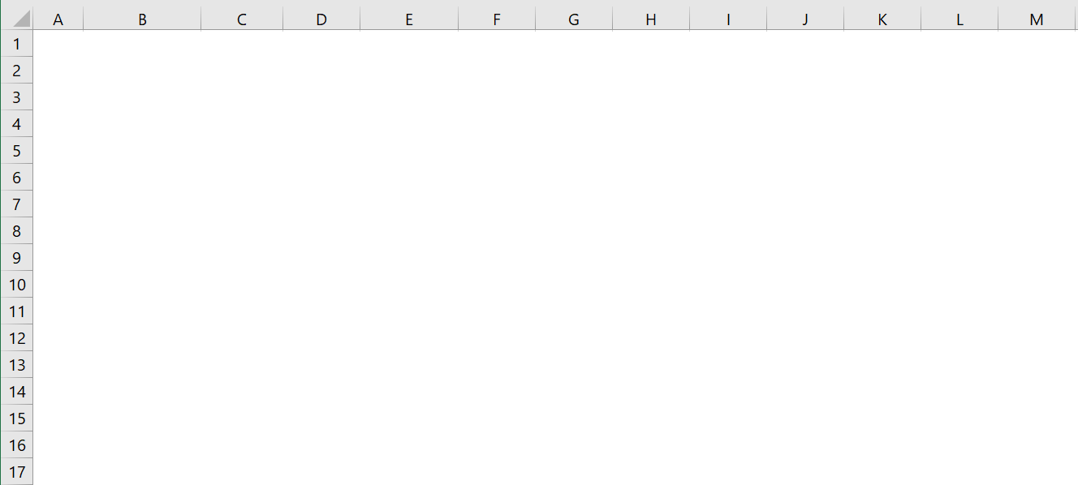
Inventory Decisions in in LittleField Technologies
CC = HQ/2 = 120Q/2

Slide 12
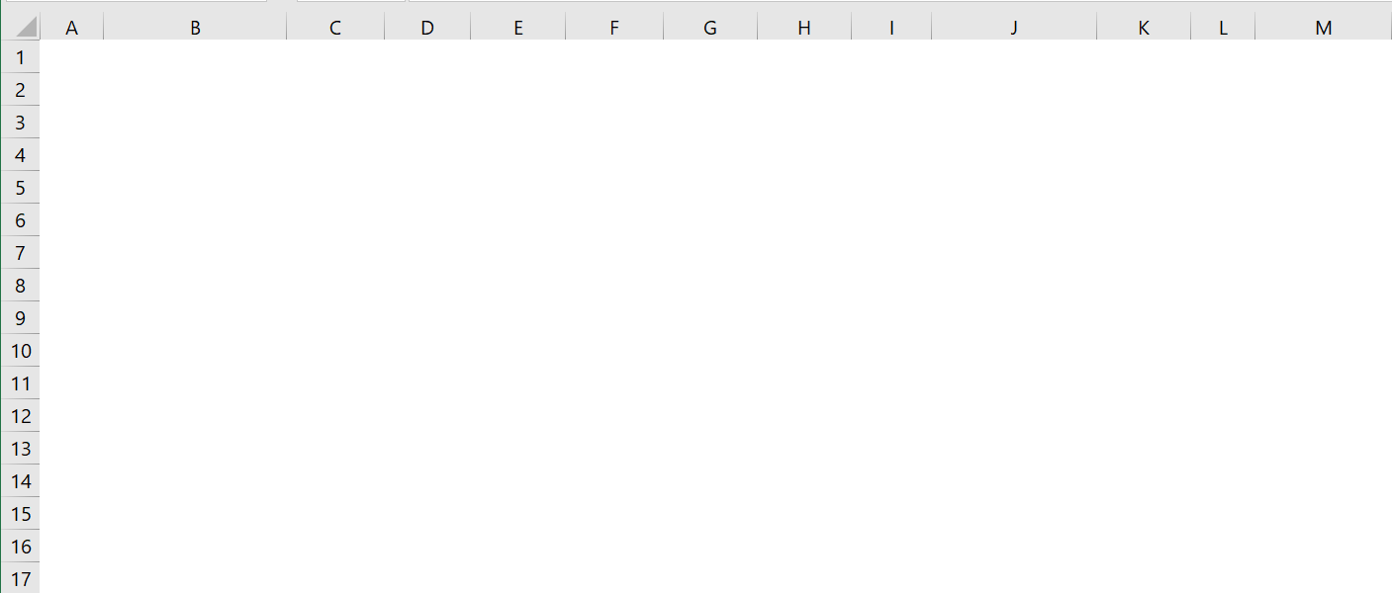
Inventory Decisions in in LittleField Technologies
TC = OC + CC = SD/Q HQ/2 = 1000(5480)/Q + 120Q/2

Slide 13

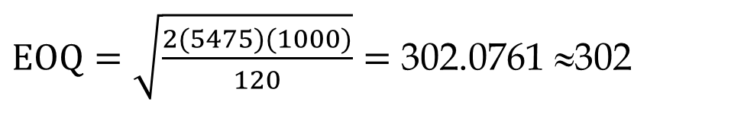
Economic Order Quantity
At EOQ (Economic Order Quantity), OC = CC
SD/Q = HQ/2 ➔ 1000(5475)/Q = 120Q/2 ➔ Q² = 91250 ➔ Q = 302 contracts
$$EOQ=\sqrt{\frac{2DS}{H}}$$
$EOQ=\sqrt{\frac{2(5475)(1000)}{120}}=$ 302.0761 ≈302
SD/Q = HQ/2
Q² = 2DS/H
That is one way to compute EOQ and not to memorize it.
EOQ = 302(60) = 18120 kits
Kits for 312 contracts are enough for how many days. 302/15 = 10.07 days.
In order to find D, we did 15(365) = 5475, but the game only runs for
50+7(24)+50 = 50+168+50 = 268 days. Is our computation incorrect?
It does not matter. Since $120 is the cost of carrying 60 kits for 365 days.
For a demand of 268 days, $120 will be multiplied by 268/365, leading to
H= $120(268/365) = 88.11.
To clarify, let's use monthly demand instead of yearly demand.

Slide 14
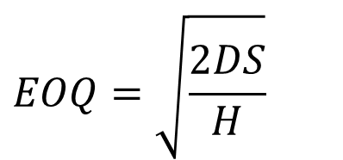
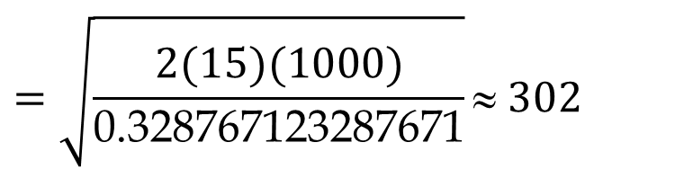
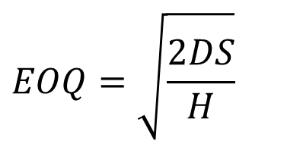
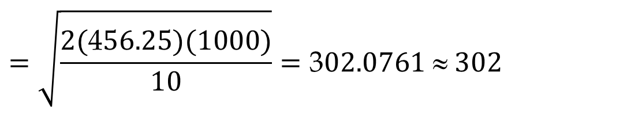
Economic Order Quantity
Since yearly demand is 5475, then monthly demand is 5475/12 = 486.6667.
The ordering cost remains $1000 per order. The carrying cost of $120 for 60 kits for one contract per year is translated into $120/12= $10 per month.
$$EOQ=\sqrt{\frac{2DS}{H}}$$
$$=\sqrt{\frac{2(\text{4}56.25)(1000)}{10}}=\text{3}02.0761 ≈ 302$$
The same is true for daily demand. We can have D=R=16 per day. S=$1000 per order, and H =120/365 = $0.328767123287671
$$EOQ=\sqrt{\frac{2DS}{H}}$$
$$=\sqrt{\frac{2(15)(1000)}{\text{0.328767123287671}}}≈ 302$$
As long as D and H are defined over the same period, year, month, week, and day, they all result in the same EOQ. The ordering cost is still S(D/Q), and the carrying cost is still H(Q/2). Nevertheless, throughout the game, based on the volume of demand and how you manage the capacity, you may use a different value as your yearly, or monthly demand (throughput) estimate each time.

Slide 15
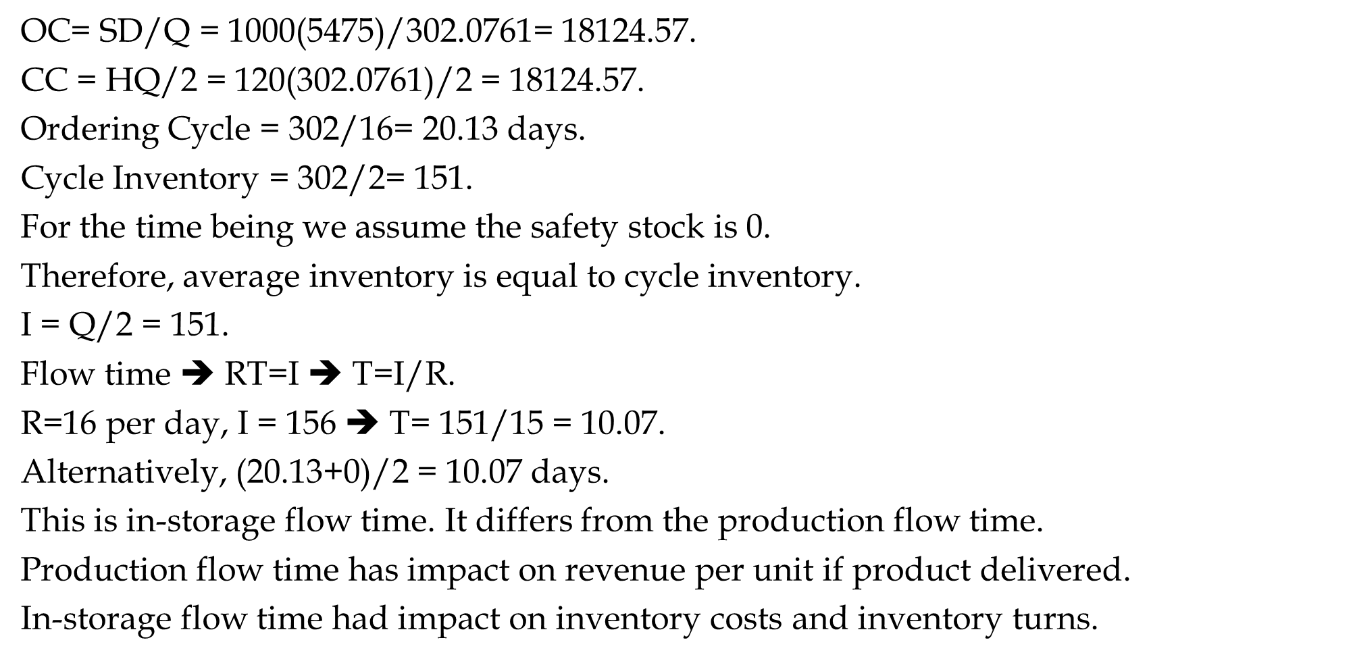
Ordering Cost, Carrying Cost, Ordering Cycle, Flow Time, InvTurns
OC= SD/Q = 1000(5475)/302.0761= 18124.57.
CC = HQ/2 = 120($\text{302.0761}$)/2 = 18124.57.
Ordering Cycle = 302/16= 20.13 days.
Cycle Inventory = 302/2= 151.
For the time being we assume the safety stock is 0.
Therefore, average inventory is equal to cycle inventory.
I = Q/2 = 151.
Flow time ➔ RT=I ➔ T=I/R.
R=16 per day, I = 156 ➔ T= 151/15 = 10.07.
Alternatively, (20.13+0)/2 = 10.07 days.
This is in-storage flow time. It differs from the production flow time.
Production flow time has impact on revenue per unit if product delivered.
In-storage flow time had impact on inventory costs and inventory turns.

Slide 16
Ordering Cost, Carrying Cost, Ordering Cycle, Flow Time, InvTurns
Inventory turns = R/I = 5475/151 = 36.26 times.
InvTurns = 1/FlowTime =1/9.75.
1/10.07 OR 36.26?
365(1/10.07) = 36.26.
Suppose kits are delivered in boxes of 400 products. That is boxes of 24000 kits. What is the impact on the total cost.
The current EOQ with all the decimal points is 311.9829.
TC(EOQ) = 1000*5475/302.0761 + 120*302.0761 = 18124.57 + 18124.57 = 36249.14.
TC(400) = 1000*5475/400 + 120*400/2 = 13687.5 + 24000 = 37687.5.
Ordering cost goes down, because we order in larger quantities.
Carrying cost goes down, because we carry more inventory.
Total cost goes up because we order other than EOQ.
Q2/Q1 = (400-302)/302 = 32.5% ⇑
TC2/TC1 = (37687.5-36249.14)/36249.14 = 4%⇑
Q: 32.5% ⇑ ➔ TC: 4%⇑

Slide 17
Periodic Inventory
Suppose there is not restriction on order size and you have decided to switch to the Periodic Inventory System. Assume that you decide to order every 30 days. That is an order size of 15(30)= 450 product (60*450 kits per order).
Compute the cycle inventory
Icycle = Q/2 = 450/2 =225.
b) Compute the number of cycles (assume LFT continues for many years).
# of cycles = 5475/450 = 12.167
c) Compute the length of a cycle.
Cycle length = 30 days.
Alternatively, (450/5475)*365 = 30.
d) Compute flow time
T= 30/2 = 15.
Alternatively, T=I/R = 225/5475 = 0.041095890 year or 356(0.041095890 ) = 15 days.

Slide 18
Periodic Inventory
e) Compute inventory turns
InvTurns = 5475/225 = 24.33
InvTurns = 1/T = 1/15??!!
1/15 or 24.33?
1/15 is in days, 24.33 is over a year
(1/15)*365= 24.33.
f) Compute the total costs?
TC = OC + CC = SD/Q + HQ/2
TC = 1000*5475/450 + 120*450/2
TC = 12166.7 + 27000 = 39166.67

Slide 19

Extensions Beyond LFT
Not in the Game.
Just for learning additional EOQ related concepts.
Assume LFT is operating indefinitely ($∞)$

Slide 20
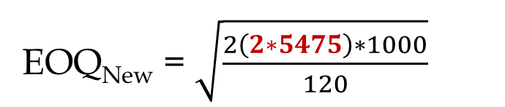
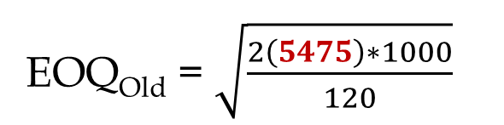
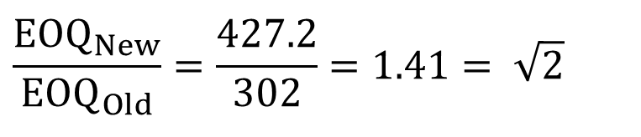
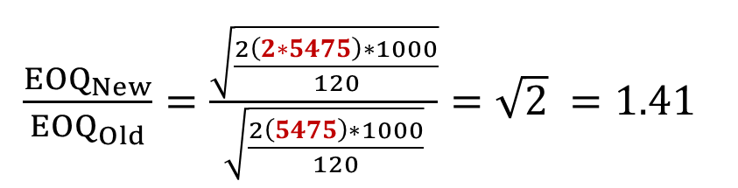
Square Root Effect- Demand Doubled
Now we go through some extensions of the Littlefield assumptions and basic EOQ model. Suppose Littlefield continues operations for many years. Suppose the following parameters remain the same. S=$1000, C=$600, h=0.2, ➔ H = hC = 0.2(600) = $120. However, assume the demand is doubled, and we have enough capacity to accept the incoming demand. D = R = 2(5475) = 11680.
Compute the impact on EOQ and TC.
EOQ_{Old} = $\sqrt{\frac{2\left(5475\right)∗1000}{120}}$
EOQ_{New} = $\sqrt{\frac{2\left(2∗5475\right)∗1000}{120}}$
$\frac{{EOQ}_{New}}{{EOQ}_{Old}}=\frac{\sqrt{\frac{2\left(2∗5475\right)∗1000}{120}}}{\sqrt{\frac{2\left(5475\right)∗1000}{120}}}=\sqrt{2} =1.41$
$$\frac{{EOQ}_{New}}{{EOQ}_{Old}}=\frac{427.2}{302}=1.41= \sqrt{2}$$
If demand is doubled, EOQ decreases by SQRT(2)

Slide 21
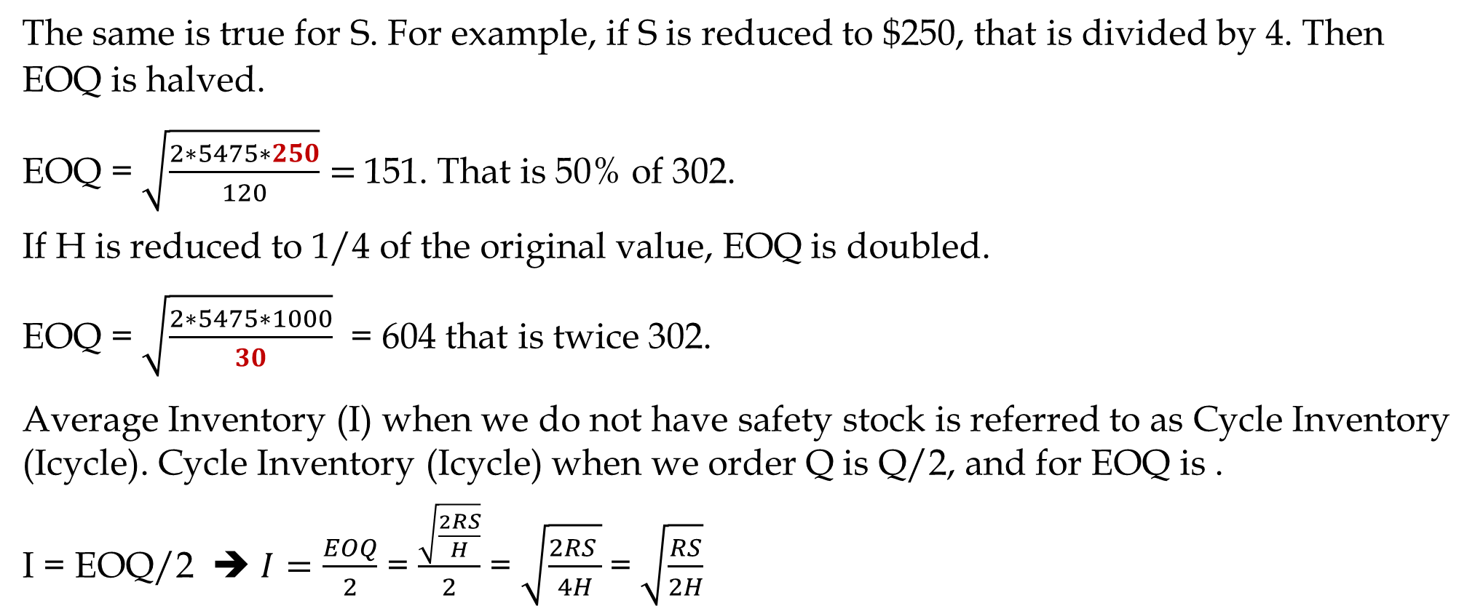
Square Root Effect- Changes in EOQ
The same is true for S. For example, if S is reduced to $250, that is divided by 4. Then EOQ is halved.
EOQ = $\sqrt{\frac{2∗5475∗250}{120}}=$151. That is 50% of 302.
If H is reduced to 1/4 of the original value, EOQ is doubled.
EOQ = $\sqrt{\frac{2∗5475∗1000}{30}}$ = 604 that is twice 302.
Average Inventory (I) when we do not have safety stock is referred to as Cycle Inventory (Icycle). Cycle Inventory (Icycle) when we order Q is Q/2, and for EOQ is .
I = EOQ/2 ➔ $I=\frac{EOQ}{2}$ = $\frac{\sqrt{\frac{2RS}{H}}}{2}$ = $\sqrt{\frac{2RS }{4H}}$= $\sqrt{\frac{RS}{2H}}$

Slide 22
Square Root Effect- Changes in EOQ, Icycle, and Flow Time
Formula Proof for Flow Time Under EOQ
If D (or R) is multiplied by K, EOQ is multiplied by SQRT(K).
If S is multiplied by K, EOQ is multiplied by SQRT(K).
If H is multiplied by K, EOQ is divided by SQRT(K).
The same can be said about Cycle inventory and In-storage flow time.
What about annual inventory cost (TC=OC+CC). Again, we assume that the operations continues for several years- That is a basic assumption in EOQ model.
Total cost of any Q?
TC_{Q} = OC_{Q} + CC_{Q}
TC_{Q} = SR/Q + HQ/2
This is a correct formula everywhere, including at EOQ, but we can simplify it for EOQ.
At EOQ, we have
OC_{EOQ} = CC_{EOQ}

Slide 23
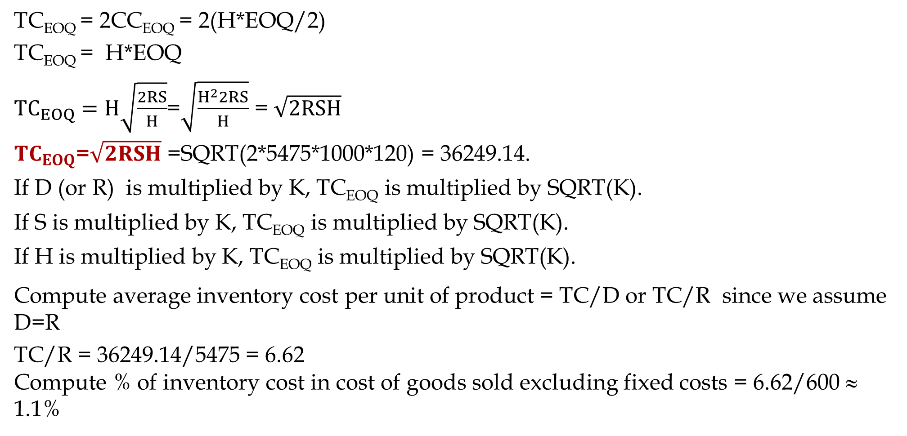
Total Inventory Cost Formula at EOQ, and Inventory Cost Per unit
TC_{EOQ} = 2CC_{EOQ} = 2(H*EOQ/2)
TC_{EOQ} = H*EOQ
${TC}_{EOQ}=H\sqrt{\frac{2RS}{H}}$=$\sqrt{\frac{H^{2}2RS}{H}}$ = $\sqrt{2RSH}$
${TC}_{EOQ}$=$\sqrt{2RSH}$ =SQRT(2*5475*1000*120) = 36249.14.
If D (or R) is multiplied by K, TC_{EOQ} is multiplied by SQRT(K).
If S is multiplied by K, TC_{EOQ} is multiplied by SQRT(K).
If H is multiplied by K, TC_{EOQ} is multiplied by SQRT(K).
Compute average inventory cost per unit of product = TC/D or TC/R since we assume D=R
TC/R = 36249.14/5475 = 6.62
Compute % of inventory cost in cost of goods sold excluding fixed costs = 6.62/600 ≈ 1.1%
.

Slide 24
Centralization vs. Decentralization Ordering
Four LFT plants. Order individually or collectively.
D =5475 and H = $120 per product per year remain the same. S = $800 fixed, plus $200 per plant. That is S = $800+$200=$1000 if each warehouse order independently.
S=800+200+200 = 1200 if two plants order together. S = 800+200+200+200+200 = $1600.
When two or more plants order together, S goes up since the truck travel time in a route to more than one warehouses is longer than a trip to a single warehouse.
Currently each plant orders independently.
We already have the followings for each warehouse.
EOQ = 302
Cycle inventory (Icycle) = 302/2 = 151
Icycle for 4 warehouses = 4(151) = 604.
Demand = 5475 per year or 15 per day ➔ Cycle length = 302/15 = 20.133 days
In-Storage Flow time = 20.133/2 = 10.1 days (Alternatively, I/R = 151/15 = 10.1 days

Slide 25
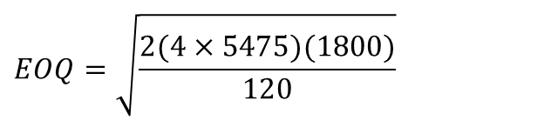
Centralization vs. Decentralization Ordering
a) Compare Cycle inventory for Centralized vs Decentralized.
Demand for 4 plants = 4(5475), and EOQ if 4 plants order together
$$EOQ=\sqrt{\frac{2(4×5475)(1800)}{120}}$$
=764.2
The total cycle inventory across all four outlets equals 382, compared to 604.
A (604-382)/604 = 37%⇓
b) Compare total inventory cost Centralized vs Decentralized.
TC-Centralized = SQRT(2*4*5475*1600*120) = 91704.
TC-Decentralized (already computed for one plant) = 36249.
TC-Decentralized 4 plant = 4(36249) = 144996.
A (144996- 91704)/144996 = 37% cost reduction

Slide 26
Ordering Interval, Inventory Cycle, Flow Time
c) Compute the ordering interval in decentralized and centralized systems.
Decentralized R/Dy = 15/Dy
Centralized R/Dy = 4(15) = 60/Dy
Decentralized = 302/15 = 20.14 days
Centralized = 790/64 = 12.74 days
d) Compute the average in-storage flow time
20.14/2 = 10.07 days
12.74/2 = 6.37 days
Alternatively- Using The Little’s Law
RT = I ➔ T= R/I
15T= 151 ➔ T = 151/15 days
60T= 382 ➔ T = 382/60 days

Slide 28
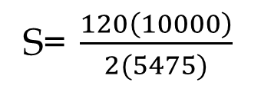
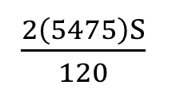
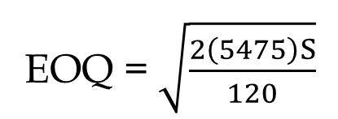
How to Reduce EOQ
To reduce EOQ we may ↓R, ↓ S, ↑H
↓R and ↑H are out of question.
Reduce S. IT&IS can help in reduction of fixed costs. It can cut operational costs for buyers and suppliers.
Suppose you could have hired an IT/IS consultant to reduce S in the game such that the EOQ is lowered to the number of kits needed for 100 contact. To what value do the consultant company needs to lower S?
EOQ = $\sqrt{\frac{2\left(5475\right)S}{120}}$
= 100
$\frac{2\left(5475\right)S}{120}$
S= $\frac{120\left(10000\right)}{2(5475)}$
S = $110
= 10000

Slide 29
How to Reduce Inventory
Centralize
  EOQ increases as the square route of demand and the square route of the ordering cost.
  Breakdown S on a larger order quantity.
Commonality, modularization and standardization is another type of Centralization.
Postponement, Delayed Differentiation.

Slide 30
Service Level - For the Last Order for the Last 50 Days
What is the Re-Order Point
We have already computed the standard deviation of the accepted daily demand which is 6.4 for the first 24 days. But standard deviation goes down when WIP gets close to Max-WIP. As we can see, the standard deviation in the first 14 days is 5.47, while it is for days 11-24 is 2.8. Assume the standard deviation of the daily demand is σ_{R} = 5. You need to recompute it throughout the game- especially for the last order.
Standard deviation of the demand during the lead time during the game differs from that of the end of the game. We will discuss the end of the game later.
During the game, we have a lead time of L= 9 days ➔ σLTD = SQRT(9)*5=15.
Demand per day R=16, Lead Time = 9 days. Lead time demand =LTD = L*R=9(16)=144
LTD ~ N(144, 15)
To compute ROP, we need to compute the service level.
Service level during the game differs from the required service level in the very last 50 days.

Slide 31

CSL For Continuously Stocked Item With & Without Lost Sales
CSL* (Without Lost Sale) $=1−\frac{HQ}{DCu}$
CSL* (With Lost Sale) = $1−\frac{HQ}{DCu+HQ}$

Slide 32
Inventory Profiles, Good & Bad Decisions

Slide 33
ROP - When We have Access to the Game
We first discuss the service level at the end of the game.
Suppose we are on $1000 contract. What service level should we choose?
What is the underage cost (Cu)?
If a contract is available but we cannot deliver it, we don’t earn $1000.
We would have spent $600 on the 60 kits required for each contract.
Cu=$1000-$600=$400. However, we do not loose this profit because we earn it in the next cycle. Since each cycle is 19.5 ≈ 20 days, and interest rate that we do not earn is 10%. Therefore, underage cost Cu = 0.1(20/365)(400) = 2.2.
What is the overage cost (Co)?
If we order kits for one extra contract, and we do not use it in this cycle, we use it in the next cycle. But we have 20% financial and storage cost per carrying the 60 kits ($600) of a contract for one year. Therefore, overerage cost Co = 0.2(20/365)(600) = 6.6
SL* = 2.2/(2.2+6.6) = 0.25

Slide 34
ROP - When We have Access to the Game
We first discuss the service level during the game. Suppose we want to make out
Suppose we are on $1000 contract. What service level should we choose?
What is the underage cost (Cu)?
If a contract is available but we cannot deliver it, we don’t earn $1000.
We would have spent $600 on the 60 kits required for each contract.
Cu=$1000-$600=$400. However, we do not loose this profit because we earn it in the next cycle. Since each cycle is 19.5 ≈ 20 days, and interest rate that we do not earn is 10%. Therefore, underage cost Cu = 0.1(20/365)(400) = 2.2.
What is the overage cost (Co)?
If we order kits for one extra contract, and we do not use it in this cycle, we use it in the next cycle. But we have 20% financial and storage cost per carrying the 60 kits ($600) of a contract for one year. Therefore, overerage cost Co = 0.2(20/365)(600) = 6.6
SL* = 2.2/(2.2+6.6) = 0.25

Slide 35
Service Level - For the Last Order for the Last 50 Days
NORM.S.INV(0.25) = -0.67 standard deviation of lead time demand to the right.
That is 0.67 to the left
We have already assumed the standard deviation of daily demand. Suppose it is σ_{R} = 5.
Standard deviation of the demand during the lead time during the game differs from that of the end of the game.
During the game, we have a lead time of 9 days. Therefore, σLTD = SQRT(9)*5=15.
Is = -0.67 (15)=-10
Demand per day R=16, Lead Time = 9 days. Lead time demand =LTD = L*R=9(16)=144
LTD ~ N(144, 15)
ROP=144-10=134 orders ➔ ROP = 176 orders x 60 kits/order = 10560 kits.
We place an order Q= 18720 kits when inventory reaches ROP=10560 kits.
But we have ignores one important component in Cu.
We did not discussed since it needs a knowledge beyond the mathematical content of our course. But we need to take it into account.

Slide 36
Service Level - For the Last Order for the Last 50 Days
What if shortage of kits lead to delay in the delivery of contract. A delay may reduce the revenue of a contract from 1000 to 0. That is a huge increase in Cu.
Therefore, throughout the game, but not in the very last 50 days of the game, apply a large service level, say 3 standard deviations to the right- which is about %99 service level. Then monitor the inventory level, if you think you carry extra inventory, instead of three standard deviations, you may chose two or even one standard deviation.
But the situation is entirely different in the very last 50 days of the game.
We place an order Q= 18720 kits when inventory reaches the kits required for 144+3*15 orders. That is 60(189)= 11340 kits.

Slide 37
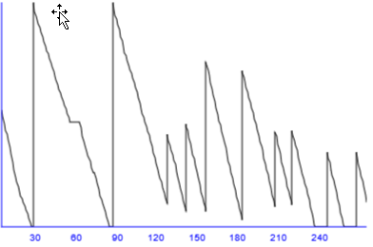
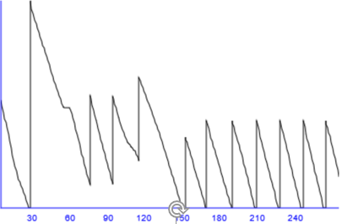

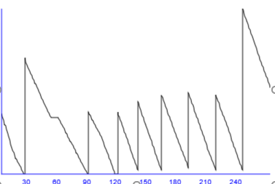
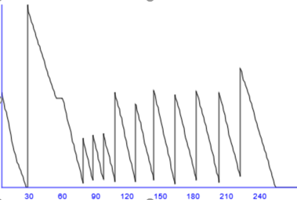
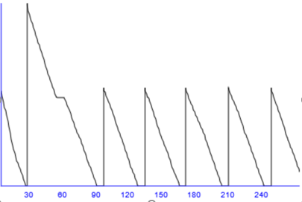
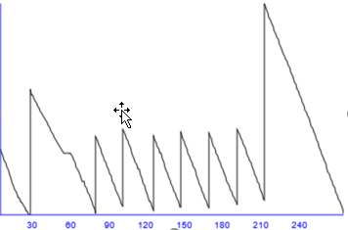
The Last 50 Days; Inventory

Slide 38
Service Level - For the Last Order for the Last 50 Days
What is L and what is σ_{LTD} a few hours before when we will be disabled of making any changes.
Suppose it is a little before 8 PM a day before the end of the game. The 218 days of the game ends at 1 PM tomorrow. The game then runs for 50 more days, but it takes a second for computer to do all the computations. Therefore, at 1:01 PM you can see your final standing.
Now it is a little before 8 PM the day before, and we have 17 hours (days) to the last 50 days. Therefore, the game has 50+17 days to run. L=67.
Demand per day = R=16
Demand in 67 days =LTD = L*R = 67(16) = 1072
Standard deviation of daily demand = σ_{R}=5
Standard deviation of demand for 67 days of demand = σ_{LTD}= SQRT(67)*5 40.9 ≈ 41
LTD=N~(1072, 41)
What are Cu and Co?

Slide 39
Service Level - For the Last Order for the Last 50 Days
If a contract is there but the kits are not, you could have spent $600 and have earned $1000. Cu = $400.
If kits for a contract are there but contract is not, you have no use for them, and at the end of the game their value is 0. Cu = $600.
SL*=$400/($400+600) = 0.4
NORM.S.INV(0.396739) = -0.253 standard deviation of lead time demand to the right.
That is -0.253347103 to the left
Is = -0.253347103 (41)=-10.38 ≈ -10
LTD=N~(1072, 41)
Q= 1072-10= 1062

Slide 40
Service Level - For the Last Order for the Last 50 Days
Should we order the kits required for 1062 contracts?
Should we order 63720 kits?
No.
Why
We need to check how much inventory we have. Suppose we have 6000 kits which is enough for 100 contracts.
Set your new order quantity 63720-6000= 57720 kits, then quickly set your ROP to more than 6000 kits to make sure that you trigger that materials order immediately.

