Slide 1
Joint Replenishment With Incremental Ordering (Setup) Cost
How can it be that mathematics, being after all a product of human thought which is independent of experience, is so admirably appropriate to the objects of reality?
Albert Einstein
Ardavan Asef-Vaziri

Slide 2
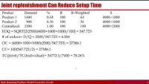
https://youtu.be/v_QD_R_Ravg

Slide 3
Joint Replenishment With Incremental Ordering (Setup) Cost
A buyer may order multiple items from a supplier and follow joint replenishment.
Suppose there are i=2 items with demand D_{i} and holding cost H_{i} = h_{i} C_{i} (i = 1,2).
There is a joint order cost S, and an order cost S_{i} for each item.
Suppose that both items are ordered together every time and let S_{total} = S + S1 + S2.
A decrease in total inventory related cost through sharing of order costs!
  D1=1600/year, D2=900/year
  S = $4,000, S1 = S2 = $1,000
  h = 0.2, C1 = C2 = $500 ➔ H1=H2=$100

Slide 4
Individual replenishment: Product 1
  D1=1600/year, S+S1= 4000+1000= 5000, H1=100
  EOQ1= SQRT[2D1(S+S1)/H1] = SQRT[2(1600)(5000)/100] =400
  # of orders= D1/Q1 = 1600/400= 4
  OC = (4000+1000)(1600/400) =20000
  CC= 100(400/2) = 20000
  TC = 40000
  Cycle-Inventory = Q1/2= 400/2 = 200
  Inventory Turns =1600/200 = 8
  Flow time ➔ RT=I ➔ RT=Q/2➔ 1600T=200 ➔ T=0.125 year
  Assuming 50 Weeks ➔ 50(.125) = 6.25 weeks
  Assuming 360 days per year ➔ 360(0.125) = 45 days

Slide 5
Individual replenishment: Product 2
  D2=900/year, S+S1= 4000+1000= 5000, H1=100
  EOQ1= SQRT[2D1(S+S1)/H1] = SQRT[2(900)(5000)/100] =300
  # of orders= D1/Q1 = 900/300= 3
  OC = (4000+1000)(900/300) =15000
  CC= 100(300/2) = 15000
  TC = 30000
  Cycle-Inventory = Q1/2= 300/2 = 150
  Inventory Turns =900/150 = 6
  Flow time ➔ RT=I ➔ RT=Q/2➔ 900T=150 ➔ T=0.1667 year
  Assuming 50 Weeks ➔ 50(. 0.1667) = 8.33 weeks
  Assuming 360 days per year ➔ 360(0.1667) = 60 days
  TC(Individual) = TC1+TC2 = 40000+30000=70000

Slide 6
Joint replenishment Can Reduce Setup Time
  Product Demand % H H-Weighted S
  Product-1 1600 0.64 100 64 4000+1000
  Product-2 900 0.36 100 36 4000+1000
  Centralized 2500 1.00 100 100 4000+2000
  EOQ = SQRT[2(2500)(4000+1000+1000)/100] = 547.723
  # of orders= D/Q = 2500/547.723 = 4.564
  OC = (4000+1000+1000)(2500/547.723) = 27386.1
  CC= 100(547.723/2) = 27386.1
  TC(Joint)/TC(Individual)= 54772.3/70000 = 78.24%
  Cycle-Inventory = 548/2 = 274
  InvTrns =2500/274 = 9.129, Flow time: 2500T=274= 0.10954 year,
  or 5.47723 weeks or 39.436 days
  Each time we order 0.64(547.723) = 351 product 1, and 198 product 2

Slide 7
Alternative Formula for the # of Joint Orders
  # of orders = SQRT[(D1H1+D2H2)/(2S_total)] =
  = [1600(100)+900(100)]/(2(6000))] = 4.56435
  Ordering cost = 4.56435(6000)= 27386.1
  Each time we order (1600+900)/4.56435 = 547.723
  0.64(547.723) = 350.542 product 1 and 197.18 product 2
  Carrying cost of Product 1 = 100(350.542/2) = 17527.1
  Carrying cost of Product 2 = 100(197.18/2) = 9859.01
  Total cos = 27386.1 + 17527.1 + 9859.01 =54722.2

Slide 8
Practice – Individual Replenishment
A company purchases components from three suppliers: Components from supplier Alpha cost $90 and are used at the rate 600 units/year; components from supplier Beta cost $24 and are used at the rate 4,000 units/year; components from supplier Gamma cost $1,000 and are used at the rate 80 units/year. The trucking company is charging a fixed cost of $1,000/truck (for the purpose of this exercise assume that you do not need to worry about the truck capacity). Currently they purchase separate truckloads from each supplier. The annual holding cost is 25% of product cost, h=0.25. What is the corresponding minimal annual cost? What is the cycle inventory of each component?

Slide 9
Practice – Joint Replenishment
2. Motor Company is considering aggregating orders from all three suppliers. In addition to $1,000 fixed truck cost for deliveries with one pick up the trucking company is charging $100 for each additional pickup. What is the corresponding minimal annual cost, and the cycle inventory of each component?

Slide 10
Centralized vs Decentralized: 6- Product, Different h & C

Slide 11
Inventory Basic Model
How can it be that mathematics, being after all a product of human thought which is independent of experience, is so admirably appropriate to the objects of reality?
Albert Einstein
Ardavan Asef-Vaziri

Slide 12
Importance of Inventory
A typical hospital spends about 20% of its budget on medical, surgical, and pharmaceutical supplies. For all hospitals it adds up to $150 billion annually.
The average inventory in US economy about $1 trillion on about $10 trillion of annual sales. About 40% in manufacturing, about 20% in wholesaler, and about 40% in retail.
What happens when a company with a large Work In Process (WIP) and Finished Goods (FG) inventory finds a market demand shift to a new product? Two choices:
  Fire-sell all WIP and FG inventories and then quickly introduce the new product ➔ Significant losses
  Finish all WIP inventory and sell all output before introducing the new product ➔ Delay and reduced market response time.
A typical firm probably has tied in inventories about
  30 percent of its Current Assets
  90 percent of its Working Capital (Current Assets – Current Liabilities).
  Poor inventory management hampers operations, diminishes customer satisfaction, and increases operating costs.
Notes:
Centura Health - This can require high costs for IT & warehouse

Slide 13
A classification Approach: ABC Analysis
ABC Analysis in terms of dollars invested, profit potential, sales or usage volume, and stockout penalties. Perpetual for class A, Periodic for class C.
Group A: Perpetual
Group C: Periodic

Slide 14
Periodic Inventory [Counting] Systems
At the beginning of each period, the existing inventory level is identified and the additional required volume to satisfy the demand during the period is ordered.
The quantity of order is variable, but the timing of order is fixed.
Re-Order Point (ROP) is defined in terms of time.
One-Bin System (Periodic)
Order Enough to Refill Bin
Physical count of items made at periodic intervals.
Disadvantage: no information on inventory between two counts.
Advantage: order for several items are made at the same time.

Slide 15
Perpetual Inventory Systems
When inventory reaches ROP an order of EOQ (Economic Order Quantity) units is placed.
The quantity of order is fixed but the timing of order is variable.
ROP is defined in terms of quantity (inventory on hand).
Two-Bin System (Perpetual)
Order One Bin of Inventory
Full
Empty
Keeps track of removals from inventory continuously, thus monitoring current levels of each item.
A point-of-sales (POS) system record items at the time of sale.

Slide 16
Why We are interested in reducing inventory
Why We are interested in reducing inventory
Has Carrying Cost
  Physical costs – we need storage and human resources.
  Financial costs (Opportunity Cost) – We could have invested our capital elsewhere and benefit from it. In the LFT Game financial cost is 10% of the cost of goods.
Has Hidden Costs
  Devaluation Cost- Components typically drop in price during their inventory life.
  Price Protection Cost. To reimburse customers for the drops in the prices.
  Return Cost.
  Obsolescence Cost- due to change in customer preferences, technological changes, etc.
Hides problems
  Even if we produce low quality product, there is enough inventory downstream.
  Untrustworthy suppliers, machine breakdowns, long changeover times, scraps and defects do not show up.
  Long flow time, Feedback loop is long. not-uniform operations.

Slide 17
How to Reduce Inventory
To reduce EOQ we may ↓R, ↓ S, ↑H
Two ways to reduce average inventory
- Reduce S
- Centralize
S does not increase in proportion of Q
EOQ increases as the square route of demand.
- Commonality, modularization and standardization is another type of Centralization
- Postponement, Delayed Differentiation

Slide 18
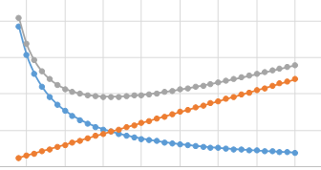
Multiple Choice Questions
1. The introduction of quantity discounts will cause the number of the units ordered to be:
  A) smaller than EOQ
  B) the same as EOQ
  C) greater than EOQ
  D) the same or smaller than EOQ
  E) the same or greater than EOQ
2. Most inventory models attempt to minimize
  A) the number of items ordered and the safety stock
  B) total inventory costs and likelihood of a stockout
  C) the number of orders placed and the average inventory
  D) All of the above
  E) None of the above

Slide 19
Multiple Choice Questions
3. Inventory that is carried to provide a cushion against uncertainty of the demand is called
  A) Seasonal inventory
  B) Safety Stock
  C) Cycle stock
  D) Pipeline inventory
  E) Speculative inventory
4. In the basic EOQ model, if annual demand doubles, the effect on the EOQ is:
  It doubles.
  It is four times its previous amount
  It is half its previous amount
  It is about 70% of its previous amount
  It increases by just above 40%

Slide 20
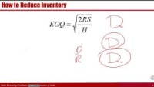
Inventory Basic Model
How can it be that mathematics, being after all a product of human thought which is independent of experience, is so admirably appropriate to the objects of reality?
Albert Einstein

Slide 21

Formula Proof for Total Cost of EOQ
Total cost of any Q?
TC_{Q} = SR/Q + HQ/2
Total Cost of EOQ? The same as above, but can also be simplified
${TC}_{EOQ}=\frac{SR}{\sqrt{\frac{2RS}{H}}}$ +$\frac{H\sqrt{\frac{2RS}{H}}}{2}$ $=2\frac{H\sqrt{\frac{2RS}{H}}}{2}$=$H\sqrt{\frac{2RS}{H}}$=$\sqrt{\frac{H^{2}2RS}{H}}$ = $\sqrt{2RSH}$
TC_{Q} = SR/Q + HQ/2
${TC}_{EOQ}$=$\sqrt{2RSH}$

Slide 22
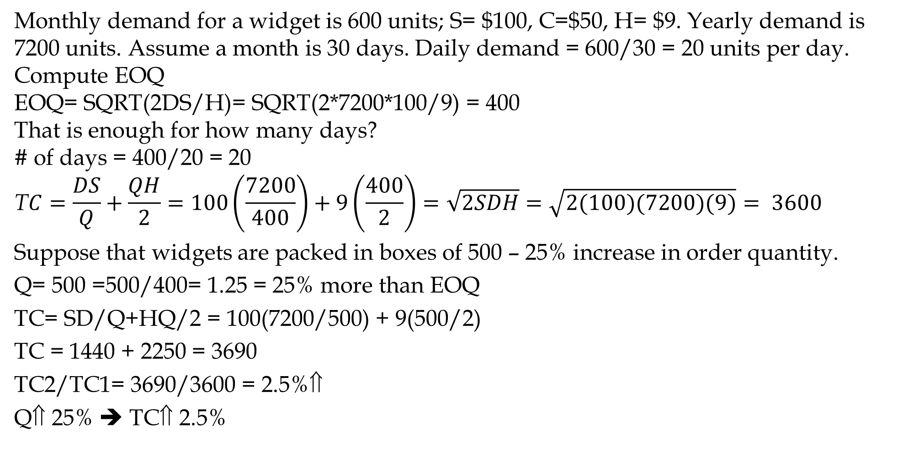
Impact of Changes- Not EOQ
Monthly demand for a widget is 600 units; S= $100, C=$50, H= $9. Yearly demand is 7200 units. Assume a month is 30 days. Daily demand = 600/30 = 20 units per day.
Compute EOQ
EOQ= SQRT(2DS/H)= SQRT(2*7200*100/9) = 400
That is enough for how many days?
# of days = 400/20 = 20
$$\text{T}C=\frac{DS}{Q}+\frac{QH}{2}=100\left(\frac{7200}{400}\right)+9\left(\frac{400}{2}\right)=\sqrt{2SDH}=\sqrt{2(100)(7200)(9)}= 3600$$
Suppose that widgets are packed in boxes of 500 – 25% increase in order quantity.
Q= 500 =500/400= 1.25 = 25% more than EOQ
TC= SD/Q+HQ/2 = 100(7200/500) + 9(500/2)
TC = 1440 + 2250 = 3690
TC2/TC1= 3690/3600 = 2.5%⇑
Q⇑ 25% ➔ TC⇑ 2.5%

Slide 23
Impact of Changes in Demand on EOQ
Suppose that the demand increases k=4 times. What is the change in the optimal order quantity, cycle stock, and # of orders per year?
S=100, H=9, D1= 7200, D2=4(7200)=28800, EOQ1 = 400
EOQ1= SQRT(2*100*7200/9) = 400
EOQ2= SQRT(2*100*4(7200)/9) = 800
4D➔ 2EOQ
Demand is multiplied by K, EOQ is multiplied by SQRT(K)

Slide 24
How to Reduce Inventory
To reduce EOQ we may ↓R, ↓ S, ↑H
Two ways to reduce average inventory
- Reduce S
- Centralize
S does not increase in proportion of Q
EOQ increases as the square route of demand.
- Commonality, modularization and standardization is another type of Centralization
- Postponement, Delayed Differentiation

Slide 25
Reducing S – JIT
By considering fixed cost as a setup cost, EOQ can be used to determine optimal production size.
Setup time reduction in just-in-time (JIT) production systems leads to smaller batches.
  Equipment with low set-up times
  Nearby suppliers with long-term relationships
  Uniform plant loading
  Low inventories with tight control
  Small batch and mixed-model production

Slide 26
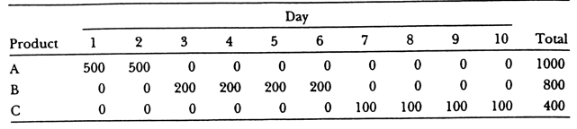
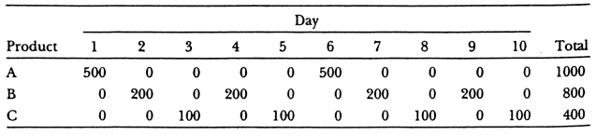
Mixed Model Production
Three products A, B, C. Production time: each 10 mins (Tp=10 mins).
Plant is working 5 days a week, 10 hours a day.
Demand at down stream station is A:3, B:2, C:1 units per hour.
The upstream station in each production run produces one week of demand: A(150), B(100), and C(50).
While the customer need it at hourly rates (either to consume or use it in production of another item) we ship it at weekly demand.
Icycle = A(75), B(50), C(25). That is 150
What if we produce AAABBC. Then the Icycle is 3. An even better model is ABACBA

Slide 27
Setup Time Reduction- Toyota Production System
Shigeo Shingo (Toyota) shortened setup times from several hours per each exchange of dies to a few minutes. He started by separating internal and external activities in a firm.
Internal activities. Those for which it is essential for machine to be down such as (i) adjusting machine speed, (ii) placing work or fixtures on machine.
  Turn sequential internal activities into parallel activities or resources.
  Convert internal activities to external activities.
External activities. Those for which it is not essential for machine to be down.
  Validating work order. Searching for tools and dies. procuring material.
  External activities should be completed prior to setup.
Standardize and practice setup routines to be perfect.
Eliminate adjustments. Smooth and simplify procedures
McLaren Applied Technologies team worked with GlaxoSmithKline to setup times in toothpaste production. Over six months changeover times dropped from 49 minutes to 15, translates into 7M more tubes of Sensodyne and Aquafresh a year

Slide 28
How to Reduce EOQ- Setup Time Reduction-
Suppose a company, with annual demand of 5000 units, and carrying cost of $10 per unit per year, wishes a cycle inventory of 200. Compute the maximum ordering cost that could make it possible.
Icycle = Q/2= EOQ/2 = 200 ➔ EOQ = 400
EOQ= SQRT(2DS/H)
400=SQRT(2*5000*S/10) ➔ 160000=10000*S/10
S=160 ➔ S<=160
Information technology can help in reduction of fixed costs. It can cut operational costs for buyers and suppliers.
Quantity Discount will reduce the purchasers’ costs. Retailers are encouraged to increase the size of their orders. Cycle inventory (and average inventory ) in the supply chain is increased. All-unit quantity discount is not an advantage in the supply chain.

Slide 29
Cycle Service Level & and Fill Rate
Ardavan Asef-Vaziri

Slide 30
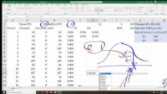

Lead Time, Re-Order Point, Cycle Service Level, and Fill Rate
Parts of the slides of this lectures were prepared over my teaching lifetime based on the material that I have learned from the following book
Ardavan Asef-Vaziri

Slide 31
Service Level vs Fill Rate-Example-1. Uniform Distribution
Order Lead Time: time from placing an order to receiving it.
Cycle Service Level (CSL): probability of fulfilling the demand.
Fill Rate (FR): proportion of the demand filled.
Suppose demand during lead time has a uniform distribution [1, 10].
Suppose you have 8 units. Compute SL and FR.
FR is always higher than SL.

Slide 32
Normal Random Number Generator

Slide 33
Service Level vs Fill Rate - Normal Distribution Demand
Demand has Normal distribution N~100, 20. Suppose you have Q units. Simulate 1000 periods. Report SL & FR for Q=140, Q=100, Q=....
Right click to open the file. Ctrl~ to see the formulas. Ctrl~ again to go back to normal view.
https://youtu.be/7RurbY9b-mY
Expected Loss= σ^2NORM.DIST(Q,μ,σ,0)-(Q-μ)*(1-NORM.DIST(Q,μ, σ,1))

Slide 34
Single Period Ordering
Underage Cost, Overage Cost, Order Quantity, Service Level, Fill Rate, Lost Sales, and Leftover
Ardavan Asef-Vaziri

Slide 35
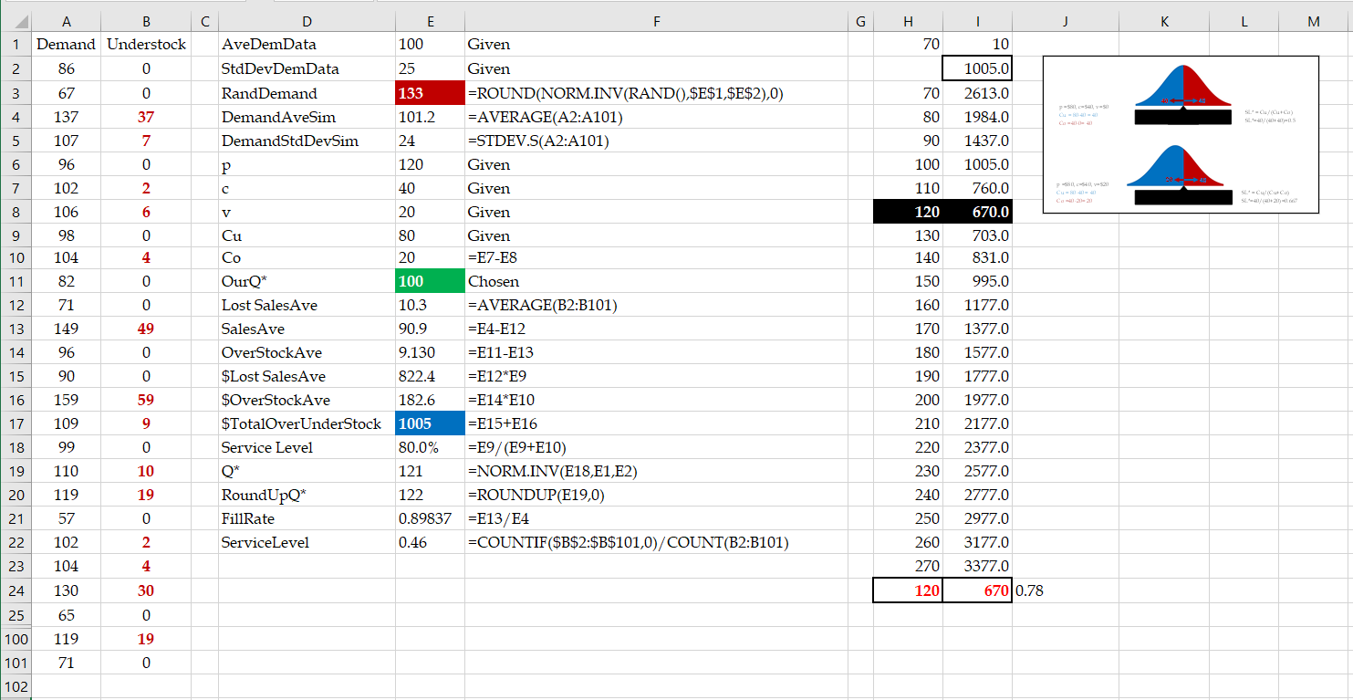
Single Period Ordering. Overage Cost, Underage Cost, and Order Quantity

Slide 36
The News Vendor Problem
Swell Productions is sponsoring an outdoor conclave for owners of collectible and classic Fords. The concession stand in the T-Bird area will sell clothing such as official Thunderbird racing jerseys. Suppose sales price is $80 per jersey, purchase cost is $40, and unsold jerseys are returned to the manufacturer for $20 per unit. Suppose the probability of jerseys sales quantities is Normally distributed with mean of 100 and standard deviation of 25. How many Jerseys Swell Production orders?
p: sale price; c: purchase cost; s: salvage value
Underage Cost: What we loose if demand is there but we do not have the product?
It depends on all costs involved. In this specific example,
Cu= p-c
Overage Cost: What we loose if we do have the product but demand is not there?
It depends on all costs involved. In this specific example,
Cu= c-v

Slide 37
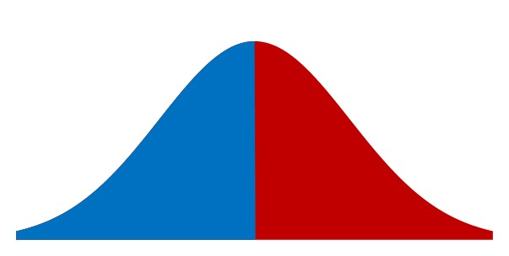
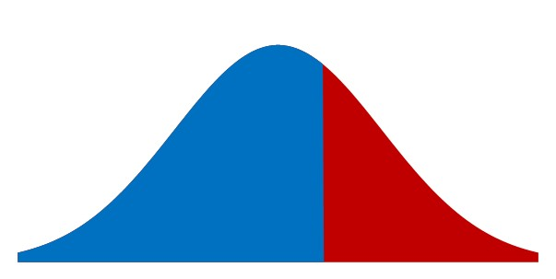
Overage Cost vs. Underage Cost
Cu: Underage Cost
Cu = 80-40 = 40
Co: Overage Cost
If Co was also 40
40
40
SL* =Blue/(Blue+Red) = Cu/(Cu+Co)
SL*= 40/(40+40) =0.5
Given a 66.67% SL
66.67% Probability
Cu: Underage Cost
Cu = 80-40 = 40
SL* =Blue/(Blue+Red)
Co: Overage Cost
Co = 40-20 = 20
20
40
Compute x

Slide 38
Optimal Service Level
CSL*: optimal cycle service level or simply optimal service level is a probability and is
SL* = Cu/(Cu+Co) = 1/(1+Co/Cu)
SL* = Cu/(Cu+Co) = P(LTD ≤ ROP)
SL* = 40/(40+20)
SL* = 2/3 = 0.67
µ: mean demand; σ: standard deviation of demand, Q*: optimal order quantity
Q= NORM.INV(SL*, µ, σ)
ROP= NORMINV(2/3,100,25) = 110.7682 ≈111
New SL = NORM.DIST(111,100,25,1) = 0.670031446

Slide 39
Example-2. Salvage Value
Demand for a product in the upcoming period is normally distributed with mean of 4000 and standard deviation of 1000.
Where is the optimal service level? How much do you order?
Sales Price = $30. Purchase cost = $10.
Salvage value (return or sell the product for this price) = $6.
Goodwill cost (present value of the long term dammage to our reputation per unit of product due to being out of stock) = $1.
LTD ~ N(4000,1000)
Overage Cost = Marginal Cost = Co = 10-6 = 4
Underage Cost = Marginal Benefit = 30-10 +1 = 21
SL*= Cu/(Cu+Co) = SL*= 21/25 = 0.84
ROP = Q = NORMINV(0.84,4000,1000) 4994.457883≈ 4995
New SL = NORM.DIST(4995,4000,1000,1) = 0.8401 ➔Risk = 15.99%

Slide 40
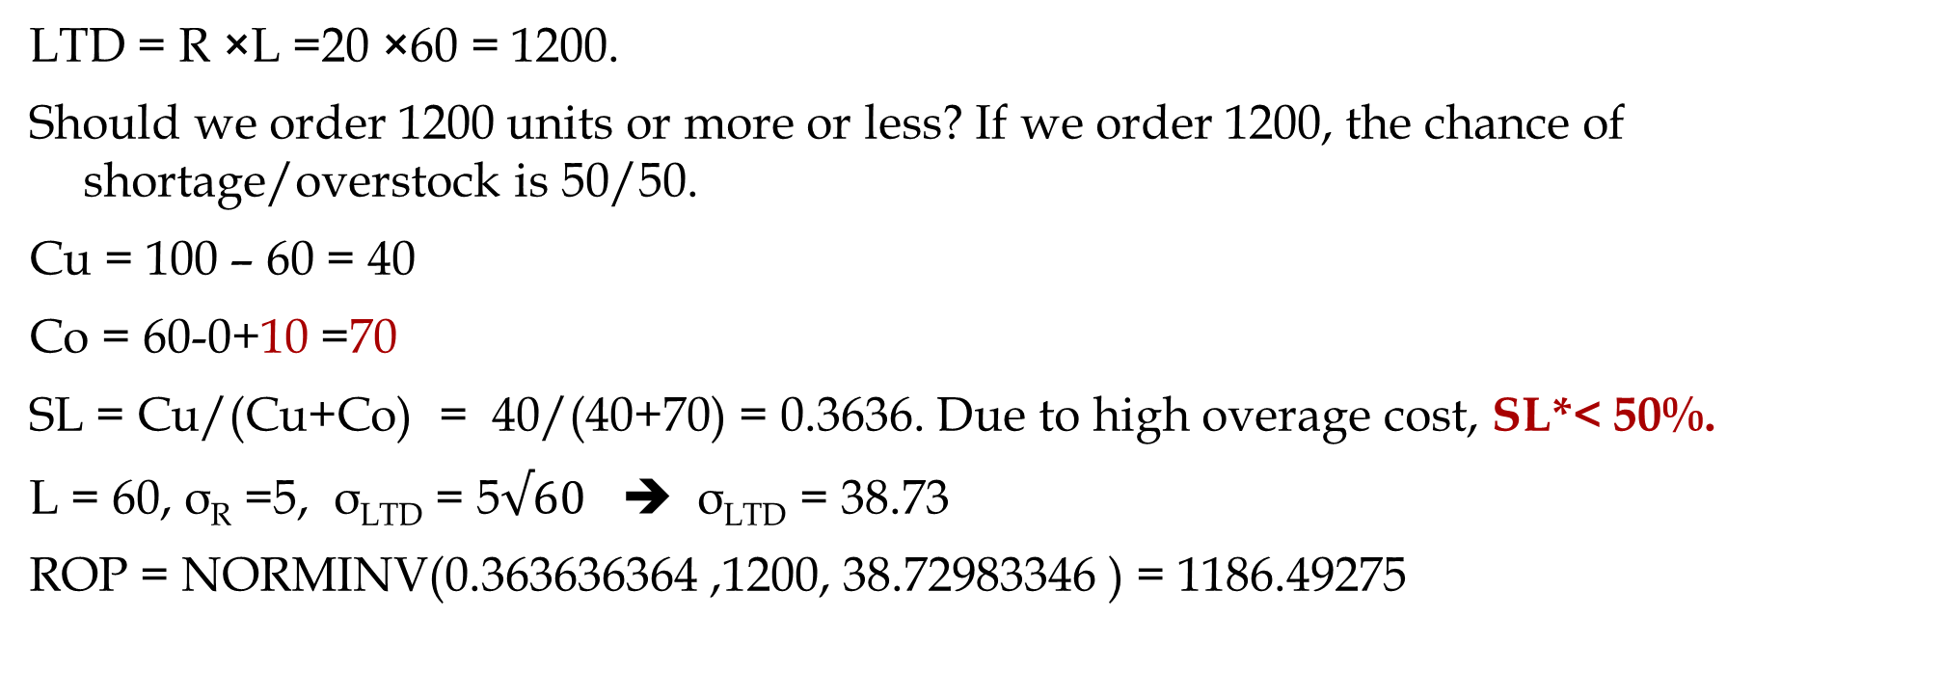
Example-3. Recycling Cost
Daily demand for your product R~N(R,σ_{R} ) = N(20, 5). Sales price is $100 per unit of product. You have decided to close this business line in 60 days. Your supplier has also decided to close the line immediately but has agreed to provide your last order at a cost of $60 per unit. Any unsold product will be disposed at cost of $10 per unit due to EPA regulations. How many units do you order
LTD = R ×L =20 ×60 = 1200.
Should we order 1200 units or more or less? If we order 1200, the chance of shortage/overstock is 50/50.
Cu = 100 – 60 = 40
Co = 60-0+10 =70
SL = Cu/(Cu+Co) = 40/(40+70) = 0.3636. Due to high overage cost, SL*< 50%.
L = 60, σ_{R} =5, σ_{LTD} = 5$√60$ ➔ σ_{LTD} = 38.73
ROP = NORMINV(0.363636364 ,1200, 38.72983346 ) = 1186.49275

Slide 41
Periodic Review Policy
Daily demand for a product has an average of R=20, and a standard deviation of σ_{R}=8 units. The review period is T= 35 days, and lead time is L= 14 days. Service level is SL*=99%.
At the beginning of the review period there are 200 units in inventory.
How many units should be ordered?
Average demand between two orders = D(T+L)=20(35+14)= 980
Standard Deviation of demand between two orders σ_{(T+L)} =SQRT(35+16)(8) =56
Z(99%)=NORM.S.INV(0.99) = 2.326348 ≈ 2.33 standard deviation added to average.
2.33(56) = 130.48 ≈ 131
Q=980+131=1111
1111/20=55.55 days of demand

Slide 42
Postponement
Ardavan Asef-Vaziri

Slide 43


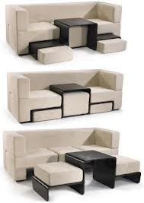

Mass Customization- Making Personalized Products on a Large Scale

Slide 44
Postponement- Delaying Differentiation As Late As Possible
Enables the use of aggregate forecasts
Reduces scrapped or obsolete inventory, increases customer service
May require new processes or product design with associated cost
Enables the delay of detailed forecasts

Slide 45


Postponement - Benetton
A world leader in knitwear
Massive volume, many stores
Many small stores with limited storage

Slide 46
Benetton - Old and New Processes
Spin or Purchase Yarn
Spin or Purchase Yarn
Dye Yarn
Manufacture Garment Parts
Finish Yarn
Join Parts
Dye Garment
This step is
postponed
Manufacture Garment Parts
Join Parts
Finish Garment

Slide 47
Postponement
Delay product differentiation or customization until closer to the time the product is sold
Have common components in the supply chain for most of the push phase
Move product differentiation as close to the pull phase of the supply chain as possible
Inventories in the supply chain are mostly aggregate

Slide 48


Example of postponement implementation
Demand Product | 100 | 200
 | 50% | 50%
 | 50% | 50%
Produce 150 of each color ahead of time
Produce 300 which can be dyed after demand is observed

Slide 49
Value of Postponement
100 different paint colors, R = 30/week, σ_{R} = 10, L = 2 weeks, CSL = 0.95
Average Demand During Lead time = LTD= 2*30=60
Standard deviation of demand during Lead time =StdDevLTD= σ_{LTD} = SQRT(L)* σ_{R} = SQRT(2)*10= 14.14
ROP =NORM.INV(0.95,60,14.14) = 83.25823
Isafety-One= 83.26-60=23.26
IsafetyAll= 100*23.26= 2326
Average 100 Products in two weeks = 100*30*2= 6000
StdDev 100 Products = SQRT(100)*10=100
StdDev 100 Products in two weeks = SQRT(2)*100=141.4
ROP-100 products =NORM.INV(0.95,6000,141.4) = 6233
Isafety-One=6233-6000-233
233 vs 2326

Slide 50




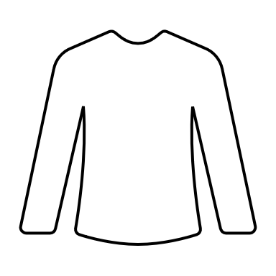
Postponement
Four shirts, the same design, different color. Demand N~(100,25).
If we dye them first and prefer to have a 95.45% service level,
how much safety stock do we need?
Q for one color =NORM.INV(0.95,100,25) = 141.1213407
Isafety for one color = 141.1213407 -100 = 41.1213407
Isafety for one colors =4(41.1213407) = 164.4853628
What if we have a high-speed dyeing machine and could postpone dyeing the uncolored fabric to when the demand comes with the same service level?
Average Demand for all colors = 4(100) =400
Standard Deviation of Demand for all colors = SQRT(4)(25) =50
=NORM.INV(0.95,400,50) = 482.2426813 ➔ Isafety 482.2426813-400
Isafety = 82. 2426813 that is
82. 2426813/ 164.4853628 or 50% improvement

Slide 51

Postponement

Slide 52


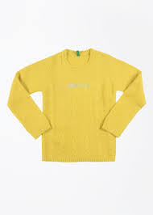

What is the impact of process postponement on Benetton’s profits? Suppose that manufacturing process takes 20 weeks, and that demands are normally distributed.
 | Option 1 – no postponement | Option 2 – with postponement
Cost c | 20 | 22
Retail price p | 50 | 50
Clearance price s | 10 | 10
Product | Mean demand | St. deviation
 | 1,000 | 500
 | 1,000 | 500
 | 1,000 | 500
 | 1,000 | 500

Slide 53
Postponement helps firm to increase profits and better match supply and demand if it produces a large variety of products whose demand is not positively correlated and is of similar size.
Product | Mean demand | St. deviation
 | 3,100 | 800
 | 300 | 200
 | 300 | 200
 | 300 | 200

Slide 54
Postponement
Ardavan Asef-Vaziri

Slide 55
Postponement
The larger the ratio of the larger to smaller number, the higher the saving in Safety Inventory
Npw Suppose we have 100% right information about the market in the second phase and fullfill the orders to precision as lond as we are not out of stock

Slide 56
Simulation

Slide 57
Simulation

Slide 58
Lower Safety Inventory & Higher Fill Rate

Slide 59
Excel Computations

Slide 61
Inventory Management
Uncertainty
DSO 581

Slide 62
How do we control inventory of long life cycle products? We study models generally applicable for ordering by retailer or distributor or warehouse of finished goods.
 | Continuous review or (r, Q) policy | Periodic review policy
Inventory monitoring | Continuous | Regular intervals
When to order | When inventory position (current inventory + on-order) drops below order point r | Regular intervals Review interval may be based on EOQ or other criteria
How much to order | Always Q | Order quantity based on inventory position (current inventory + on-order) and order-up-to-level

Slide 63
Continuous review models – (r,Q)

Slide 64
Continuous review inventory model-how do they look?
Number of units on hand
Q
r
dL
SS
Range of Demand
Stockout
L
Time

Slide 65
Periodic review policy

Slide 66
Periodic review or fixed time period policies imply that orders are placed and received at regular intervals
Periodic review system easier to administer, especially when we order multiple items from a single source
In periodic review systems, there is no “order or reorder point” since orders are placed at regular intervals independent of the inventory levels
Periodic review policies followed in many real situations
Features

Slide 67
Periodic Review Inventory Model
OUL
Inventory on hand (in units)
Safety stock
L
L
L
Place order
T
T
T
Time
Stock out

Slide 68


How do we make decisions in periodic review models? We first introduce some notation
Order quantity (q)
Safety stock (ss)
σ_{LTD} is the standard deviation of demand during the lead time plus the review interval
σ_{LTD} = . if the lead time is variable
Order-up-to-level- Inventory position
OUL-I
We need to calculate OUL
function of the safety factor (z) and σ_{LTD} .
σ_{LTD} = . if the lead time is fixed and
$$σ_{R}\sqrt{(L+T)}$$
$$\sqrt{σ_{R}^{2}(L+T)+R^{2}σ_{L}^{2}}$$

Slide 69
How do we make decisions in periodic review models? We now calculate OUL and q
Order-up-to-level
Order quantity
OUL = R(T+L) + Safety stock
Q = R(T+L) + zσ_{LTD} - I

Slide 70
Example – Decisions for periodic review policy
Daily demand for a product is 20 units. The review period is 30 days, and lead time is 16 days. Management has set a service level of 1% stockout probability.
At the beginning of the review period there are 200 units in inventory. The daily demand standard deviation is 7.
How many units should be ordered?
Notes:
21

Slide 71
Solution
CSL= 0.99;
Using Excel, z = NORMSINV(0.99) = 2.326
Order quantity q = d(T+L) + z σ_{LTD} - I
Order quantity q = 20(30+16) + 2.326*47.5 - 200 ≈ 830 -> 41.5 days of demand
Average inventory carried = ?
Notes:
22

Slide 72
Example with fill rate
In above example, what if performance measure is fill rate of 99%?
Using the formula for z or table, given fill rate FR and coefficient of variation, z = 0.5
Order quantity q = d(T+L) + z σ_{LTD} - I
Order quantity q = 20(30+16) + 0.5*47.5 - 200 ≈ 744 -> 37 days of demand
Average inventory carried?
Notes:
22

Slide 73
Applications of inventory models in practice

Slide 74
Practical issues in using the models
Is the assumption of normal distribution valid? Alternatives?
What about “C” items with sporadic demand?
How does one deal with seasonality in demand? End-of-month demand spikes?

Slide 75
How do we estimate the values of parameters used in the models:
Fixed ordering/setup costs
Inventory holding costs
Shortage or stockout costs per unit
What are the elements of fixed costs?
How can they change?
“Inventory driven cost”
What constitutes holding costs?
How much does it hurt us when the customer does not find the desired unit?
Does this always imply lost sales?

Slide 76
Important issues for long-term inventory reduction
Measure lead times - average and variability
If lead times are long and/or variable, what factors are responsible?
Measure variability in demand and supply
If there is considerable variability in demand and supply, what are the root causes?
What determines order frequency or order quantity?
ERP
EOQ
Rule of thumb

Slide 77
Impact of inventory centralization on Safety stock

Slide 78
N locations, at each location identical mean demand d, normally distributed with standard deviation σ, lead time L=1, continuous review
Each location has safety stock σz
Total safety stock Nσz
If inventory is centralized, standard deviation at the centralized warehouse is
Total safety stock

Slide 79
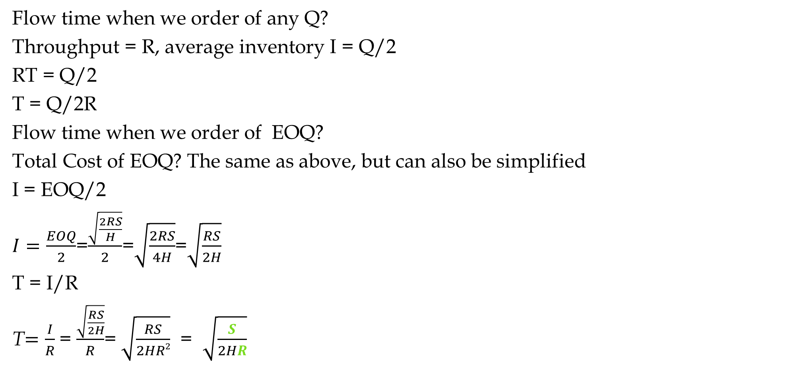
Formula Proof for Flow Time Under EOQ
Flow time when we order of any Q?
Throughput = R, average inventory I = Q/2
RT = Q/2
T = Q/2R
Flow time when we order of EOQ?
Total Cost of EOQ? The same as above, but can also be simplified
I = EOQ/2
$I=\frac{EOQ}{2}$=$\frac{\sqrt{\frac{2RS}{H}}}{2}$=$\sqrt{\frac{2RS}{4H}}$=$\sqrt{\frac{RS}{2H}}$
T = I/R
T$=\frac{I}{R}$ = $\frac{\sqrt{\frac{RS}{2H}}}{R}$= $\sqrt{\frac{RS}{2HR2}}$ = $\sqrt{\frac{S}{2HR}}$

Slide 80

Formula Proof for Total Cost of EOQ
Total cost of any Q?
TC_{Q} = SR/Q + HQ/2
Total Cost of EOQ? The same as above, but can also be simplified
${TC}_{EOQ}=\frac{SR}{\sqrt{\frac{2RS}{H}}}$ +$\frac{H\sqrt{\frac{2RS}{H}}}{2}$ =
${TC}_{EOQ}=2\frac{H\sqrt{\frac{2RS}{H}}}{2}$=$H\sqrt{\frac{2RS}{H}}$=$\sqrt{\frac{H^{2}2RS}{H}}$=$\sqrt{2RSH}$
${TC}_{EOQ}$=$\sqrt{2RSH}$

Slide 81
Plaining for a Coming Period
Marketing’s forecast for sales is 3200 units.

Slide 82
The Newsvendor Problem
Characteristics of Newsvendor problem:
Making a Single Decision on quantity Q to sell in selling period
The demand during the selling period is not certain.
The decision must be made before the actual demand is observed.
Once the decision is made, it cannot be changed.
Both leftover inventory and shortage are costly
The goal is to find the optimal quantity Q* that maximizes the expected profit.
Applications?
Perishable Product (e.g., food, flowers), Seasonal products (Christmas trees, seasonal clothing), Revenue Management (Airlines and hotels), Capacity Investment, …

Slide 83
What is a demand model?
A demand model specifies what demand outcomes are possible and the probability of these outcomes.
Traditional distributions from statistics can be used as demand models:
  e.g., the Normal, Gamma, Poisson distributions

Slide 84
The density function tells you the probability of a particular outcome occurring.
  e.g. the probability demand will be exactly 5 units.
The distribution function tells you the probability the outcome will be a particular value or smaller.
  e.g. the probability demand will be 5 or fewer units.
Both can be used to describe a demand model, but we will most often work with distribution functions.
Density functions can take all kinds of shapes (they don’t always have to look like a bell curve).
Distribution functions always start low and increase towards 1.0

Slide 85
Density & Distribution Function
f(x) vs F(x)
NORM.DIST(x,mean,stddev,0) vs NORM.DIST(x,mean,stddev,1)
ϕ (x) vs φ(x)

Slide 86
Solution
CSL= 0.99;
Using Excel, z = NORMSINV(0.99) = 2.326
Order quantity q = d(T+L) + z σ_{LTD} - I
Order quantity q = 20(30+16) + 2.326*47.5 - 200 ≈ 830 -> 41.5 days of demand
Average inventory carried = ?
Notes:
22

Slide 87
Example with fill rate
In above example, what if performance measure is fill rate of 99%?
Using the formula for z or table, given fill rate FR and coefficient of variation, z = 0.5
Order quantity q = d(T+L) + z σ_{LTD} - I
Order quantity q = 20(30+16) + 0.5*47.5 - 200 ≈ 744 -> 37 days of demand
Average inventory carried?
Notes:
22

Slide 88
Service Level vs Fill Rate

Slide 89
What fill rate (FR) can you achieve with your current safety stock?
Good approximation formula for determining item fill rate given:
z value
mean demand μ and standard deviation σ
demand distribution is normal
provided z > 0 or desired fill rate > 50%,
used to calculate coefficient of variation cv= σ/μ

Slide 90
How does demand variability impact service level?
CSL and fill rate (FR(z,cv)) for different scenarios
For CSL=90% and cv=0.1, FR=99.5%; when cv=0.5, FR=97.5%; when cv=5, FR=76%

Slide 91
Using the earlier equation and working backwards, we can determine the safety stock necessary for achieving a desired fill rate,
z can be obtained by solving a quadratic equation in z
We first need to find cv!

Slide 92
Example: Let us consider the same setting as before except that the service level requirement now is fill rate of 99%.
Optimal order quantity = 600
Given desired fill rate of 99%, the desired z is
where FR = 0.99, μ = 320, σ = 16 for lead time demand.
r = d*L + z*σ_{LTD} = 20*16 + 0.5*16 ≈ 328 -> 16.5 days of demand
Safety stock = 0.5*16 ≈ 8 -> ½ day of demand
σ_{LTD} = σ_{d}*√L = 4* √16 = 16
Notes:
21

Slide 93
How does the desired service level impact the required inventory level?
6
5
Based on
67% forecast accuracy
30 day replenishment lead-time
no supply uncertainty
4
3
Safety Stock (Weeks)
2
1
0
88%
90%
92%
94%
96%
98%
100%
Based on
67% forecast accuracy
30 day replenishment LT
no supply uncertainty
Fill rate (up to 99.99%)

Slide 95
Expected Loss, Expected Sales & Expected Leftover

Slide 96
Expected Loss, Expected Sales & Expected Leftover

Slide 97
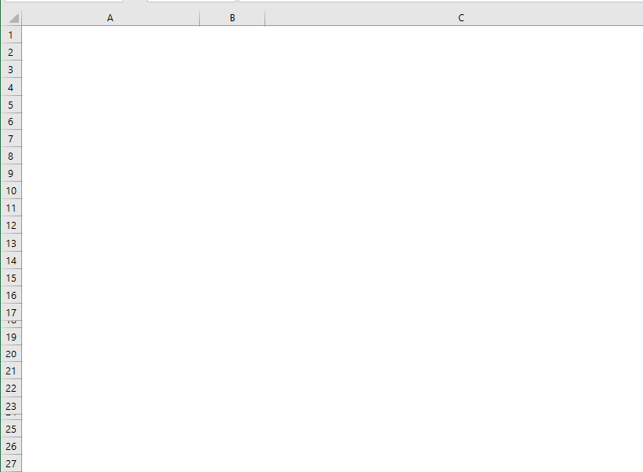
More Metrics- Excel Implementation

Slide 98
Fill Rate Always Exceeds Service Level

Slide 99
Service Level vs Fill Rate

Slide 100
Customer Service level –csl vs. fill rate

Slide 101
How to evaluate our customer service level?
Which measure to select?
Does it measure what we really want?
How does it impact inventory?
How do we set target customer service levels?
Fill rate
Pros: More directly related to a measure of shipped quantity relative to demand.
Cons: It is more complicated to implement a safety stock calculation.
Did we consider product substitution?

Slide 102
Safety stock level for different cv, CSL and FR (µ = 100, L=1)
cv | 98% |  | 99% |  | 99.9%
 | CSL | FR | CSL | FR | CSL | FR
0.10 | 20.5 | 6 | 23.3 | 10 | 30.9 | 20
0.25 | 51.3 | 26 | 58.2 | 34 | 77.3 | 57
0.50 | 102.7 | 68 | 116.3 | 83 | 154.5 | 126
1.00 | 205.4 | 166 | 232.6 | 194 | 309.0 | 273
5.00 | 1027.0 | 1134 | 1163.0 | 1252 | 1545.0 | 1600
99% fill rate is typically equivalent to 90%-95% CSL (for cv up to 0.3).
99% CSL is estimated at 99.985% fill rate (for cv=0.2) .
This may not seem a lot different, but it increases safety stock by 50%.

