Slide 1
Inventory Basic Model
How can it be that mathematics, being after all a product of human thought which is independent of experience, is so admirably appropriate to the objects of reality?
Albert Einstein
You may watch the following Less-Excel-Oriented Lecture First
https://www.csun.edu/~aa2035/CourseBase/Inventory/Inventory.ToShare/Ch12a.html
On the page that appears- click on the purple part then Allow Adobe Flash to RUN
You may start from minute 12.
Ardavan Asef-Vaziri
Systems and Operations Management
David Nazarian College of Business and Economics
California State University, Northridge
March 2020

Slide 2
Teams and Clusters- In this Course and In Future
This Semester
Next Semester

Slide 3
Problem 1: Optimal Policy
In our EOQ (Economic Order Quantity) models, R and D are used interchangeable.
D is demand, R is throughput.
We assume R=D ➔ Everything produced is sold.
A toy manufacturer uses 32000 silicon chips annually. The Chips are used at a steady rate during the 240 days a year that the plant operates. Holding cost is 60 cents per unit per year. Ordering cost is $24 per order.
a) How much should we order each time to minimize our total costs (total ordering and carrying costs)?
D = 32000, H = $0.6 per unit per year , S = $24 per order
Ordering Quantity = Q
# of orders = D/Q = 32000/Q
Cost of each order = S = $24
OC = 24*32000/Q
Recorded Lecture is on Page 13

Slide 4
Problem 1: Optimal Policy-Excel

Slide 5
Number of Orders & Ordering Cost

Slide 6
Average Inventory & Carrying Cost
At the start of cycle we have Q, at the end of the cycle we have 0.
Average inventory = (Q+0)/2 = Q/2
Q/2 is also called cycle inventory.
Quantity
In each cycle we have Q/2 inventory.
In all cycles we have Q/2 inventory.
Throughout the year we have Q/2 inventory.
Cost of carrying (holding) one unit of inventory for one year = H
Total Holding Costs (Total Carrying Costs) = CC = HQ/2
Time

Slide 7
EOQ: Minimized Total Cost When OC=CC

Slide 8
Economic Order Quantity
At EOQ (Economic Order Quantity, OC=CC
SD/Q = HQ/2
24(32000)/Q= 0.6Q/2
Q²= 2560000
Q = 1600
SD/Q = HQ/2
Q² = 2DS/H
That is one way to compute EOQ and not to memorize it.

Slide 9
Number of Orders & Length of Ordering Cycle
b) How many times should we order ?
  R=D = 32000 per year, EOQ = 1600 each time
  # of times that we order = D/EOQ
  D/Q = 32000/1600 = 20 times.
c) What is the length of an order cycle ?
We order 20 times.
Working days = 240/year
240/20 = 12 days.
Alternatively
32000 is required for one year (240 days)
Each day we need 32000/240 = 133.333
1600 is enough for how long?
(1600/133.33) = 12 day

Slide 10
Ordering, Carrying, and Total Cost
d) Compute the total ordering cost and total cost.
Ordering Cost = 24(32000/1600) = 24(20) = $480
e) Compute the average inventory
Average inventory = (Q+0)/2 = 1600/2 =800
f) Compute the total carrying cost.
We have Q/2 throughout the year
Inventory carrying costs = average inventory (Q/2) multiplied by cost of carrying one unit of inventory for one year (H)
Carrying Cost = H(Q/2) = 0.6(1600/2) = $480
g) Compute the total cost.
Total Cost = Ordering cost + Carrying cost
Total cost = $480+$480 = $960

Slide 11
Cycle Inventory, Average Inventory, Flow Time
g) Compute the flow time ?
Demand = 32000 per year
Therefore throughput = 32000 per year
Maximum inventory = EOQ = 1600
Average inventory = Cycle Inventory = 1600/2 = 800
Cycle inventory is always defined as Max Inventory divided by 2.
Cycle inventory = Q/2
If there is no safety stock
Average inventory is the same as Cycle inventory = Q/2.
If there is safety stock- We will discuss it in ROP lecture
Average inventory = Cycle Inventory +Safety Stock = Q/2 +Is

Slide 12
Flow Time & Inventory Turns
RT=I ➔ 32000T=800
T=800/32000=1/40 year
Year = 240 days
T=240(1/40)= 6 days
Alternatively, the length of an order cycle is 12 days. The first item of an order spends 0 days, the last item spends 12 days.
On average they spend (0+12)/2 = 6 days
h) Compute inventory turns.
Inventory turn = Demand divided by average inventory.
Average inventory = I = Q/2
Inventory turns = D/(Q/2)= 32000/(1600/2)
Inventory turns = 40 times per year.
RT=I ➔ T=I/R = I/D
➔ InvTurns = 1/T
InvTurns = D/I = R/I

Slide 13
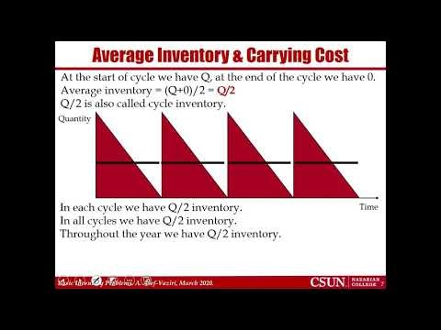
Flow Time & Inventory Turns
https://youtu.be/mR9H30WvRlA

Slide 14
Problem 2: A Policy vs. The Optimal Policy
Victor sells a line of upscale evening dresses in his boutique. He charges $300 per dress, and sells average 30 dresses per week. Currently, Vector orders 10 week supply at a time from the manufacturer. Assume 50 weeks per year. Victor estimates his administrative cost of placing each order at $225. He pays $150 per dress. His inventory carrying cost including cost of capital, storage, and obsolescence is 20% of the purchasing cost.

Slide 15
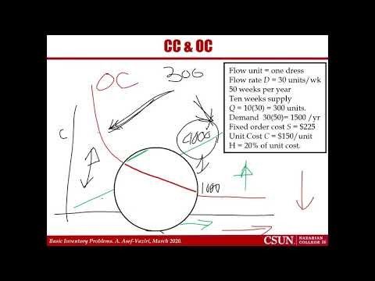
Problem 2: Recorded Lecture
https://youtu.be/TIFdDIgOgyI

Slide 16
CC & OC
a) Compute the total ordering cost and carrying cost under the current ordering policy?
Number of orders/yr = D/Q = 1500/300
= 5
(D/Q) S = 5(225) = 1,125/yr.
Average inventory = Q/2 = 300/2 = 150
H = 0.2(150) = 30
Flow unit = one dress
Flow rate D = 30 units/wk
50 weeks per year
Ten weeks supply
Q = 10(30) = 300 units.
Demand 30(50)= 1500 /yr
Fixed order cost S = $225
Unit Cost C = $150/unit
H = 20% of unit cost.
Annual holding cost = H(Q/2) = 30(150) = 4,500 /yr.
Total annual costs = 1125+4500 = 5625
b) Without any further computation, is EOQ larger than 300 or smaller? Why?

Slide 17
Flow Time
c) Compute the flow time.
Average inventory = cycle inventory = I = Q/2
Average inventory = 300/2 = 150
Throughput? R?
R= D, D= 30/week
Current flow time
RT= I
30T= 150 ➔ T= 5 weeks
Did we really need this computations?
Cycle is 10 weeks (each time we order demand of 10 weeks).
The first item is there for 0 week.
The last item is there for 10 weeks.
On average (10+0)/2 = 5 weeks.

Slide 18
Inventory Turns and Flow Time
d) What is average inventory and inventory turns under this policy ?
Inventory turn = Demand divided by average inventory.
I = Q/2
Inventory turns = D/(Q/2)= 1500/(300/2) = 10 times
InvTurn = R/I
T=I/R
InvTurn = 1/T
We already computed T
T = 5 weeks ➔ Turn = 1/T= 1/5 ????
Is InvTurn 10 or 1/5
Have we made a mistake?
InvTurn = 1/5 per week, year = 50 weeks
InvTurn =(1/5)(50) = 10
=

Slide 19
Optimal Policy vs. Current Policy
e) Compute Victor’s total annual cost of inventory system (carrying plus ordering but excluding purchasing) under the optimal ordering policy?
Q* = EOQ =
= 150 units.
The total optimal annual cost will be
225(1500/150) + 30(150/2) = 2250 + 2250 = $4,500
Compared to 5,625, there is about 20% reduction in the total costs.
Total cost here is equal to carrying cost there.

Slide 20
How to Reduce Inventory
To reduce EOQ we may ↓R, ↓ S, ↑H
Two ways to reduce average inventory
- Reduce S
- Centralize
S does not increase in proportion of Q
EOQ increases as the square route of demand.
- Commonality, modularization and standardization is another type of Centralization
- Postponement, Delayed Differentiation

Slide 21
S, H and R in the Game
60 kits in a product @ $10 / kit
Input Material Cost = $600
Interest rate about 10%
H = 10%(600) = $60/year
50 days + 7*24 days + 50 days = 268 days
What is R? What is H?
Estimate Average R for year, or for 268 days, or for month, or for day
R /day ➔ H/365 = 60/365 = 16.5 cents/day
R /month ➔ H/12 = 60/12 = $5/month
R/268 day ➔ 268H/365 =

Slide 22
R for One Month and H/12
Estimate the demand for the next month.
Use H/12
S is given in the problem. Perhaps $1000 per order.
Find EOQ
Find Cycle
Estimate the demand for the cycle
Adjust H
Find the modified EOQ

