Slide 1

Inventory Basic Model
How can it be that mathematics, being after all a product of human thought which is independent of experience, is so admirably appropriate to the objects of reality? Albert Einstein

Slide 2
Problem 1: Optimal Policy
In our EOQ models, R and D are used interchangeable.
D is demand, R is throughput.
We assume R=D ➔ Everything produced is sold.
A toy manufacturer uses 32000 silicon chips annually. The Chips are used at a steady rate during the 240 days a year that the plant operates. Holding cost is 60 cents per unit per year. Ordering cost is $24 per order.
a) How much should we order each time to minimize our total costs (total ordering and carrying costs)?
D = 32000, H = $0.6 per unit per year , S = $24 per order
Ordering Quantity = Q
# of orders = D/Q = 32000/Q
Cost of each order = S = $24
OC = 24*32000/Q

Slide 3
Problem 1: EOQ

Slide 4
Problem 1
Cost of carrying one unit of inventory for one year = H
Average Inventory
At the start of cycle we have Q, at the end of the cycle we have 0.
Average inventory = (Q+0)/2 = Q/2
Q/2 is also called cycle inventory.
In each cycle we have Q/2 inventory.
In all cycles we have Q/2 inventory.
Throughout the year we have Q/2 inventory.
CC = HQ/2
Time

Slide 5
Problem 1: Optimal Policy
Cost of carrying one unit of inventory for one year = H
At EOQ (Economic Order Quantity, OC=CC
OC = CC
SD/Q = HQ/2
24(32000)/Q= 0.6Q/2
Q²= 2560000
Q = 1600
Q² = 2DS/H

Slide 6
Problem 1
b) How many times should we order ?
  D = 32000 per year, EOQ = 1600 each time
  # of times that we order = D/EOQ
  D/Q = 32000/1600 = 20 times.
c) What is the length of an order cycle ?
We order 20 times.
Working days = 240/year
240/20 = 12 days.
Alternatively
32000 is required for one year (240 days)
Each day we need 32000/240 = 133.333
1600 is enough for how long?
(1600/133.33) = 12 day

Slide 7
Problem 1
d) Compute the average inventory
At the start of cycle we have Q, at the end of the cycle we have 0.
Average inventory = (Q+0)/2 = Q/2
Q/2 is also called cycle inventory.
Time
In each cycle we have Q/2 inventory.
In all cycles we have Q/2 inventory.
Throughout the year we have Q/2 inventory.

Slide 8
Problem 1
d) Compute the average inventory
Average inventory = (Q+0)/2 = 1600/2 =800
e) Compute the total carrying cost.
We have Q/2 throughout the year
Inventory carrying costs = average inventory (Q/2) multiplied by cost of carrying one unit of inventory for one year (H)
Total Annual Carrying Cost = H(Q/2) = 0.6(1600/2) = $480
f) Compute the total ordering cost and total cost.
Ordering Cost = 24(32000/1600) = 24(20) = $480
Carrying Cost = H(Q/2) = 0.6(1600/2) = $480
Total Cost = Ordering cost + Carrying cost
Total cost = $480+$480 = $960

Slide 9
Problem 1
Note that at EOQ total carrying costs is equal to total ordering costs.
HQ/2 = SD/Q
HQ²=2DS
If we solve this equation for Q we will have
Q²=2DS/H
That is one way to compute EOQ and not to memorize it.

Slide 10
Problem 1
g) Compute the flow time ?
Demand = 32000 per year
Therefore throughput = 32000 per year
Maximum inventory = EOQ = 1600
Average inventory = 1600/2 = 800
RT=I ➔ 32000T=800
T=800/32000=1/40 year
Year = 240 days
T=240(1/40)= 6 days
Alternatively, the length of an order cycle is 12 days. The first item of an order when received spends 0 days, the last item spends 12 days.
On average they spend (0+12)/2 = 6 days

Slide 11
Problem 1
h) Compute inventory turns.
Inventory turn = Demand divided by average inventory.
Average inventory = I = Q/2
Inventory turns = D/(Q/2)= 32000/(1600/2)
Inventory turns = 40 times per year.
Notes:
Cycle inventory is always defined as Max Inventory divided by 2.
Cycle inventory = Q/2
If there is no safety stock
Average inventory is the same as Cycle inventory = Q/2.
If there is safety stock- We will discuss it in ROP lecture
Average inventory = Cycle Inventory +Safety Stock = Q/2 +Is

Slide 12
Problem 2: Other Policies vs. Optimal Policy
Victor sells a line of upscale evening dresses in his boutique. He charges $300 per dress, and sells average 30 dresses per week. Currently, Vector orders 10 week supply at a time from the manufacturer. He pays $150 per dress, and it takes two weeks to receive each delivery. Victor estimates his administrative cost of placing each order at $225. His inventory carrying cost including cost of capital, storage, and obsolescence is 20% of the purchasing cost. Assume 50 weeks per year.

Slide 13
Problem 2
a) Compute the total ordering cost and carrying cost under the current ordering policy?
Number of orders/yr = D/Q = 1500/300
= 5
(D/Q) S = 5(225) = 1,125/yr.
Average inventory = Q/2 = 300/2 = 150
H = 0.2(150) = 30
Flow unit = one dress
Flow rate D = 30 units/wk
50 weeks per year
Ten weeks supply
Q = 10(30) = 300 units.
Demand 30(50)= 1500 /yr
Fixed order cost S = $225
Unit Cost C = $150/unit
H = 20% of unit cost.
Lead time L = 2 wees
Annual holding cost = H(Q/2) = 30(150) = 4,500 /yr.
Total annual costs = 1125+4500 = 5625
b) Without any further computation, is EOQ larger than 300 or smaller? Why?

Slide 14
Problem 2
c) Compute the flow time.
Average inventory = cycle inventory = I = Q/2
Average inventory = 300/2 = 150
Throughput? R?
R= D, D= 30/week
Current flow time
RT= I
30T= 150 ➔ T= 5 weeks
Did we really need this computations?
Cycle is 10 weeks (each time we order demand of 10 weeks).
The first item is there for 0 week.
The last item is there for 10 weeks.
On average (10+0)/2 = 5 weeks.

Slide 15
Problem 2
d) What is average inventory and inventory turns under this policy ?
Inventory turn = Demand divided by average inventory.
I = Q/2
Inventory turns = D/(Q/2)= 1500/(300/2) = 10 times
InvTurn = R/I
T=I/R
InvTurn = 1/T
We already computed T
T = 5 weeksTurn = 1/T= 1/5 ????
Is InvTurn 10 or 1/5
Have we made a mistake?
InvTurn = 1/5 per week, year = 50 weeks
InvTurn =(1/5)(50) = 10
=

Slide 16
Problem 2
e) Compute Victor’s total annual cost of inventory system (carrying plus ordering but excluding purchasing) under the optimal ordering policy?
Q* = EOQ =
= 150 units.
The total optimal annual cost will be
225(1500/150) + 30(150/2) = 2250 + 2250 = $4,500
Compared to 5,625, there is about 20% reduction in the total costs.
Total cost here is equal to carrying cost there.

Slide 17
Problem 2
f) When do you order (re-order point) ?
An order for 150 units two weeks before he expects to run out.
That is, whenever current inventory drops to 30 units/wk * 2 wks = 60 units. Which is the re-order point.
When to order? When inventory on hand is 60.
How much to order? 150.
R and Q Strategy.

Slide 18
Problem 3; Centralization vs. Decentralization
Central Electric (CE) serves its European customers through a distribution network that consisted of four warehouses, in Poland, Italy, France, and Germany. The network of warehouses was built on the premise that it will allow CE to be close to the customer. Contrary to expectations, establishing the distribution network led to an inventory crisis. CE is considering to consolidate the regional warehouses into a single master warehouse in Austria. The following data is for the sake of analysis of this problem - not real world data. Currently, each warehouse manages its ordering independently. Demand at each outlet averages 800 units per day. Assume a year is 250 days. Each unit of product costs $200, and CE has a holding cost of 20% per annum. The fixed cost of each order (administrative plus transportation) is $900 for the decentralized system and $2025 for the centralized system.

Slide 19
Problem 3; Centralization vs. Decentralization
Decentralized: Four warehouses in Poland, Italy, France, and Germany
Centralized: One warehouse in Austria
The holding cost will be the same in both decentralized and centralized ordering systems.
H(decentralized) =20%(200) = $40 per unit per yr.
H(centralized) = $40 per unit per yr.
The ordering cost in the centralized ordering system is $2025.
S(decentralized) = $900 per order.
S(centralized) >> $900 = $2025 per unit per yr. The problem assumes this. It is also realistic, when we deliver centrally, S goes up since the truck travel time in a route to 4 warehouses is longer than a trip to a single warehouse.

Slide 20
Problem 3
Compute EOQ and cycle inventory in decentralized ordering
Four outlets
Each outlet demand
D = 800(250) = 200,000
S= 900
C = 200
H = 0.2(200) = 40
If all warehouses merged into a single warehouse, then S= 2025
=3000
With a cycle inventory of 1500 units for each warehouse.
The total cycle inventory across all four outlets equals 6000.
b) Compute EOQ and cycle inventory in the centralized ordering
In this problem, in the centralized system, S = $2025.
=9000
and a cycle inventory of 4500.

Slide 21
Problem 3
c) Compute the total annual holding cost + ordering cost (not including purchasing cost) for both policies
TC = S(D/Q) + H(Q/2)
Decentralized
TC= 900(200000/3000) + 40(3000/2)
TC = 60000+60000= 120000
Decentralized: TC for all 4 warehouses = 4(120000)=480000
Centralized
TC= 2025(800000/9000) + 40(9000/2)
TC= 180000+180000 = 360000
480000 ➔ 360000; about 25% improvement in the total costs

Slide 22
Problem 3
d) Compute the ordering interval in decentralized and centralized systems.
Decentralized = (3000/200000)(250) = 3.75 days
Centralized = (9000/800000)(250) = 2.821 days
e) Compute the average flow time
3.75/2 = 1.875 days
2.821/2 = 1.41 days
RT = I ➔ T= R/I
200000T= 1500 ➔ T = 1500/200000 year or 1.875 days
800000T= 4500 ➔ T = 4500/800000 year or 1.41 days
The same computations

Slide 23
Problem 3: Inventory Turns
f) Compute inventory turns
Inventory Turns = Demand /Average inventory = R/I = InvTurn
Demand Average inventory Inventory Turns
200000 1500 200000/1500 = 133.33
800000 4500 800000/4500 = 177.78
g) If the lead time is 2 days, when do you order? (re-order point)?
Decentralized 2(800) = 1600 units
Centralized = 2(4)(800) = 6400 units

Slide 24
Why We are interested in reducing inventory.
Inventory adversely affects all competing edges (P/Q/V/T)
Has cost
  Physical carrying costs
  Financial costs
Has risk of obsolescence
  Due to market changes
  Due to technology changes
Leads to poor quality
  Feedback loop is long
Hides problems
  Unreliable suppliers, machine breakdowns, long changeover times, too much scrap.
Causes long flow time, not-uniform operations

Slide 25
How to Reduce EOQ
To reduce EOQ we may ↓R, ↓ S, ↑H
Two ways to reduce average inventory
- Reduce S
- Postponement, Delayed Differentiation
- Centralize
S does not increase in proportion of Q
EOQ increases as the square route of demand.
- Commonality, modularization and standardization is another type of Centralization

Slide 26
Why not Always Centralized
If centralization reduces inventory, why doesn’t everybody do it?
  Higher shipping cost
  Longer response time
  Less understanding of customer needs
  Less understanding of cultural, linguistics, and regulatory barriers
These disadvantages my reduce the demand.

Slide 27
Multiple Choice
1. Vector sells a line of upscale evening dresses in his boutique. He orders 500 units at a time. Under this policy, his total ordering cost is $3000 per year, and his total carrying cost is $4000 per year. Vector’s EOQ is
  A) greater than 500
  B) less than 500
  C) 500
  D) 7500
  E) cannot be determined
2. World class corporations try to reduce average inventory by
  A) dropping “2” from EOQ formula
  B) increasing H and decreasing D
  C) decreasing S
  D) centralization
  both C and D

Slide 28
Multiple Choice
3. The introduction of quantity discounts will cause the number of the units ordered to be:
  A) smaller than EOQ
  B) the same as EOQ
  C) greater than EOQ
  D) the same or smaller than EOQ
  E) the same or greater than EOQ
4. Total ordering cost when ordering EOQ is $2100. Caring cost per unit per year is $7. Compute EOQ.
  100 units
  300 units
  500 units
  600 units
  Cannot be determined

Slide 29
Multiple Choice
5. Most inventory models attempt to minimize
  A) the number of items ordered and the safety stock
  B) total inventory costs and likelihood of a stockout
  C) the number of orders placed and the average inventory
  D) All of the above
  E) None of the above
6. Inventory that is carried to provide a cushion against uncertainty of the demand is called
  A) Seasonal inventory
  B) Safety Stock
  C) Cycle stock
  D) Pipeline inventory
  E) Speculative inventory

Slide 30
Multiple Choice
7. In the basic EOQ model, if annual demand doubles, the effect on the EOQ is:
  It doubles.
  It is four times its previous amount
  It is half its previous amount
  It is about 70% of its previous amount
  It increases by just above 40%

Slide 31
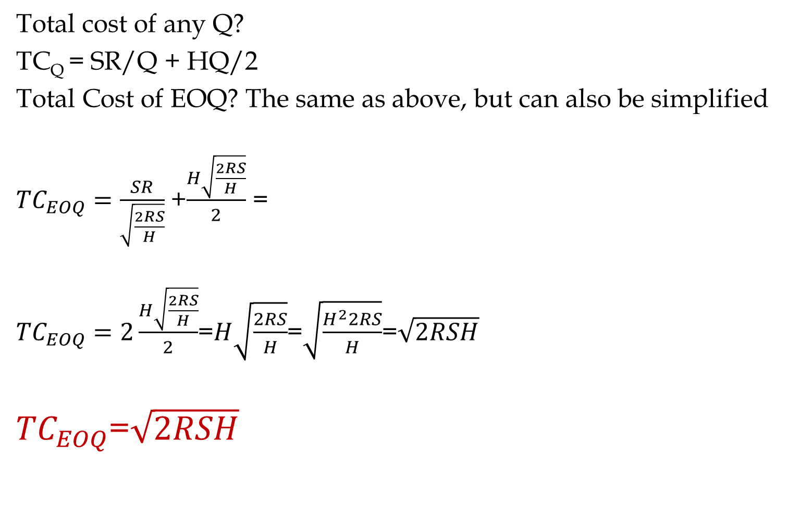
Formula Proof for Total Cost of EOQ
Total cost of any Q?
TC_{Q} = SR/Q + HQ/2
Total Cost of EOQ? The same as above, but can also be simplified
${TC}_{EOQ}=\frac{SR}{\sqrt{\frac{2RS}{H}}}$ +$\frac{H\sqrt{\frac{2RS}{H}}}{2}$ =
${TC}_{EOQ}=2\frac{H\sqrt{\frac{2RS}{H}}}{2}$=$H\sqrt{\frac{2RS}{H}}$=$\sqrt{\frac{H^{2}2RS}{H}}$=$\sqrt{2RSH}$
${TC}_{EOQ}$=$\sqrt{2RSH}$

Slide 32
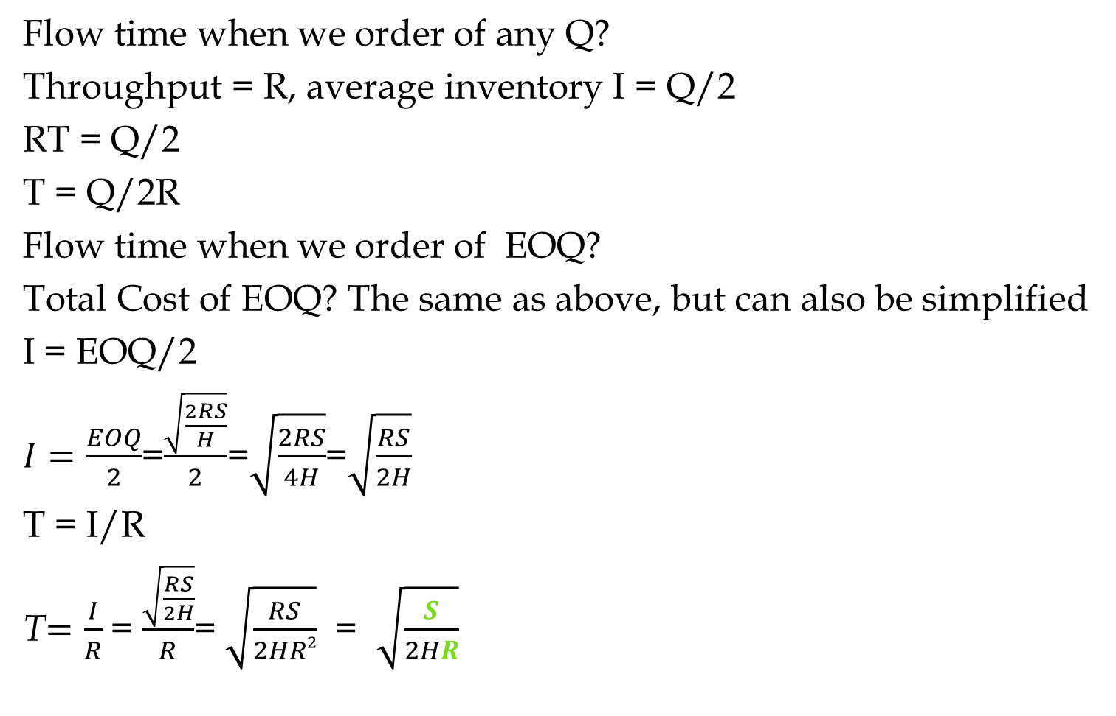
Formula Proof for Flow Time Under EOQ
Flow time when we order of any Q?
Throughput = R, average inventory I = Q/2
RT = Q/2
T = Q/2R
Flow time when we order of EOQ?
Total Cost of EOQ? The same as above, but can also be simplified
I = EOQ/2
$I=\frac{EOQ}{2}$=$\frac{\sqrt{\frac{2RS}{H}}}{2}$=$\sqrt{\frac{2RS}{4H}}$=$\sqrt{\frac{RS}{2H}}$
T = I/R
T$=\frac{I}{R}$ = $\frac{\sqrt{\frac{RS}{2H}}}{R}$= $\sqrt{\frac{RS}{2HR2}}$ = $\sqrt{\frac{S}{2HR}}$

