Slide 1
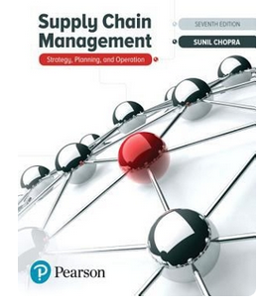
Aggregation
Transportation Cost vs Inventory Carrying Cost
Based on the material in
Ardavan Asef-Vaziri

Slide 2
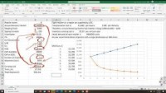

Slide 3
Logistics Costs & Aggregation- Transportation vs Inventory Costs
https://youtu.be/l7Kfb9UDb_k

Slide 4
Logistics Costs & Aggregation- Transportation vs Inventory Costs

Slide 5
LogiTans.vs.Carry.xlsx

