Slide 1

Extensions Beyond LFT
Not in the Game.
Just for learning additional EOQ related concepts.
Assume LFT is operating indefinitely ($∞)$

Slide 2
Problem-1. Periodic Inventory System
In this section, we go through some extensions of the Littlefield assumptions and basic EOQ model. These concepts may not exist in the LittleField game. They are general inventory concepts, but we discuss them in the context of the LittleField Technologies.
Problem-1. Suppose you have decided to switch to the Periodic Inventory System. Assume that you decide to order every 30 days. That is an order size of 15(30)= 450 product (60*450 kits per order). We assume all months are 30 days and a year is 12.17 months.
Compute the cycle inventory
Icycle = Q/2 = 450/2 =225.
b) Compute the number of cycles (assume LFT continues for many years).
# of cycles = 5475/450 = 12.17
c) Compute the length of a cycle.
Cycle length = 30 days.

Slide 3
Periodic Inventory
d) Compute flow time
T= 30/2 = 15.
Alternatively, T=I/R = 225/5475 = 0.041095890 year or 225/15= 15 days.
e) Compute inventory turns
InvTurns = 5475/225 = 24.33
InvTurns = 1/T = 1/15??!!
1/15 or 24.33?
1/15 is in days, 24.33 is over a year
(1/15)*365= 24.33.
f) Compute the total inventory costs.
TC = OC + CC = SD/Q + HQ/2
TC = 1000*5475/450 + 120*450/2
TC = 12166.7 + 27000 = 39166.7

Slide 4
Other Than EOQ
Problem-2. Return to continuous inventory system. Suppose kits are delivered in boxes of 400 products. That is boxes of 24000 kits. What is the impact on the total cost.
The current EOQ with all the decimal points is 311.9829.
TC(EOQ) = 1000*5475/302.0761 + 120*302.0761 = 18124.57 + 18124.57 = 36249.14.
TC(400) = 1000*5475/400 + 120*400/2 = 13687.5 + 24000 = 37687.5.
Ordering cost goes down, because we order in larger quantities.
Carrying cost goes down, because we carry more inventory.
Total cost goes up because we order other than EOQ.
Q2/Q1 = (400-302)/302 = 32.5% ⇑
TC2/TC1 = (37687.5-36249.14)/36249.14 = 4%⇑
Q: 32.5% ⇑ ➔ TC: 4%⇑

Slide 5
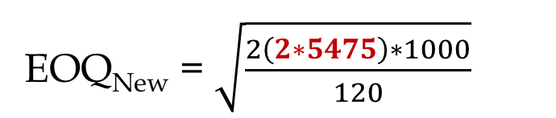
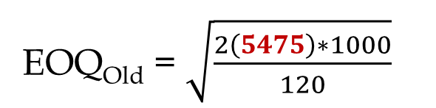
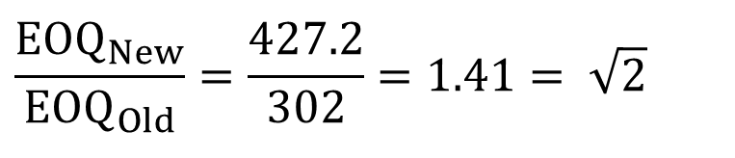
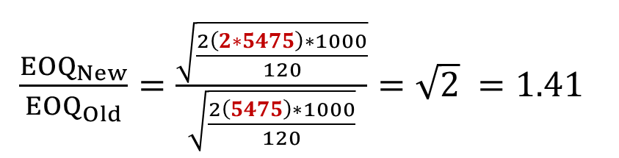
Square Root Effect- Demand Doubled
Problem -3. Suppose the following parameters remain the same. S=$1000, C=$600, h=0.2, ➔ H = hC = 0.2(600) = $120. However, assume the demand is doubled, and we have enough capacity to accept the incoming demand. D = R = 2(5475) = 11680.
Compute the impact on EOQ and TC.
EOQ_{Old} = $\sqrt{\frac{2\left(5475\right)∗1000}{120}}$
EOQ_{New} = $\sqrt{\frac{2\left(2∗5475\right)∗1000}{120}}$
$\frac{{EOQ}_{New}}{{EOQ}_{Old}}=\frac{\sqrt{\frac{2\left(2∗5475\right)∗1000}{120}}}{\sqrt{\frac{2\left(5475\right)∗1000}{120}}}=\sqrt{2} =1.41$
$$\frac{{EOQ}_{New}}{{EOQ}_{Old}}=\frac{427.2}{302}=1.41= \sqrt{2}$$
If demand is doubled, EOQ decreases by SQRT(2)

Slide 6
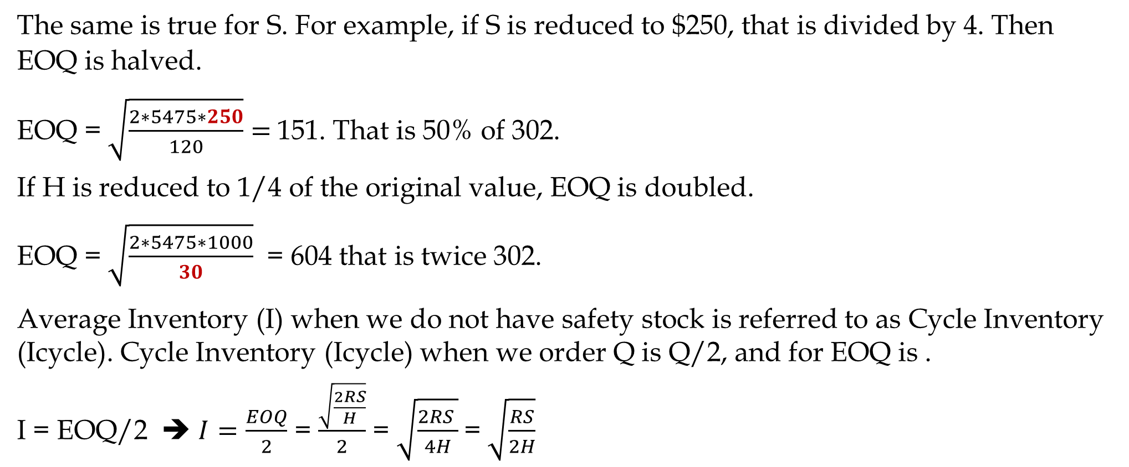
Square Root Effect- Changes in EOQ
The same is true for S. For example, if S is reduced to $250, that is divided by 4. Then EOQ is halved.
EOQ = $\sqrt{\frac{2∗5475∗250}{120}}=$151. That is 50% of 302.
If H is reduced to 1/4 of the original value, EOQ is doubled.
EOQ = $\sqrt{\frac{2∗5475∗1000}{30}}$ = 604 that is twice 302.
Average Inventory (I) when we do not have safety stock is referred to as Cycle Inventory (Icycle). Cycle Inventory (Icycle) when we order Q is Q/2, and for EOQ is .
I = EOQ/2 ➔ $I=\frac{EOQ}{2}$ = $\frac{\sqrt{\frac{2RS}{H}}}{2}$ = $\sqrt{\frac{2RS }{4H}}$= $\sqrt{\frac{RS}{2H}}$

Slide 7
Square Root Effect- Changes in EOQ, Icycle, and Flow Time
Formula Proof for Flow Time Under EOQ
If D (or R) is multiplied by K, EOQ is multiplied by SQRT(K).
If S is multiplied by K, EOQ is multiplied by SQRT(K).
If H is multiplied by K, EOQ is divided by SQRT(K).
The same can be said about Cycle inventory and In-storage flow time.
What about annual inventory cost (TC=OC+CC). Again, we assume that the operations continues for several years- That is a basic assumption in EOQ model.
Total cost of any Q?
TC_{Q} = OC_{Q} + CC_{Q}
TC_{Q} = SR/Q + HQ/2
This is a correct formula everywhere, including at EOQ, but we can simplify it for EOQ.
At EOQ, we have
OC_{EOQ} = CC_{EOQ}

Slide 8
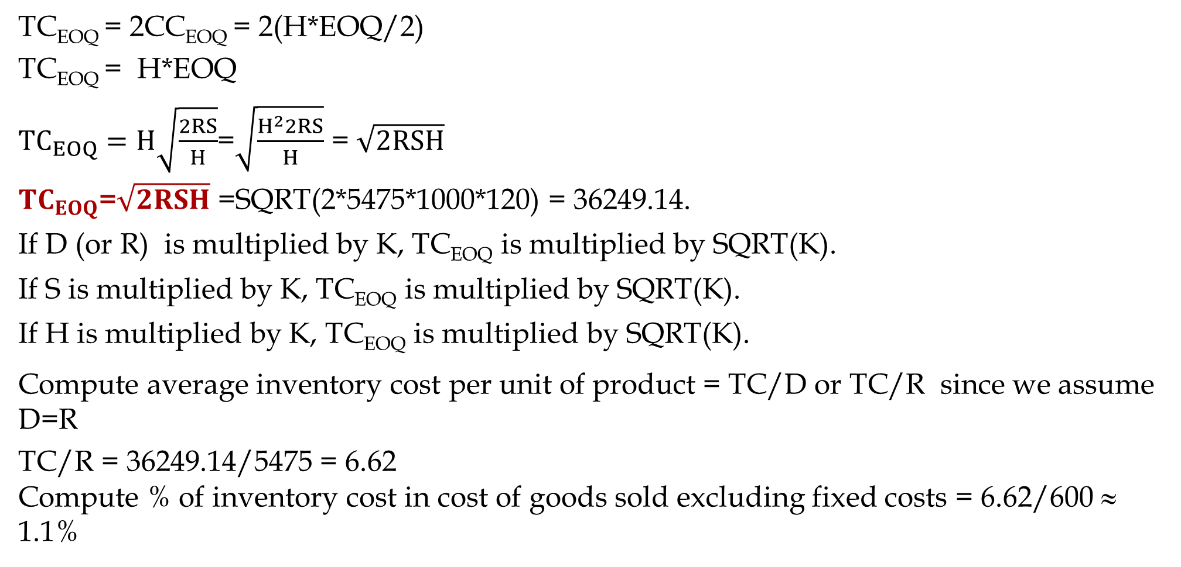
Total Inventory Cost Formula at EOQ, and Inventory Cost Per unit
TC_{EOQ} = 2CC_{EOQ} = 2(H*EOQ/2)
TC_{EOQ} = H*EOQ
${TC}_{EOQ}=H\sqrt{\frac{2RS}{H}}$=$\sqrt{\frac{H^{2}2RS}{H}}$ = $\sqrt{2RSH}$
${TC}_{EOQ}$=$\sqrt{2RSH}$ =SQRT(2*5475*1000*120) = 36249.14.
If D (or R) is multiplied by K, TC_{EOQ} is multiplied by SQRT(K).
If S is multiplied by K, TC_{EOQ} is multiplied by SQRT(K).
If H is multiplied by K, TC_{EOQ} is multiplied by SQRT(K).
Compute average inventory cost per unit of product = TC/D or TC/R since we assume D=R
TC/R = 36249.14/5475 = 6.62
Compute % of inventory cost in cost of goods sold excluding fixed costs = 6.62/600 ≈ 1.1%
.

Slide 9
Centralization vs. Decentralization Orderong
Four LFT plants. Order individually or collectively.
D =5475 and H = $120 per product per year remain the same. S = $800 fixed, plus $200 per plant. That is S = $800+$200=$1000 if each warehouse order independently.
S=800+200+200 = 1200 if two plants order together. S = 800+200+200+200+200 = $1600.
When two or more plants order together, S goes up since the truck travel time in a route to more than one warehouses is longer than a trip to a single warehouse.
Currently each plant orders independently.
We already have the followings for each warehouse.
EOQ = 302
Cycle inventory (Icycle) = 302/2 = 151
Icycle for 4 warehouses = 4(151) = 604.
Demand = 5475 per year or 15 per day ➔ Cycle length = 302/15 = 20.133 days
In-Storage Flow time = 20.133/2 = 10.1 days (Alternatively, I/R = 151/15 = 10.1 days

Slide 10
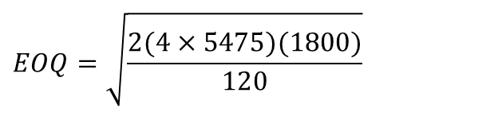
Centralization vs. Decentralization Orderong
a) Compare Cycle inventory for Centralized vs Decentralized.
Demand for 4 plants = 4(5475), and EOQ if 4 plants order together
$$EOQ=\sqrt{\frac{2(4×5475)(1800)}{120}}$$
=764.2
The total cycle inventory across all four outlets equals 382, compared to 604.
A (604-382)/604 = 37%⇓
b) Compare total inventory cost Centralized vs Decentralized.
TC-Centralized = SQRT(2*4*5475*1600*120) = 91704.
TC-Decentralized (already computed for one plant) = 36249.
TC-Decentralized 4 plant = 4(36249) = 144996.
A (144996- 91704)/144996 = 37% cost reduction

Slide 11
Ordering Interval, Inventory Cycle, Flow Time
c) Compute the ordering interval in decentralized and centralized systems.
Decentralized R/Dy = 15/Dy
Centralized R/Dy = 4(15) = 60/Dy
Decentralized = 302/15 = 20.14 days
Centralized = 790/64 = 12.74 days
d) Compute the average in-storage flow time
20.14/2 = 10.07 days
12.74/2 = 6.37 days
Alternatively- Using The Little’s Law
RT = I ➔ T= R/I
15T= 151 ➔ T = 151/15 days
60T= 382 ➔ T = 382/60 days

Slide 12
Three Alternatives

Slide 13
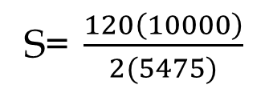
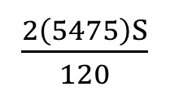
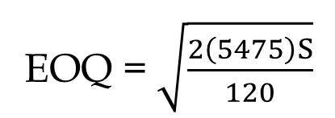
How to Reduce EOQ
To reduce EOQ we may ↓R, ↓ S, ↑H
↓R and ↑H are out of question.
Reduce S. IT&IS can help in reduction of fixed costs. It can cut operational costs for buyers and suppliers.
Suppose you could have hired an IT/IS consultant to reduce S in the game such that the EOQ is lowered to the number of kits needed for 100 contact. To what value do the consultant company needs to lower S?
EOQ = $\sqrt{\frac{2\left(5475\right)S}{120}}$
= 100
$\frac{2\left(5475\right)S}{120}$
S= $\frac{120\left(10000\right)}{2(5475)}$
S = $110
= 10000

Slide 14
How to Reduce Inventory
Centralize
  EOQ increases as the square route of demand and the square route of the ordering cost.
  Breakdown S on a larger order quantity.
Commonality, modularization and standardization is another type of Centralization.
Postponement, Delayed Differentiation.

