Slide 1
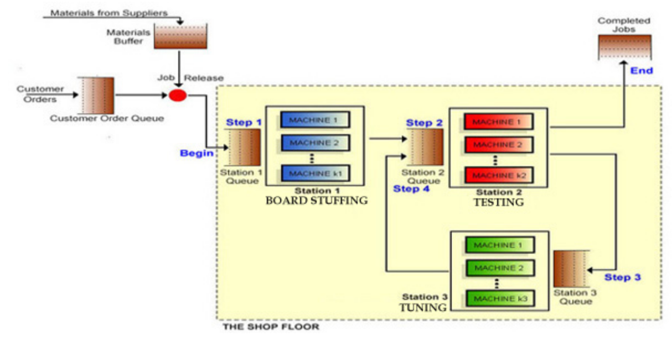
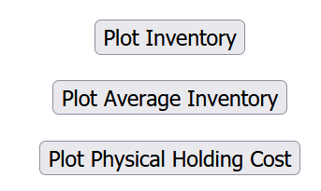
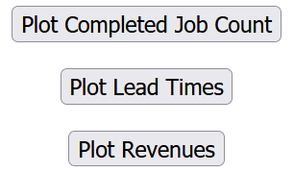
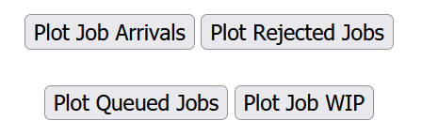

First 24 Days; Demand, Production, Inventory, Utilization and Capacity

Slide 2
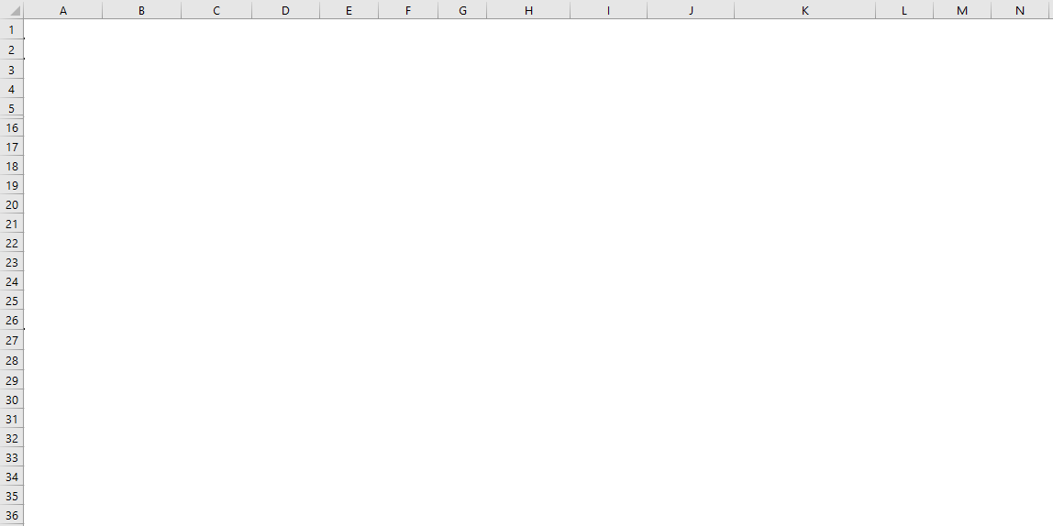
The First 24 Days; Demand, Accepted Demand, Production, and Inventory

Slide 3
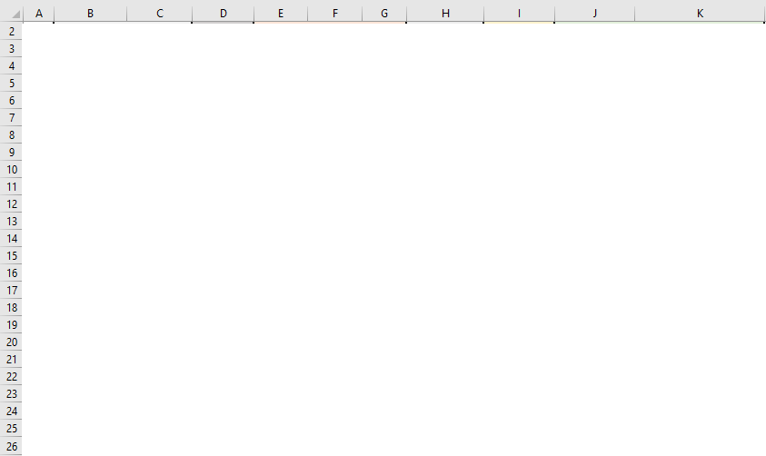
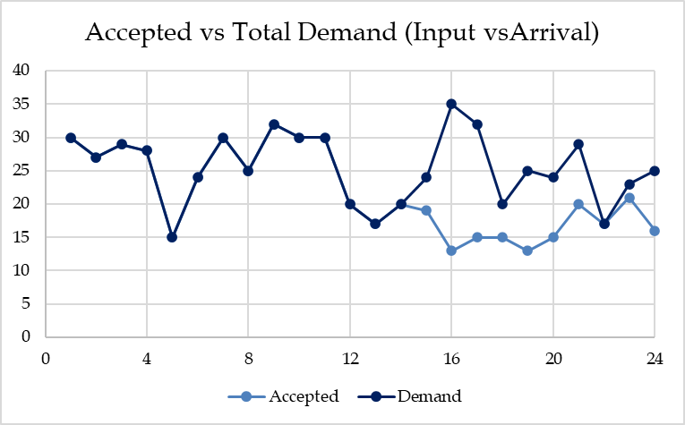
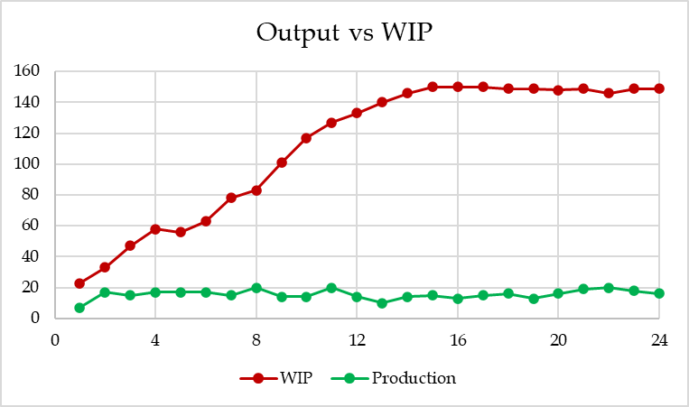
The First 24 Days; Demand, Accepted Demand, Production, and Inventory

Slide 4
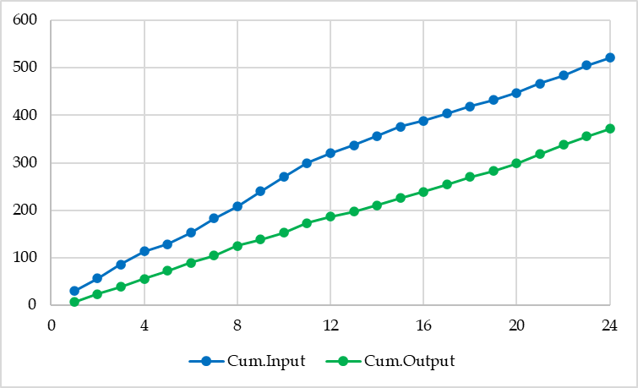
Input, Output, Inventory, and Flow Time
I
T

Slide 5
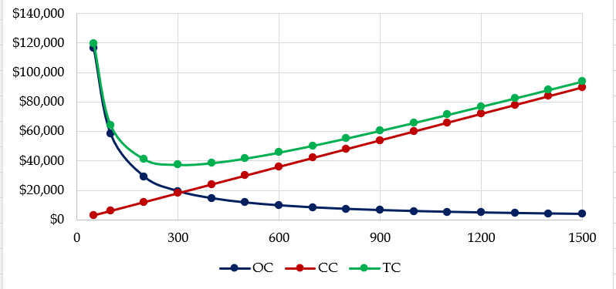
EOQ
EOQ

Slide 6
Inventory Decisions in LittleField Technologies
R and D are used interchangeably in our EOQ (Economic Order Quantity) models.
D is demand, and R is throughput. We assume R = D ➔ Everything produced is sold.
Note that only part of the actual demand enters our system when we do not allow all the demand (arrival) to come (due to a Max-WIP). That is the accepted demand or input.
For the first 24 days, the average daily output was 15.5. We round it down to 15 per day. (You need to work with the actual game data throughout the game.)
We need 60 kits for each contract at $10 per kit. That is the purchase price of C=$600 per unit of product. While the demand is probabilistic and moves up and down around the average, to use the EOQ model, we need to assume that the demand is deterministic and R = D = 16 until we increase the capacity or there is a change in demand.
The kits are used at a steady rate of 15(60) = 900 per day, and a year is 365 days. That is 5475 products or 350400 kits per year.
In this basic inventory model, we assume the game continues for many years. If we do not fully use what we have ordered this year, we can use it next year.

Slide 7
Inventory Decisions in LittleField Technologies
We have 10% capital cost (interests) and 10% physical storage cost during the game. That is a total of h=20% per dollar invested in inventory per year, or H=hC=0.20($600) = $120 per product per year.
The ordering cost is S=$1000 per order.
How much should we order each time to minimize our total annual inventory ( ordering and carrying) costs?

Slide 8
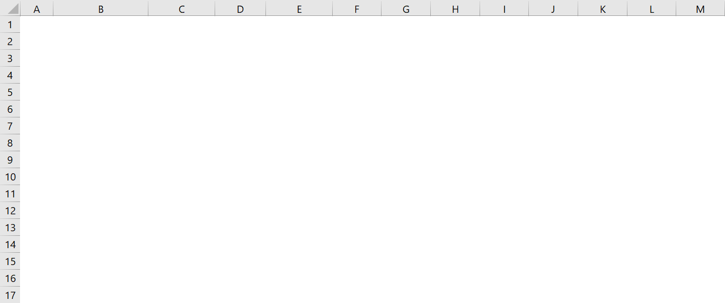
Number of Orders & Ordering Costs
D = R = (15)(365) = 5475 contracts per year or D = R = 60(5475) = 350400 kits per year.
H = 0.2($10) = $2 per kit per year, or H = $10*0.20(60) = $120 per contract per year.
S = $1000 per order. Ordering Quantity = Q.
# of orders per year = D/Q = 5475/Q.
OC = SD/Q = 1000(5480)/Q

Slide 9
Average Inventory & Carrying Cost
At the start of the cycle, we have the order size of Q units. At the end of the cycle, we have 0. Average inventory = (Q+0)/2 = Q/2 units.
Q/2 is also called cycle inventory.
Quantity
Time
In each cycle, we have Q/2 inventory ➔ In all cycles, we have Q/2 inventory.
Throughout the year, we have Q/2 inventory.
Cost of carrying (holding) one unit of inventory for one year = H $ per unit per year.
Total Holding Costs (Total Carrying Costs) = CC = HQ/2 $ per year.

Slide 10
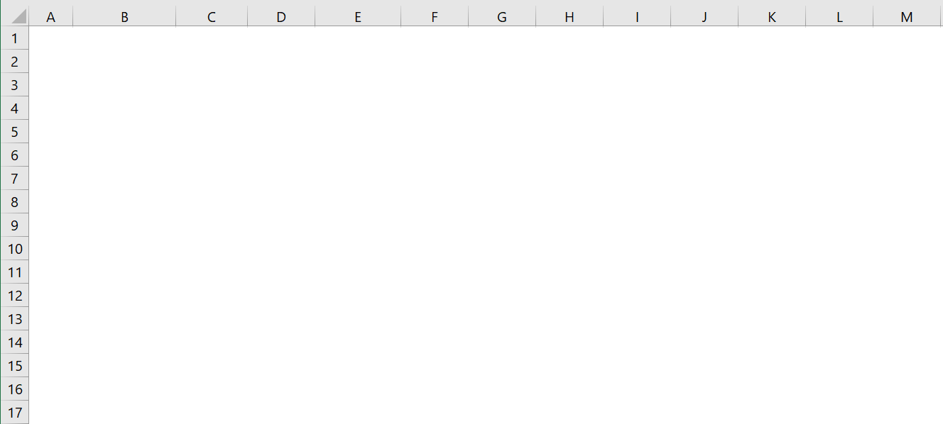
Inventory Decisions in in LittleField Technologies
CC = HQ/2 = 120Q/2

Slide 11
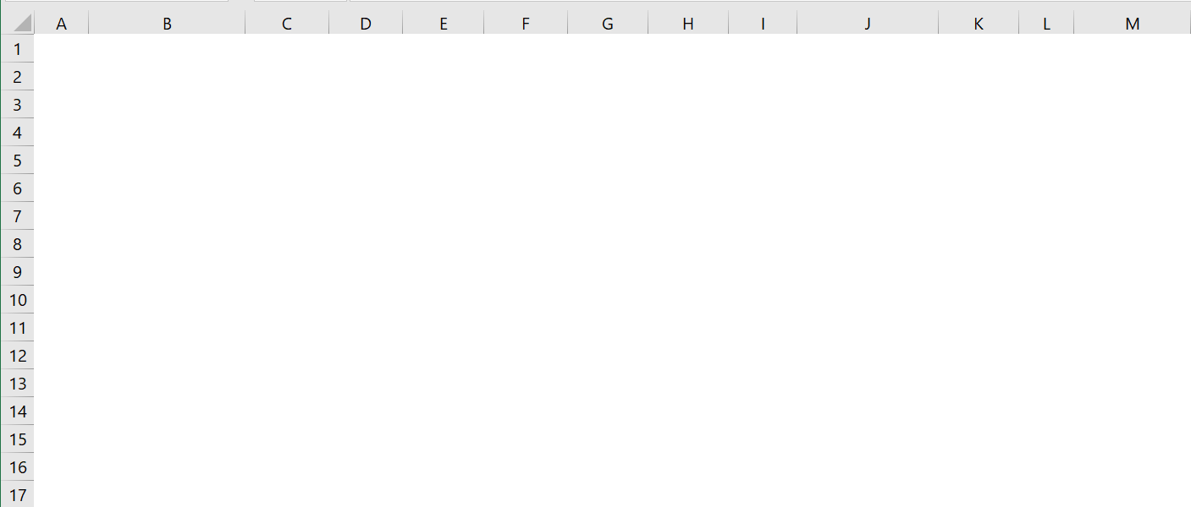
Inventory Decisions in in LittleField Technologies
TC = OC + CC = SD/Q+HQ/2 = 1000(5480)/Q + 120Q/2

Slide 12
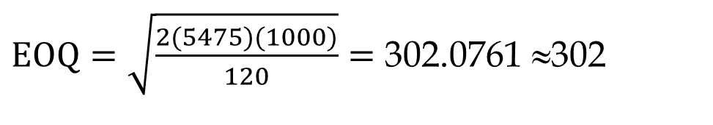

Economic Order Quantity
a) Compute EOQ. At EOQ (Economic Order Quantity), OC = CC
SD/Q = HQ/2 ➔ 1000(5475)/Q = 120Q/2 ➔ Q² = 91250 ➔ Q = 302 contracts
SD/Q = HQ/2 ➔ Q² = 2DS/H
$$EOQ=\sqrt{\frac{2DS}{H}}$$
$EOQ=\sqrt{\frac{2(5475)(1000)}{120}}=$ 302.0761 ≈302
That is one way to compute EOQ and not to memorize it.
EOQ = 302(60) = 18120 kits.
b) How often do we order (ordering cycle)?
Kits for 302 contracts are enough for how many days?
Ordering Cycle = 302.0761/15 = 20.138 ≈ 20 days.

Slide 13
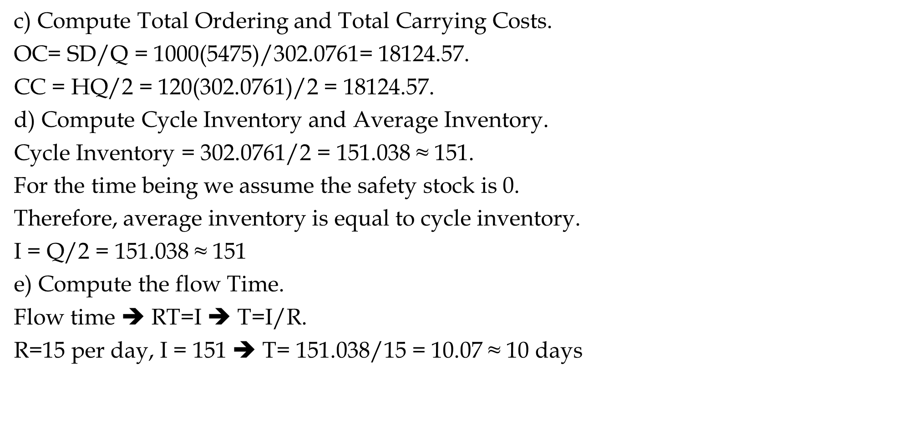
Ordering Cost, Carrying Cost, Ordering Cycle, Flow Time
c) Compute Total Ordering and Total Carrying Costs.
OC= SD/Q = 1000(5475)/302.0761= 18124.57.
CC = HQ/2 = 120($\text{302.0761}$)/2 = 18124.57.
d) Compute Cycle Inventory and Average Inventory.
Cycle Inventory = $\text{302.0761}$/2 = 151.038 ≈ 151.
For the time being we assume the safety stock is 0.
Therefore, average inventory is equal to cycle inventory.
I = Q/2 = 151.038 ≈ 151
e) Compute the flow Time.
Flow time ➔ RT=I ➔ T=I/R.
R=15 per day, I = 151 ➔ T= 151.038/15 = 10.07 ≈ 10 days

Slide 14
InvTurns
Alternatively, (20+0)/2 = 10 days.
This is in-storage flow time. It differs from the production flow time.
Production flow time has impact on revenue per unit if product delivered.
In-storage flow time had impact on inventory costs and inventory turns.
f) Compute Inventory Turns
InvTurns = 5475/ 151.038 = 36.25 ≈ 36 per year
InvTurns = 1/FlowTime =1/10.
1/10 OR 36?
1/10 per day and 36 per year.
Almost because we rounded both 10 and 36.

Slide 15
Economic Order Quantity
In order to find D, we did 15(365) = 5475, but the game only runs for
50+7(24)+50 = 50+168+50 = 268 days. Is our computation incorrect?
It does not matter. Since $120 is the cost of carrying 60 kits for 365 days.
For a demand of 268 days, $120 will be multiplied by 268/365, leading to
H= $120(268/365) = 88.11.
To clarify, let's use monthly demand instead of yearly demand.

Slide 16
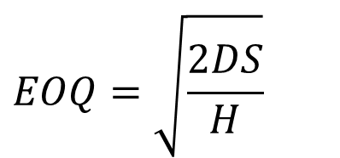
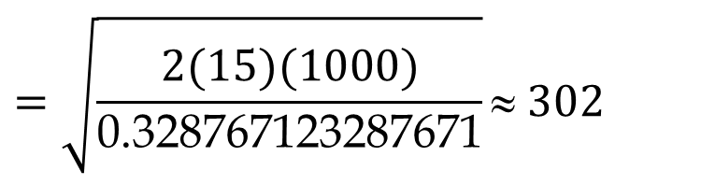
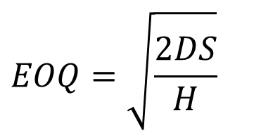
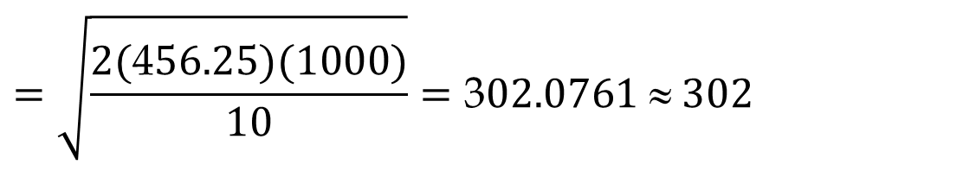
Economic Order Quantity
Since yearly demand is 5475, then monthly demand is 5475/12 = 486.6667.
The ordering cost remains $1000 per order. The carrying cost of $120 for 60 kits for one contract per year is translated into $120/12= $10 per month.
$$EOQ=\sqrt{\frac{2DS}{H}}$$
$$=\sqrt{\frac{2(\text{4}56.25)(1000)}{10}}=\text{3}02.0761 ≈ 302$$
The same is true for daily demand. We can have D=R=16 per day. S=$1000 per order, and H =120/365 = $0.328767123287671
$$EOQ=\sqrt{\frac{2DS}{H}}$$
$$=\sqrt{\frac{2(15)(1000)}{\text{0.328767123287671}}}≈ 302$$
As long as D and H are defined over the same period, year, month, week, and day, they all result in the same EOQ. The ordering cost is still S(D/Q), and the carrying cost is still H(Q/2). Nevertheless, throughout the game, based on the volume of demand and how you manage the capacity, you may use a different value as your yearly, or monthly demand (throughput) estimate each time.

