Slide 1
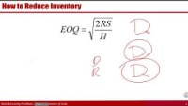
Inventory Basic Model
How can it be that mathematics, being after all a product of human thought which is independent of experience, is so admirably appropriate to the objects of reality?
Albert Einstein

Slide 2
Why We are interested in reducing inventory
Has carrying cost
  Physical carrying costs – we need storage and human resources.
  Financial costs (Opportunity Cost) – We could have invested our capital elsewhere and benefit from it. In the LFT Game financial cost is 10% of the cost of goods.
Has Hidden Costs
  Devaluation Cost- Components typically drop in price during their inventory life
  Price Protection Cost. To reimburse customers for the drops in the prices.
  Return Cost
  Obsolescence Cost
Hides problems
  Even if we produce low quality product, there is enough inventory downstream.
  Untrustworthy suppliers, machine breakdowns, long changeover times, scraps and defects do not show up.
  Long flow time, Feedback loop is long. not-uniform operations.

Slide 3

Formula Proof for Total Cost of EOQ
Total cost of any Q?
TC_{Q} = SR/Q + HQ/2
Total Cost of EOQ? The same as above, but can also be simplified
${TC}_{EOQ}=\frac{SR}{\sqrt{\frac{2RS}{H}}}$ +$\frac{H\sqrt{\frac{2RS}{H}}}{2}$ $=2\frac{H\sqrt{\frac{2RS}{H}}}{2}$=$H\sqrt{\frac{2RS}{H}}$=$\sqrt{\frac{H^{2}2RS}{H}}$ = $\sqrt{2RSH}$
TC_{Q} = SR/Q + HQ/2
${TC}_{EOQ}$=$\sqrt{2RSH}$

Slide 4
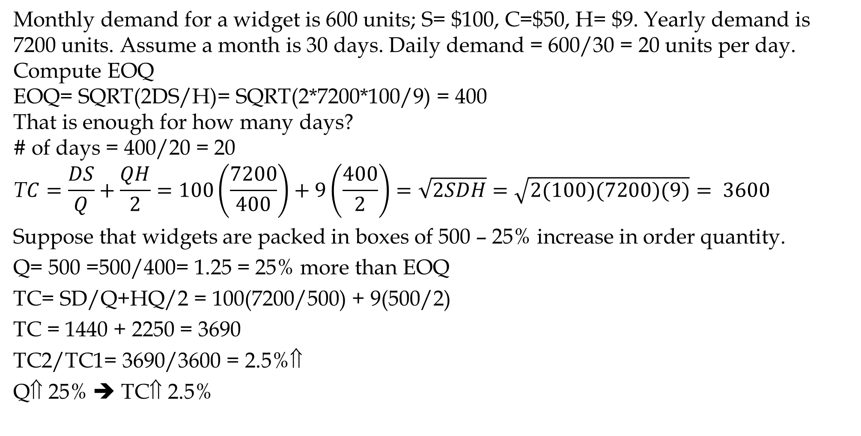
Impact of Changes- Not EOQ
Monthly demand for a widget is 600 units; S= $100, C=$50, H= $9. Yearly demand is 7200 units. Assume a month is 30 days. Daily demand = 600/30 = 20 units per day.
Compute EOQ
EOQ= SQRT(2DS/H)= SQRT(2*7200*100/9) = 400
That is enough for how many days?
# of days = 400/20 = 20
$$\text{T}C=\frac{DS}{Q}+\frac{QH}{2}=100\left(\frac{7200}{400}\right)+9\left(\frac{400}{2}\right)=\sqrt{2SDH}=\sqrt{2(100)(7200)(9)}= 3600$$
Suppose that widgets are packed in boxes of 500 – 25% increase in order quantity.
Q= 500 =500/400= 1.25 = 25% more than EOQ
TC= SD/Q+HQ/2 = 100(7200/500) + 9(500/2)
TC = 1440 + 2250 = 3690
TC2/TC1= 3690/3600 = 2.5%⇑
Q⇑ 25% ➔ TC⇑ 2.5%

Slide 5
Impact of Changes in Demand on EOQ
Suppose that the demand increases k=4 times. What is the change in the optimal order quantity, cycle stock, and # of orders per year?
S=100, H=9, D1= 7200, D2=4(7200)=28800, EOQ1 = 400
EOQ1= SQRT(2*100*7200/9) = 400
EOQ2= SQRT(2*100*4(7200)/9) = 800
4D➔ 2EOQ
Demand is multiplied by K, EOQ is multiplied by SQRT(K)

Slide 6
How to Reduce Inventory
To reduce EOQ we may ↓R, ↓ S, ↑H
Two ways to reduce average inventory
- Reduce S
- Centralize
S does not increase in proportion of Q
EOQ increases as the square route of demand.
- Commonality, modularization and standardization is another type of Centralization
- Postponement, Delayed Differentiation

Slide 7
Reducing S – JIT
By considering fixed cost as a setup cost, EOQ can be used to determine optimal production size.
Setup time reduction in just-in-time (JIT) production systems leads to smaller batches.
  Equipment with low set-up times
  Nearby suppliers with long-term relationships
  Uniform plant loading
  Low inventories with tight control
  Small batch and mixed-model production

Slide 8
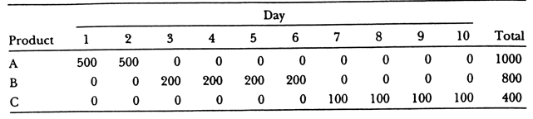
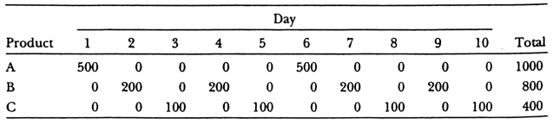
Mixed Model Production
Three products A, B, C. Production time: each 10 mins (Tp=10 mins).
Plant is working 5 days a week, 10 hours a day.
Demand at down stream station is A:3, B:2, C:1 units per hour.
The upstream station in each production run produces one week of demand: A(150), B(100), and C(50).
While the customer need it at hourly rates (either to consume or use it in production of another item) we ship it at weekly demand.
Icycle = A(75), B(50), C(25). That is 150
What if we produce AAABBC. Then the Icycle is 3. An even better model is ABACBA

Slide 9
Setup Time Reduction- Toyota Production System
Shigeo Shingo (Toyota) shortened setup times from several hours per each exchange of dies to a few minutes. He started by separating internal and external activities in a firm.
Internal activities. Those for which it is essential for machine to be down such as (i) adjusting machine speed, (ii) placing work or fixtures on machine.
  Turn sequential internal activities into parallel activities or resources.
  Convert internal activities to external activities.
External activities. Those for which it is not essential for machine to be down.
  Validating work order. Searching for tools and dies. Procuring material.
  External activities should be completed prior to setup.
Standardize and practice setup routines.
Eliminate adjustments. Smooth and simplify procedures.
McLaren Applied Technologies team worked with GlaxoSmithKline to setup times in toothpaste production. Over six months changeover times dropped from 49 minutes to 15, translates into 7M more tubes of Sensodyne and Aquafresh a year

