Slide 1
Inventory Basic Model
How can it be that mathematics, being after all a product of human thought which is independent of experience, is so admirably appropriate to the objects of reality?
Albert Einstein
Ardavan Asef-Vaziri
Systems and Operations Management
David Nazarian College of Business and Economics
California State University, Northridge
March 2020

Slide 2
Teams and Clusters- In this Course and In Future
This Semester
Next Semester

Slide 3
Problem 1: Optimal Policy
In our EOQ (Economic Order Quantity) models, R and D are used interchangeably.
D is demand, R is throughput.
We assume R=D ➔ Everything produced is sold.
A toy manufacturer uses 32000 silicon chips annually. The Chips are used at a steady rate during the 240 days a year that the plant operates. Holding cost is 60 cents per unit per year. Ordering cost is $24 per order.
a) How much should we order each time to minimize our total costs (total ordering and carrying costs)?
D = 32000, H = $0.6 per unit per year , S = $24 per order
Ordering Quantity = Q
# of orders = D/Q = 32000/Q
Cost of each order = S = $24
OC = 24*32000/Q
Recorded Lecture is on Page 13

Slide 4
Problem 1: Optimal Policy-Excel

Slide 5
Number of Orders & Ordering Cost

Slide 6
Average Inventory & Carrying Cost
At the start of cycle we have Q, at the end of the cycle we have 0.
Average inventory = (Q+0)/2 = Q/2
Q/2 is also called cycle inventory.
Quantity
In each cycle we have Q/2 inventory.
In all cycles we have Q/2 inventory.
Throughout the year we have Q/2 inventory.
Cost of carrying (holding) one unit of inventory for one year = H
Total Holding Costs (Total Carrying Costs) = CC = HQ/2
Time

Slide 7
EOQ: Minimized Total Cost When OC=CC

Slide 8
Economic Order Quantity
At EOQ (Economic Order Quantity, OC=CC
SD/Q = HQ/2
24(32000)/Q= 0.6Q/2
Q²= 2560000
Q = 1600
SD/Q = HQ/2
Q² = 2DS/H
That is one way to compute EOQ and not to memorize it.

Slide 9
Number of Orders & Length of Ordering Cycle
b) How many times should we order ?
  R=D = 32000 per year, EOQ = 1600 each time
  # of times that we order = D/EOQ
  D/Q = 32000/1600 = 20 times.
c) What is the length of an order cycle ?
We order 20 times.
Working days = 240/year
240/20 = 12 days.
Alternatively
32000 is required for one year (240 days)
Each day we need 32000/240 = 133.333
1600 is enough for how long?
(1600/133.33) = 12 day

Slide 10
Ordering, Carrying, and Total Cost
d) Compute the total ordering cost and total cost.
Ordering Cost = 24(32000/1600) = 24(20) = $480
e) Compute the average inventory
Average inventory = (Q+0)/2 = 1600/2 =800
f) Compute the total carrying cost.
We have Q/2 throughout the year
Inventory carrying costs = average inventory (Q/2) multiplied by cost of carrying one unit of inventory for one year (H)
Carrying Cost = H(Q/2) = 0.6(1600/2) = $480
g) Compute the total cost.
Total Cost = Ordering cost + Carrying cost
Total cost = $480+$480 = $960

Slide 11
Cycle Inventory, Average Inventory, Flow Time
g) Compute the flow time ?
Demand = 32000 per year
Therefore throughput = 32000 per year
Maximum inventory = EOQ = 1600
Average inventory = Cycle Inventory = 1600/2 = 800
Cycle inventory is always defined as Max Inventory divided by 2.
Cycle inventory = Q/2
If there is no safety stock
Average inventory is the same as Cycle inventory = Q/2.
If there is safety stock- We will discuss it in ROP lecture
Average inventory = Cycle Inventory +Safety Stock = Q/2 +Is

Slide 12
Flow Time & Inventory Turns
RT=I ➔ 32000T=800
T=800/32000=1/40 year
Year = 240 days
T=240(1/40)= 6 days
Alternatively, the length of an order cycle is 12 days. The first item of an order spends 0 days, the last item spends 12 days.
On average they spend (0+12)/2 = 6 days
h) Compute inventory turns.
Inventory turn = Demand divided by average inventory.
Average inventory = I = Q/2
Inventory turns = D/(Q/2)= 32000/(1600/2)
Inventory turns = 40 times per year.
RT=I ➔ T=I/R = I/D
➔ InvTurns = 1/T
InvTurns = D/I = R/I

Slide 13
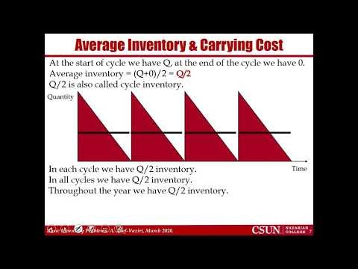
Flow Time & Inventory Turns
https://www.youtube.com/watch?v=pRv-rXPvfws

Slide 14
Problem 2: A Policy vs. The Optimal Policy
Victor sells a line of upscale evening dresses in his boutique. He charges $300 per dress, and sells on average 30 dresses per week. Currently, Vector orders 10 week supply at a time from the manufacturer. Assume 50 weeks per year. Victor estimates his administrative cost of placing each order at $225. He pays $150 per dress. His inventory carrying cost including cost of capital, storage, and obsolescence is 20% of the purchasing cost.

Slide 15
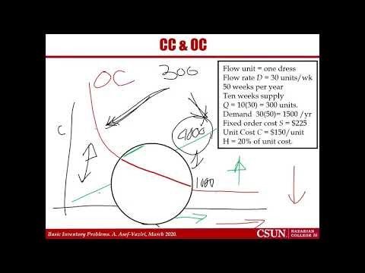
Problem 2: Recorded Lecture
https://youtu.be/TIFdDIgOgyI

Slide 16
CC & OC
a) Compute the total ordering cost and carrying cost under the current ordering policy?
Number of orders/yr = D/Q = 1500/300
= 5
(D/Q) S = 5(225) = 1,125/yr.
Average inventory = Q/2 = 300/2 = 150
H = 0.2(150) = 30
Flow unit = one dress
Flow rate D = 30 units/wk
50 weeks per year
Ten weeks supply
Q = 10(30) = 300 units.
Demand 30(50)= 1500 /yr
Fixed order cost S = $225
Unit Cost C = $150/unit
H = 20% of unit cost.
Annual holding cost = H(Q/2) = 30(150) = 4,500 /yr.
Total annual costs = 1125+4500 = 5625
b) Without any further computation, is EOQ larger than 300 or smaller? Why?

Slide 17
Flow Time
c) Compute the flow time.
Average inventory = cycle inventory = I = Q/2
Average inventory = 300/2 = 150
Throughput? R?
R= D, D= 30/week
Current flow time
RT= I
30T= 150 ➔ T= 5 weeks
Did we really need this computations?
Cycle is 10 weeks (each time we order demand of 10 weeks).
The first item is there for 0 week.
The last item is there for 10 weeks.
On average (10+0)/2 = 5 weeks.

Slide 18
Inventory Turns and Flow Time
d) What is average inventory and inventory turns under this policy ?
Inventory turn = Demand divided by average inventory.
I = Q/2
Inventory turns = D/(Q/2)= 1500/(300/2) = 10 times
InvTurn = R/I
T=I/R
InvTurn = 1/T
We already computed T
T = 5 weeks ➔ Turn = 1/T= 1/5 ????
Is InvTurn 10 or 1/5
Have we made a mistake?
InvTurn = 1/5 per week, year = 50 weeks
InvTurn =(1/5)(50) = 10
=

Slide 19
Optimal Policy vs. Current Policy
e) Compute Victor’s total annual cost of inventory system (carrying plus ordering but excluding purchasing) under the optimal ordering policy?
Q* = EOQ =
= 150 units.
The total optimal annual cost will be
225(1500/150) + 30(150/2) = 2250 + 2250 = $4,500
Compared to 5,625, there is about 20% reduction in the total costs.
Total cost here is equal to carrying cost there.

Slide 20
Problem 3; Centralization vs. Decentralization
Central Electric (CE) serves its European customers through a distribution network that consists of four warehouses, in Poland, Italy, France, and Germany. CE is considering to consolidate the regional warehouses into a single master warehouse in Austria. Currently, each warehouse manages its ordering independently. Demand at each outlet averages 800 units per day. Assume a year is 250 days. Each unit of product costs $200, and CE has a holding cost of 20% per year. The fixed cost of each order (administrative plus transportation) is $900 for the decentralized system and $2025 for the centralized system.
These are not real-life data. They are fictitious for the sake of simplifying the analysis.

Slide 21
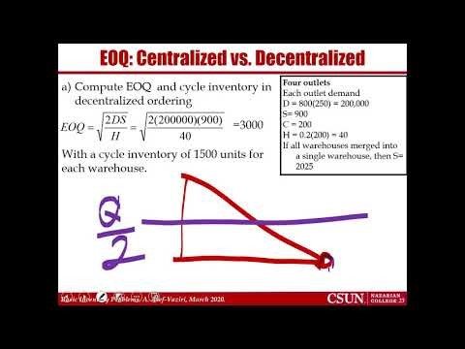
Problem 3: Recorded Lecture
https://youtu.be/mR9H30WvRlA

Slide 22
Centralization vs. Decentralization
Decentralized: Four warehouses in Poland, Italy, France, and Germany
Centralized: One warehouse in Austria
The holding cost will be the same in both decentralized and centralized ordering systems.
H(decentralized) =20%(200) = $40 per unit per yr.
H(centralized) = $40 per unit per yr.
The ordering cost in the centralized ordering system is $2025.
S(decentralized) = $900 per order.
S(centralized) >> $900 = $2025 per unit per yr. The problem assumes this. It is also realistic, when we deliver centrally, S goes up since the truck travel time in a route to 4 warehouses is longer than a trip to a single warehouse.

Slide 23
EOQ: Centralized vs. Decentralized
Compute EOQ and cycle inventory in decentralized ordering
Four outlets
Each outlet demand
D = 800(250) = 200,000
S= 900
C = 200
H = 0.2(200) = 40
If all warehouses merged into a single warehouse, then S= 2025
=3000
With a cycle inventory of 1500 units for each warehouse.
The total cycle inventory across all four outlets equals 6000.
b) Compute EOQ and cycle inventory in the centralized ordering
In this problem, in the centralized system, S = $2025.
=9000
The total cycle inventory across all four outlets equals 4500.

Slide 24
TC: Centralized vs. Decentralized
c) Compute the total annual holding cost + ordering cost (not including purchasing cost) for both policies
TC = S(D/Q) + H(Q/2)
Decentralized
TC= 900(200000/3000) + 40(3000/2)
TC = 60000+60000= 120000
Decentralized: TC for all 4 warehouses = 4(120000)=480000
Centralized
TC= 2025(800000/9000) + 40(9000/2)
TC= 180000+180000 = 360000
480000 ➔ 360000; about 25% improvement in the total costs

Slide 25
Ordering Interval, Inventory Cycle, Flow Time
d) Compute the ordering interval in decentralized and centralized systems.
Decentralized R/Dy = 800/Dy
Centralized R/Dy = 4(800) = 3200/Dy
Decentralized = 3000/800 = 3.75 days
Centralized = 9000/3200 = 2.81 days
e) Compute the average flow time
3.75/2 = 1.875 days
2.821/2 = 1.41 days
Alternatively- Using The Little’s Law
RT = I ➔ T= R/I
800T= 1500 ➔ T = 1500/800 = 1.875 days
3200T= 4500 ➔ T = 4500/3200 = 1.41 days

