Slide 1
Managing Flow Variability: Safety Inventory
Forecasts Depend on: (a) Historical Data and (b) Market Intelligence.
Demand Forecasts and Forecast Errors
Safety Inventory and Service Level
Optimal Service Level – The Newsvendor Problem
Lead Time Demand Variability
Pooling Efficiency through Aggregation
Shortening the Forecast Horizon
Levers for Reducing Safety Inventory
Notes:
........................................................................................................................................................................................................................................ ........................................................................................................................................................................................................................................
........................................................................................................................................................................................................................................ ........................................................................................................................................................................................................................................
........................................................................................................................................................................................................................................ ........................................................................................................................................................................................................................................
........................................................................................................................................................................................................................................ ........................................................................................................................................................................................................................................
........................................................................................................................................................................................................................................ ........................................................................................................................................................................................................................................
........................................................................................................................................................................................................................................ ........................................................................................................................................................................................................................................
........................................................................................................................................................................................................................................ ........................................................................................................................................................................................................................................
........................................................................................................................................................................................................................................ ........................................................................................................................................................................................................................................
........................................................................................................................................................................................................................................

Slide 3
Four Characteristics of Forecasts
Forecasts are usually (always) inaccurate (wrong). Because of random noise.
Forecasts should be accompanied by a measure of forecast error. A measure of forecast error (standard deviation) quantifies the manager’s degree of confidence in the forecast.
Aggregate forecasts are more accurate than individual forecasts. Aggregate forecasts reduce the amount of variability – relative to the aggregate mean demand. StdDev of sum of two variables is less than sum of StdDev of the two variables.
Long-range forecasts are less accurate than short-range forecasts. Forecasts further into the future tends to be less accurate than those of more imminent events. As time passes, we get better information, and make better prediction.

Slide 4
Demand During Lead Time is Variable N(μ,σ)
Demand of sand during lead time has an average of 50 tons.
Standard deviation of demand during lead time is 5 tons
Assuming that the management is willing to accept a risk no more that 5%.

Slide 5
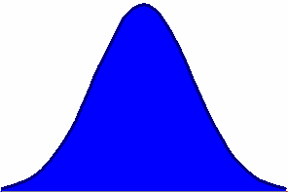

Forecasts should be accompanied by a measure of forecast error
Forecast and a Measure of Forecast Error

Slide 6
Demand During Lead Time
Inventory
Demand during LT
Lead Time
Time

Slide 7
ROP when Demand During Lead Time is Fixed
LT

Slide 8
Demand During Lead Time is Variable
LT

Slide 9
Demand During Lead Time is Variable
Inventory
Time

Slide 10
Safety Stock
Quantity
A large demand
during lead time
Average demand
during lead time
ROP
Safety stock reduces risk of
stockout during lead time
Safety stock
LT
Time

Slide 11
Safety Stock
Quantity
ROP
LT
Time

Slide 12
Re-Order Point: ROP
Demand during lead time has Normal distribution.
If we order when the inventory on hand is equal to the average demand during the lead time;
then there is 50% chance that the demand during lead time is less than our inventory.
However, there is also 50% chance that the demand during lead time is greater than our inventory, and we will be out of stock for a while.
We usually do not like 50% probability of stock out
We can accept some risk of being out of stock, but we usually like a risk of less than 50%.

Slide 13
Safety Stock and ROP
Service level
Risk of a
stockout
Probability of
no stockout
ROP
Quantity
Average
demand
Safety
stock
0
z
z-scale
Each Normal variable x is associated with a standard Normal Variable z
x is Normal (Average x , Standard Deviation x) ➔ z is Normal (0,1)

Slide 14
z Values
Service level
Risk of a
stockout
Probability of
no stockout
ROP
SL z value
0.9 1.28
0.95 1.65
0.99 2.33
Average
demand
Quantity
Safety
stock
0
z
z-scale
There is a table for z which tells us
Given any probability of not exceeding z. What is the value of z
Given any value for z. What is the probability of not exceeding z

Slide 15
μ and σ of Demand During Lead Time
Demand of sand during lead time has an average of 50 tons. Standard deviation of demand during lead time is 5 tons. Assuming that the management is willing to accept a risk no more that 5%. Find the re-order point.
What is the service level.
Service level = 1-risk of stockout = 1-0.05 = 0.95
Find the z value such that the probability of a standard normal variable being less than or equal to z is 0.95
Go to normal table, look inside the table. Find a probability close to 0.95. Read its z from the corresponding row and column.

Slide 16

z Value using Table
Given a 95% SL
95% Probability
Page 319: Normal table
0.05
The table will give you z
z
Second digit
after decimal
Z = 1.65
Up to the first digit
after
decimal
1.6
Probability

Slide 17
The standard Normal Distribution F(z)
F(z) = Prob( N(0,1) < z)
F(z)
0
z

Slide 18
Relationship between z and Normal Variable x
Service level
Risk of a
stockout
Probability of
no stockout
ROP
Quantity
Average
demand
Safety
stock
0
z
z-scale
z = (x-Average x)/(Standard Deviation of x)
x = Average x +z (Standard Deviation of x)
μ = Average x
σ = Standard Deviation of x
➔ x = μ +z σ

Slide 19
Relationship between z and Normal Variable ROP
Service level
Risk of a
stakeout
Probability of
no stockout
ROP
Quantity
Average
demand
Safety
stock
0
z
z-scale
LTD = Lead Time Demand
ROP = Average LTD +z (Standard Deviation of LTD)
ROP = LTD+zσ_{LTD} ➔ ROP = LTD + I_{safety}

Slide 20
Demand During Lead Time is Variable N(μ,σ)
Demand of sand during lead time has an average of 50 tons.
Standard deviation of demand during lead time is 5 tons
Assuming that the management is willing to accept a risk no more that 5%.
z = 1.65
Compute safety stock
I_{safety} = zσ_{LTD}
I_{safety} = 1.64 (5) = 8.2
ROP = LTD + I_{safety}
ROP = 50 + 1.64(5) = 58.2

Slide 21
Service Level for a given ROP
SL = Prob (LTD ≤ ROP)
LTD is normally distributed ➔ LTD = N(LTD, σ_{LTD} ).
ROP = LTD + zσ_{LTD} ➔ ROP = LTD + I_{safety} ➔ I _{safety} = z σ_{LTD}
At GE Lighting’s Paris warehouse, LTD = 20,000, σ_{LTD} = 5,000
The warehouse re-orders whenever ROP = 24,000
I _{safety} = ROP – LTD = 24,000 – 20,000 = 4,000
I _{safety} = z σ_{LTD} ➔ z = I _{safety} / σ_{LTD} = 4,000 / 5,000 = 0.8
SL= Prob (Z ≤ 0.8) from Appendix II ➔ SL= 0.7881

Slide 22
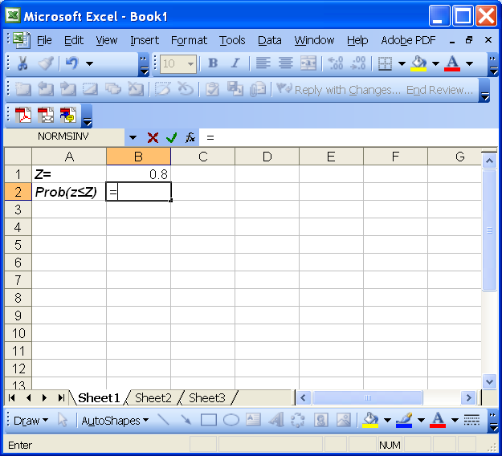
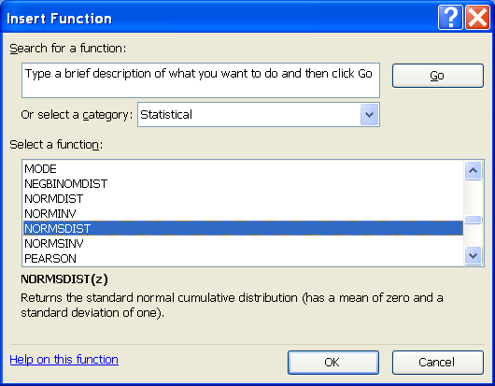
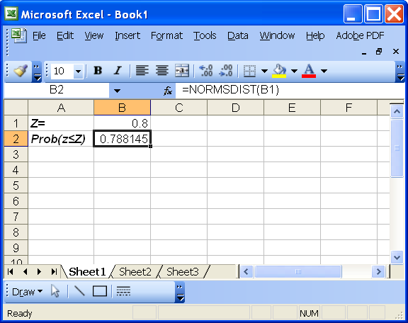
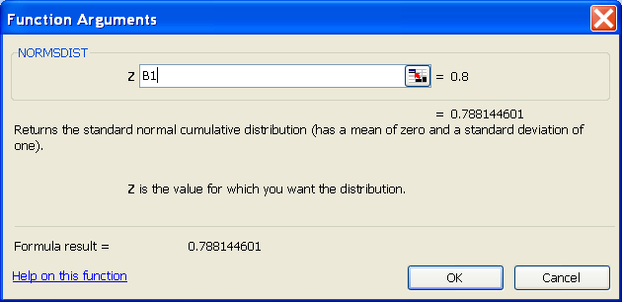
Excel: Given z, Compute Probability

Slide 23
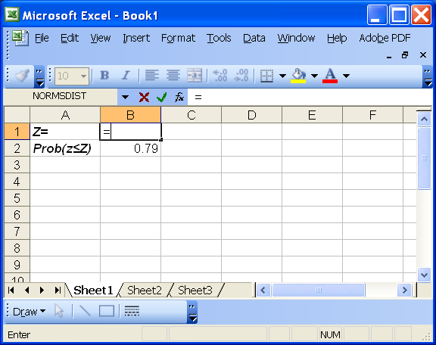
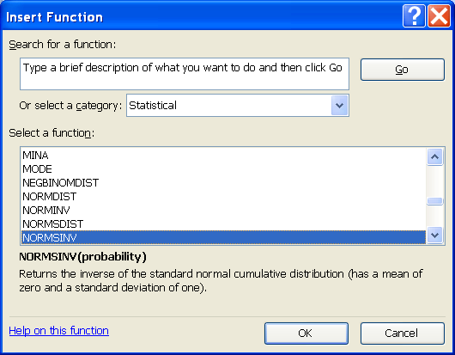
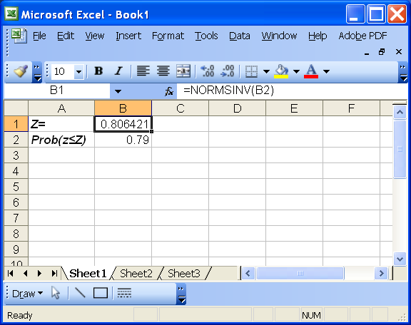
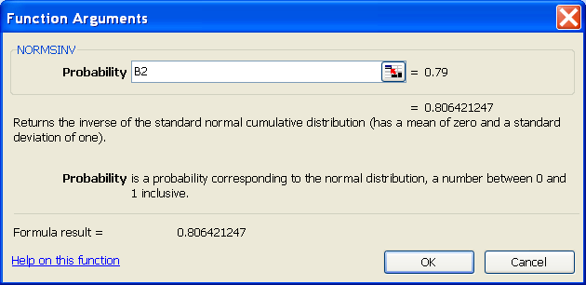
Excel: Given Probability, Compute z

Slide 24
μ and σ of demand per period and fixed LT
Demand of sand has an average of 50 tons per week.
Standard deviation of the weekly demand is 3 tons.
Lead time is 2 weeks.
Assuming that the management is willing to accept a risk no more that 10%. Compute the Reorder Point

Slide 25
μ and σ of demand per period and fixed LT
R: demand rate per period (a random variable)
R: Average demand rate per period
σ_{R}: Standard deviation of the demand rate per period
L: Lead time (a constant number of periods)
LTD: demand during the lead time (a random variable)
LTD: Average demand during the lead time
σ_{LTD}: Standard deviation of the demand during lead time

Slide 26
μ and σ of demand per period and fixed LT
A random variable R: N(R, σ_{R}) repeats itself L times during the lead time. The summation of these L random variables R, is a random variable LTD
If we have a random variable LTD which is equal to summation of L random variables R
LTD = R₁+R₂+R₃+…….+R_{L}
Then there is a relationship between mean and standard deviation of the two random variables

Slide 27
μ and σ of demand per period and fixed LT
Demand of sand has an average of 50 tons per week.
Standard deviation of the weekly demand is 3 tons.
Lead time is 2 weeks.
Assuming that the management is willing to accept a risk no more that 10%.
z = 1.28, R = 50, σ_{R} = 3, L = 2
I_{safety} = zσ_{LTD} = 1.28(4.24) = 5.43
ROP = 100 + 5.43

Slide 28
Lead Time Variable, Demand fixed
Demand of sand is fixed and is 50 tons per week.
The average lead time is 2 weeks.
Standard deviation of lead time is 0.5 week.
Assuming that the management is willing to accept a risk no more that 10%. Compute ROP and I_{safety}.

Slide 29
μ and σ of lead time and fixed Demand per period
L: lead time (a random variable)
L: Average lead time
σ_{L}: Standard deviation of the lead time
RL
R: Demand per period (a constant value)
LTD: demand during the lead time (a random variable)
LTD: Average demand during the lead time
σ_{LTD}: Standard deviation of the demand during lead time
R
L

Slide 30
μ and σ of demand per period and fixed LT
A random variable L: N(L, σ_{L}) is multiplied by a constant R and generates the random variable LTD.
If we have a random variable LTD which is equal to a constant R times a random variables L
LTD = RL
Then there is a relationship between mean and standard deviation of the two random variables
RL
R
L

Slide 31
Variable R fixed L…………….Variable L fixed R
R
+
R
+
R
+
R
+
R
RL
R
R
R
R
R
R
L
L

Slide 32
Lead Time Variable, Demand fixed
Demand of sand is fixed and is 50 tons per week.
The average lead time is 2 weeks.
Standard deviation of lead time is 0.5 week.
Assuming that the management is willing to accept a risk no more that 10%. Compute ROP and I_{safety}.
z = 1.28, L = 2 weeks, σ_{L} = 0.5 week, R = 50 per week
I_{safety} = zσ_{LTD} = 1.28(25) = 32
ROP = 100 + 32

Slide 33
Both Demand and Lead Time are Variable
R: demand rate per period
R: Average demand rate
σ_{R}: Standard deviation of demand
L: lead time
L: Average lead time
σ_{L}: Standard deviation of the lead time
LTD: demand during the lead time (a random variable)
LTD: Average demand during the lead time
σ_{LTD}: Standard deviation of the demand during lead time

