Slide 1

On the Student s’ Academic Success Facet of the Strategic Positioning of a College of Business
Ardavan Asef-Vaziri
Systems and Operations Management, COBAE, CSUN

Slide 2
CSUN Transformation Process
Value System
Information Infrastructure
Value System
Information Infrastructure
Freshmen
Regional
International
Freshmen
Regional
International
Network of Value Added and Non-Value Added Activities
Network of Value Added and Non-Value Added Activities
Graduate
Drop-offs
Graduate
Drop-offs
Transfers
Regional
International
Transfers
Regional
International
Human
Resources
Capital
Resources
Human
Resources
Capital
Resources

Slide 3
Process Competencies
Perceptions
Customer Value Proposition
➔
➔
Stakeholders Satisfaction
Customer Satisfaction
Expectations
➔
➔
➔
➔
Process Competencies
Value Chain Performance
Financial Performance
➔
➔
➔
➔
➔
➔
Cost
Cost
Flow Time
Quality
Flexibility
Quality

Slide 4
Competitive Space; Quality and Cost Efficiency
S
B
P
Quality of the Resources and Processes
CSUN
N
Cost

Slide 5
Competitive Space; Quality and Cost Efficiency
Quality of the Resources and Processes
Cost
Cost Efficiency: 1/Cost

Slide 6
Competitive Space; Quality and Cost Efficiency
World
Class
Universities
Quality of the Resources and Processes
Cost Efficiency

Slide 7
Competitive Space; Quality and Cost Efficiency
S:1/45
P:1/42
B=1/15
N/15
C:1/7
S
B
P
Quality of the Resources and Processes
CSUN
N
Cost Efficiency

Slide 8
Flow Time: COABE. 11-Years Graduation Rate and Time To Graduation Performance

Slide 9
Competing Edges and Process Competencies
Perceptions
Customer Value Proposition
➔
➔
Stakeholders Satisfaction
Customer Satisfaction
Expectations
➔
➔
➔
➔
Process Competencies
Value Chain Performance
Financial Performance
RT=I
R = Throughput = 1574
I = Population = 6144
T =3.94 year life at CSUN
Freshman 41%
Drop-off 11%
TtD = 0.25 TtGF
TtGT = 0.5 TtGF
TtGF =6.0 years
➔
Inventory
➔
➔
➔
➔
➔
Throughput
Cost
Flow Time
Flow Time
Flow Time
Quality
Flexibility

Slide 10

Flow Time: Time To Graduation

Slide 11

Flow Time: Time To Graduation
4-year GR =13%, 9- year GR= 67%. Time to graduation, for those graduating in ≤ 9 years has µ = 6.3, σ = 2.6 years.

Slide 12
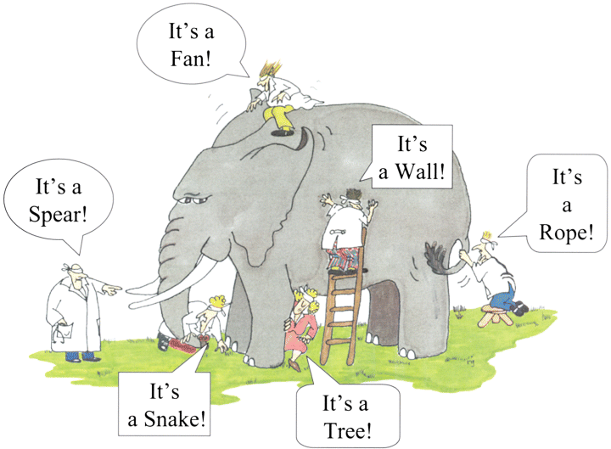
Systems Thinking; Rumi- Elephant in the Dark
Global Optimal vs. Local Optimal

Slide 13
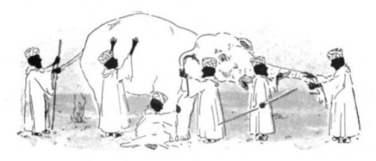
Systems Thinking; Elephant in the Dark
Rumi, the 13th Century Persian poet, and the teacher of Sufism, has a retelling of the story of the blind men and an elephant originated in India "The elephant in the dark".
  Felt the elephant with his palm in the darkness.
  If each had a candle, differences would disappear.
From Rumi that Muslim teacher of Sufism and Systems -thinking in 13th century to Eliahu Goldratt, an Israeli physicist in 20th
Theory of constraints
  An enterprise is a chain
  The chain is only as strong as its weakest link.

Slide 14

Theory of Constraints
  Just like the links of a chain, the resources and learning processes at CSUN work together to generate value for the students and other stakeholders. A chain is as strong as its weakest link.
Time, effort, and funds devoted to non-binding constraints are a waste of organizational resources.

Slide 15
The Weakest Link; The binding Constraint
Better text books
Revision of our teaching material
Assignments to fill the gap between capability of our students and requirements of our text books
Hiring higher quality professors
Replacing Problem solving with case studies
Active learning, problem based learning, Peer Lerning
Increasing the utilization of our classrooms
Replacing chairs and desks of the classrooms
Add more Technology in classroom
Ipad in our classroom

Slide 16
Competitive Space; Quality and Cost Efficiency
Production of a Cartier Rolex watch and Asef’s
Watch using exactly the same
process competencies.
Quality of Raw material and WIP
Physical segregation ➔ politically incorrect
Honor Student Sessions ➔ not fit the schedule of all honors
Virtual Segregation
Cost Efficiency

Slide 17
The Core Course of Operations Management
Pre-requisites and Past Performance
15%(A,A-)
35%(C-,D+, D,D-,F)
15%(B-,B, B+)
35%(C, C+)
OM
FM
LD5
LD4
LD3
GW
LD2
LD2

Slide 18
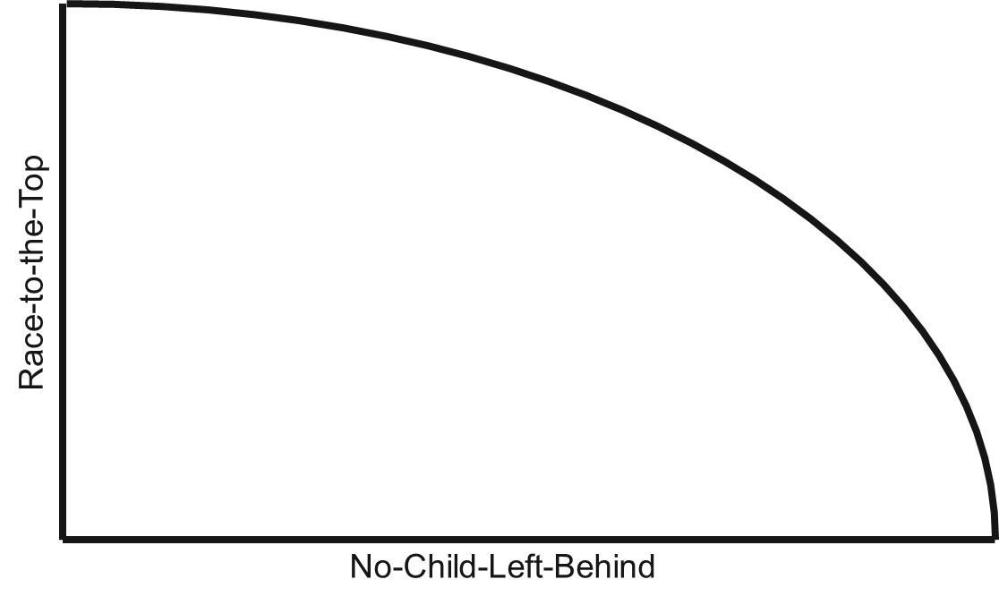
The Gap Between Layers of Students
Turn D and F students into C students. Or Turn A and B students into MS and PhD candidates. Unlike Sci., Eng. and Soc. Science at CSUN, COBAE is not known for MS and PhD.

Slide 19

Scheduled Availability and Net Availability
We need to refuses to accept current NA/SA as a constraint, and treat them as variables.
Exploit the constraints
Subordinate everything else to that constraint
Elevate the Constraints
When the constraint is relaxed, look for the next constraint

Slide 20
The 3 Binding Constraints
Deep Gap in Students Capabilities
Low Scheduled Availability
Net Availability Distracts

Slide 21


Scheduled Availability and Net Availability
Scheduled-availability: the time that students spend on campus or anywhere on their education.
Net-availability: level of concentration during scheduled-availability. Surfing unrelated sites and text messaging are perfect instantiations of net-availability detracts

Slide 22

How to Operationalize the Strategy
Promotion/advertisement. Reduce working & leisure time.
Improved time management
Develop a culture, if you are not focused now you need to allocate more time later.
NPV of the direct financial costs of delayed graduation.
NPV of economics and social costs of delayed graduation.
Changing the fee structure.
Grant Writing. From SUBWAY to on-campus employment.
Centralization, e.g. Admission and Library processes. Intends to allocate the released resources to more value-added activities such as advisement and internship.
Flipped Classroom. Deliver the lectures online. Assign the class time to more value added activities.

Slide 23
Time to Graduation vs. Variety
What % of honor and likely-honor students
can take honor sessions ?
(schedule conflict).
Variety
4
5
6
7
8
9
Time to Graduation (TtG)

Slide 24
Retention Rate vs. Variety
Variety
Retention Rate (RR)
40%
50%
60%
70%
80%
90%

Slide 25

Scheduled Availability and Net Availability
The most binding constraints on GR & TtG are
  Scheduled-availability: the time that students spend on campus or anywhere on their education.
  Net-availability: level of concentration during scheduled-availability. Surfing unrelated sites and text messaging are perfect instantiations of net-availability detracts.
We need to refuses to accept current NA/SA as a constraint, and treat them as variables.
Exploit the constraints
Subordinate everything else to that constraint
Elevate the Constraints
When the constraint is relaxed, look for the next constraint

Slide 26
How to Increase SA&NA. Student Side
Reduce working hours, leisure time
Improved time management
NPV of the direct financial costs of delayed graduation..
NPV of economics and social costs of delayed graduation.
Changing the fee structure. Not the same fee for 12-21units, benefit of economy of scale, failure or low quality graduates.
Centralization of processes such as library, no downsizing, allocate the released resources to advisement and internship
Develop a culture, if you are not focused now you need to allocate more time later.
Flipped Classroom. Deliver the lectures online. Assign the class time to more value added activities.

Slide 27
Admissions & Records; Inverse Seasonality Relationship
Notes:
FRANCIS

Slide 28

eTranscript
Notes:
FRANCIS

Slide 29
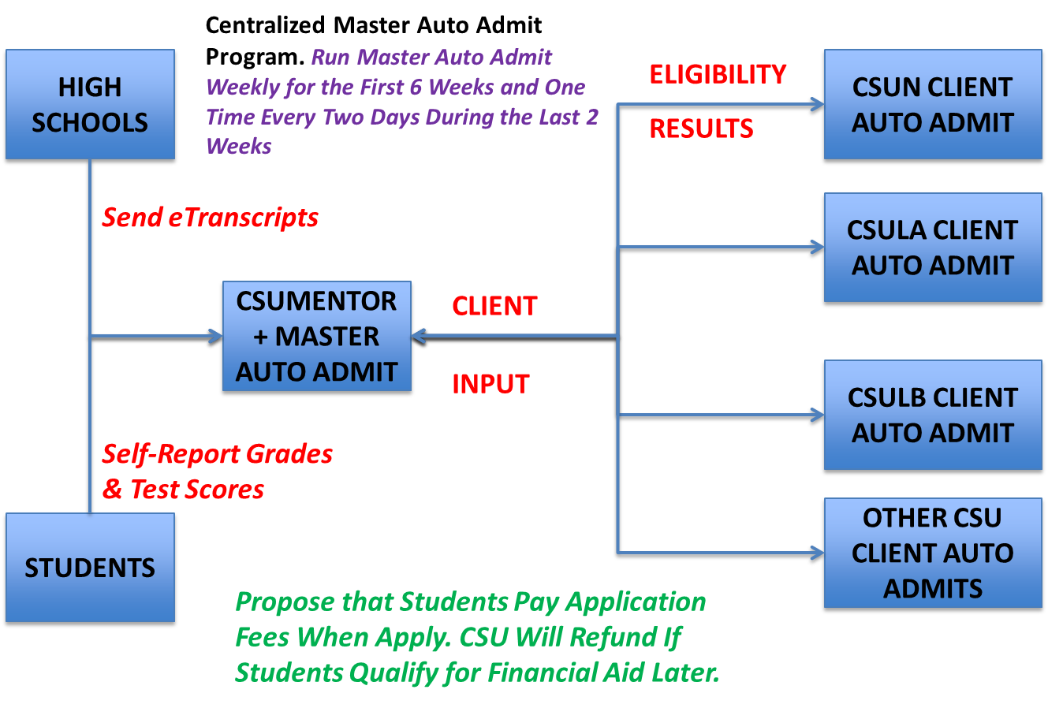
Centralized Admission
Notes:
JULIAN

Slide 30
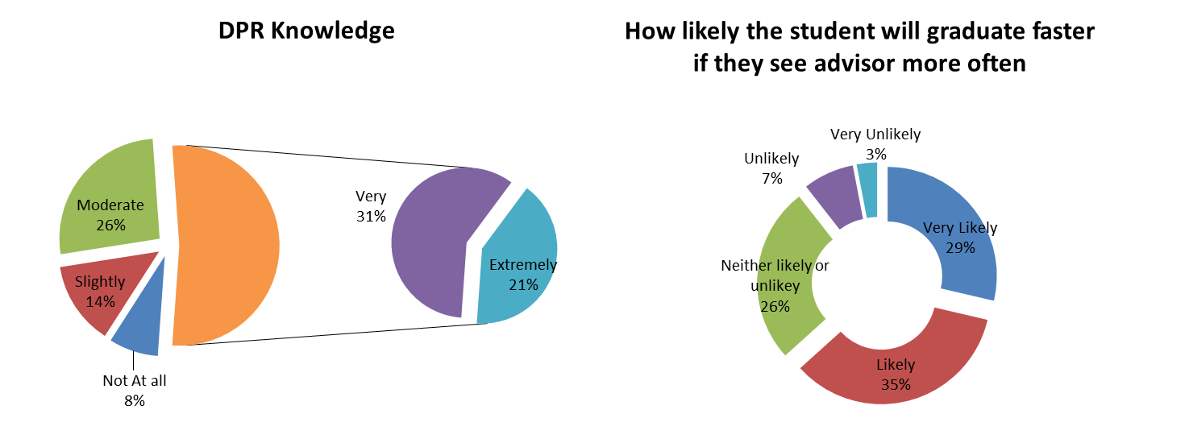
DPR Knowledge; Questionnaire Results
Notes:
TONI

Slide 31
Academic Advisement Reform
Use $9.7M in potential cost savings from e-Transcript and Master Auto Admit to:
  Hire more academic advisors
    $70,000 annual salary/academic advisor
    138 new academic advisors ($9.7M/$70K)
    CSUN gets 12 more academic advisors per year
  Provide advising services during evening hours
  Mandatory advisement for students with GPA < 3.0 every semester.
  Provide more workshop on DPR knowledge

Slide 32
Savings from One Semester Shorter TtG
Notes:
JULIAN

Slide 33
Course Repetition Reduction
Each (resident) student reduces course repetition by 1.2 semester units per semester.
CSU saves $16.4 million per year

Slide 34
Course Delivery System Matrix
Traditional, Hybrid, Online, or Flipped
  On the spectrum from pure qualitative to pure quantitative, where the course is standing. Which of the 4 course delivery system is the strategic fit for this type of courses.
  Where the student is standing; FM, SM, JR, SR. Which of the 4 course delivery system is the strategic fit for this year in the program.
  On the spectrum from pure individual work to pure teamwork, where the course is standing. Which of the 4 course delivery system is the strategic fit for this type of course.
  On the spectrum from pure qualitative to pure quantitative, where the course is standing. What can Ipad do for this type of courses.

Slide 35
Flipped Classroom
    By delivering the lectures online using recorded screen captures, the students are empowered to stop, rewind, and Fast Forward the professor.
    This is an excellent learning power.
    Class time is no
Problem solving
Trouble shouting
Participation
Enhancement
Real world Apps
and Discussions
Systems-thinking
Creative -thinking
Case studies
Web-based Simulation
    longer spent on teaching the basic concepts, but on more value-added activities

Slide 36
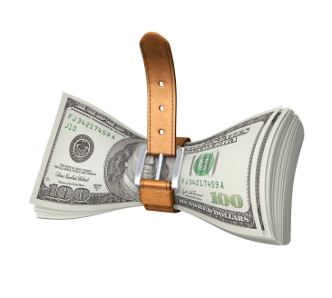

Cost World – Bounded World
Reduction in the cost of a traditional course delivery by switching it to online is bound by the total cost of the course.
Improvement by moving online or hybrid is also limited. 2%, 5%, 10%, or
-%?

Slide 37


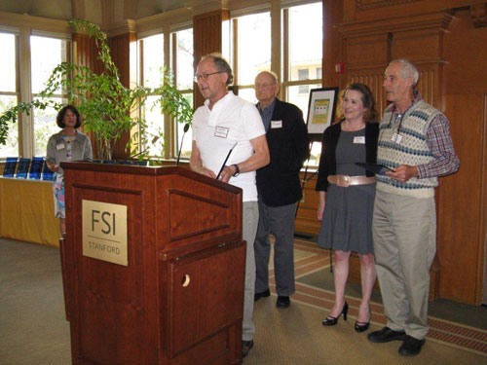
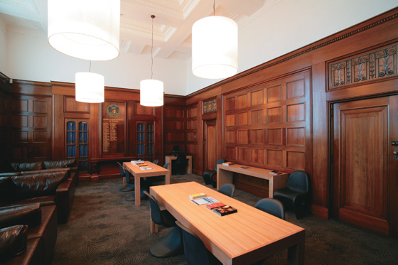
Costs = Trips, Professors, Classrooms, TAs
For the hybrid courses to achieve their cost reduction goal from the students’ perspective, it is important to bundle 2-4 courses in a hybrid form - to save a direct $ and indirect (time) cost of round trip to campus.
Online and hybrid, no prof., extensive TA hours?
Opportunity cost of room > Opportunity
cost of professor.

Slide 38

Cost World – Behavioral Aspects
Make the educational entity more efficient through workforce reduction? Human resources will informally resist.
First generation college students;
face-to-face, live communication with their professors; their role models, their future friends. That is a valuable chuck to put on their parents table.

Slide 39

Cost World vs. Throughput World
Flipped Courses belong to the throughout world. The feasible region of the throughput in the direction of improvement of the objective function is unbounded.
Online courses are Made To Stock products. Flipped classroom is Make to Order.

Slide 40
Cost World vs. Throughput World
Class discussions in a flipped classroom can differentiate us. Transfer our courses into a non-tradable products; a product renewing itself in each new offering. Flipped Courses add to dynamic capabilities of universities.
Not even a single class session is cancelled in a flipped classroom, while all the lectures are delivered online.

Slide 41
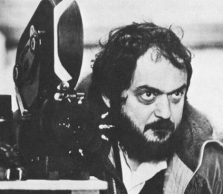
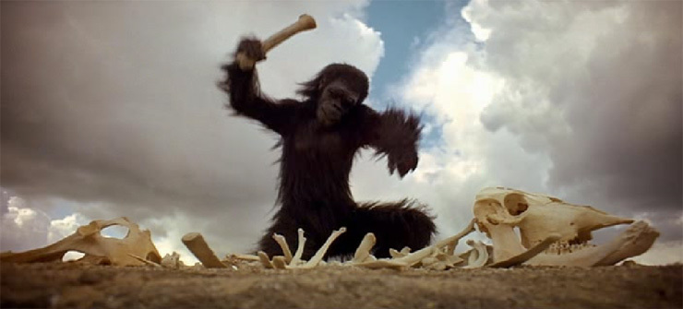

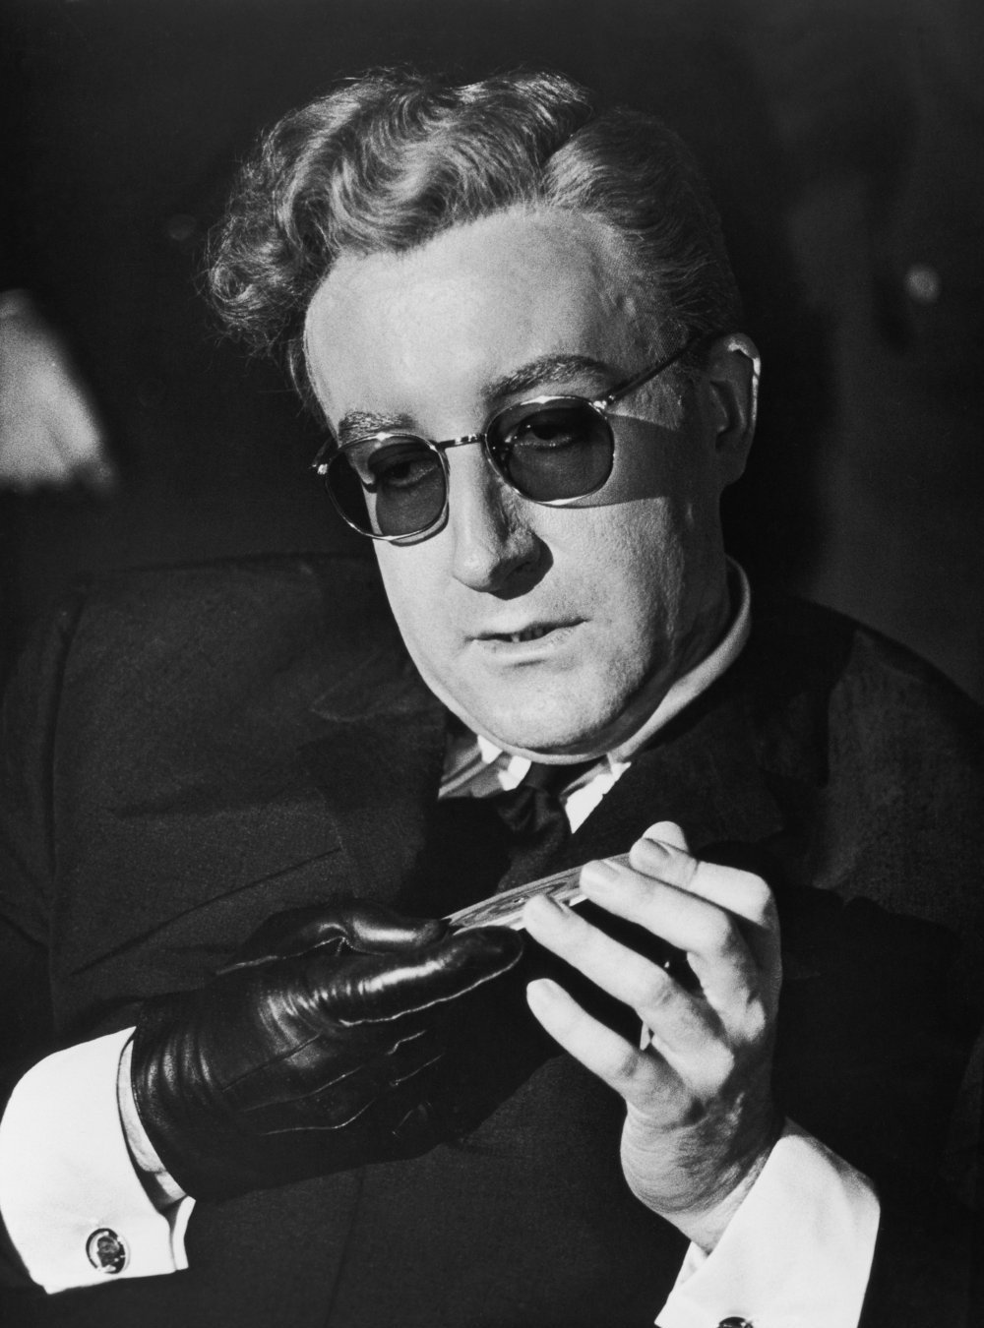
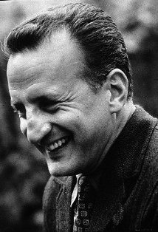
Great Films are not just a great Idea

Slide 42
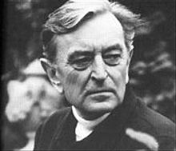




Great Films are a Network of Good Chunks well Integrated.

Slide 43
Flipped Classroom Has All the Competing Edges of Traditional, Hybrid, and Online Courses
In order for a flipped classroom to outperform its substitutes it need to at least have all online and hybrid capabilities.
Four competing edges of a successful course is clear, consistent, high expectations, just in time support, continual assessment (early feedback and understand secret of early effective warning system warning on performance and how to improve) , student engagement social engagement collaborative teaching

Slide 44
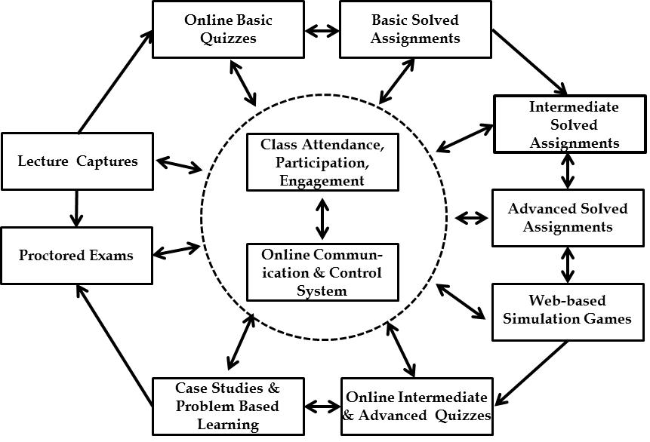
The Total Flipped Classroom System

Slide 45


Class Attendance, Class Participation, Class Engagement
Class Attendance
Class Enhancement
Class Participation

Slide 46
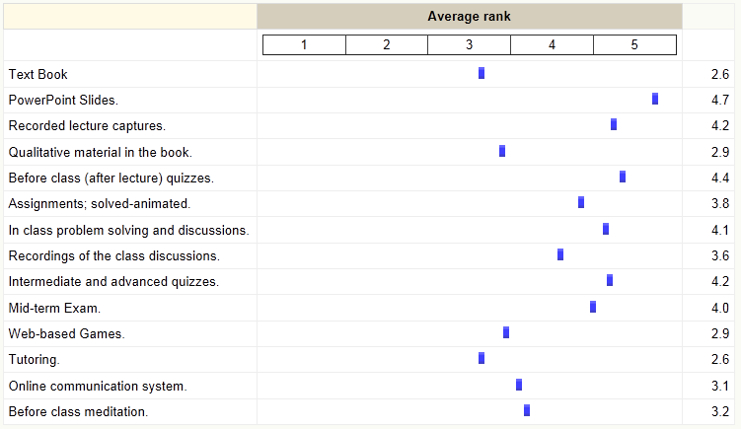
The network of 16 Resources and Learning Processes to Re-enforce the Core Concept

Slide 47
Time To Graduation- Micro View; Statistics

Slide 48
CSUN. 11-Years Graduation Rate and Time To Graduation Performance

Slide 49
Time To Graduation- Micro View; Statistics

Slide 50

Meetings, Pounds of Sticky Notes
  Meetings; how to improve something; Ex. Increasing GR and reducing TtG.
Sticky notes ➔ 10s of ideas; each writes a different prescription.
Each sticky note looking at the hill on its own horizon as the top of the mountain
Local View, Local Optimization, Sub-system optimization.
Global ➔ Send the students to China, Brazil, India….
Global ➔ Have a global view- ➔ Systems Thinking ➔ see the elephant

Slide 51
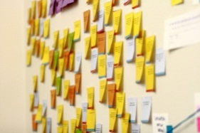
Meetings, Sticky Notes
  Meetings; how to improve something; Ex. Increasing GR and reducing TtG.
Sticky notes ➔ 10s of ideas; each writes a different prescription.
Each sticky note looking at the hill on its own horizon as the top of the mountain
Local View, Local Optimization, Sub-system optimization.
Global ➔ Send the students to China, Brazil, India….
Global ➔ Have a global view- ➔ Systems Thinking ➔ see the elephant

Slide 52
Flexibility of Processes vs. Quality of Row Material
do not offer enough elective courses
for the required courses, students on long waiting lines and beg their professors to enroll in a session fitting their schedule. They work 20-40 hrs
Cost
Flow Time
Flexibility
Quality
Flexibility

