Slide 1

Initiative 2025
A system Theory & Operations Strategy Perspective
Ardavan Asef-Vaziri
Systems and Operations Management, DN-COBE CSUN

Slide 2
In order to accelerate TtG and GR, we will subsidize summer class
In God we trust; all others must bring data.
W. Edwards Deming 1900-1993.

Slide 3
Malaria, mosquito, and DDT
Back in the 1950, people in a region of Borneo (in Indonesia) were having trouble with malaria. In an effort to save lives, the World Health Organization (WHO) decided to intervene by drastically reducing the mosquito population (mosquitoes being carriers of malaria). To do so, they sprayed the insecticide DDT all over the area, killing many mosquitoes and significantly reducing the incidence of malaria.

Slide 4
DDT, Wasps, Caterpillars, and Roofs
However, DDT not only successfully killed mosquitoes - it also attacked a parasitic wasp population. These wasps, it turned out, had kept in check a population of thatch-eating caterpillars. So with removal of the wasps, the caterpillars flourished, and soon building roofs started falling in all over the place.

Slide 5
DDT, Geckoes, Cats, and Rats
As if that was not enough the insects, poisoned by DDT, were consumed by geckoes. The biological half-life of DDT is around 8-years, so animals like geckoes do not metabolize it very fast, and it stays in their system for a long time. Those geckoes, carrying the DDT poison, were in turn hunted and eaten by the cat population. With far less cats, rats took over and multiplied, and this in turn led to outbreaks of typhus and sylvatic plague (which are passed on by rats).

Slide 6
Mission Accomplished
By now the cure had become worse than the initial disease, so the WHO parachuted a bunch of live cats into Borneo. The event was known as Operation Cat Drop.

Slide 7
CSUN Transformation Process
Value System
Information Infrastructure
Value System
Information Infrastructure
Network of Value Added and Non-Value Added Activities
Network of Value Added and Non-Value Added Activities
Freshmen
Freshmen
Graduate
Drop-outs
Graduate
Drop-outs
Transfers
Transfers
Human
Resources
Capital
Resources
Human
Resources
Capital
Resources

Slide 8
Process Competencies
Perceptions
Customer Value Proposition
➔
➔
Stakeholders Satisfaction
Customer Satisfaction
Expectations
➔
➔
➔
➔
Process Competencies
Value Chain Performance
Financial Performance
➔
➔
➔
➔
➔
➔
Cost
Cost
Flow Time
Quality
Flexibility
Quality

Slide 9
Count what is countable.
Measure what is measurable.
What is not measurable, make it measurable.
Galileo Galilei, 1564 -1642.

Slide 10
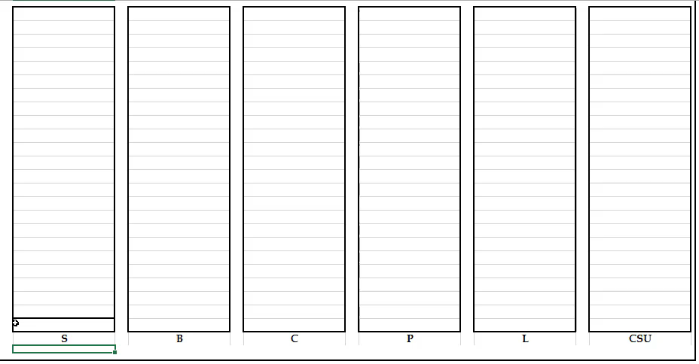
Quality of Human and Capital Resources

Slide 11
Competitive Space; Quality and Cost Efficiency
Quality of the Resources and Processes
Cost

Slide 12
Competitive Space; Quality and Cost Efficiency
Quality of the Resources and Processes
Cost Efficiency: $36000/Cost
Cost

Slide 13
Competitive Space; Quality and Cost Efficiency
S
B
World
Class
Universities
C
P
Quality of the Resources and Processes
CSUN
L
Cost Efficiency
S ≈ 1, P ≈ 1, B ≈ 3, N ≈ 3, CSUN ≈ 6. Money Magazine ➔ one of the top 10 money valued

Slide 14
Competing Edges and Process Competencies
Perceptions
Customer Value Proposition
➔
➔
Stakeholders Satisfaction
Customer Satisfaction
Expectations
➔
➔
➔
➔
Process Competencies
Value Chain Performance
Financial Performance
➔
Inventory
➔
➔
➔
➔
➔
Throughput
Cost
Flow Time
Flow Time
Flow Time
Quality
Flexibility

Slide 15
16-Year Performance. Head Counts, Incomings, Graduates, Drop-outs.

Slide 16
6-Period Moving Average (alpha =0.29 ES), Incomings, Graduates, Drop-outs

Slide 17
Competing Edges and Process Competencies at DN-CBAE
RT=I
R = Throughput = 1668, I = Population = 6255
T =3.75 year life at CSUN
Freshman ≈ 40%, Transfer ≈ 60%, and & Drop-out ≈ 14%
Freshman ≈ 35%, Transfer ≈ 53%, and & Drop-out ≈ 12%
TtD=0.25 TtGF & TtGT=0.5 TtGF
0.35TtGF+0.53(0.5TtGF)+0.12(0.25TtGF)=3.75
0.645TtGF = 3.75 ➔ TtGF = 5.81
If 73 per year increase in population included, then
0.645TtGF = 6878/1668
TtGF= 6.4

Slide 18
95% Confidence Interval: TtG for FTF and FTT

Slide 19
Increase in Freshmen HC: Incoming FTF/FTT, Headcount FTF/FTT

Slide 20
From 3-D space of Quality-Cost-Time, 1-D space of Q/C/T
Assuming the expected TtG at Stanford is 4 years.
In the TtG dimension, CSUN performs 50% weaker than Stanford. In the TtG, if Stanford is 1, CSUN performs 0.67.
Given the previous Q/C for CSUN is 3 times of that of Stanford.
If we map the three dimensional space of Q-C-T into one dimensional space of Q/C/T
Q/C = 3 ➔ Q/C/T = 0.67(3) =2.
In that 50% additional time, the students not only pay all their tuition fee, but also still are employed at a low rate, perhaps under 40 hours and perhaps lover benefits. So it is reasonable to assign a weight of 2 or even 3 to that 0.5, changing 1.5 to 2, or 2.5.
Therefore, 1/1.5 or 0.67 ➔ 1/2 or 0.5 ➔1/2.5 or 0.4
The Q/C/T of CSUN then turn into 1.5, and 1.2, respectively

Slide 21
Competitive Space; Quality/Cost/Time Efficiency
Quality of the Resources and Processes
Time-Cost Efficiency
Cost Efficiency

Slide 22
Competitive Space; Quality/Cost/Time Efficiency
S
B
World
Class
Universities
C
P
Quality of the Resources and Processes
CSUN
L
Time-Cost Efficiency

Slide 23
Flexibility of Processes vs. Quality of Row Material
We do not offer enough elective courses.
For the required courses, students on long waiting lines and beg their professors to enroll in a session fitting their schedule. They work 20-40 hrs.
Cost
Flow Time
Flexibility
Quality
Flexibility

Slide 24
Competitive Space; Quality and Cost Efficiency
S
B
World
Class
Universities
C
P
Quality of the Resources and Processes
CSUN
L
Flexibility &Time-Cost Efficiency

Slide 25
The University-Wide Event, Feb. 2014. “Enhancing the Academic Potential of our Students.” Solutions↓
Let students know we expect them to graduate.
Address students from a holistic perspective.
Mentor students.
Help students connect the dots. Don’t allow them to experience the University as a fragmented bureaucracy.
Smile, say hello, look students in the eye, and ask they how their day is going.
Show students that you care (know and use their names; follow up if you know something happened to a student; be specific in praising students’ work; be responsive to student inquiries. Encourage free-flow discussion in class, including opposing views.

Slide 26
The University-Wide Event, Feb. 2014. “Enhancing the Academic Potential of our Students.” Solutions↓
Understand students come to CSUN with some bad habits.
Let students know not only what services are available to help them but also how to access and use them.
Talk about the needs and benefits of simple reading, critical thinking, and observing deadlines.
Acknowledge the power differential students feel with us;
Provide opportunities for student reflection.
Share your love of learning.
Reflect on how you deal with your frustration with students.
Explore options with students. Listen to their goals and reassure them.
Don’t give up on a struggling student.

Slide 27
The University-Wide Event, Feb. 2014. “Enhancing the Academic Potential of our Students.” Solutions↓
Establish a sense of belonging to the campus.
Come to class prepared and enthusiastic about teaching.
Engage students through active learning. Focus on skills, not just content.
Incorporate technology in the classrooms.
If these are the solutions then why we are riding full speed to online.

Slide 28
More Recently- Mid 2016
Mission
Academic Standards
Academic Integrity
High DUF (D, F, W, U)
What a student think of a full load
California Compete
Strategic Priorities
ACC third in the nation
Core review
Mindset 12 units per semester while 15 or more is needed
They do NOT need to start their education by an internship

Slide 29
More Recently- Mid 2017
Unattended consequences
Things College, Dept., Individual do.
Institute of Urban studies??
Classes to be diversified=- more classes offered
Online and hybrid- students are self motivated
A module to show what an online class looks like
Prerequisite to assure academic preparedness
What courses have high rejection rates

Slide 30
Faculty Senate Last Meeting, 2016
CSUN’s approach to enhancing student success center around:
  1. Teaching and Learning
  2. Student Support Services
  3. Student Engagement and Belonging
  4. Streamlining the Path to a Degree.
Five areas of focus in the proposal are:
  1. Enrollment Management,
  2. Advising
  3. Data Capability Expansion
  4. First Year for Freshmen and Transfers
  5. Retention.

Slide 31
Faculty Senate Last Meeting, 2016
Various long-term and short-term projects as they relate to the five areas of focus.
Strategies for reducing student-to-faculty ratios in lower division GE and major courses.
Literature suggests that first-generation students and students from traditionally underrepresented groups perform better in classes that are less than 50-80 students.
Strategies to reduce class size (40-50 students) in a small number of courses with high DUF rates.
We need to figure out what works, and then we plan to ask for funding to continue with strategies that work.

Slide 32

Where is the Solution?
Better text books
Revision of our teaching material
Assignments to fill the gap between capability of our students and requirements of our text books
Hiring higher quality professors
Replacing Problem solving with case studies
Active learning, problem based learning, Peer Learning
Increasing the utilization of our classrooms
Replacing chairs and desks of the classrooms
Add more Technology in classroom
Ipad in our classroom

Slide 33
Effect of Performance Measures
Tell me how you will measure me and I will tell you how I will behave.
If you measure me in an illogical way, … do not complain about illogical behavior.
If you measure me in an unreasonable way, no one knows how I will behave....
Not even me.

Slide 34
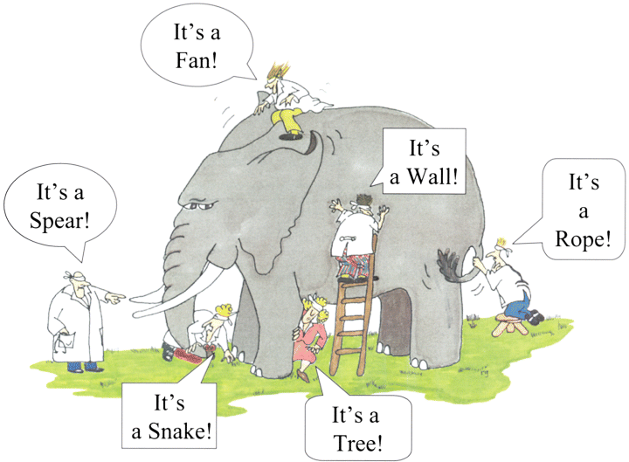
Systems Thinking; Rumi- Elephant in the Dark

Slide 35
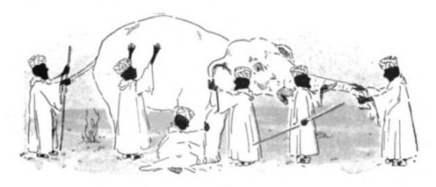
Systems Thinking; Elephant in the Dark
Rumi, the 13th Century Persian poet, and the teacher of Sufism, has a retelling of the story of the blind men and an elephant originated in India "The elephant in the dark".
  Felt the elephant with his palm in the darkness.
  If each had a candle, differences would disappear.
From Rumi that Muslim teacher of Sufism and Systems -thinking in 13th century to Eliahu Goldratt, an Israeli physicist in 20th
Theory of constraints
  An enterprise is a chain
  The chain is only as strong as its weakest link.

Slide 36
Theory of Constraints
  Just like the links of a chain, the resources and learning processes at CSUN work together to generate value for the students and other stakeholders. A chain is as strong as its weakest link.
Time, effort, and funds devoted to non-binding constraints are a waste of organizational resources.
We need to refuses to accept current NA/SA as a constraint, and treat them as variables.
Exploit the constraints
Subordinate everything else to that constraint
Elevate the Constraints
When the constraint is relaxed, look for the next constraint
What is the constraint?

Slide 37
FTE/Student; FTF, FTT, HC-Net-F, HC-Net-T

Slide 38
SAT (V&M), H-GPA

Slide 39
SAT (V&M), H-GPA

Slide 40
95% CI: 1-Tail Test of Hypothesis HGPA, SATV, SATM

Slide 41
Required Number of FTF Graduates to Reduce TtG to 7, 6, 5, 4 Years

Slide 42
Required % Increase in GR to Reduce TtG to 7, 6, 5, 4 Years

Slide 43
Required % Increase in GR to Reduce TtG to 7, 6, 5, 4 Years- 6P-MA (ES; α =0.29)

Slide 44
The Efficient Frontier: CSUN vs Stanford

Slide 45
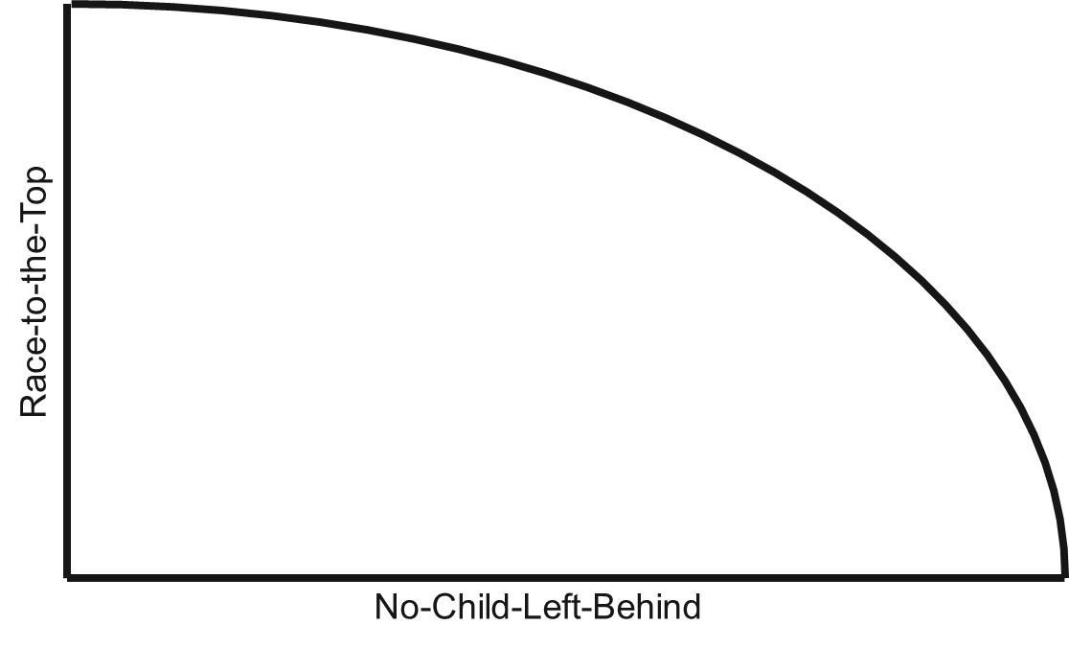
Binding Constraints
PWP, MTS, MTO
Turn D and F students into C students. Or Turn A and B students into MS and PhD candidates. Unlike Sci., Eng. and Soc. Science at CSUN, COBAE is not known for MS and PhD.

Slide 46

Race to the Top
PWP, MTS, MTO
No Child Left Behind

Slide 47
Competitive Space; Quality and Cost Efficiency
Production of a Cartier Rolex watch and Asef’s
Watch using exactly the same
process competencies.
Quality of Raw material and WIP
Physical segregation ➔ politically incorrect
Honor Student Sessions ➔ not fit the schedule of all honors
Virtual Segregation
Cost Efficiency

Slide 48
Time to Graduation vs. Variety
What % of honor and likely-honor students
can take honor sessions ?
(schedule conflict).
Variety
4
5
6
7
8
9
Time to Graduation (TtG)

Slide 49
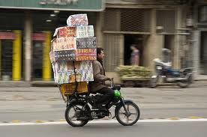
Continuity
Lack of vertical and horizontal link between courses. When we want to create something new, we think of creating a new object. A system is composed of objects off course, but more importantly, what defines a system is the network of the interrelationships between the objects. There are about 400-500 cars in the US, let’s get the best component of each, for example the best engine, perhaps Rolls Royce, best transmission- perhaps Mercedes, the best X, the best Y, ……. Let’s put them together; it cannot even ride, because the links do not work. My OM course is vertically related toMATH103,MATH140, ECON160, BUS497. It is also horizontally related to FIN303. link creation.

Slide 50

Scheduled Availability
NPV of the direct financial costs of delayed graduation.
NPV of economics and social costs of delayed graduation.
Promotion/advertisement. Reduce working & leisure time.
Improved time management
Changing the fee structure. Not the same fee for 12-21units, benefit of economy of scale, failure or low quality graduates.
Centralization, e.g. Admission and Library processes. Intends to allocate the released
resources to more value-added
Pooling, e.g., Admission and Records.
Flipped Classroom. Deliver the lectures online. Assign the class time to more value added activities.

Slide 51

Net Availability
Net-availability: the level of concentration during scheduled-availability. Surfing unrelated sites and text messaging in class are examples of net-availability detract.
I will have my cell phone laptop or tablet OFF except for reasons directly and fully related to SOM306 material.
I will not create any background noise or disturbance during lectures. Otherwise, after the first not, my class participation grade will be set to zero.
I understand the Student Core Values are: Respect, Honesty, Integrity, Commitment, and Responsibility.

Slide 52
Binding Constraints
Lack of Understanding the Requirements of Quantitative Courses. There are profound differences in the nature, learning tools, technology, and the requirements of quantitative vs. qualitative courses.
Lack of Understanding the Appropriateness of Online Courses.
Assuming four rows of a matrix as freshman, sophomore, junior, and senior, and four columns of quantitative, close to quantitative, close to qualitative, and qualitative courses, directions of our future research is to analyze which of traditional, hybrid, online, and flipped classes is the strategic fit for each of the 16 elements of this matrix.

Slide 53
Course Delivery System Matrix
Traditional, Hybrid, Online, or Flipped
  On the spectrum from pure qualitative to pure quantitative, where the course is standing. Which of the 4 course delivery system is the strategic fit for this type of courses.
  Where the student is standing; FM, SM, JR, SR. Which of the 4 course delivery system is the strategic fit for this year in the program.
  On the spectrum from pure individual work to pure teamwork, where the course is standing. Which of the 4 course delivery system is the strategic fit for this type of course.
  On the spectrum from pure qualitative to pure quantitative, where the course is standing. What can Ipad do for this type of courses.

Slide 54
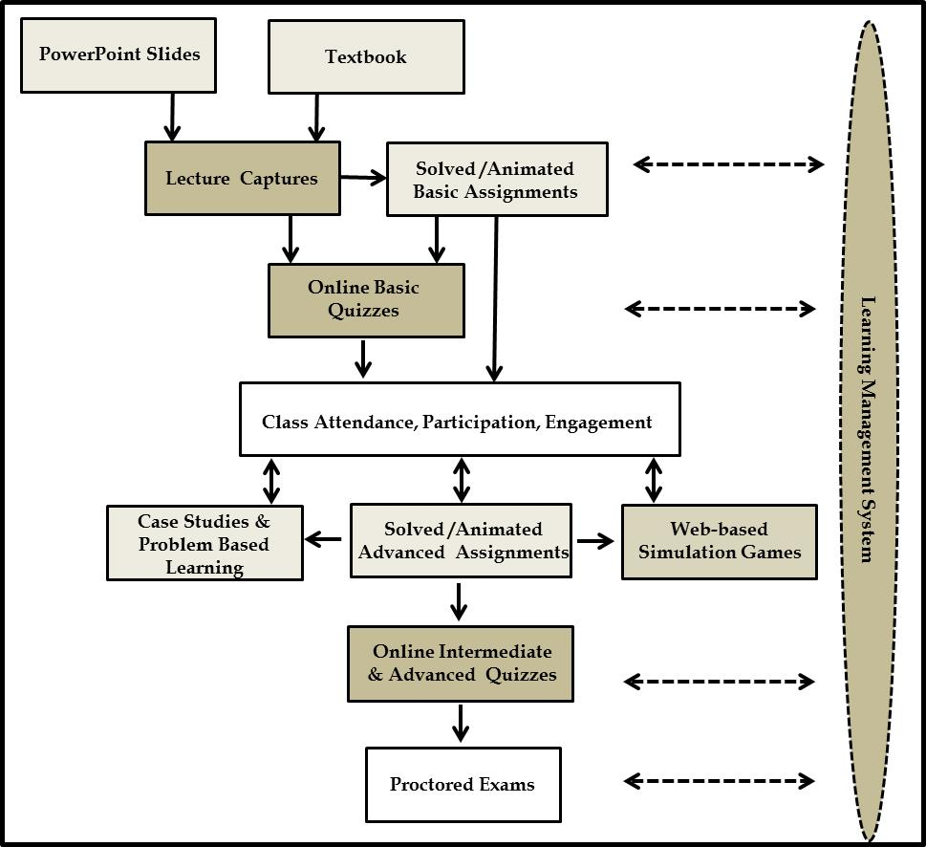
Flipped Classroom

Slide 55
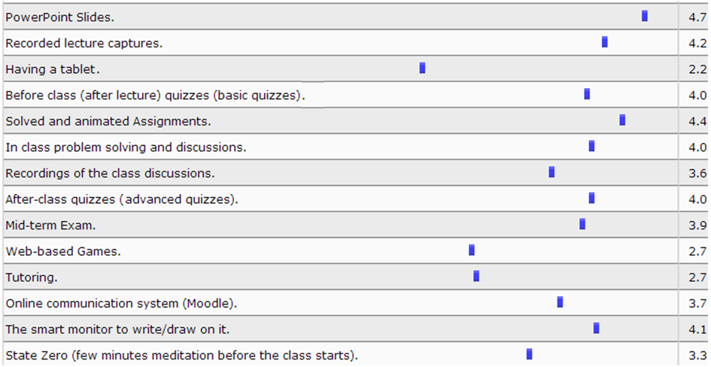

Slide 56
Admissions & Records; Inverse Seasonality Relationship
Notes:
FRANCIS

Slide 57

eTranscript
Notes:
FRANCIS

Slide 58
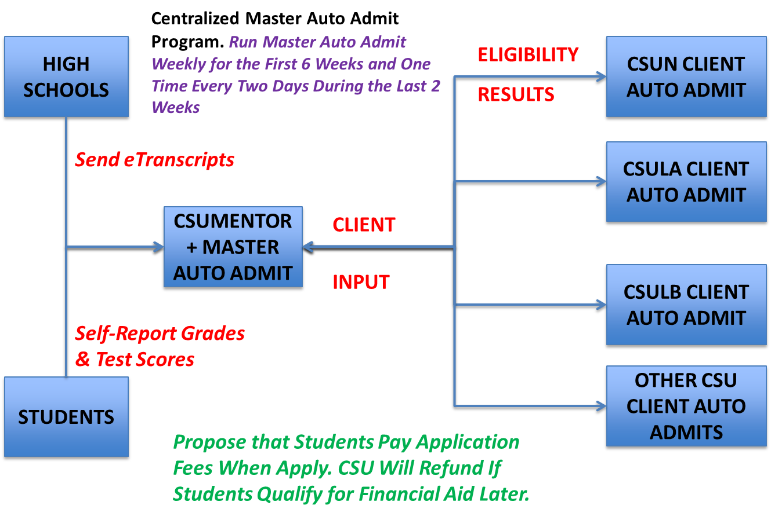
Centralized Admission
Notes:
JULIAN

Slide 59
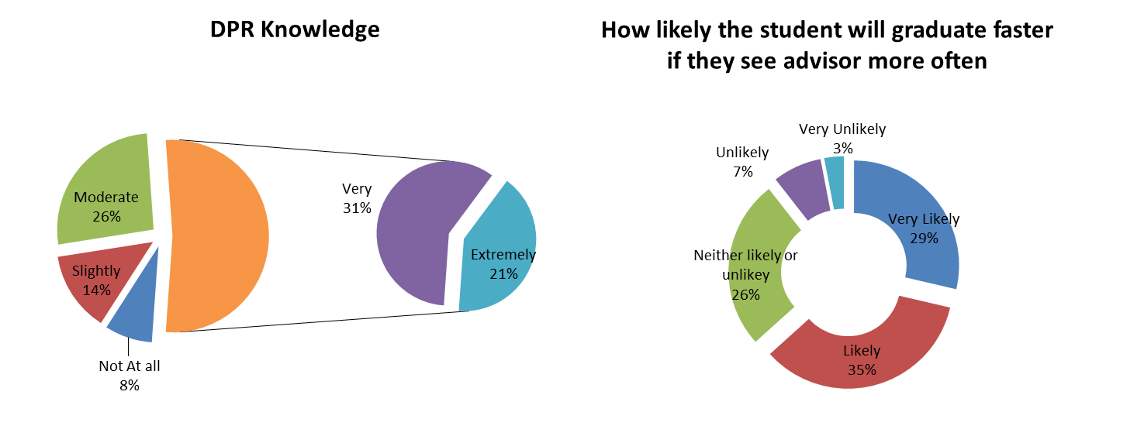
DPR Knowledge; Questionnaire Results
Notes:
TONI

Slide 60
Academic Advisement Reform
Use $9.7M in potential cost savings from e-Transcript and Master Auto Admit to:
  Hire more academic advisors
    $70,000 annual salary/academic advisor
    138 new academic advisors ($9.7M/$70K)
    CSUN gets 12 more academic advisors per year
  Provide advising services during evening hours
  Mandatory advisement for students with GPA < 3.0 every semester.
  Provide more workshop on DPR knowledge

Slide 61
Savings from One Semester Shorter TtG
Notes:
JULIAN

Slide 62
Course Repetition Reduction
Each (resident) student reduces course repetition by 1.2 semester units per semester.
CSU saves $16.4 million per year

Slide 63
Flipped Classroom
    By delivering the lectures online using recorded screen captures, the students are empowered to stop, rewind, and Fast Forward the professor.
    This is an excellent learning power.
    Class time is no
Problem solving
Trouble shouting
Participation
Enhancement
Real world Apps
and Discussions
Systems-thinking
Creative -thinking
Case studies
Web-based Simulation
    longer spent on teaching the basic concepts, but on more value-added activities

Slide 64
Retention Rate vs. Variety
Variety
Retention Rate (RR)
40%
50%
60%
70%
80%
90%

Slide 65
Flipped Classroom Has All the Competing Edges of Traditional, Hybrid, and Online Courses
In order for a flipped classroom to outperform its substitutes it need to at least have all online and hybrid capabilities.
Four competing edges of a successful course is clear, consistent, high expectations, just in time support, continual assessment (early feedback and understand secret of early effective warning system warning on performance and how to improve) , student engagement social engagement collaborative teaching

Slide 66
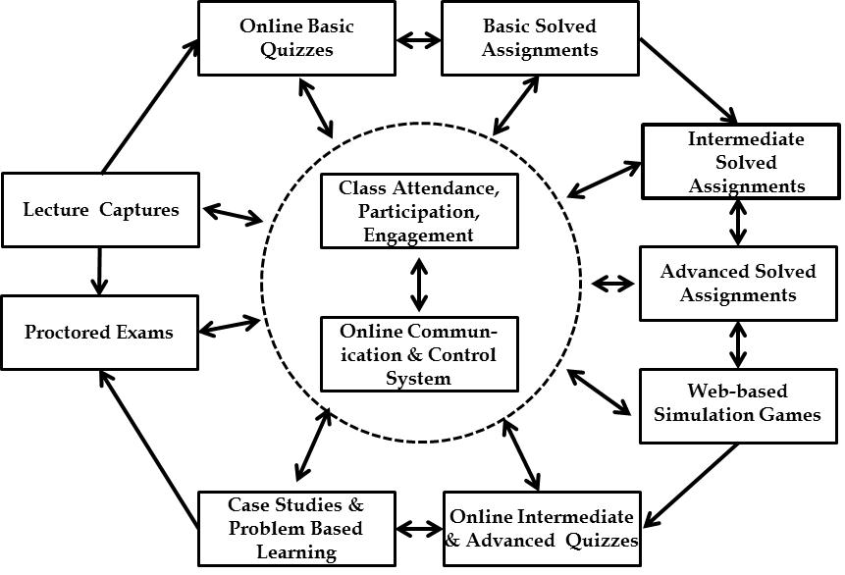
The Total Flipped Classroom System

Slide 67
From 2 dimensional space of Quality-Cost to one dimensional space of Quality/Cost
Based on the subjective evaluation of about 1000 SOM306 students we reached to the conclusion that the quality of the resources and learning processes of a world class institute such as Stanford is twice of that of CSUN. We can argue this. You may believe it is more or less. So please give me your numbers.
At the same time., I am working on quantifying this. So if you have sources of data that we can help to quantify this let me know. Thanks.
Based on the tuition and its related fees we reached to the conclusion that the cost efficiency of CSUN is 6 times of that of Stanford.
We then can conclude that quality to cost for CSUN is 3 times of that of Stanford.

Slide 68
http://siteresources.worldbank.org/INTAFRREGTOPTEIA/Resources/acad_qual_rank_guide.pdf
https://www.google.com/#q=How+can+I+measure+quality+of+undergraduate+business+schools
Count what is countable.
Measure what is measurable.
What is not measurable, make it measurable.
Galileo Galilei, 1564 -1642.

Slide 69
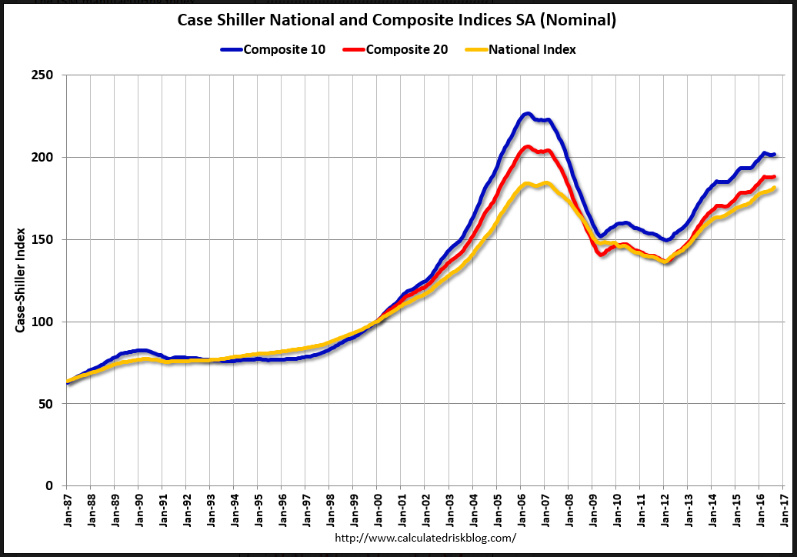

Slide 70
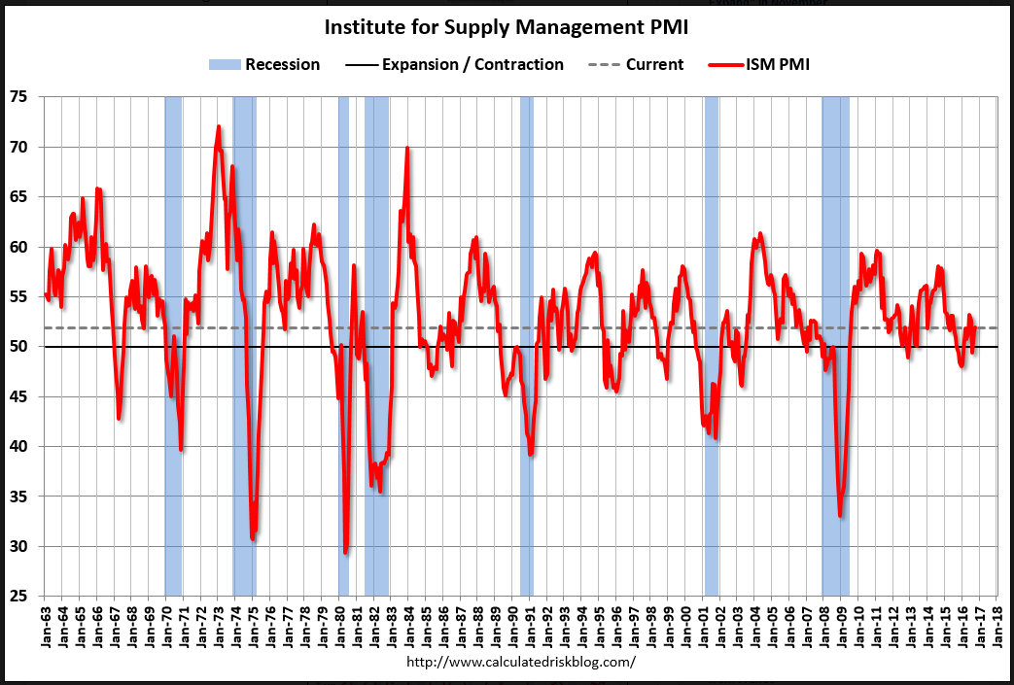

Slide 71
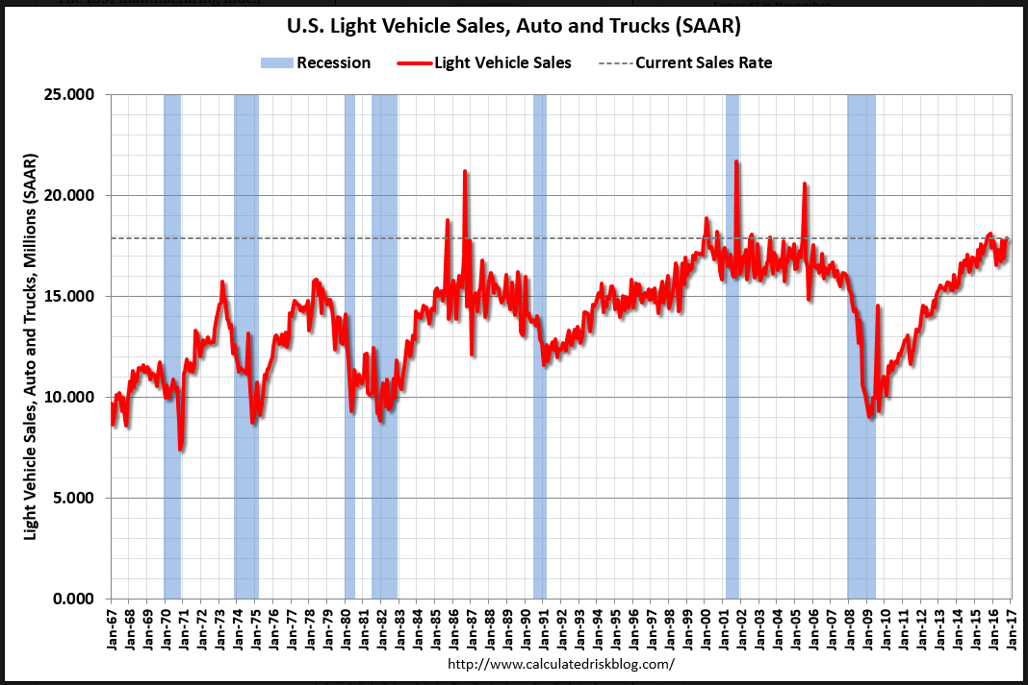

Slide 72
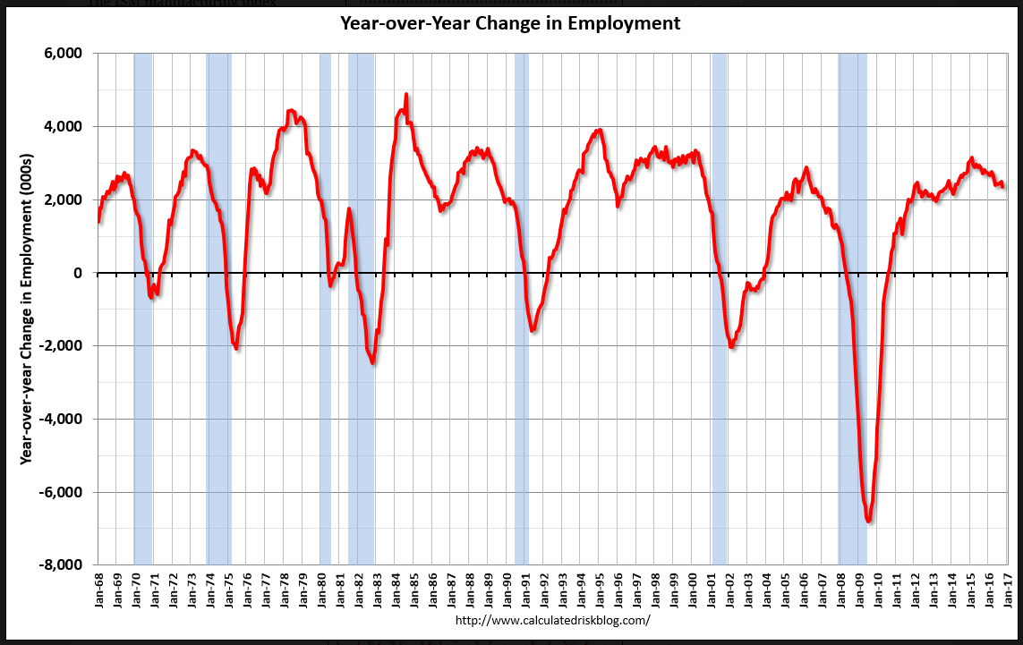

Slide 73
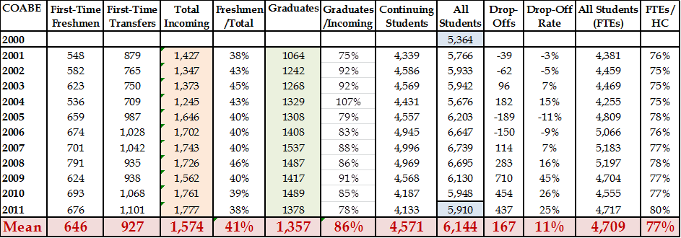
Flow Time: COABE. Graduation Rate and Time To Graduation Performance

Slide 74


Flow Time: Time To Graduation

Slide 75
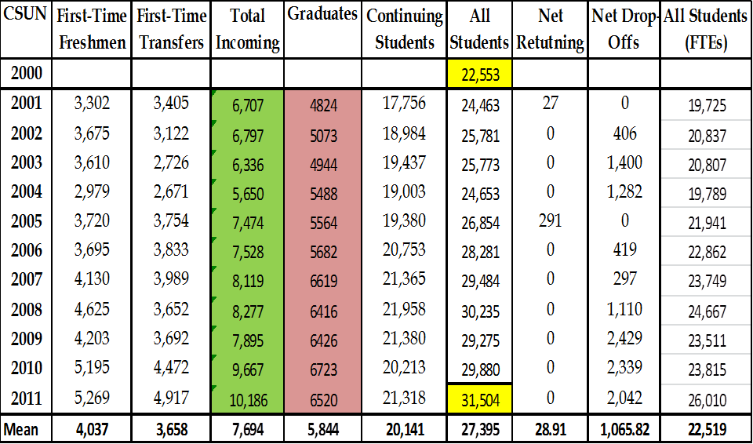
CSUN. Graduation Rate and Time To Graduation Performance

Slide 76

Flow Time at CSUN: Time To Graduation
4-year GR =13%, 9- year GR= 67%. Time to graduation, for those graduating in ≤ 9 years has µ = 6.3, σ = 2.6 years.

