Slide 1
Reviewing The Basic Statistics and Business Economics Concepts in an MBA Operations Management Course
A. Asef-Vaziri, California State University, Northridge, POMS, Washington DC, 2019.

Slide 2

Sourcing Game

Slide 3
Sourcing Game
A Generic Product H+ in all Worlds. A Proprietary Product Specific to Each World, Produced in a Single World, Demand in All Words.
Statistics and Business Economics Review
  Demand Curve
  Linear Cost Curve
  From Linear Demand Curve to Uniform Distribution
  From Uniform Distribution to Binomial Distributions
  From Binomial to Normal Distribution
  Y=X1+X2 vs Y=2X
Negotiate and execute purchasing agreements that address:
  Collaboration in SC. Supplier to Distributor
  Risk sharing
  Working capital management

Slide 4
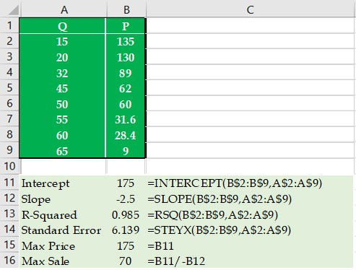
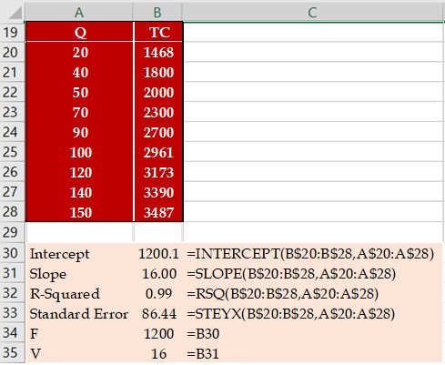
From Predictive to Associative Regression

Slide 5
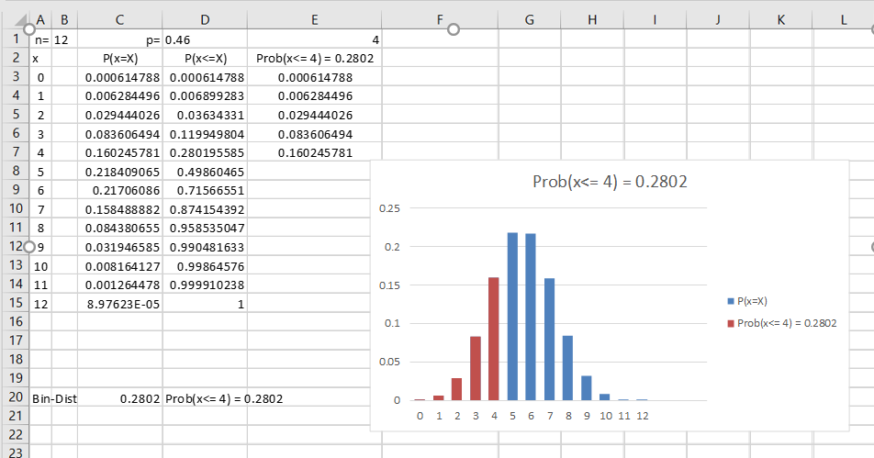
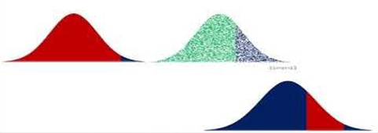
Non Linear TR, Linear TC, U, B, and N Distributions

Slide 6
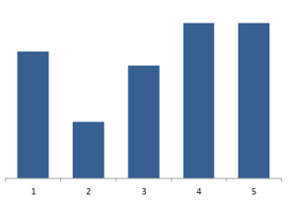
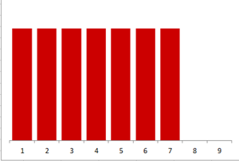
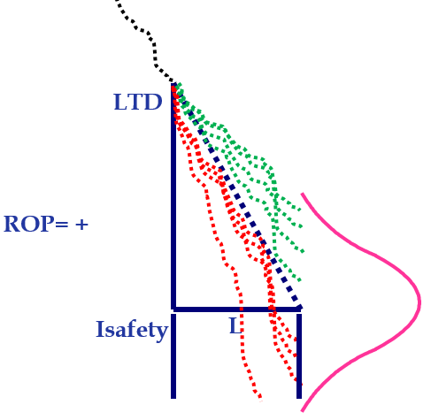
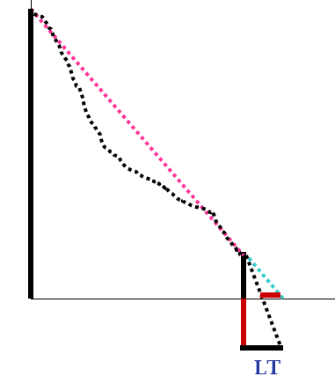
L vs R, ROP, and Is

Slide 7
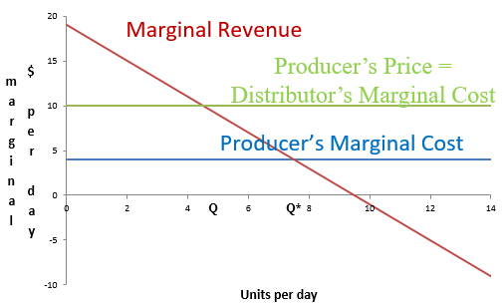
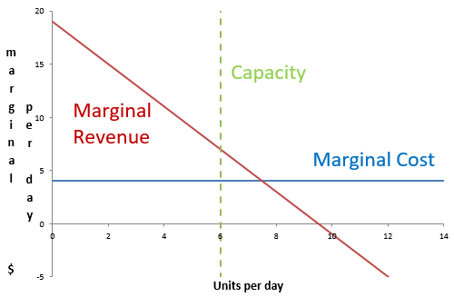
Coordination- Double Marginalization

Slide 8
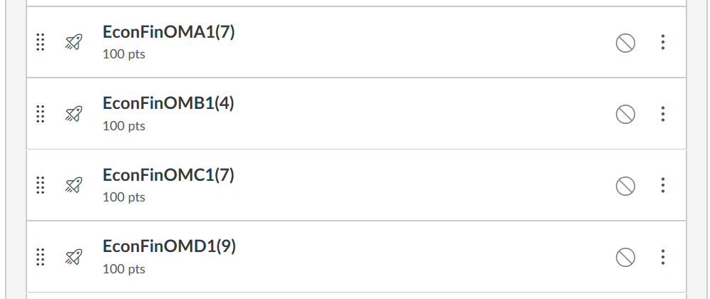
Four Problems. 26 Instances of Each on CANVAS
26 instances
Each problem contains 4-9 MC questions.
Replacing CANVAS FtB by MCs

Slide 9
Set Price ➔ Sales ➔ Production➔ TC ➔ ROP
160
140
120
100
80
60
40
20
0
0
10
20
30
40
50
60
70
2200
2000
1800
1600
1400
L=3.5 days
↓
Compute ROP
1200
1000
0
10
20
30
40
50
60
70

Slide 10

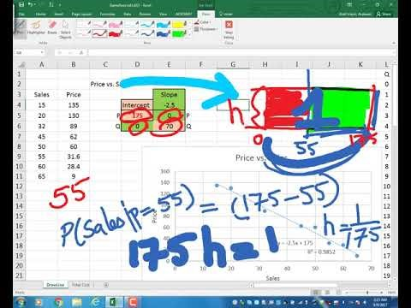
Recorded Lecture – From ECON to STAT
https://www.youtube.com/watch?v=2_qlQiYTLCs&t=1188s

Slide 11
Problem 1
Given the Price vs Quantity Sold (P-Q) data, and the Total Costs vs. Quantity Produced (TC-Q) data, and assuming that the quantity produced is equal to the quantity sold.
Using the P-Q data, prepare a linear demand curve. Compute Max-P and Max-Q. Then prepare a non-linear demand curve.
2. Using TC-Q data, estimate the total fixed costs, and variable cost per unit of product.
3. Compute the Coefficient of Determination (R-Squared) , Correction Coefficient (CC), and Standard Deviation of the estimates (Standard Error) for the Total Costs.

Slide 12
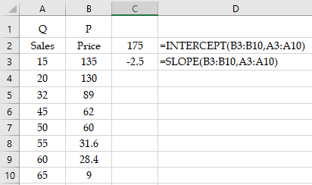
Problem 1. Estimate Demand Curve: Max D(Q) and Max P
Prepare a linear demand curve using the following price and sales data.

Slide 13
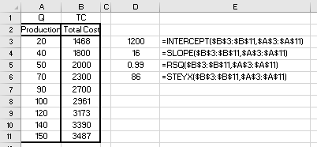
Problem 1. Estimate Fixed and Variable Costs

Slide 14
General R² Values

Slide 15
Estimate Demand Curve: Max D(Q) and Max P
Draw the demand curve using exponential regression.
Another Example If You Wish

Slide 16
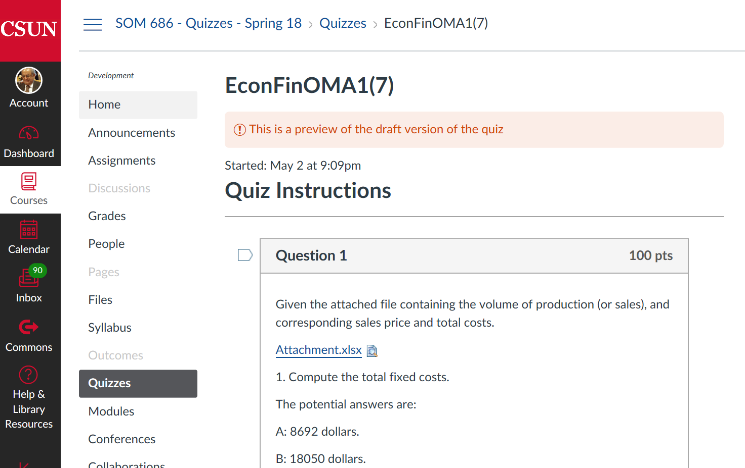
Problem 1. 26 Instances on CANVAS

Slide 17
Problem 2.
Draw the Total Revenue Curve.
At around what quantity of sales is the revenue maximized?
At around what volume of sales is total profit maximized?
At around what quantity of sales do you have a break-even point (loss to profit or profit to loss) ?
At around what quantity of sales do you have another break-even point (profit to loss or loss to profit) ?

Slide 18
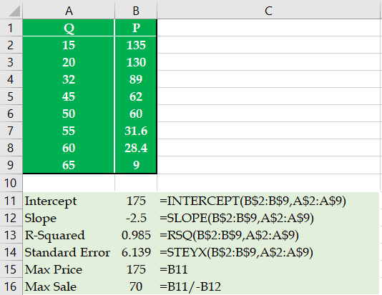
Problem 2. Total Revenue
P = 175-2.5Q, TR=PQ
TR = 175Q-2.5Q²

Slide 19
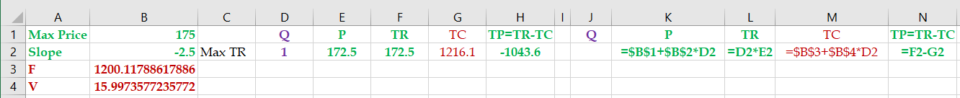
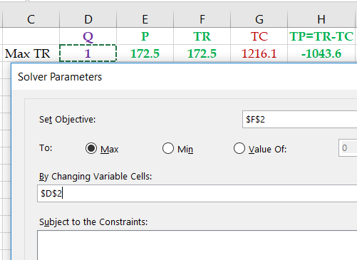
Problem 2. Compute P Associated with Max TR
2. At around what quantity of sales is the revenue maximized?

Slide 20
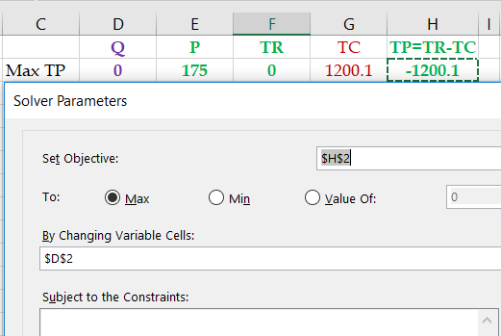
Problem 2. Compute P Associated with Max TP
3. At around what volume of sales is total profit maximized?

Slide 21
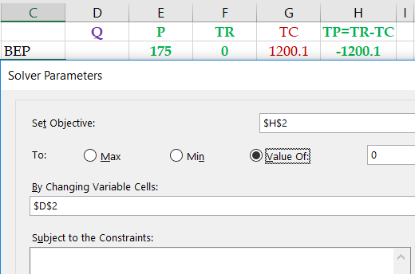
Problem 2. Find a BEP
4. At around what quantity of sales do you have the first break-even point (from loss to profit)?

Slide 22
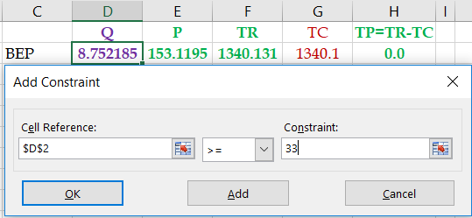
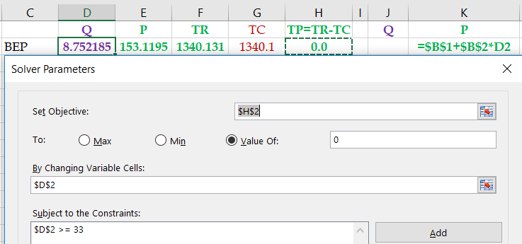
Problem 2. Find the Other BEP

Slide 23
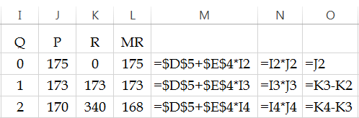
Problem 2- Draw the Marginal Revenue Curve
5. Draw the Marginal revenue curve, along with the linear demand curve:
P=175-2.5Q
R=PQ
MR=R_{t}-R_{t-1}
Three Other Examples If You Wish

Slide 24
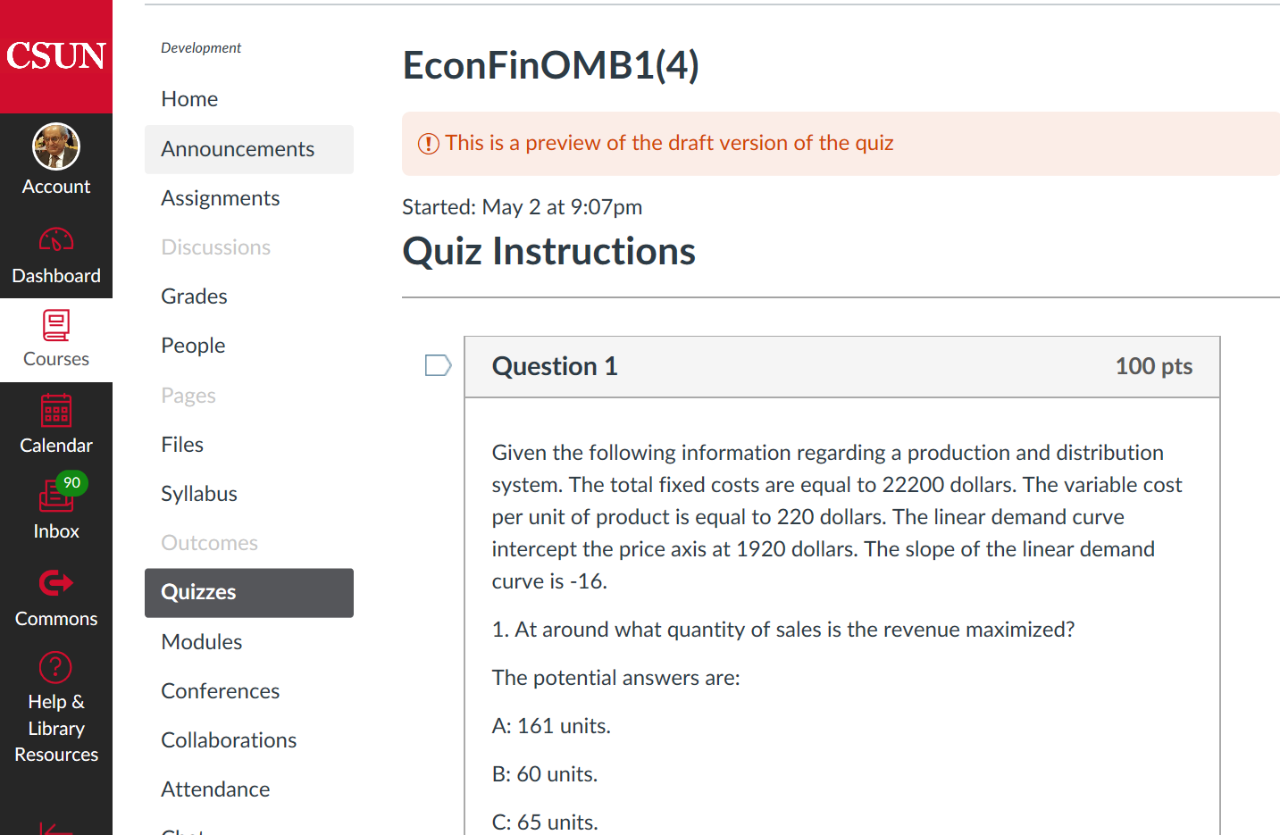
Problem 2. 26 Instances on CANVAS

Slide 25
Problem 3.
1. Given the daily linear demand curve of P=175-2.5 Q, define the Uniform Distribution associated to this linear demand curve. Define a, b, and f(x), where f(x) is the height of the U-Distribution.
2. Compute the probability of sale if the price is set to $105.
3. Compute the expected revenue from each visitor.
4. Compute the expected number of units sold per day.
5. Compute the average daily total revenue.
6. Compute the standard deviation of the number of units sold per day.

Slide 26
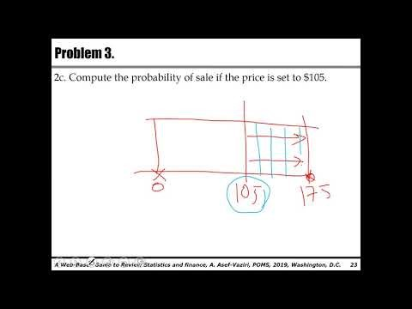
Problem 3. Lecture
https://youtu.be/LuQlX4OBAqU

Slide 27
Problem 3.
1. Given the daily linear demand curve of P=175-2.5 Q, define the Uniform Distribution associated to this linear demand curve. Define a, b, and f(x), where f(x) is the height of the U-Distribution.
f(x) = 1/(175-0) = 1/175 for 0≤x≤175
f(x) = 0, elsewhere

Slide 28
Problem 3.
2. Compute the probability of sale if the price is set to $105.
Probability of sale =
1-105/175
3. Given the above price of 105 dollars, and the maximum number of visitors per day, compute the expected number of units sold per day and revenue per visitor.
The expected number of units sold = 0.4(70) = 28 units.
The expected revenue per visitor = 0.4(105) = 42

Slide 29
Problem 3.
4. Given the price of $105 and 70 visitors per day, compute the average daily total revenue.
Alternatively, Product price is $105, probability of sales is 0.4. Therefore, expected revenue is 0.4(105)= $42 per visitor.

Slide 30
Problem 3.
5. Given the above price, compute the standard deviation of the number of units sold per day.
Linear Demand Curve ➔ Uniform Distribution ➔ Set Price ➔ Binomial Distribution.
μ= np =70(0.4) = 28
σ = SQRT(np(1-p)) = 4.1
Daily Demand ~N(28, 4.1)
Two Other Example If you Wish

Slide 31
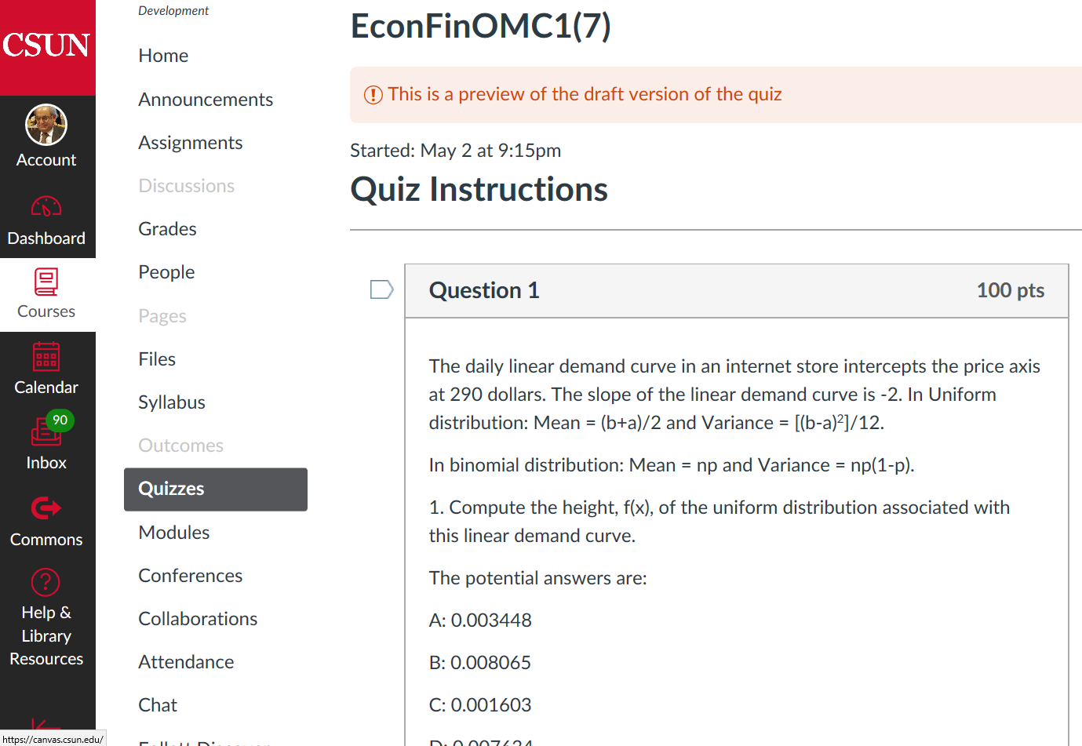
Problem 3. 26 Instances on CANVAS

Slide 32
Problem 4.
Given a daily demand of U~(0, 175), and n= 70 visitors.
1. Compute the price (and the associated quantity) that maximizes the total revenue. Compute the maximum total revenue per day.
2. Given F=$1200 and V= $16. Compute the price that maximizes the total profit.
3. How many units are sold per day at the price that maximizes the total profit. Compute the maximum total profit per day.
4. Compute the Variance of the daily sales.
5. Given an ordering lead time is 4 days. Compute the Variance of the lead time demand.
6. Compute the re-order point. Service level is 90%. Compute the safety stock.

Slide 33
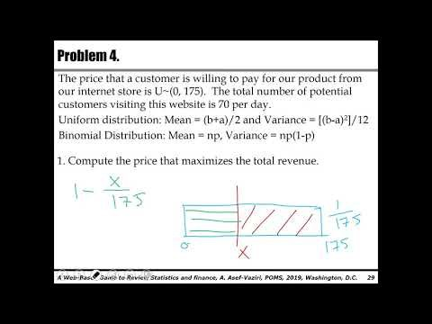
Problem 4. Lecture
https://youtu.be/4S6VMufq_Ok

Slide 34
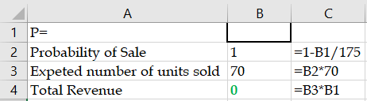
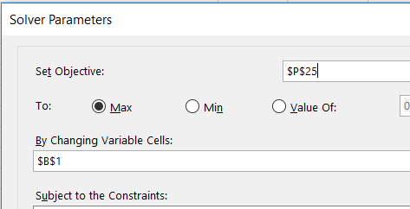

Problem 4.
1. U~(0, 175), n = 70 per day. Compute the price that maximizes the total revenue.
Price =X
Probability of sales = (175-P)/175 = 1-X/175
Number of units sold = 70*((1-X/175))
TR = X*70*((1-X/175))
Solver:
Maximize TR by changing Price

Slide 35
Problem 4.
2. How many units are sold at the price that maximizes the total revenue?
Probability of Sales is 50%. There are 70 customers.
0.5(70)=35
3. Compute the maximum total revenue per day.
=35*87.5 = 3,062.5
4. Compute the price that maximizes the total profit. Solver maximize Profit

Slide 36
Problem 4.
5. How many units are sold per day at the price that maximizes the total profit?
0.45428571(70) = 31.8 units.
6. Compute the maximum total profit per day.
31.8 (95.5) = $1,328.1.
0.45428571(95.5)(70) = $1,328.1
7. Given the price that maximizes the total profit, compute the standard deviation of the daily sales.
n=70, P=95.5, Pmax= 175
Probability of sales = 0.454
σ_{R} =SQRT(np(1-p) = SQRT(70(0.454)(1-0.454) = 4.166

Slide 37
Problem 4.
8. Compute the Variance of the lead time demand.
VAR_{LTD} = L*VAR_{R} = 4* 17.3537 = 69.415
σ_{LTD} = SQRT(L) σ_{R} = SQRT(4)* 4.166 = 8.33

Slide 38
R Variable vs L Variable

Slide 39
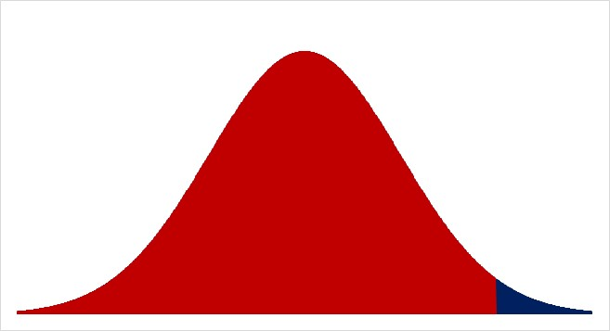
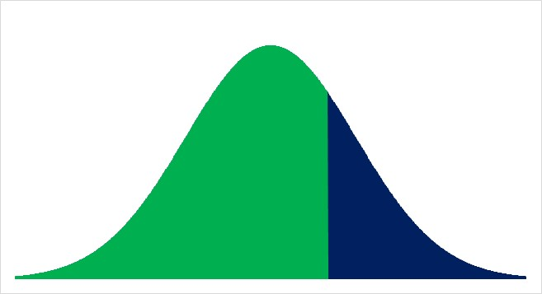
Normal Probability Distribution

Slide 40
More Than 50% Service Level

Slide 41
Problem 4.
9. Compute the re-order point. Service level is 90%.
R~N[np,np(1-p)]
R~N(31.8, 4.17)
LTD = LR= 4(31.8) = 127.2
σ_{LTD}=SQRT(L)*σ_{R} = SQRT(4)(4.17) = 8.33
LTD~N(127.2, 8.33)
SL=0.9
=NORM.INV(0.9,127.2,8.33)
ROP =137.88
10. Compute the safety stock.
137.88-127.2 = 10.68
The Last Example if you Wish

Slide 42
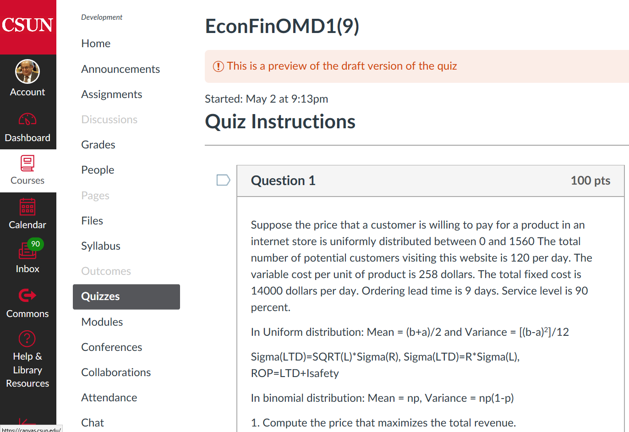
Problem 4. 26 Instances on CANVAS

Slide 43
Prameters: Sourcing Game I&II
assignment | 1a | 1a | 1b | 1b
product | Hormone plus | Circulation view | Motion view | Proteins view
SCENARIO PARAMETERS
daily customers (n) | 30 | 14 | 40 | 12
maximum willingness to pay (x-max) | $500 | $1,000 | $400 | $1,186
variable cost ( c ) | $100 | $100 | $100 | $100
Lead time in days (W) | 3.5 | 3.5 | 3.5 | 3.5
CALCULATIONS AT OPTIMAL PRICE
price x' = (x-max + c) /2 | $300 | $550 | $250 | $643
success rate p' = (x-max - x')/x-max | 0.4 | 0.5 | 0.4 | 0.5
daily demand mean D' = np' | 12.0 | 6.3 | 15.0 | 5.5
daily demand stddev s' = sqrt(np'(1-p')) | 2.7 | 1.9 | 3.1 | 1.7
Z-statistic for service level | 3.0 | 3.1 | 3.0 | 3.1
optional ROP = WD' + Zs'(sqrt(W)) | 57 | 33 | 70 | 29
daily profit = D'(x' - c) | $2,400 | $2,835 | $2,250 | $2,983
Assignment daily profit | $5,235 |  | $5,233

Slide 44
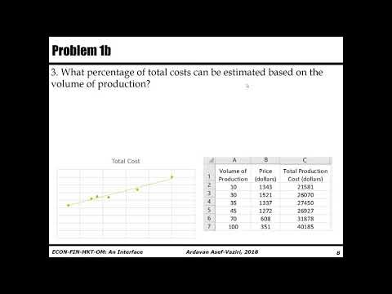
Problem 1b. Lecture on the Next Problem.
https://youtu.be/o-6RWQy-mGM

