Slide 1
Average Grade Computation
Ardavan Asef-Vaziri

Slide 2
Average Grade Computation, Mid Semester, Before and After Final
Composition of marks in one of your courses is as follows: Internet Games, 10 %; Weekly Quizzes, 30%; Midterm Exam, 20%; Final Exam, 40%. Suppose at the end of the semester, your grades are as follows: Internet Games; 80, Weekly Quizzes; 90, Midterm Exam; 90, Final Exam; 70.
Compute your overall average grade at the end of the semester.
Suppose you have not taken the final exam yet. We have been asked to report your current grade in the scale of A, A-, B+, B, B-, C+, C, C-, D+, D, D-, or F. Compute your numerical average grade before taking the final on the scale of 1 to 100. This numerical grade will be used to identify your letter grade.
What do you need to get in the final exam to secure an overall grade of B+ in the course (an overall average of 86 or more).

Slide 3
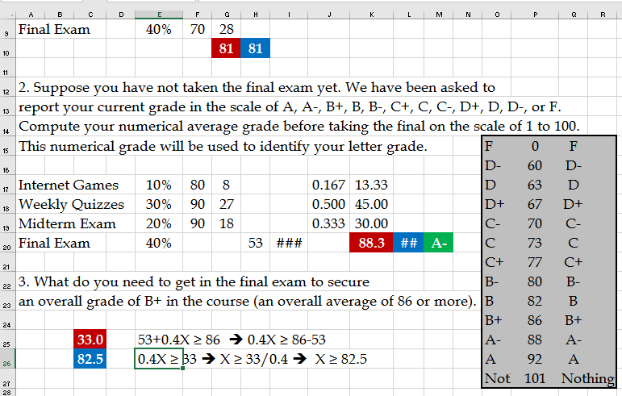

Average Grade Computation, Mid Semester, Before and After Final
http://www.csun.edu/~aa2035/CourseBase/Forecasting/WMA-2020/8.QuizSolutionToMathQuiz.xlsx

Slide 4

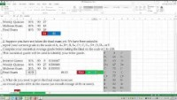
Average Grade Computation
https://youtu.be/cHD3CVqxNms

