Slide 1
Weighted Moving Average
Problems
Ardavan Asef-Vaziri

Slide 2

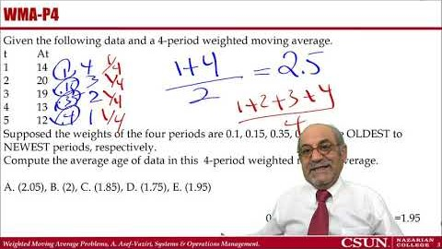
Recorded Lecture https://www.youtube.com/watch?v=TtS_QkhwXhs

Slide 3
Weighted Moving Average Problem 1 (WMA-P1)
Given the following data and a 4-period weighted moving average.
t At
1 14
2 20
3 19
4 13
5 12
Supposed the weights of the four periods are 0.1, 0.15, 0.35, 0.4 for the OLDEST to NEWEST periods, respectively.
Compute the 4-period weighted moving average in period 5
A. (15.8), B. (13.2), C. (14.2), D. (16.4), E. (16.2)
0.4*12+0.35*13+0.15*19+0.1*20 = 14.2

Slide 4
WMA-P2
Given the following data and a 4-period weighted moving average.
t At
1 14
2 20
3 19
4 13
5 12
Supposed the weights of the four periods are 0.1, 0.15, 0.35, 0.4 for the OLDEST to NEWEST periods, respectively.
Compute the 4-period weighted moving average forecast in period 6.
A. (15.8), B. (13.2), C. (14.2), D. (16.4), E. (16.2)
0.4*12+0.35*13+0.15*19+0.1*20=14.2

Slide 5
WMA-P3
Given the following data and a 4-period weighted moving average.
t At
1 14
2 20
19
13
12
Supposed the weights of the four periods are 2, 4, 6, 7 for the OLDEST to NEWEST periods, respectively.
Compute the 4-period weighted moving average in period 5.
A. (16.47), B. (16.05), C. (14.63), D. (12.95), E. (14.39)
(7/19)*12+ (6/19)* 13+ (4/19)* 19+ (2/19)* 20 =14.63

Slide 6
WMA-P4
Given the following data and a 4-period weighted moving average.
t At
1 14
2 20
19
13
12
Supposed the weights of the four periods are 0.1, 0.15, 0.35, 0.4 for the OLDEST to NEWEST periods, respectively.
Compute the average age of data in this 4-period weighted moving average forecast.
A. (2.05), B. (2), C. (1.85), D. (1.75), E. (1.95)
0.4*1+0.35*2+0.15*3+0.1*4 =1.95

Slide 7
WMA-P5&P6
The age of data in which of the following techniques is younger
Four period moving average
Age of data = (1+4)/2 = 2.5
B. Exponential Smoothing with alpha = 0.25
Age of data = 1/alpha = 1/0.25 = 4 periods
C. Five period weighted moving average with weights of 0.1, 0.1, 0.2, 0.2, and 0.40 for the OLDEST to NEWEST periods, respectively.
0.4(1)+0.2(2)+0.2(3)+0.1(4)+0.1(5)= 2.3
D. Five period weighted moving average with weights of 0.2, 0.2, 0.2, 0.2, and 0.2 for the OLDEST to NEWEST periods, respectively.
(1+5)/2=3

Slide 8
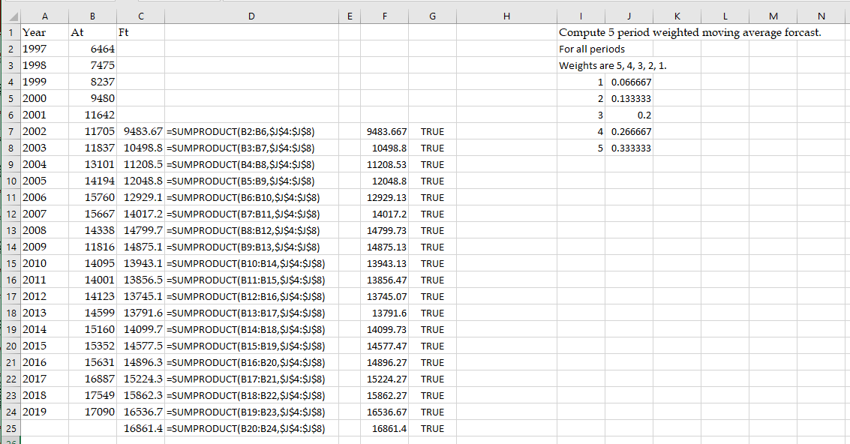
WMA-P7

