Slide 1
If you can look into the seeds of time,
and say which grain will grow and which will not
speak then unto me.
William Shakespeare, 1564-1616.

Slide 2
Exponential Smoothing

Slide 3
1-2. Short Questions and Multiple Choices
1. Given an actual demand of 60 for a period when forecast of 70 was anticipated, and an alpha of 0.3, what would the forecast for the next period be using simple exponential smoothing?
  F = (1-0.3)(70)+0.3(60) = 67
2. Suppose you have been asked to generate a demand forecast for a product for year 2012 using an exponential smoothing method. The forecast demand in 2011 was 910. The actual demand in 2011 was 850. Using this data and a smoothing constant of 0.3, which of the following is the demand forecast for year 2012?
  A) 850
  B) 885
  C) 892
  D) 925
  E) 930
  F = (1-0.3)(910)+0.3(850) = 892

Slide 4
3.Short Questions and Multiple Choices
3. Given the following demand
Suppose the forecast for period 2 is equal to the actual for period 1. What is your forecast for period 4 using exponential smoothing and α=0.5?
  A) 300
  B) 400
  C) 500
  D) 550
  E) none of the above
Period | Demand
1 | 300
2 | 500
3 | 600
F_{t+1} = (1-α)F_{t}+ α(A_{t})
F_{t+1} = (1-0.5)F_{t}+ 0.5(A_{t})
F_{t+1} = (1/2) F_{t}+ (1/2) (A_{t})
F_{t+1} = (F_{t}+A_{t})/2
F₃ = (F₂+A₂)/2
F₃ = (300+500)/2= 400
F₄ = (F₃+A₃)/2 = (400+600)/2 = 500

Slide 5
4-5. Short Questions and Multiple Choices
4. Use exponential smoothing to forecast this period’s demand if α = 0.2, previous actual demand was 30, and previous forecast was 35.
  A) 29
  B) 31
  C) 34
  D) 36
  E) 37
  F = (1-0.2)(35)+0.2(30) = 34
5. Exponential smoothing is being used to forecast demand. The previous forecast of 66 turned out to be 5 units larger than actual demand. The next forecast is 65. Compute α?
F_{(t+1)} = F_{t} + α (A_{t}-F_{t})
65
66
+5
- 5
65 = 66 + α (-5)
5 α = 1
α = 0.2

Slide 6
6. Short Questions and Multiple Choices
6. The president of State University wants to forecast student enrollments for the next academic year based on the following historical data for the past 5 years. What is your forecast for next year using exponential smoothing with α = 0.4?

Slide 7
7-8. Short Questions and Multiple Choices
7. For what value of α, exponential smoothing becomes naïve method?
  A) α =0
  B) α =0.25
  C) α =0.5
  D) α =0.75
  E) α =1
8. For what value of α, exponential smoothing becomes a straight line?
  A) α =0
  B) α =0.25
  C) α =0.5
  D) α =0.75
  E) α =1
F_{t+1} = (1-α)F_{t}+ α(A_{t})
F_{t+1} = (A_{t})
F_{t+1} = (1-1)F_{t}+ 1(A_{t})
F_{t+1} = (1-α)F_{t}+ α(A_{t})
F_{t+1} = F_{t}
F_{t+1} = (1-0)F_{t}+ 0(A_{t})

Slide 8
9-10. Short Questions and Multiple Choices
9. A forecast based on the previous forecast plus a percentage of the forecast error is:
  A) a naive forecast
  B) a simple moving average forecast
  C) a centered moving average forecast
  D) an exponentially smoothed forecast
  E) an associative forecast
10. In exponential smoothing forecasting, using large values of the smoothing coefficient α generates forecasts that are more:
  A) accurate
  B) responsive
  C) random
  D) stable
  E) level
F_{t+1} = (1-α)F_{t}+ α(A_{t})
F_{t+1} = F_{t}+ α(A_{t}-F_{t} )
F_{t+1} = (1-α)F_{t}+ α(A_{t})

Slide 9
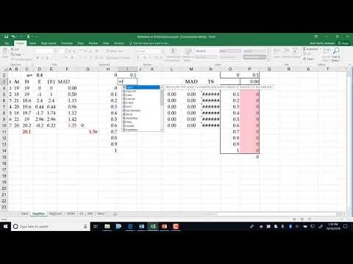
Lecture of Problems 11a &11b.
https://www.youtube.com/watch?v=2OkoBbEm10I&t=9s

Slide 10
11a. Exponential Smoothing-Alpha using Data Table

Slide 11
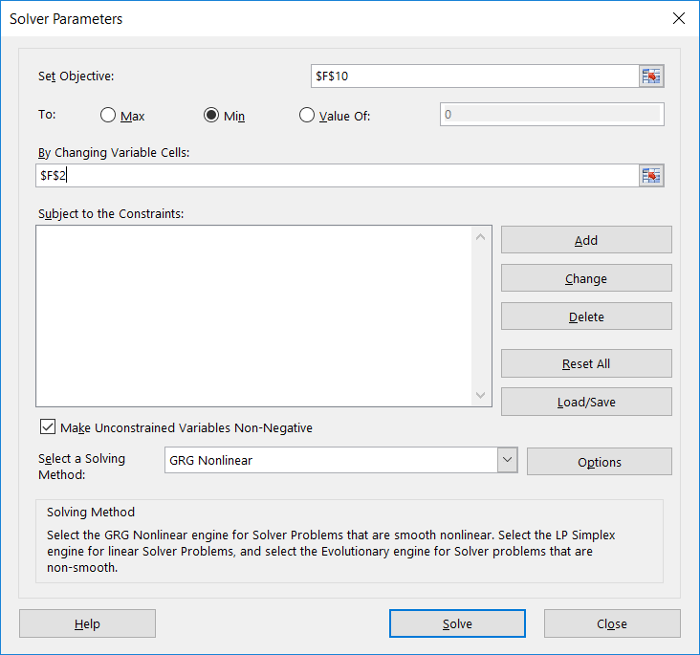
11b. Exponential Smoothing-Find Alpha Using Solver

Slide 12
12. Short Questions and Multiple Choices
11. It can be mathematically proved that the Age of data in exponential smoothing is 1/α . The larger the α, the larger the number of periods in the moving average. True or false? Why?
False
α = 0.5 ➔ age of data is 2 periods.
α = 0.2 ➔ age of data is 5 periods.
α = 0.1 ➔ age of data is 10 periods.

Slide 13
13-14. Short Questions and Multiple Choices
13. Given a forecast using a 6 period moving average. What is the average age of data?
The last piece (newest piece) of data is only 1 period old.
The first piece (oldest piece) of data in a 6 period moving average is 6 periods old.
The average age of data is (1+6)/2 = 3.5
14. If the age of data in exponential smoothing is 1/ α, for what value of α, exponential smoothing performs close to a six period moving average?
The age of data in a 6 period moving average is 3.5.
The age of data in exponential smoothing is 1/ α.
1/ α = 3.5
α = 1/3.5
α = 0.29

Slide 14
15. Problem
Given the following demand data
Month Feb Mar Apr May Jun Jul Aug
Demand 19 18 15 20 18 22 20
Draw the data
b) Provide forecasts for the next period using ES and α=0.2, compute MAD, compute standard deviation of your forecast.

Slide 15
Problem 1
c) Provide forecasts for the next period using 5-period MA.
Based on MAD, which method is better? ES or MA?

Slide 16
15. Problem
d) Provide forecasts for September using Naïve method (forecast of the next period is the same as the actual for this period).
Based on MAD, which method is better? ES or NM?

Slide 17
15. Problem
e) Provide forecasts and standard deviation of forecast for September using linear Regression. Also Compute R-Squared (Coefficient of determination) and Correlation Coefficient.

Slide 18
(f) Which Technique ?
When comparing several methods, we need to use the same time horizon for all methods. We need to have actual as well as forecasts for all methods for all periods of MAD computations
Here we have Actual for periods 1 to 7; that is 7 periods.
Regression can provide us with forecast for periods 1 to ∞
Five period moving average can only provide forecast for periods 6 and 7; that is 2 periods
Therefore, to compare all these methods, we can compute MAD only over 2 periods. But two periods is not enough.
Naïve Method or Exponential Smoothing ?
Naïve method forecasts for periods 2 to 7; That is 6 periods
Exponential Smoothing for periods 2 to 7; That is 6 periods
We can compare NM and ES over 6 periods.

