Slide 1
Chapter 7
Demand Forecasting in a Supply Chain
Forecasting -2
Exponential Smoothing
Ardavan Asef-Vaziri
Based on
Operations management: Stevenson
Operations Management: Jacobs and Chase
Supply Chain Management: Chopra and Meindl

Slide 2

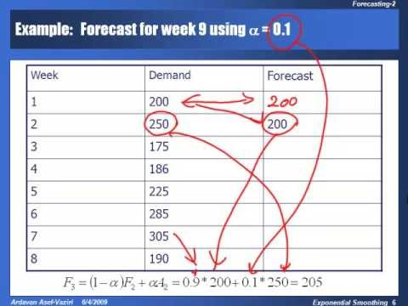
Chapter 7
Demand Forecasting in a Supply Chain
https://www.youtube.com/watch?v=A1nCIgYSuw4&t=1599s

Slide 3
Time Series Methods
Simple Moving Average
  Discard old records
  Assign same weight for recent records
Weighted Moving Average
  Assign different weights for recent records
Exponential Smoothing is a type of weighted moving average

Slide 4
Exponential Smoothing

Slide 5
Exponential Smoothing
t
At
Ft
1
100
100
2
100
3
110
α=0.2
150
Since I have no information for F1, I just enter A1 which is 100. Alternatively we may assume the average of all available data as our forecast for period 1.
A1 ⬅ F2
F3 =(1-α)F2 + α A2
F3 =0.8(100) + 0.2(150)
F3 =80 + 30 = 110
F3 =(1-α)F2 + α A2
F2 & A2 ⬅ F3
A1 ⬅ F2
A1 & A2 ⬅ F3

Slide 6
Exponential Smoothing
α=0.2
t
At
Ft
1
100
100
2
150
100
3
110
4
112
120
F4 =(1-α)F3 + α A3
F4 =0.8(110) + 0.2(120)
F4 =88 + 24 = 112
F4 =(1-α)F3 + α A3
A3 & F3 ⬅ F4
A1 & A2 ⬅ F3
A1& A2 & A3 ⬅ F4

Slide 7
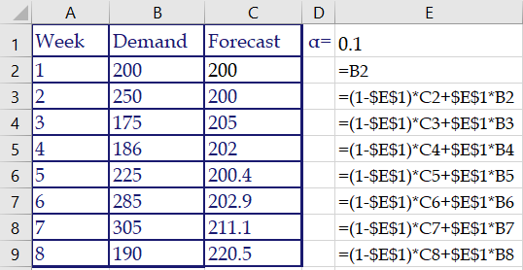
Example: Forecast for week 9 using α = 0.1

Slide 8
α = 0.1, 0.2, 0.4
Large α or Small α
  When does it work?
  When does it not?
ES or MA ?

Slide 9
Comparison
As α becomes larger, the predicted values exhibit more variation, because they are more responsive to the demand in the previous period.
  A large α seems to track the series better.
  Value of stability
This parallels our observation regarding MA: there is a trade-off between responsiveness and smoothing out demand fluctuations.

Slide 10
Comparison
Choose the forecast with lower MAD.

Slide 11
Which α to choose?
In general want to calculate MAD for many different values of α and choose the one with the lowest MAD.
Same idea to determine if Exponential Smoothing or Moving Average is preferred.
Note that one advantage of exponential smoothing requires less data storage to implement.

Slide 12
All Pieces of Data are Taken into Account in ES
F_{t} = a A_{t–1} + (1 – a) F_{t–1}
F_{t–1} = a A_{t–2} + (1 – a) F_{t–2}
F_{t} = aA_{t–1}+(1–a)aA_{t–2}+(1–a)²F_{t–2}
F_{t–2} = a A_{t–3} + (1 – a) F_{t–3}
F_{t} = aA_{t–1}+(1–a)aA_{t–2}+(1–a)²a A_{t–3} + (1 – a) ³ F_{t–3}
= aA_{t–1}+(1–a)aA_{t–2}+(1–a)²aA_{t–3} +(1–a)³aA_{t–4}
+(1–a)⁴aA_{t–5}+(1–a)⁵aA_{t–6} +(1–a)⁶aA_{t–7}+…
A large number of data are taken into account– All data are taken into account in ES.

Slide 13
What is better? Exponential Smoothing or Moving Average
Age of data in moving average is (1+ n)/2 .
Age of data in exponential smoothing is about 1/ α.
(1+n)/2 = 1/ α ⎝ α = 2/(n+1)
If we set α = 2/(n +1) , then moving average and exponential smoothing are approximately equivalent.
  It does not mean that the two models have the same forecasts.
  The variances of the errors are identical.

Slide 14
Compute MAD & TS

Slide 15
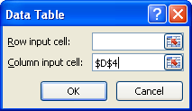
Data Table Excel
Data, what if, Data table
This is a one variable Data Table
Min, conditional formatting

Slide 16

Office Button

Slide 17
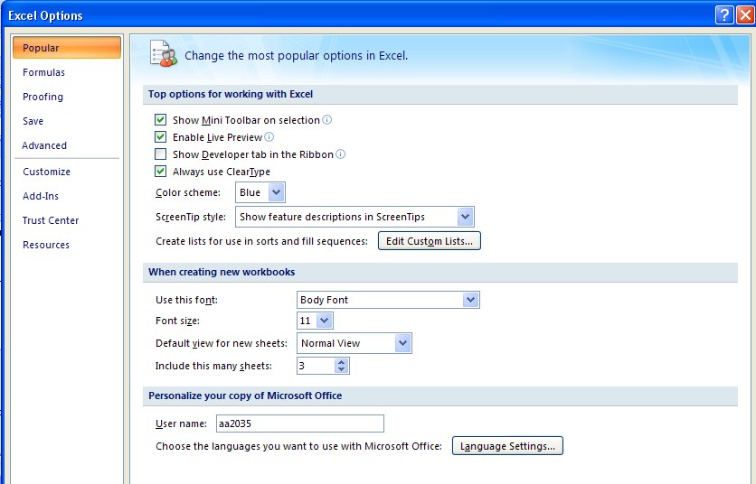
Add-Inns

Slide 18
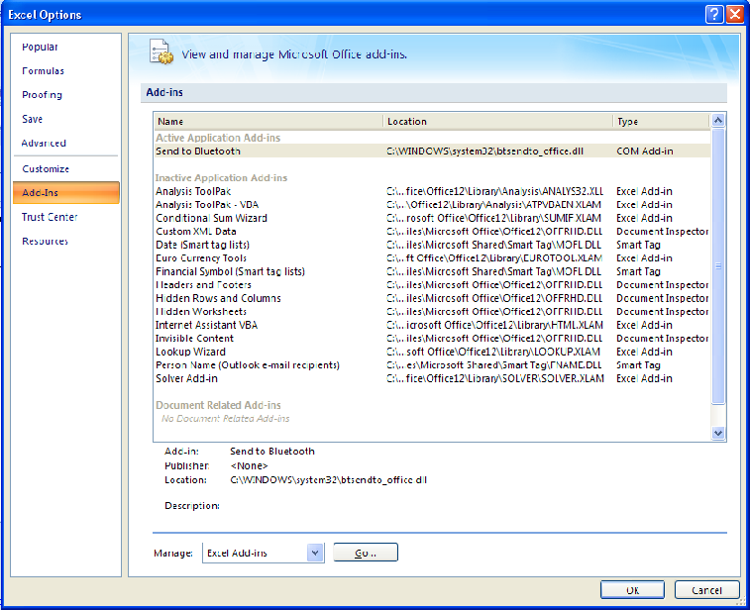
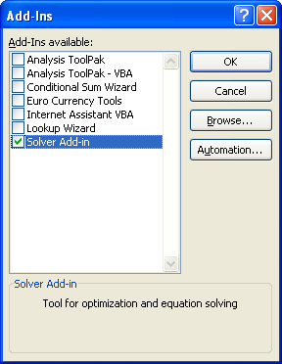
Not OK, but GO, then Check Mark Solver

Slide 19
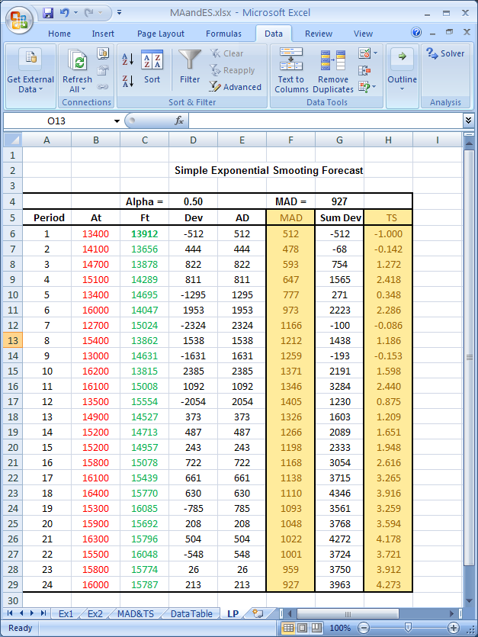
Data Tab/ Solver

Slide 20
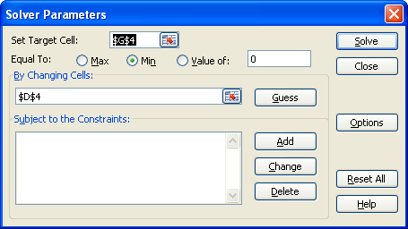
Target Cell/Changing Cells

Slide 21

Optimal α Minimal MAD

Slide 22
NOTE – The following pages are not recorded
Note: The following discussion – from the next page up to the end of this set of slides – are not recorded.

Slide 23
Measures of Forecast Error; Additional Indices
Error: difference between predicted value and actual value (E)
Mean Absolute Deviation (MAD)
Tracking Signal (TS)
Mean Square Error (MSE)
Mean Absolute Percentage Error (MAPE)

Slide 24
Measures of Forecast Error

