Slide 1
Exponential Smoothing
Optimal Alph
DataTable & SOLVER
If you can look into the seeds of time, and say which grain will grow and which will not
speak then unto me.
William Shakespeare, 1564-1616.

Slide 2

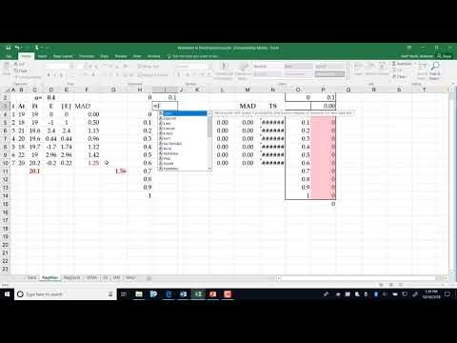
Lecture
https://youtu.be/2OkoBbEm10I
Nonlinear optimization and Data-Tables to determine the optimal vale of α that minimizes the MAD, MSE, or MARD.

Slide 3
Find α using Data Table – The Recorded Lecture is also Inside

Slide 4
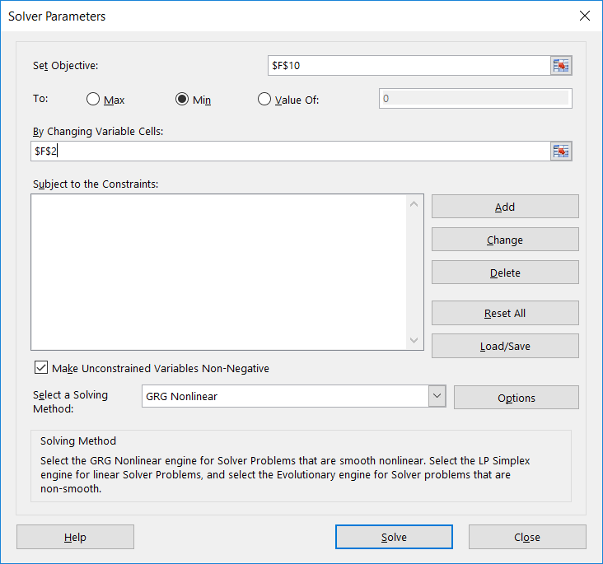
Find α using Solver
4

