Slide 1
Chapter 7
Demand Forecasting in a Supply Chain
Forecasting -3
Static Trend and Seasonality
Ardavan Asef-Vaziri
Based on Supply Chain Management
Chopra and Meindl

Slide 2
Characteristics of Forecasts
Forecasts are rarely perfect because of randomness.
Beside the average, we also need a measure of variations– Standard deviation.
Forecasts are more accurate for groups of items than for individuals.
Forecast accuracy decreases as time horizon increases.

Slide 3
Forecasting Methods
Qualitative: primarily subjective; rely on judgment and opinion
Time Series: use historical demand only
  Static
  Adaptive
Causal: use the relationship between demand and some other factor to develop forecast
Simulation
  Imitate consumer choices that give rise to demand
  Can combine time series and causal methods
Notes:
Notes:

Slide 4
Components of an Observation
Observed demand (O) =
Systematic component (S) + Random component (R)
Level (current deseasonalized demand)
Trend (growth or decline in demand)
Seasonality (predictable seasonal fluctuation)
Systematic component: Expected value of demand
Random component: The part of the forecast that deviates
from the systematic component

Slide 5
Example: Tahoe Salt
Forecast demand for the next four quarters.
Notes:
Notes:

Slide 6
Static Methods
Systematic component = (level + trend)(seasonal factor)
F_{t+l} = [L + (t + l)T]S_{t+l}
= forecast in period t for demand in period t + l
L = estimate of level for period 0
T = estimate of trend
S_{t} = estimate of seasonal factor for period t
D_{t} = actual demand in period t
F_{t} = forecast of demand in period t

Slide 7
Static Methods
Estimating level and trend
Estimating seasonal factors

Slide 8
Estimating Level and Trend
Before estimating level and trend, demand data must be deseasonalized
Deseasonalized demand = demand that would have been observed in the absence of seasonal fluctuations
Periodicity (p)
  the number of periods after which the seasonal cycle repeats itself
  for demand at Tahoe Salt p = 4

Slide 9
Seasonalized Time Series; Odd p

Slide 10
Seasonality Indices; Odd p
In front of each number I have an average.
Averages do not contain seasonality. They are seasonality free data.
I can compare each day with the average of the 5 closest days and find the seasonality of that day

Slide 11
Seasonality Indices; Even p
(8000+13000+23000+34000)/4 =1950 ➔ But put it where
(13000+23000+34000+10000)/4=20000 ➔ But put it where

Slide 12
Seasonalized Time Series; Even p

Slide 13
Seasonalized Time Series; Even p

Slide 14
Deseasonalizing Demand
For the example, p = 4 is even. For t = 3:
D3 = {D1 + D5 + 2Sum(i=2 to 4) [Di]}/8
={8000+10000+2(13000+23000)+34000)}/8 = 19750
D4 = {D2 + D6 + 2Sum(i=3 to 5) [Di]}/8
={13000+18000+2(23000+34000)+10000)}/8 = 20625

Slide 15
Deseasonalizing Demand
Then include trend
D_{t} = L + tT
where D_{t} = deseasonalized demand in period t
L = level (deseasonalized demand at period 0)
T = trend (rate of growth of deseasonalized demand)
Trend is determined by linear regression using deseasonalized demand as the dependent variable and period as the independent variable (can be done in Excel)

Slide 16
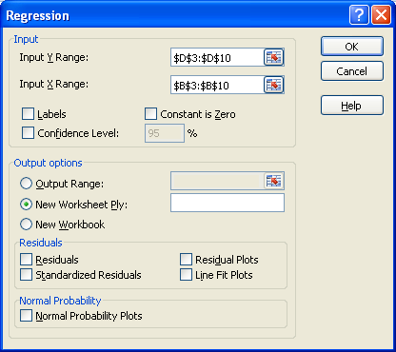
Linear Regression on the Deseasonalized Demand
Data/Data Analysis/Regression

Slide 17
Liner Regression
L = 18,439 and T = 523.81
F_{t} = 18,439 + 523.81 t
Replace t with 1,2, 3, ….., 12

Slide 18
Final Estimation of the Seasonal Factors
Use the previous equation to calculate deseasonalized demand for each period
S_{t} = D_{t} / D_{t} = seasonal factor for period t
In the example,
D₂ = 18439 + (524)(2) = 19487 D₂ = 13000
S₂ = 13000/19487 = 0.67
The seasonal factors for the other periods are calculated in the same manner

Slide 19
Final Estimation of the Seasonal Factors

Slide 20
Estimating the Forecast
Using the original equation, we can forecast the next four periods of demand:
F13 = (L+13T)S1 = [18439+(13)(524)](0.47) = 11868
F14 = (L+14T)S2 = [18439+(14)(524)](0.68) = 17527
F15 = (L+15T)S3 = [18439+(15)(524)](1.17) = 30770
F16 = (L+16T)S4 = [18439+(16)(524)](1.67) = 44794

