Slide 1
Regression Problems
Ardavan Asef-Vaziri

Slide 2

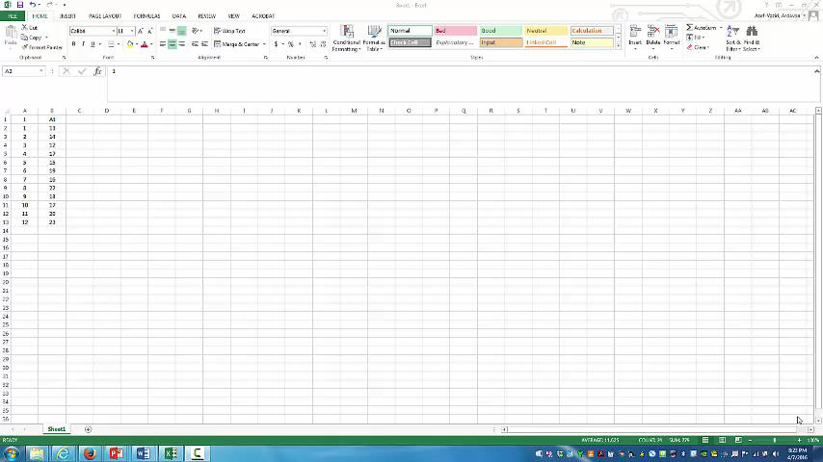
Watch this Lecture then Go through The Slides
This is an unedited in-class recording

Slide 3
Regression Analysis
The primary method for associative forecasting is Regression Analysis.
The relationship between two or more variables.
The relationship could be linear or non-linear.
Simple Linear Regression : Linear Regression Between Two Variables
We could use available data to investigate such a relationship. We use this relationship to forecast future.
The relationship between a dependent variable and one or more independent variables. The independent variables are also referred to as predictor variables.
We may use regression to investigate the relationship between demand (y) and time (x), or advertisement (x) as independent variable and sales (y) as the dependent variable.
We can associate terms such as Association Analysis, Causal Analysis, Time Sires Analysis, Regression for Prediction, and Regression for Association to Regression Analysis.

Slide 4
Regression
An linear trend is when the amount of increase in Y (dependent Variable) for each unit increase in X (independent Variable) is constant. For example for each 1 unit crease in X there is 0.2 units increase in Y.
An exponential trend is when the percentage of increase in Y foe each unit increase in X is constant. For example for each 1 unit increase in X there is 2% increase in Y.
A causal model provides evidence of an association between an independent variable and the variable to be forecast.
Causal models relate a time series or other dependent variables to independent variables that are believed to explain or cause its behavior. They do not provide evidence of a causal relationship between an independent variable and the variable to be forecast.
For causal modeling, scatter charts are used to detect linear or nonlinear relationships between the independent and dependent variables.
Crease in X

Slide 5
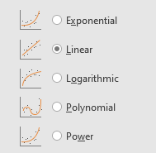
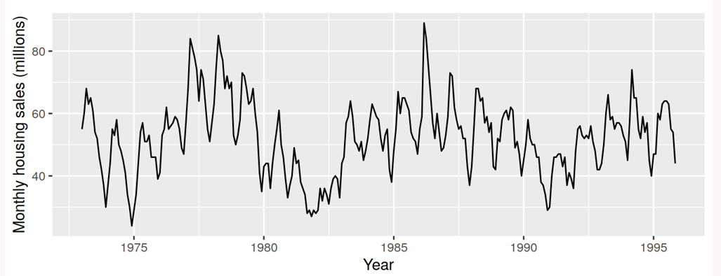
Patterns

Slide 6
Mean Squared Error- Measure of Forecast Accuracy
y=b0+b1x
1
b₁
b₀

Slide 7
Linear Relationship
Linear relationship between two variables is stated as
y = b₀ + b₁ x
y : Dependent variable
x : Independent variable
b₀ : Intercept with y axis
b₁ : Slope of the line
b₁ > 0
b₁ < 0
b₁ = 0
Correlation coefficient is a measure of the strength of a linear association between two variables. It has a value between -1 and +1
R_{xy} = +1 : two variables are perfectly related through a line with positive slope.
R_{xy} = -1 : two variables are perfectly related through a line with negative slope.
R_{xy} = 0 : two variables are not linearly related.
Coefficient of Determination and Correlation Coefficient are both measures of associations between variables.
Correlation Coefficient for linear relationship between two variables.
Coefficient of Determination for linear and nonlinear relationships between two and more variables.

Slide 8
LA/LB Ports – Twenty-Foot Equivalent Unit (TEUs)

Slide 9
Excel Regression

Slide 10
Regression Output
Correlation Coefficient +↑. Close to + 1
Coefficient of Determination ↑ Close to 1
Standard Deviation of Forecast ↓
If the first period is 1, next period is 10+1 = 11
P-value ↓ less than 0.05

Slide 11
Regression Output
Provide the equation of the Regression line.
F_{t} = 94.13 +30.71t
What is your forecast for the next period?
Next period?
F11 = 94.13 +30.71(11) = 431.7
Mean Forecast = 431.7, Standard Deviation of Forecast = 22.21

Slide 12
Regression Problem 2
Given the following regression report for the relationship between demand and time. (Demand is the dependent variable and Time is the independent variable)
What is your forecast for the next period?
52+10(20+1) = 262
What is the standard deviation of your forecast for the next period? 15.05
Is there a strong relationship between the dependent and the independent variables?
Yes R-Square (Coefficient of Determination) id 0.95, Multiple R (Correlation Coefficient) is 0.97, p-value is very small
Is the relationship positive or negative?
Positive. We can check it by Multiple R being + or b1 being +

Slide 13
Short Questions
1. If the coefficient of determination between interest rate (x) and residential real estate prices (y) is 0.85, this means that:
  A) 85% of the y values are positive
  B) 85% of the variation in y can be explained by the variation in x
  C) 85% of the x values are equal
  D) 85% of the variation in x can be explained by the variation in y
  E) none of the above
2. Which value of the coefficient of correlation (r) indicates a stronger correlation than 0.7?
  A) 0.6
  B) -0.9
  C) 0.4
  D) -0.5
  E) none of the above

Slide 14
Short Questions
3. In a good regression we expect
  P-value to be high and R-square to be high
  P-value to be low and R-square to be low
  P-value to be low and R-square to be high
  P-value to be high and R-square to be low
  none of the answers
4. Discuss the relationship between MAD in moving average and exponential smoothing and Standard Error in regression.
Standard Error in regression is an estimate of the Standard Deviation of the Forecast.
Standard Deviation of the Forecast = Standard Error
MAD in moving average and exponential smoothing is an estimate of the Standard Deviation of the Forecast.
Standard Deviation of the Forecast = 1.25MAD

Slide 15
Regression
Provide forecasts and standard deviation of forecast for September using linear Regression. Also Compute R-Squared (Coefficient of determination) and Correlation Coefficient.

Slide 16
Seasonality
Seasonality is when a time series show a recurring pattern over day, a week, a month, a year or less.
A time series with a seasonal pattern can be modeled using multi-variable regression by treating the season as a 0/1dummy variable. For example we can have X1, X2, and X3 for Spring, Summer, and Fall. Then X2=1 means this specific piece of data is for Summer. When all of them are 0, then we are in Winter. The number of variables are always one less than the number of seasons.

Slide 17
Seasonality Enhanced Regression Using 0/1 Variables

Slide 18
LA/LB Ports Total TEU Data (2015-2019)

Slide 19
DNCBE-CSUN Incoming Students
Given 16 years data on the college of Business incoming students. Using 6-period moving average.
A) Commune Average and Standard Deviation of the data.
B) Computed Standard Error and 95% Confidence Interval for the average number of incoming students.
C) Compute MAD, MSE, MARD (MAPE).
E) Compute your forecast for the next period.
F) Compute the standard deviation of your forecast for the next period using MAD, MSE, MARD (MAPE).
G) What is the average Age of data
H) Draw the Tracking Signal Curve.
I) Using the Standard Deviation obtained by MSE, compute the probability of the next period demand to be less that 90% of your forecast.

Slide 20
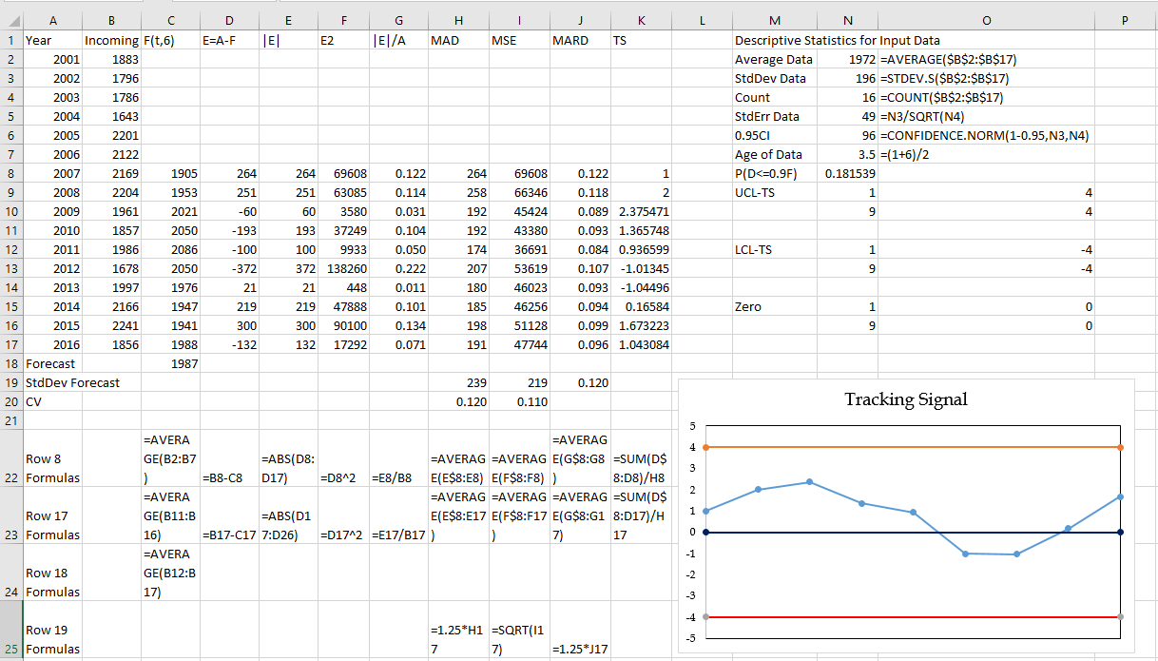
DNCBE-CSUN Incoming Students
F_{t+1} = (1/2) F_{t}+ (1/2) (A_{t})
F_{t+1} = (F_{t}+A_{t})/2
F₃ = (F₂+A₂)/2
F₃ = (300+500)/2= 400
F₄ = (F₃+A₃)/2 = (400+600)/2 = 500

Slide 21
Comparing Several Forecasting Techniques
When comparing several methods, we need to use the same time horizon for all methods. We need to have actual as well as forecasts for all methods for all periods of MAD computations
Here we have Actual for periods 1 to 7; that is 7 periods.
Regression can provide us with forecast for periods 1 to ∞
Five period moving average can only provide forecast for periods 6 and 7; that is 2 periods
Therefore, to compare all these methods, we can compute MAD only over 2 periods. But two periods is not enough.
Naïve Method or Exponential Smoothing ?
Naïve method forecasts for periods 2 to 7; That is 6 periods
Exponential Smoothing for periods 2 to 7; That is 6 periods
We can compare NM and ES over 6 periods.

