Slide 1
Forecasting 3
Regression Analysis
Ardavan Asef-Vaziri

Slide 2
Regression Analysis
The primary method for associative forecasting is Regression Analysis.
The relationship between two or more variables.
The relationship could be linear or non-linear.
Simple Linear Regression : Linear Regression Between Two Variables
We could use available data to investigate such a relationship. We use this relationship to forecast future.
The relationship between a dependent variable and one or more independent variables. The independent variables are also referred to as predictor variables.
We may use regression to investigate the relationship between demand (y) and time (x), or advertisement (x) as independent variable and sales (y) as the dependent variable.

Slide 3
Scatter Diagram

Slide 4
Graphical - Judgmental Solution
b₁
1
b₀

Slide 5
Simple Linear Relationship
Linear relationship between two variables is stated as
y = b₀ + b₁ x
y : Dependent variable
x : Independent variable
b₀ : Intercept with y axis
b₁ : Slope of the line
b₁ > 0
b₁ < 0
b₁ = 0

Slide 6
The Correlation Coefficient
Correlation coefficient is a measure of the strength of a linear association between two variables. It has a value between -1 and +1
R_{xy} = +1 : two variables are perfectly related through a line with positive slope.
R_{xy} = -1 : two variables are perfectly related through a line with negative slope.
R_{xy} = 0 : two variables are not linearly related.
Coefficient of Determination and Correlation Coefficient are both measures of associations between variables.
Correlation Coefficient for linear relationship between two variables.
Coefficient of Determination for linear and nonlinear relationships between two and more variables.

Slide 7

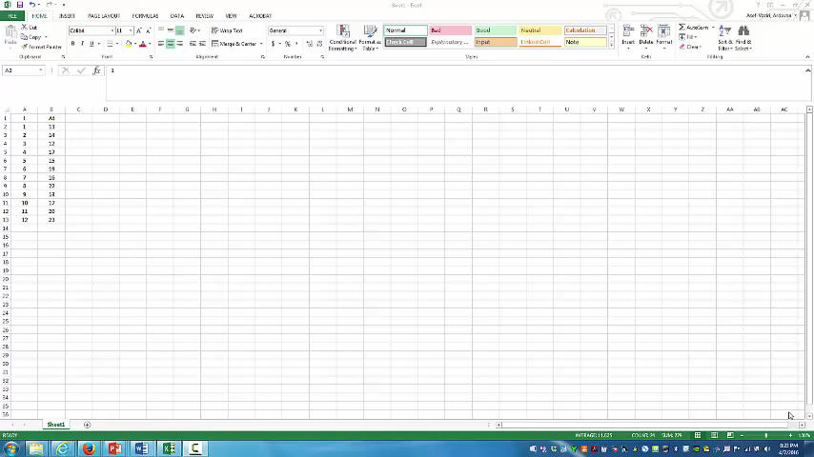
Regression in Excel
This is an unedited in-class recording

Slide 8
Excel Regression

Slide 9
Regression Output
Correlation Coefficient +↑. Close to + 1
Coefficient of Determination ↑ Close to 1
Standard Deviation of Forecast ↓
If the first period is 1, next period is 10+1 = 11
P-value ↓ less than 0.05

Slide 10
Regression Output
F_{t} = 94.13 +30.71t
What is your forecast for the next period.
F11 = 94.13 +30.71(11) = 431.7
Mean Forecast = 431.7, Standard Deviation of Forecast = 22.21

Slide 11
Regression Problem 1
What is your forecast fore the next period?
In which period are we?
7. Next period is 8.
Standard Deviation of Forecast = 2.09

Slide 12
Regression Problem 2
Given the following regression report for the relationship between demand and time. (Demand is the dependent variable and Time is the independent variable)
What is your forecast for the next period?
52+10(20+1) = 262
What is the standard deviation of your forecast for the next period? 15.05
Is there a strong relationship between the dependent and the independent variables?
Yes R-Square (Coefficient of Determination) id 0.95, Multiple R (Correlation Coefficient) is 0.97, p-value is very small
Is the relationship positive or negative?
Positive. We can check it by Multiple R being + or b1 being +

Slide 13
Short Questions 1-2
1. If the coefficient of determination between interest rate (x) and residential real estate prices (y) is 0.85, this means that:
  A) 85% of the y values are positive
  B) 85% of the variation in y can be explained by the variation in x
  C) 85% of the x values are equal
  D) 85% of the variation in x can be explained by the variation in y
  E) none of the above
2. Which value of the coefficient of correlation (r) indicates a stronger correlation than 0.7?
  A) 0.6
  B) -0.9
  C) 0.4
  D) -0.5
  E) none of the above

Slide 14
Short Questions 3-4
3. In a good regression we expect
  P-value to be high and R-square to be high
  P-value to be low and R-square to be low
  P-value to be low and R-square to be high
  P-value to be high and R-square to be low
  none of the answers
4. Discuss the relationship between MAD in moving average and exponential smoothing and Standard Error in regression.
Standard Error in regression is an estimate of the Standard Deviation of the Forecast.
Standard Deviation of the Forecast = Standard Error
MAD in moving average and exponential smoothing is an estimate of the Standard Deviation of the Forecast.
Standard Deviation of the Forecast = 1.25MAD

Slide 15
Some Points on Mathematics of Linear Regression

Slide 16
Mathematical Solution
^
|y₉ – y₉ |

Slide 17
SST : Pictorial Representation
y₁₀ -
y
y_{i}

Slide 18
SSE , SST and SSR
SST : A measure of how well the observations cluster around y
SSE : A measure of how well the observations cluster around ŷ
If value of x did not play any role in the value of y, we should
SST = SSE
If value of x plays the full role in the value of y then
SSE = 0
SST = SSE + SSR
SSR : Sum of the squares due to regression
SSR is explained portion of SST
SSE is unexplained portion of SST

Slide 19
Coefficient of Determination for Goodness of Fit
SSE = SST - SSR
The largest value for SSE is
SSE = SST
SSE = SST =======> SSR = 0
SSR/SST = 0 =====> the worst fit
SSR/SST = 1 =====> the best fit
Correlation Coefficient = Sign of b1 times Square Root of the Coefficient of Determination)

Slide 20
Additional Resources
For Simple Regression, you may watch the Following Video
https://www.youtube.com/watch?v=i2bqvDRapxo
For Multiple Regression, you may watch the Following Video
https://www.youtube.com/watch?v=HgfHefwK7VQ

