Slide 1
Regression Using Data Analysis
Ardavan Asef-Vaziri

Slide 2

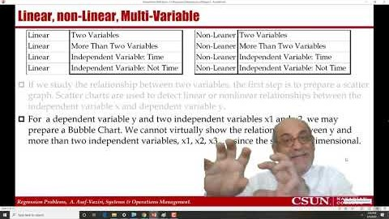
Recorded Lecture
https://www.youtube.com/watch?v=DQznGbwQVCg&t=13s

Slide 3
Regression Analysis
Regression Analysis is used both for Prediction (forecasting) and Association to explore the relationship between a dependent variable and one or more independent variables. The independent variable(s) are also referred to as predictors.
We may use regression to investigate the relationship between demand or sales (y) and time , the relationship between sales (y) and price (x), the relationship between total costs (y) and quantity produced (x), and course grade (y) and study hours (x) .
Multi-variable regression is when we analyze the relationship between one dependent variable y and several independent variables x1, x2, x3, …
A linear relationship is when the amount of increase in y for each unit increase in x is constant. For example, for each 1 unit crease in x there is 0.2 units increase in y.
An exponential relationship (an example of non-linear relationship) is when the percentage of increase in y for each unit increase in x is constant. For example, for each 1 unit increase in x there is 2% increase in y.

Slide 4
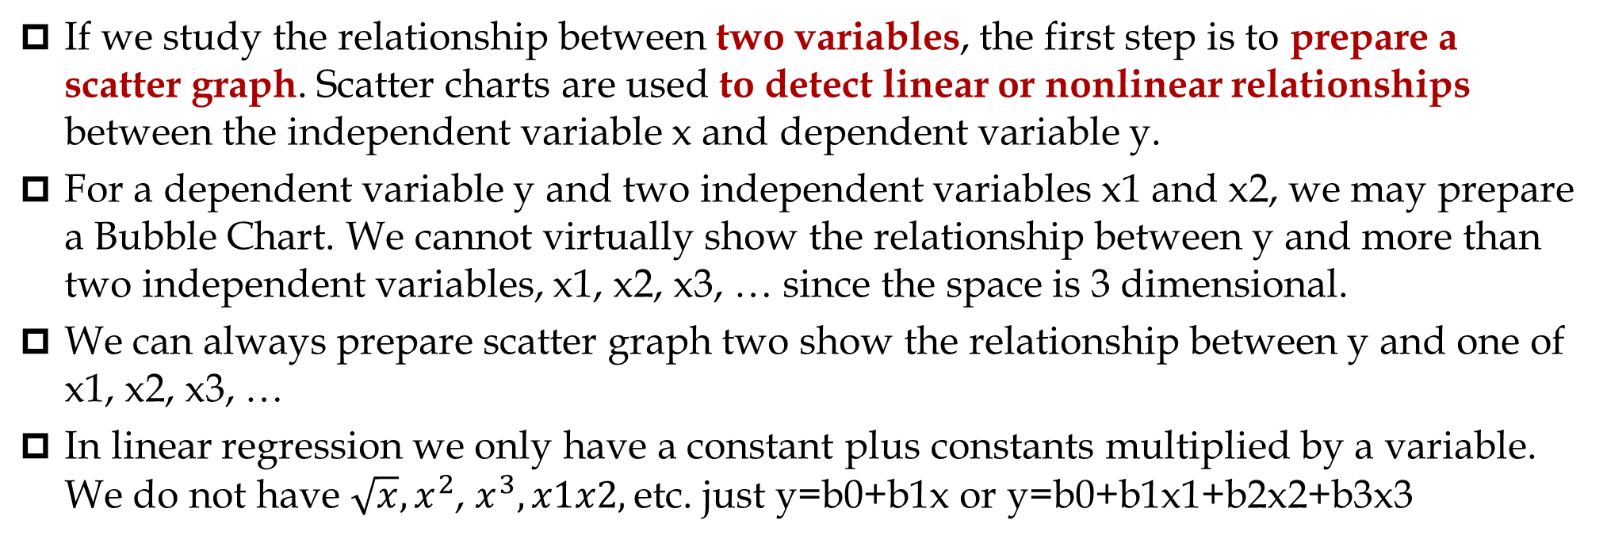
Linear, non-Linear, Multi-Variable
If we study the relationship between two variables, the first step is to prepare a scatter graph. Scatter charts are used to detect linear or nonlinear relationships between the independent variable x and dependent variable y.
For a dependent variable y and two independent variables x1 and x2, we may prepare a Bubble Chart. We cannot virtually show the relationship between y and more than two independent variables, x1, x2, x3, … since the space is 3 dimensional.
We can always prepare scatter graph two show the relationship between y and one of x1, x2, x3, …
In linear regression we only have a constant plus constants multiplied by a variable. We do not have $\sqrt{x}, x^{2}$, $x^{3}, x1x2,$etc. just y=b0+b1x or y=b0+b1x1+b2x2+b3x3

Slide 5
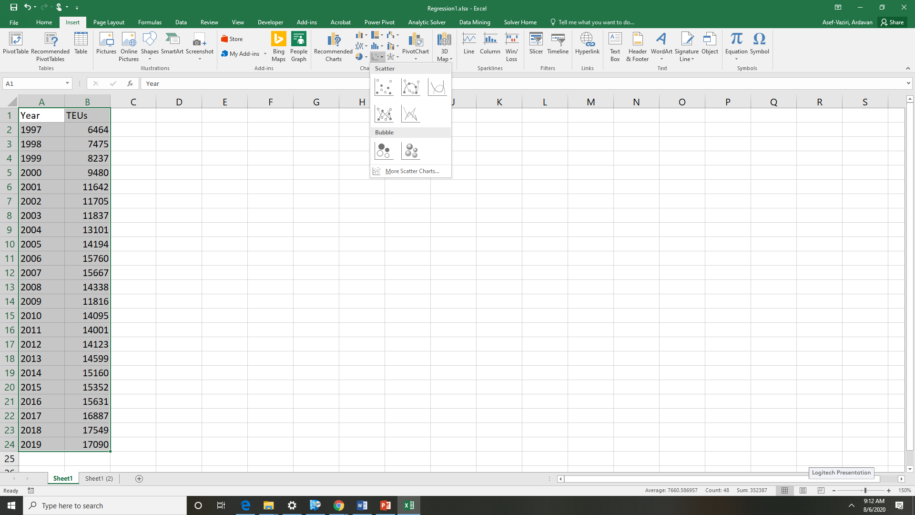

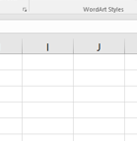
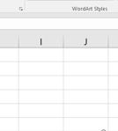
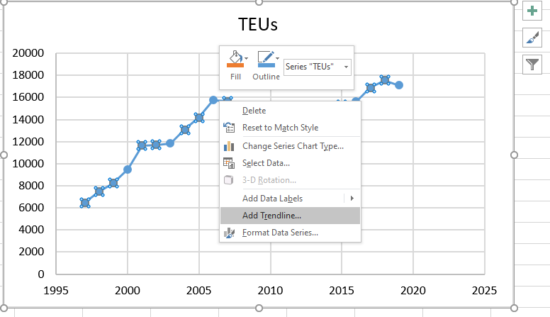
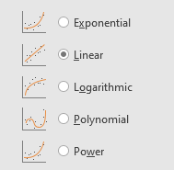
Scatter Graphs and Trend Lines

Slide 6
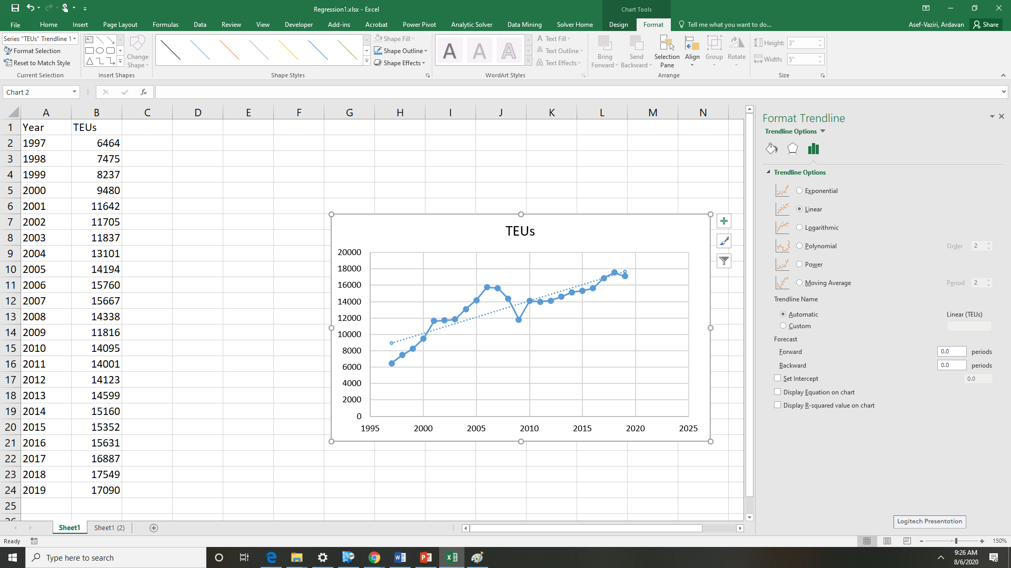
Adding Equation and R-Squared
y = 396.76x - 783383
R² = 0.7735

Slide 7
Least Squared Method- Measure of Forecast Accuracy
3000
2500
2000
1500
1000
500
b₀
1
b₁
0
1
3
5
7
9
11

Slide 8
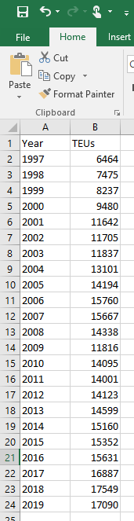
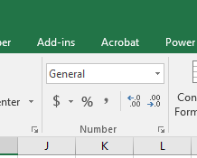
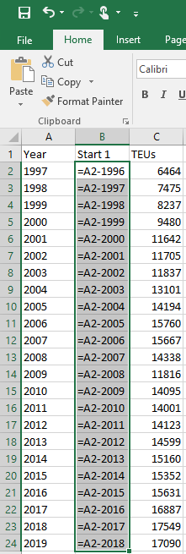
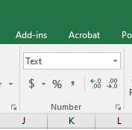
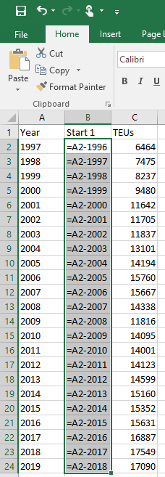
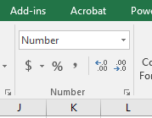
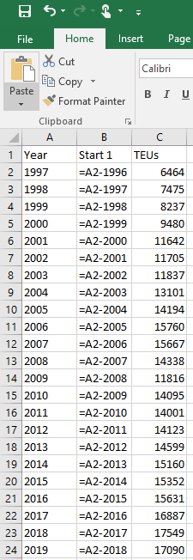
23 Years LA/LB Ports - Opening a File Which May Have Turned into Text

Slide 9
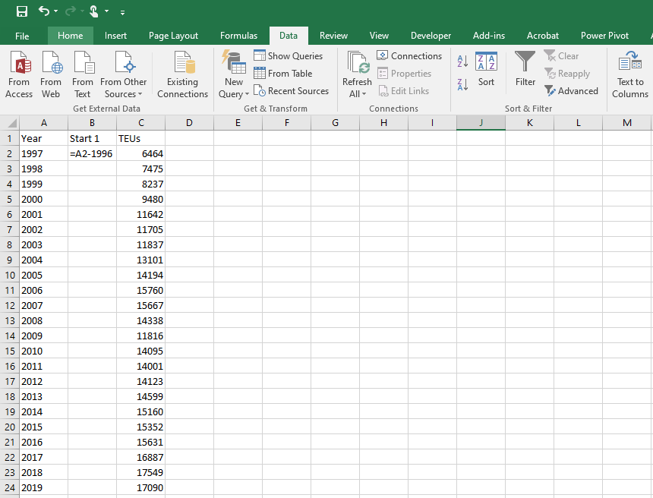
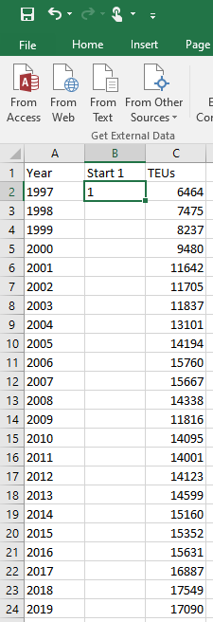
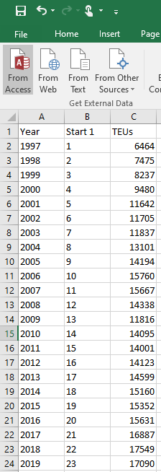
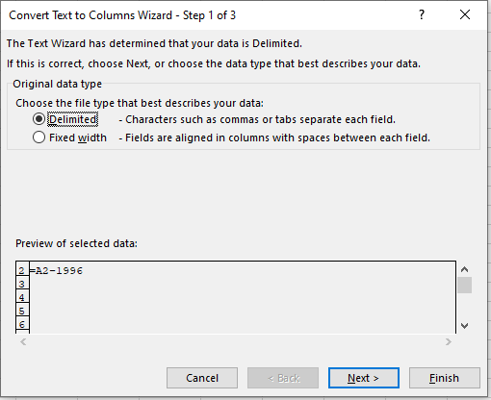
Text/Numbers /Text to Columns/Fixed/Delimited/Finished/Next

Slide 10
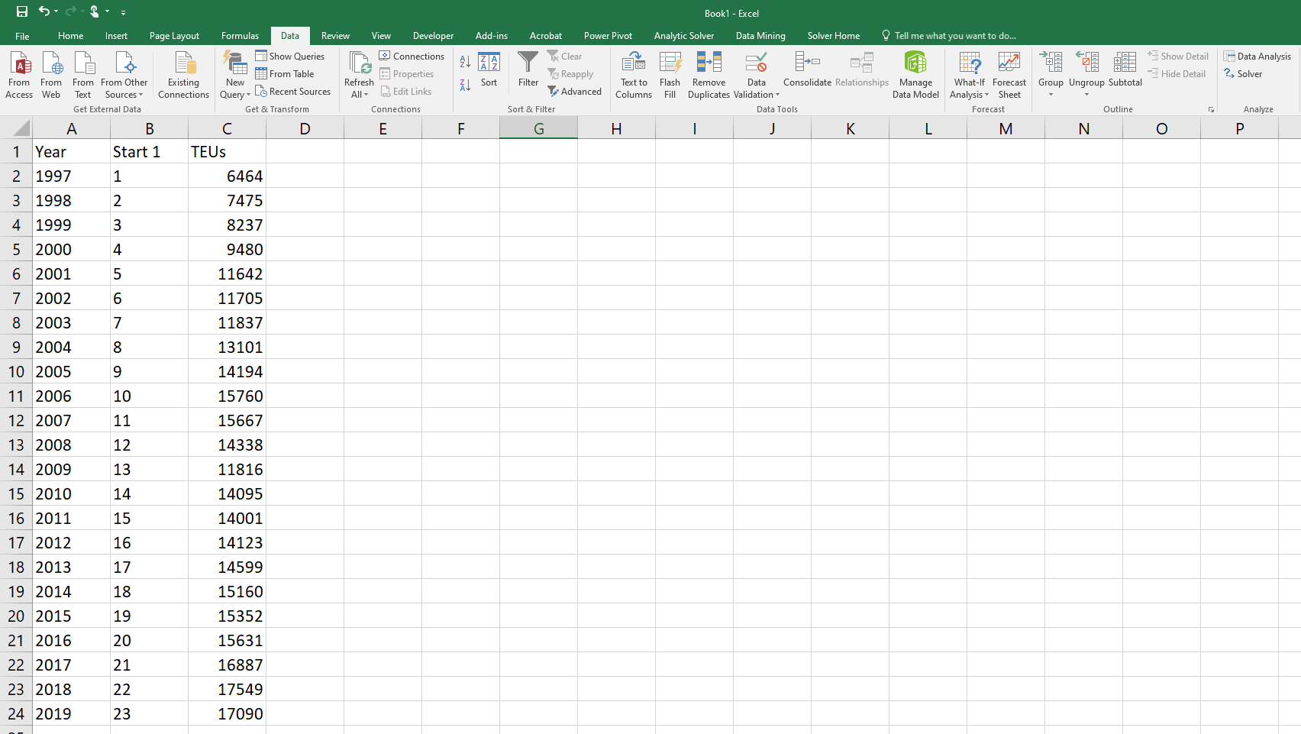
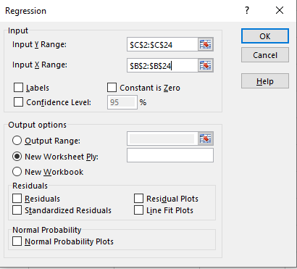
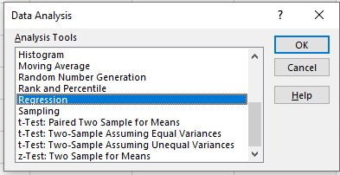
Data/Data Analysis/Regression/Y/X/Output
E1

Slide 11
Organized Output – 23 Years LA/LB Ports Data
Correlation Coefficient (-1 to +1). The closer to 1 or -1 the better.
RSQ= 0.77
Coefficient of Determination. The closer to 1 the better.
R=sign of b1 times SQRT(RSQ)
To know if the line had + or - slope we look at X Variable 1 or Multiple R
R = +SQRT(0.77)= 0.88
Standard Error is the standard deviation of our forecast. The smaller the better
Standard Error Serves the same purpose as 1,25MAD and SQRT(MSE)
The number of periods is 23, therefore, if we have started from period 1,
The NEXT period is period 24
The forecast for the next period
has Normal Distribution
With an average of
F24=8552.043+396.761*24
y=8552.04+396.76x
We want is less that .05
F24= 18074.3
Regression Line
E08 means 10^8 = 100000000
The standard Deviation is
E-8 means 1/(10^8) = 1/100000000= 0.00000001
Standard Error =1490.58

Slide 12
Additional Example- Data Analysis - Regression Output
Correlation Coefficient (-1 to 1). We want close to 1 or -1 +↑.
Coefficient of Determination (0 to 1) . We want close to 1↑.
Standard Deviation of Forecast . We like smal values ↓
If the first period is 1, next period is 10+1 = 11
P-value ↓ less than 0.05
Regression Equation
Ft = 94.13 +30.71t
Forecast for the next period?
Next period?
If the first period was 1
F11 = 94.13 +30.71(11) = 431.7
Mean Forecast = 431.7
StdDev. Forecast = 22.21

Slide 13
B1 and R
Linear relationship between two variables is stated as
y = b₀ + b₁ x
y : Dependent variable
x : Independent variable
b₀ : Intercept with y axis
b₁ : Slope of the line
b₁ and R< 0
b₁ and R= 0
b₁ and R> 0
Correlation coefficient (R) is a measure of the strength of a linear association between two variables. It has a value between -1 and +1
R = +1 : two variables are perfectly related through a line with positive slope.
R = -1 : two variables are perfectly related through a line with negative slope. -1 is as good as a +1.
R = 0 : two variables are not linearly related.
Correlation Coefficient (R) and Coefficient of Determination (RSQ= R²) are both measures of associations between the independent variable (s) and the dependent variable.
R for linear relationship between two variables.
RSQ for linear and nonlinear relationships between two and more variables.

Slide 14
Some Other Information
Coefficient of determination (RSQ) states that 100RSQ% of the variation in y can be explained by the variation in x.
Positive and negative Correlation Coefficient (R) values represent the same strength of association. For example, R=-0.8 and R=+0.8 represent the same level of strength in the relationship between x and y. The value of RSQ=R^2 =0.64 is the same for both.
We like to have very small p-value. At least less than 0.05. A small p-value indicates that there is a relationship between x and y.
We benefit from 1.25MAD as SQRT(MSE) as the standard deviation of the demand. Standard Error of Regression serves the same purpose.
There is a small difference between SQRT(MSE) and Standard Error.

Slide 15
Coefficient of Determination & Correlation Coefficients

Slide 16
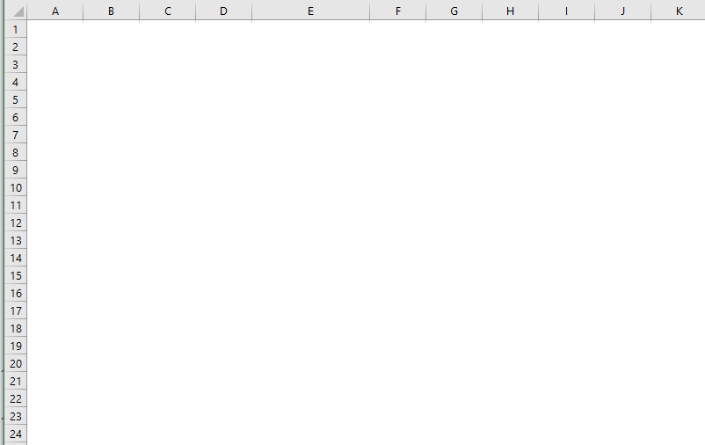
MSE vs. Standard Error in Regression: n-2 not n

