Slide 1
Basic Predictive Analysis
Basics of Time Series Analysis
Introduction to Forecasting & Time Series
Those who do not remember the past are condemned to repeat it
George Santayana Spanish philosopher, poet and novelist(1863-1952)

Slide 2

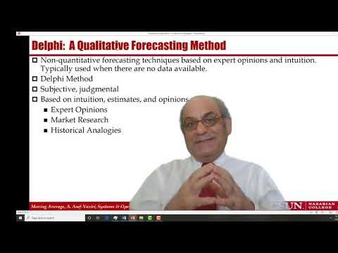
Introduction to Forecasting and Time Series
https://youtu.be/V1AT5BrEIsc

Slide 3
All Business Processes & Functions Need Forecasting
Forecast: a prediction of the future value of a variable of interest, such as demand.
Marketing, finance, and operations are the three key building blocks of manufacturing and service organizations.
They all need forecasting for planning, organizing, and budgeting.

Slide 4
Four Characteristics of All Forecasting Techniques
Forecasts are almost always inaccurate- Differ from actual.
Forecasts should be accompanied by a measure of forecast error- such as standard deviation or coefficient of variation.
Forecasts for aggregate items are more accurate than individual forecasts. Aggregate forecasts reduce the amount of variability – relative to the aggregate mean demand. Standard deviation of sum of two variables is less than sum of the standard deviation of the two variables.
Long-range forecasts are less accurate than short-range forecasts. Forecasts further into the future tends to be less accurate than those of more imminent events. As time passes, we get better information, and make better prediction.

Slide 5
World Containerized Cargo-2016

Slide 6
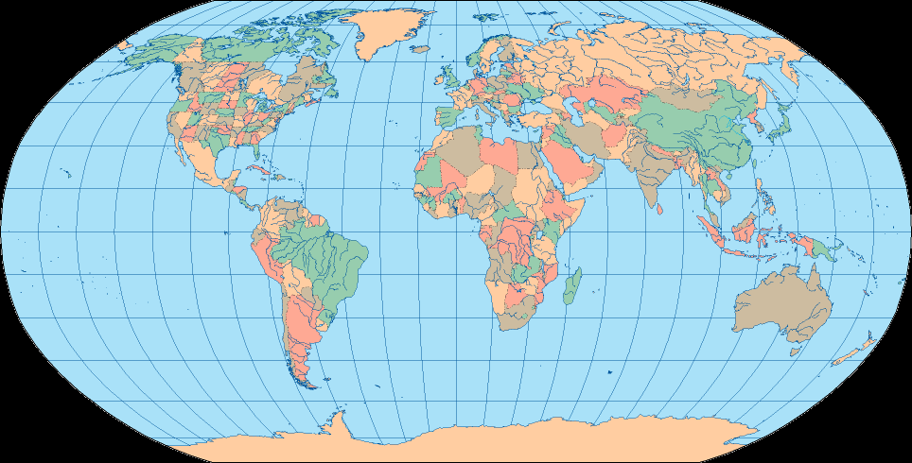
US-China Alternative Routes
Narvik, Norway
Prince Rupert, Canada
New York
Vostochny, Russia
Norfolk
Rotterdam, Netherlands
New York
Norfolk
Savannah
Los Angeles
Hong Kong, China
Savannah
Ensenada, Mexico
Colima, Mexico
Singapore

Slide 7
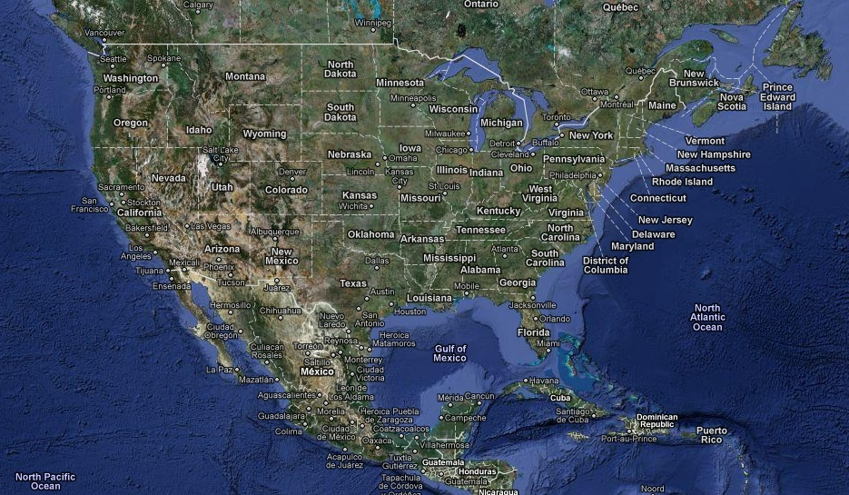
Aggregate Forecasts Are More Accurate
4 Weeks
2 Weeks
3 Weeks

Slide 8
Forecasts More into Future Are Less Accurate
2-3 days
3-4 days
14 days

Slide 9
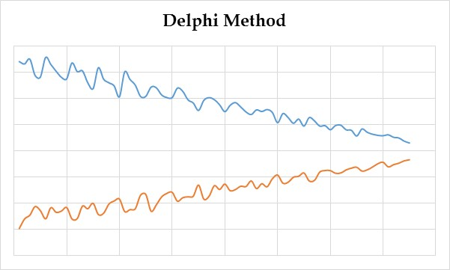
Delphi: A Qualitative Forecasting Method
Non-quantitative forecasting techniques based on expert opinions and intuition. Typically used when there are no data available.
Delphi Method
Subjective, judgmental
Based on intuition, estimates, and opinions
  Expert Opinions
  Market Research
  Historical Analogies

Slide 10
Historical forecast performance
Initial forecast =2000 units.
Average A/F Ratio 1.06
StdDev A/F= 0.38
"Expected actual demand "= 1.06(2000)
"Standard deviation of actual demand"=
"Standard deviation of A/F ratios "×"Forecast"
=0.38*2000= 760
A~N(2120,760)

Slide 11
Types of Forecasting- Time Series
Quantitative Techniques
  Time Series Analysis - Analyzing the data on a variable of interest (such as sales, demand, etc.) measured at successive time periods.
    Moving Average
    Weighted Moving Average
    Exponential Smoothing
  Regression Analysis - Relating a dependent variable (demand) to other independent variables (time, price, income, etc.)
    Linear – Single-Variable or Multi-Variables
    Nonlinear - Single-Variable or Multi-Variables
    Time Series or Causal
Measures of Accuracy
  Mean Absolute Deviation (MAD)
  Mean Squared Error (MSE)
  Mean Absolute Relative Deviation (MARD) [Mean Absolute Percentage Error (MAPE)]
  Tracking Signal (TS)

Slide 12
Systematic & Random Variations - LA/LB Ports 23 Years TEUs
Time Series. A relationship between the variable of interest – demand - and time.
Systematic Components (Expected)
  Level (current deseasonalized
  Trend (growth or decline)
  Seasonality (less than one year)
  Cycles (every several years)
Random Components (Not Predictable)
Cycles
1,200
1,000
Trend
800
Seasonality
Level
600
400

Slide 13
Basic Predictive Analysis
Basics of Time Series Analysis
Some Data Sets
Those who do not remember the past are condemned to repeat it
George Santayana Spanish philosopher, poet and novelist(1863-1952)

Slide 14

Ports of LOS Angeles & Log Beach Monthly Data (1000s TEUs)
TEU: Twenty-Foot Equivalent Unit – A 20 feet intermodal container. We use this data in our Predictive Analytics Assignment. You may open the Table below
You may use the following formula to turn the matrix into a column. =INDEX($B$2:$X$13,IF(MOD(ROWS(B$17:B17),12)>0,MOD(ROWS(B$17:B17),12),12),IF(INT(ROWS(B$17:B17)/12)<>ROWS(B$17:B17)/12,INT(ROWS(B$17:B17)/12)+1,INT(ROWS(B$17:B17)/12)))

Slide 15
Data Base to Generate Thousands Sets of Data – Prescriptive Analytics

Slide 16
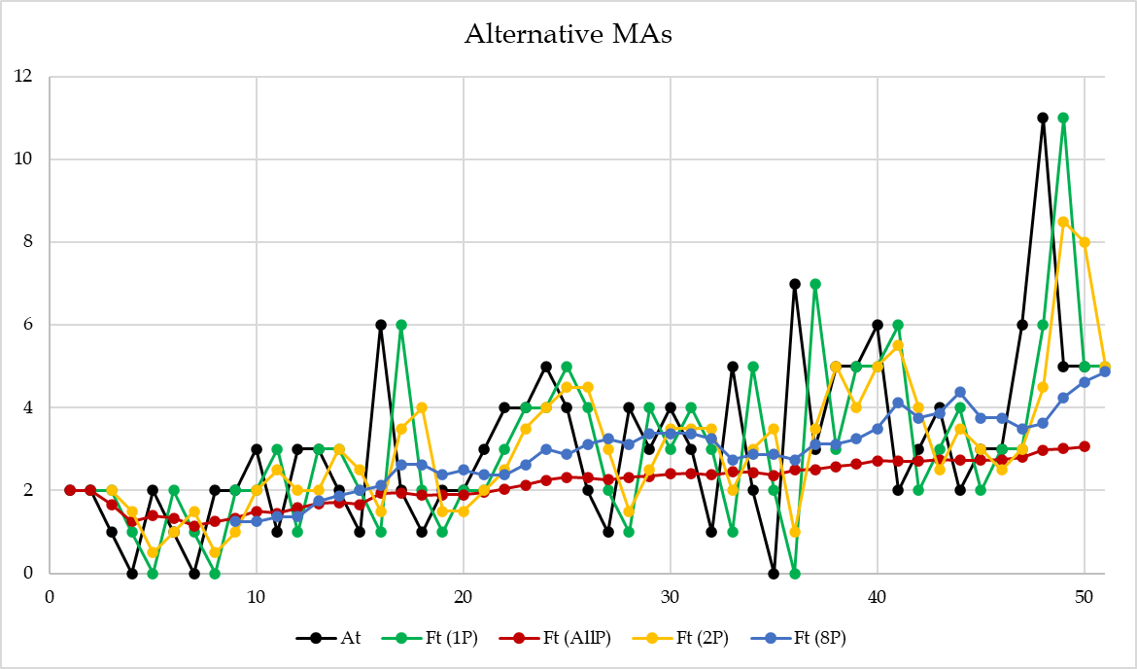
Snapshot vs Time Series – Prescriptive vs Predictive Analytics

Slide 17
Basic Predictive Analysis
Basics of Time Series Analysis
Moving Average
Those who do not remember the past are condemned to repeat it
George Santayana Spanish philosopher, poet and novelist(1863-1952)

Slide 18
Moving Average – This Slide and the Next 2 Slides Are Recorded At

Slide 19
Mean Absolute Deviation (MAD) & Tracking Signal (Signal)
On the same previous link https://youtu.be/GICffBJLrsg

Slide 20
MSE & MAPE (MARD) – On the same link https://youtu.be/GICffBJLrsg
This part of the lecture is also recorded in the link on the previous page. That is https://youtu.be/GICffBJLrsg

Slide 21
A Good Practice to Review Everything and also Know Bias

Slide 22
Stationary vs Nonstationary

Slide 23
A Formula For All Moving Averages- NOT REQUIRED

Slide 24
Basic Predictive Analysis
Basics of Time Series Analysis
Moving Average Problems
Those who do not remember the past are condemned to repeat it
George Santayana Spanish philosopher, poet and novelist (1863-1952)

Slide 25
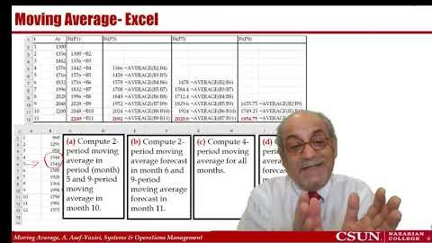

The Lecture https://youtu.be/g_lg0F_7Hmc
The Lecture https://youtu.be/g_lg0F_7Hmc

Slide 26
Moving Average: n-periods
The moving averages forecasting methods use the average of a set of most recent data as the forecast for the next period.
The moving averages forecasting methods are not usually used in the presence of considerable trend and seasonal patterns.
We have data for 8 periods. What is your forecast for the next period (period 9).
We can compute (i) the average all data, (ii) last period demand, the average of the (iii) last 2-periods, (vi) last 3-periods, (v) last n-periods.

Slide 27
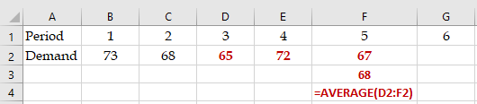
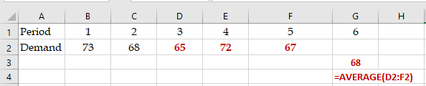
Moving Average vs. Moving Average Forecast
Given the following data,
a) Compute 3-period moving average for period 5?
Period 1 2 3 4 5
Demand 73 68 65 72 67
b) Compute 3-period moving average forecast for period 6?

Slide 28
Notations
3 period moving average in period 5: MA(5,3)
3 period moving average forecast in period 5: FMA(5,3)
n period moving average forecast in period t: FMA(t,n)
n period moving average : MA(t,n)
n period moving average forecast : Ft(np)
Naïve Forecast: Forecast for next period = Actual for this period. F(t+1) = At
3-period moving average in month t
  Ft(3p) = Average (At+A(t-1)+A(t-2))
5-period moving average
  Ft(5p) = Average (At+A(t-1)+A(t-2)+A(t-3)+A(t-4))
8-period moving average
  Ft(8p) = Average (At+A(t-1)+A(t-2)+A(t-3)+A(t-4)+A(t-5)+A(t-6)A(t-7))
For Simplicity, in many cases, we simply use At and Ft for actual and forecast values.

Slide 29
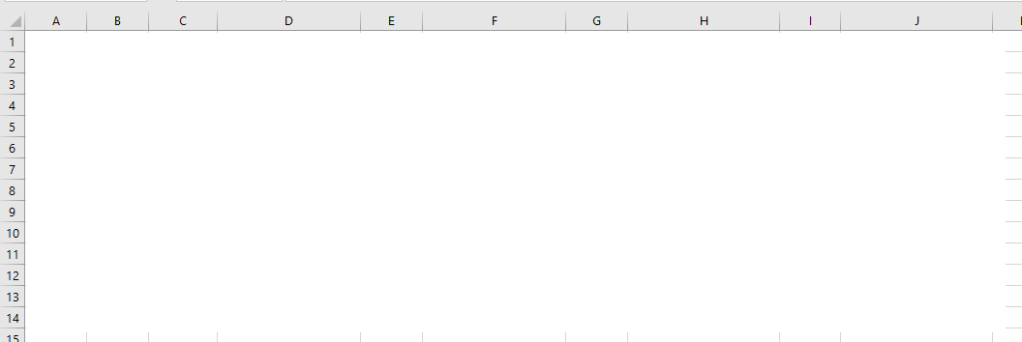
Moving Average- Excel
(a) Compute 2-period moving average in period (month) 5 and 9-period moving average in month 10.
(b) Compute 2-period moving average forecast in month 6 and 9-period moving average forecast in month 11.
(c) Compute 4-period moving average for all months.
(d) Compute 4-period moving average forecast for all months including the next month.

Slide 30
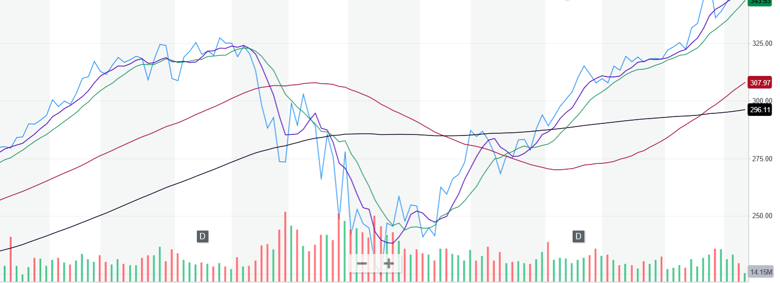
n-period - Large vs. Small
In order to increase the responsiveness of a forecast (i.e., respond quickly to the data changes) made using the moving average technique, the number of periods in the average should be:
  A) decreased
  B) increased
  C) multiplied by a larger alpha
  D) multiplied by a smaller alpha
  none of the above
AAPL: 5, 10, 50, 100

Slide 31
Age of Data
Compute the age of data in 3 period moving average forecasts.
In a 3 period moving average forecast, the most recent piece of data belongs to the previous period. It is 1 period old. The second piece is 2 periods and the oldest piece is 3 periods old.
Average Age of Data = (1+2+3)/3 = 2.
However when we have a linear trend, we can average the first and the last pieces of data
Average Age of Data = (1+3)/2 = 2.
We can do the same even for non-linear patterns, but the answer will be an approximate (not exact).
Compute the age of data in 7 period moving average forecasts.
Average Age of Data = (1+7)/2 = 4.

Slide 32
N-Period MA to (n+1)-Period MA
The 5-period moving average in month 6 was 150 units. Actual demand in month 7 is 180 units. What is 6 period moving average in month 7?
MA⁵₆ = (A6+A5+A4+A3+A2)/5
MA⁶₇ = (A7+A6+A5+A4+A3+A2)/6
MA⁵₆ = (A6+A5+A4+A3+A2)/5 = 150
A6+A5+A4+A3+A2 = 750
A7 = 180
MA⁶₇ = (A7+A6+A5+A4+A3+A2)/6
MA⁶₇ = (180+750)/6 = 155

Slide 33
Alternative Solution
The 5-period moving average in month 6 was 150 units. Actual demand in month 7 is 180 units. What is 6 period moving average in month 7?
We may assume that 5-period moving average was
MA⁵₆=(150+150+150+150+150)/5 = 150.
Now we have
MA⁶₇=(180+150+150+150+150+150)/6 = 155.
We could have also said suppose A7= 150+30.
If A7 was 150, then
MA⁶₇ = 150, since all the actual values are 150.
But the reality is the most current value is 30 units more than 150.
In 6 period moving average there are 6 numbers: 30/6=5.
MA⁶₇ = 150+5 =155

Slide 34
Another Example- n-period MA to (n+1)-period MA
Actual demand in month 8 is 160 units. The 4-period moving average in month 7 was 110 units. What is 5-period moving average in month 8?
  A) 100
  B) 110
  C) 120
  D) 140
  E) 150
MA⁴₇ = (A7+A6+A5+A4)/4 = 110
A7+A6+A5+A4 = 440
A8 = 160
MA⁵₈ = (A8+ A7+A6+A5+A4)/5
MA⁵₈ = (160+440)/5 = 120
Alternatively, if A7 was 110, then MA⁵₈ = 110.
But A7=110+50
We need divide 50 by 5, that is 10. MA⁵₈ =110+10 = 120

Slide 35
n-period to n-period From Month t to t+1
Suppose the 5-period moving average in period 20 is equal to 800. Suppose period 16 demand is 850. Also suppose the demand for period 21 is 900. Compute 5-period moving average for period 21.
= (
+A16)/5
MA⁵₂₀ = (A20+A19+A18+A17+A16)/5
MA⁵₂₀ = (A20+A19+A18+A17+A16)/5 =800
= (
➔
+850)/5 =800
+850 =4000
➔
=3150
MA⁵₂₁ = (A21+A20+A19+A18+A17)/5
MA⁵₂₁ = (A21+A20+A19+A18+A17)/5 =???
= (
+A21)/5
= (
+900)/5
=
(3150+900)/5 =810
MA⁵₂₁ = MA⁵₂₀ +(A21- A16)/5
MA⁵₂₁ = 800 +(900- 850) /5=810

Slide 36
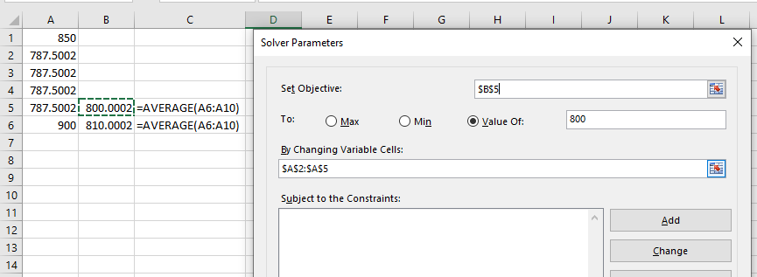
Alternative Solution
Suppose the 5-period moving average in period 20 is equal to 800. Suppose period 16 demand is 850. Also suppose the demand for period 21 is 900. Compute 5-period moving average for period 21.
MA⁵₂₀ = (A20+A19+A18+A17+A16)/5 =800
MA⁵₂₁ = (A21+A20+A19+A18+A17)/5 =???
We drop 850/5 and we add 900/5
We drop -850/5 and we add +900/5
MA⁵₂₀ = 800 -850/5 +900/5
MA⁵₂₀ = 800 +10 =810
Alternatively
Solver

Slide 37
Basic Predictive Analysis
Basics of Time Series Analysis
Measures of Forecasting Error
MAD, TS, MSE, MARD (MAPE), StdDev Forecast Problems
Predictions are usually difficult, especially about the future.
Yogi Berra The former New York Yankees Catcher

Slide 38
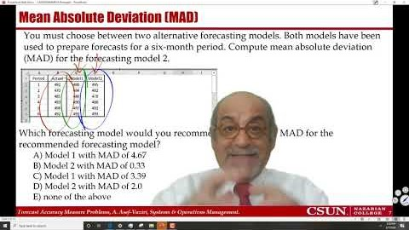
Recorded Lecture
https://youtu.be/2NJcpIBSUmc

Slide 39
Bring Your Qs to ZOOM
Please go through these slides. If you have question bring it to our ZOOM session.
All the excel-sheets are active. You can double-click on them, and they get open.
You can also right click on them and open the file.
In all cases, I recommend to select all, and then paste it into a new work-sheet.
This is especially important if intend to use SOLVER.
In the following slides

Slide 40
Forecasting Error
Error = Deviation =Et= At-Ft ➔ E=A-F.
Absolute Deviation = Absolute Error = ABS(E) = |E|.
Mean Absolute Deviation (MAD) = AVERAGE(|E|) over the available periods.
Forecast for next period: F(t+1) = MA(t,n).
Standard Deviation of Demand = 1.25MAD ➔ What MAD? MAD(t).
Tracking Signal (TS) = SUM(E)/MAD.
Squared Error = E² = E^2.
Mean Squared Error (MSE) = AVERAGE(E^2) over the available periods.
Forecast for next period: F(t+1) = MA(t,n).
Standard Deviation of Demand = SQRT(MSE) ➔ What MSE? MSE(t).
MARD= AVERAGE(|E|/A).
Forecast for next period: F(t+1) = MA(t,n).
StdDev= Relative Error =1.25 MARD ➔ What MARD? MARD(t).

Slide 41
Mean Absolute Deviation- Measure of Forecast Accuracy
MAD = Average(|A-F|)
3000
2500
2000
1500
1000
500
0
1
3
5
7
9
11

Slide 42
Mean Absolute Deviation & Tracking Signal
Compute MAD and TS at the end of period 4 for the following data,
Sum |A-F| = 15
MAD = Sum |A-F| /n =15/4 = 3.75
Sum (A-F) = 9
TS = Sum(A-F)/MAD
TS = 9/3.75 = 2.4
The sum of the forecast errors (SFE) and the mean absolute deviation (MAD) are calculated in each period. The values of SFE and MAD in the last period to be 46 and 21, respectively. Which of the following is the value of tracking signal in the last period?
TS= SFE/MAD ➔ TS= 46/21= 2.2

Slide 43
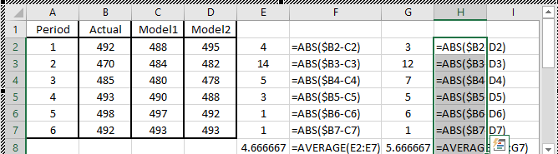
Mean Absolute Deviation (MAD)
You must choose between two alternative forecasting models. Both models have been used to prepare forecasts for a six-month period. Compute mean absolute deviation (MAD) for the forecasting model 2.
Which forecasting model would you recommend? What is the MAD for the recommended forecasting model?
  Model 1 with MAD of 4.67
  Model 2 with MAD of 0.33
  C) Model 1 with MAD of 3.39
  D) Model 2 with MAD of 2.0
  E) None of the above

Slide 44
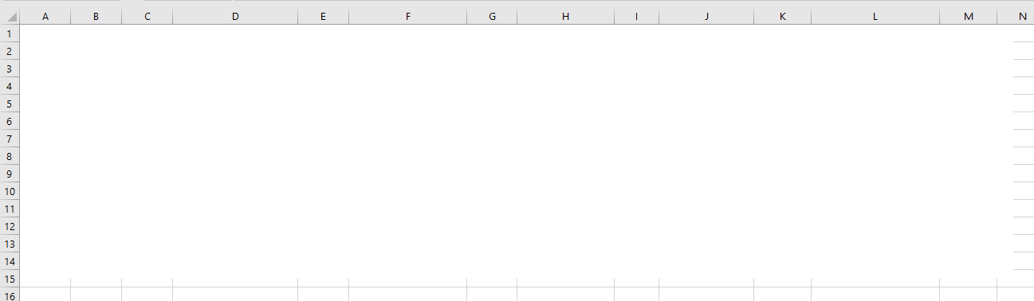
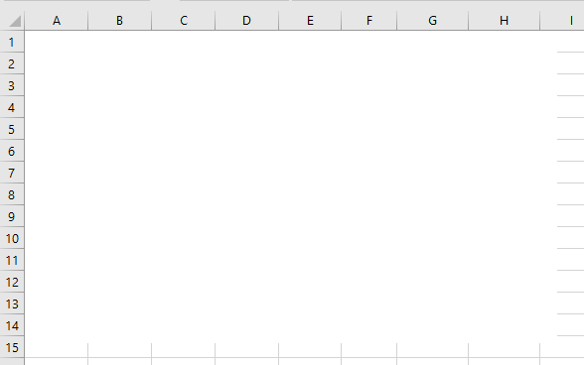
MAD & Standard Deviation of Forecast
(a) Compute 2-period and 6-period moving average for all months including the next month.
(b) Compute Absolute Deviation (Error) for all months.
(c) Compute MAD for all months.
(d) Compute 2-period and 6-period moving averages. (e) Chose the preferred method. (f) Forecast using the preferred method. (g) Compute the standard deviation of the forecast using MAD.

Slide 45
Compare Two Methods- Based on MAD
Which one is a better forecasting technique?
2-period MA.
4-period MA.
8-period MA.
12-period MA.
The one with minimal MAD

Slide 46
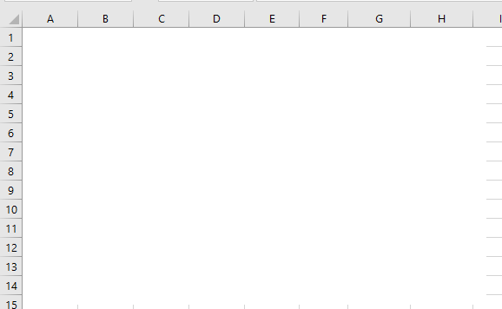
Tracking Signal
(a) Compute average and standard deviation of the forecast for the next period using 5-period moving averages. (b) Compute the Tracking Signal (TS) for all periods. TS=SUM(A-F)/MAD

Slide 47
Mean Absolute Deviation- Measure of Forecast Accuracy
MAD = Average(|A-F|)
3000
2500
2000
1500
1000
500
0
1
3
5
7
9
11

Slide 48
Mean Absolute Deviation- Measure of Forecast Accuracy
MSE = Average(A-F)²
3000
2500
2000
1500
1000
500
0
1
3
5
7
9
11

Slide 49
Mean Absolute Deviation- Measure of Forecast Accuracy
MAD vs. MES
3000
2500
2000
1500
1000
500
0
1
3
5
7
9
11

Slide 50
Mean Squared Error- Measure of Forecast Accuracy
MSE = Average((A-F)²)

Slide 51
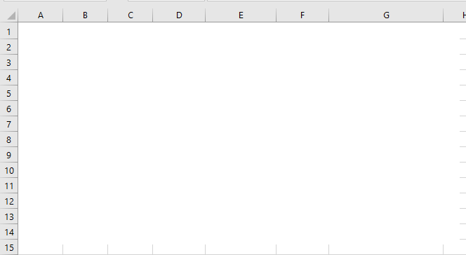
Mean Squared Error
(a) Compute forecast for next period using 3-period moving average. (b) Compute the standard deviation of the forecast using MSE.

Slide 52
Mean Absolute Relative Deviation- Measure of Forecast Accuracy
MARD = Average(|A-F|/A)
3000
2500
2000
1500
1000
500
0
1
3
5
7
9
11

Slide 53
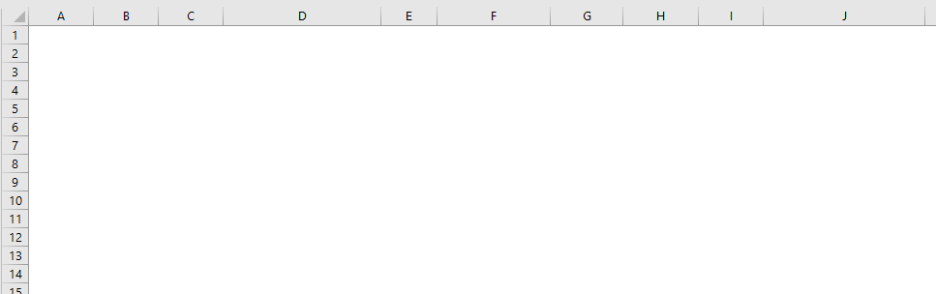
Mean Relative Absolute Deviation- MARD- MAPE
|E|= |A-E|
MAD = AVERAGE (|E|)
MARD= AVERAGE(|E|/A)
StdDev= Relative Error =1.25 MARD
Forecast for next period = ?
Standard Deviation of Forecast for next period = ?

Slide 54
Main Applications of MAD, MSE, MARD
To select the best forecasting technique based on minimal MAD, MSE, MARD.
To estimate the standard deviation of the forecast and minimize it.
If our current period is period t, our next period is period t+1. Our forecast for the next period if F(t+1). But F(t+1) is the average of demand for the next period.
Demand for the next period has Normal Distribution with the average of F(t+1) and a Standard Deviation which is computed based on MAD, MSE, or MARD in period t.
Standard Deviation of demand for t+1 is computed based on MAD, MSE, MARD in period t.
Current Period: t
Forecast for the next period: F(t+1).
Standard deviation of the forecast in period t+1:
  1.25 MAD or SQRT(MSE), or 1.25MARD in period t
  These three numbers are not equal

Slide 55
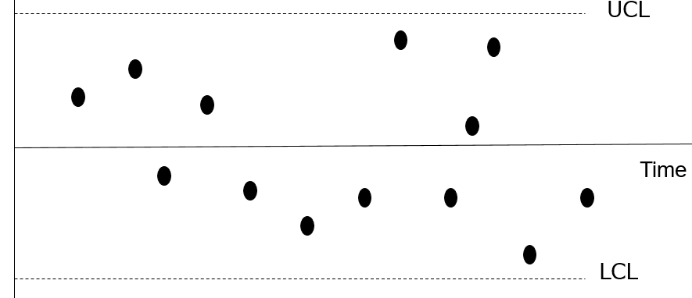
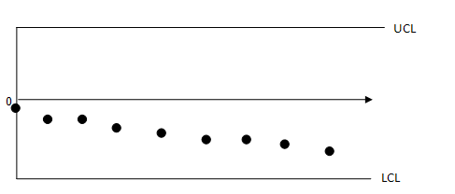
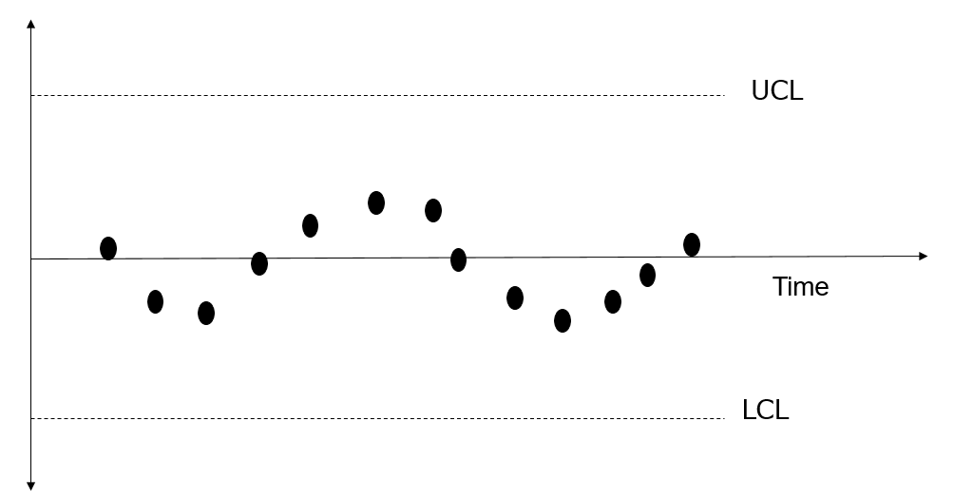
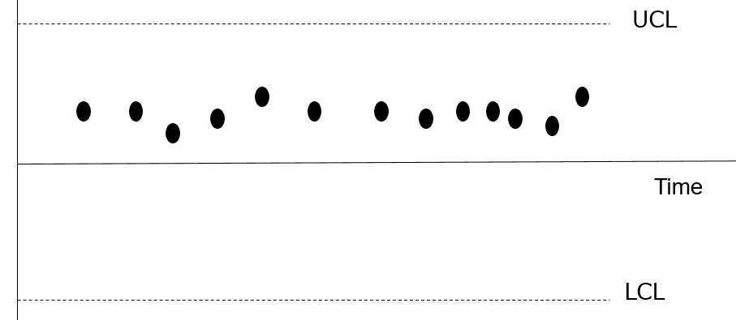
Main Applications of TS
TS = SUM(A-F)/MAD. TS has the SUM of the errors in its numerator. Therefore we expect it to be zero or close to zero. TS needs to remain within reasonable control limits
TS should not show a pattern. If there is a pattern, that means there was a systematic component f the data, but our forecasting technique failed to recognize it.

