Slide 1
Basic Predictive Analysis
Basics of Time Series Analysis
Simple Exponential Smoothing
One of my older lectures on Exponential Smoothing is accessible at https://youtu.be/A1nCIgYSuw4
Those who do not remember the past are condemned to repeat it
George Santayana Spanish philosopher, poet and novelist(1863-1952)

Slide 2
Time Series Methods
Moving Average
  Discard old records
  Assign same weight for recent records
$$F_{t+1}= {0.25A}_{t}+{0.25A}_{t−1}+{0.25A}_{t−2}+{0.25A}_{t−3}$$
Assign different weights
  Weighted moving average
$$F_{t+1}= 0.4{0A}_{t}+0.30A_{t−1}+0.2{0A}_{t−2}+0.10A_{t−3}$$

Slide 3
Example: Forecast for week 9 using α = 0.1
Week | Demand | Forecast
1 | 200
2 | 250 | 200
3 | 175
4 | 186
5 | 225
6 | 285
7 | 305
8 | 190
Week | Demand | Forecast
1 | 200
2 | 250 | 200
3 | 175 | 205
4 | 186
5 | 225
6 | 285
7 | 305
8 | 190
Week | Demand | Forecast
1 | 200
2 | 250 | 200
3 | 175 | 205
4 | 186 | 202
5 | 225 | 200
6 | 285 | 203
7 | 305 | 211
8 | 190 | 220

Slide 4
The Same Example: α =0.1 vs α = 0.4
Choose the forecast with lower MAD.

Slide 5
Comparison
As a becomes larger, the predicted values exhibit more variation, because they are more responsive to the demand in the previous period.
  A large a seems to track the series better.
  Value of stability
This parallels our observation regarding MA: there is a trade-off between responsiveness and smoothing out demand fluctuations.
In general want to calculate MAD for many different values of a and choose the one with the lowest MAD. The same is true for MSE and MAPE (MARD)
Same idea to determine if Exponential Smoothing or Moving Average is preferred.
One advantage of exponential smoothing requires less data storage to implement.

Slide 6
Exponential Smoothing Includes All Pieces of Data
t
At
Ft
1
100
100
2
100
3
110
α=0.2
150
Since I have no information for F1, I just enter A1 which is 100. Alternatively, we may assume the average of all data, or the INTERCEPT of the regression line, as our forecast for period 1.
A1 ⬅ F2
F3 =(1-α)F2 + α A2
F3 =0.8(100) + 0.2(150)
F3 =80 + 30 = 110
F3 =(1-α)F2 + α A2
F2 & A2 ⬅ F3
A1 ⬅ F2
A1 & A2 ⬅ F3

Slide 7
Exponential Smoothing Includes All Pieces of Data
t
At
Ft
1
100
100
2
150
100
3
110
4
112
120
α=0.2
F4 =(1-α)F3 + α A3
F4 =0.8(110) + 0.2(120)
F4 =88 + 24 = 112
F4 =(1-α)F3 + α A3
A3 & F3 ⬅ F4
A1 & A2 ⬅ F3
A1& A2 & A3 ⬅ F4

Slide 8
All Pieces of Data are Taken into Account in ES
F_{t+1} = aA_{t} +(1 – a)F_{t}
F_{t} = aA_{t–1} +(1 – a)F_{t–1}
F_{t+1} = aA_{t} +(1 – a) [aA_{t–1} +(1 – a)F_{t–1}]
F_{t+1} = aA_{t} +a (1 – a) A_{t–1} +(1 – a)²F_{t–1}
F_{t–1} = aA_{t–2} + (1 – a) F_{t–2}
F_{t+1} = aA_{t} +a (1 – a) A_{t–1} +(1 – a)²[aA_{t–2} + (1 – a) F_{t–2}]
F_{t+1} = aA_{t} +a (1 – a) A_{t–1} +a (1 – a)²A_{t–2} + (1 – a)³ F_{t–2}
F_{t–2} = a A_{t–3} + (1 – a) F_{t–3} and F₁ = F_{t–(t-1)} and F₁ = A1
F_{t+1} = aA_{t} +a(1 – a)A_{t–1} +a(1 – a)²A_{t–2} + a(1 – a)³ A_{t–3} +……………+ a(1 – a)^{t-1} F_{t–(-t-1)}
F_{t+1} = aA_{t} +a(1 – a)A_{t–1} +a(1 – a)²A_{t–2} + a(1 – a)³ A_{t–3} + a(1 – a)⁴A_{t–4} ………+ a(1 – a)^{t-1} A₁

Slide 9
Summation of All Weights Is Equal to 1
S = a +a(1 – a) +a(1 – a)² + a(1 – a)³ + a(1 – a)⁴ +……+ a(1 – a)^{t-1}
S(1 – a) = a(1 – a) +a(1 – a)² + a(1 – a)³ + a(1 – a)⁴ +……+ a(1 – a)^{t}
S-S(1 – a) = a-a(1 – a)^{t}
S(1-1+ a) = a-a(1 – a)^{t}
aS= a[1-(1 – a)^{t} ]
S=1-(1 – a)^{t}
Since alpha is <1 then 1-alpha is <1, and when t increases, then something <1 to the power of a large number tends to 0. Therefore S=1

Slide 10
Age of Data In Exponential Smoothing
Age of data in moving average is (1+ n)/2 .
Age of data in exponential smoothing is about 1/ a.
(1+n)/2 = 1/ a ➔ a = 2/(n+1)
If we set a = 2/(n +1) , then moving average and exponential smoothing are approximately equivalent.
  It does not mean that the two models have the same forecasts.
  The variances of the errors are identical.

Slide 11
Why Age of Data is 1/alpha
F_{t+1} = aA_{t} +a(1 – a)A_{t–1} +a(1 – a)²A_{t–2} + a(1 – a)³ A_{t–3} + a(1 – a)⁴A_{t–4} ………+ a(1 – a)^{t-1} A₁
Weights = a, a(1 – a), a(1 – a)², a(1 – a)³, a(1 – a)⁴ ,……, a(1 – a)^{t-1}
Ages = 1, 2, 3, 4, ………..t
Weights times Ages = 1a+ 2a(1 – a)+ 3a(1 – a)²+ 4a(1 – a)³+ 5a(1 – a)⁴ +……+ ta(1 – a)^{t-1}
Weights times Ages = a[1+ 2(1 – a)+ 3(1 – a)²+ 4(1 – a)³+ 5(1 – a)⁴ +……+ t(1 – a)^{t-1}]
S = a +a(1 – a) +a(1 – a)² + a(1 – a)³ + a(1 – a)⁴ +……+ a(1 – a)^{t-1}=1
S= a[1+(1 – a) +(1 – a)² + (1 – a)³ + (1 – a)⁴ +……+ (1 – a)^{t-1}]=1
S= 1+(1 – a) +(1 – a)² + (1 – a)³ + (1 – a)⁴ +……+ (1 – a)^{t-1}=1/a
Derivation with respect to alpha =
0-1-2(1 – a)¹ -3(1 – a)² -4(1 – a)³ +……-(t-1) (1 – a)^{t-2}=-1/a²

Slide 12
Why Age of Data is 1/alpha
F_{t+1} = aA_{t} +a(1 – a)A_{t–1} +a(1 – a)²A_{t–2} + a(1 – a)³ A_{t–3} + a(1 – a)⁴A_{t–4} ………+ a(1 – a)^{t-1} A₁
Weights times Ages = a[1+ 2(1 – a)+ 3(1 – a)²+ 4(1 – a)³+ 5(1 – a)⁴ +……+ t(1 – a)^{t-1}]
S= 1+(1 – a) +(1 – a)² + (1 – a)³ + (1 – a)⁴ +……+ (1 – a)^{t-1}=1/a
Derivation with respect to alpha =
0-1-2(1 – a)¹ -3(1 – a)² -4(1 – a)³ +……-(t-1) (1 – a)^{t-2}=-1/a²
1+2(1 – a)¹ +3(1 – a)² +4(1 – a)³ +……+(t-1) (1 – a)^{t-2}=1/a²
Weights times Ages = a[1+ 2(1 – a)+ 3(1 – a)²+ 4(1 – a)³+ 5(1 – a)⁴ +……+ t(1 – a)^{t-1}]
Weights times Ages = a(1/a²) = 1/a

Slide 13
Compute MAD & TS

Slide 14
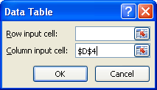
Data Table Excel
Data, what if, Data table
This is a one variable Data Table
Min, conditional formatting

Slide 15

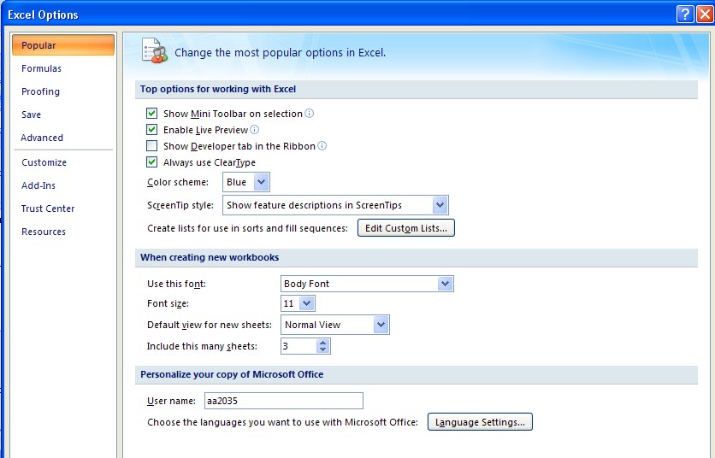
Office Button

Slide 16
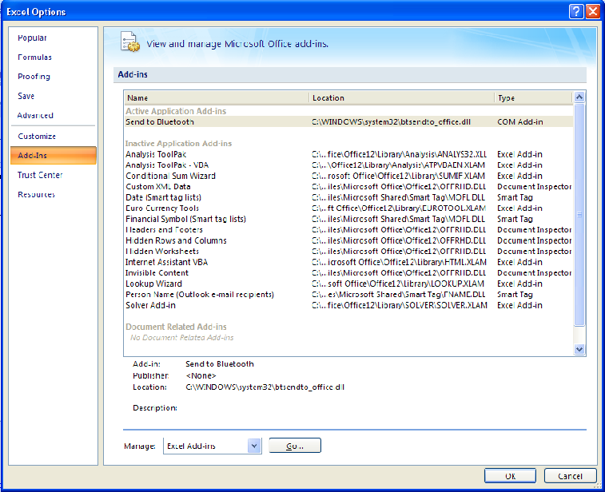
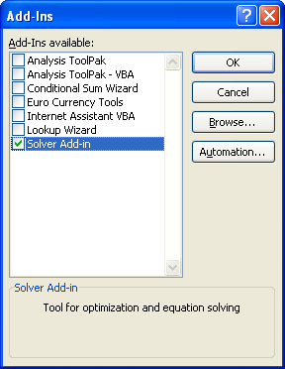
Not OK, but GO, then Check Mark Solver

Slide 17
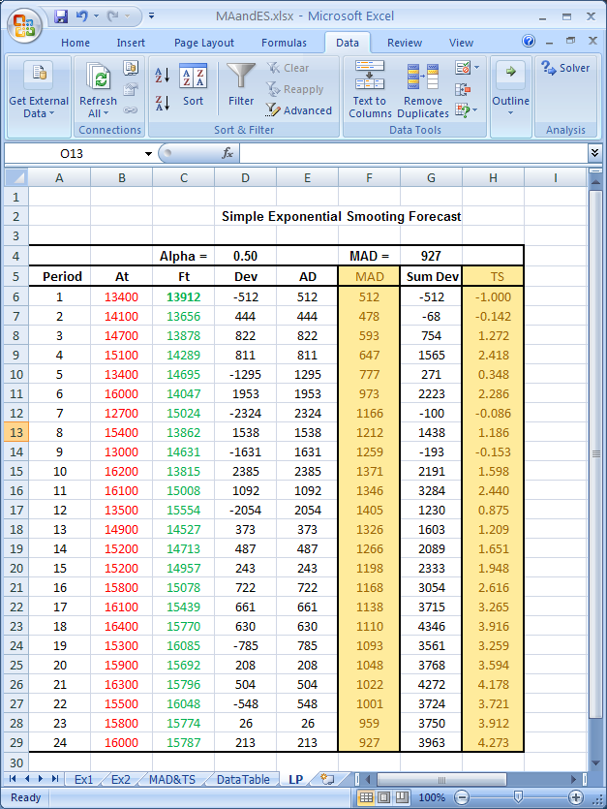
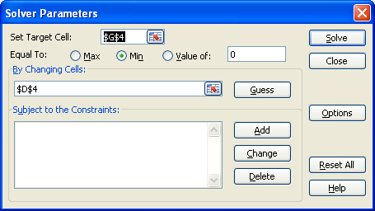
Data Tab/ Solver

Slide 18

Optimal α Minimal MAD

Slide 19
Exponential Smoothing
Optimal Alpha
DataTable & SOLVER
If you can look into the seeds of time, and say which grain will grow and which will not
speak then unto me.
William Shakespeare, 1564-1616.

Slide 20

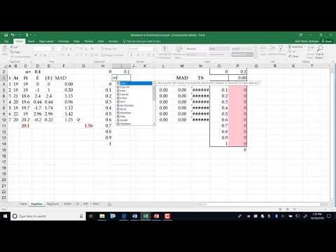
Lecture
https://youtu.be/2OkoBbEm10I
Nonlinear optimization and Data-Tables to determine the optimal vale of α that minimizes the MAD, MSE, or MARD.

Slide 21
Find α using Data Table – The Recorded Lecture is also Inside

Slide 22
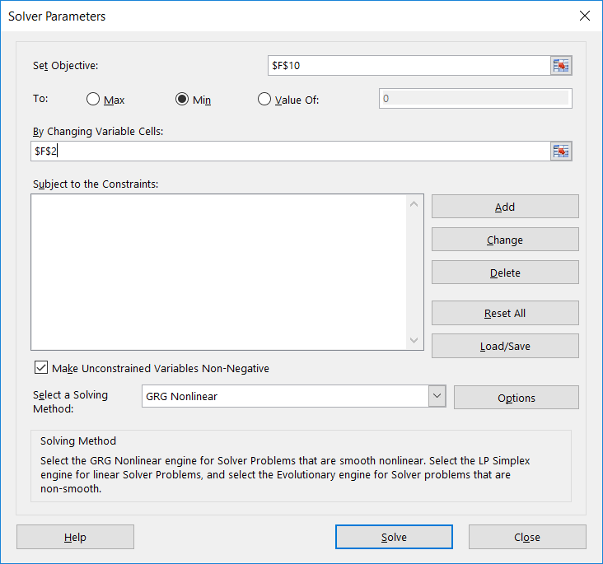
Find α using Solver

Slide 23
Basic Predictive Analysis
Basics of Time Series Analysis
Exponential Smoothing Problems
If you can look into the seeds of time, and say which grain will grow and which will not
speak then unto me.
William Shakespeare, 1564-1616.

Slide 24

The Lecture https://youtu.be/1J6ysRf75K0
The Lecture https://youtu.be/g_lg0F_7Hmc

Slide 25
Exponential Smoothing- Two Formulas That are the same

Slide 26
From This Period to the Next Period
1. Given an actual demand of 60 for a period when forecast of 70 was anticipated, and an alpha of 0.3, what would the forecast for the next period be using simple exponential smoothing?
F = (1-0.3)(70)+0.3(60) = 67
2. You have been asked to forecast demand for a product using an exponential smoothing. The actual demand and forecast for year 2019 where 850 and 910, respectively. Compute the demand forecast for 2020 using a smoothing constant of 0.3.
  F = (1-0.3)(910)+0.3(850) = 892
3. Given the following demand. What is your forecast for period 4 using exponential smoothing and α=0.5? 1:(300), 2:(500), 3:(600).
F_{t+1} = (1-α)F_{t}+ α(A_{t})
F_{t+1} = (1-0.5)F_{t}+ 0.5(A_{t})
F_{t+1} = (1/2) F_{t}+ (1/2) (A_{t})
F_{t+1} = (F_{t}+A_{t})/2
F₃ = (F₂+A₂)/2
F₃ = (300+500)/2= 400
F₄ = (F₃+A₃)/2 = (400+600)/2 = 500

Slide 27
α: Large or Small, 0.1, 0.2, 0.4
4. Is large α better or small α?
We do not know. It depends on data.
The best α is the one that minimizes our metric which may be MAD or MSE or MARD.

Slide 28
MAD in Excel
5. The president of State University wants to forecast student enrollments for the next academic year based on the following historical data for the past 5 years. What is your forecast for next year using exponential smoothing with α = 0.4?

Slide 29
Role of α
6. A forecast based on the previous forecast plus a percentage of the forecast error is:
  A) a naive forecast
  B) a simple moving average forecast
  C) a centered moving average forecast
  D) an exponentially smoothed forecast
  E) an associative forecast
7. In exponential smoothing forecasting, using large values of the smoothing coefficient α generates forecasts that are more:
  A) accurate
  B) responsive
  C) random
  D) stable
  E) level
F_{t+1} = (1-α)F_{t}+ α(A_{t})
F_{t+1} = F_{t}+ α(A_{t}-F_{t} )
F_{t+1} = (1-α)F_{t}+ α(A_{t})

Slide 30
Meaning of α - From Naïve to No Change
8. For what value of α, exponential smoothing becomes naïve method?
  A) α =0
  B) α =0.25
  C) α =0.5
  D) α =0.75
  E) α =1
9. For what value of α, exponential smoothing becomes a straight line?
  A) α =0
  B) α =0.25
  C) α =0.5
  D) α =0.75
  E) α =1
F_{t+1} = (1-α)F_{t}+ α(A_{t})
F_{t+1} = (A_{t})
F_{t+1} = (1-1)F_{t}+ 1(A_{t})
F_{t+1} = (1-α)F_{t}+ α(A_{t})
F_{t+1} = F_{t}
F_{t+1} = (1-0)F_{t}+ 0(A_{t})

Slide 31
Change Alpha Value from 1 to 0 by 0.1 steps

Slide 32
Finding α
10. Exponential smoothing is being used to forecast demand. The current forecast of 66 was 5 units larger than actual demand. The next forecast is 65. Compute α?
F_{(t+1)} = F_{t} + α (A_{t}-F_{t})
65
66
+5
- 5
65 = 66 + α (-5)
5 α = 1
α = 0.2
11. It can be mathematically proved that the Age of data in exponential smoothing is 1/α . The larger the α, the larger the number of periods in the moving average. True or false? Why?
False
α = 0.5 ➔ age of data is 2 periods.
α = 0.2 ➔ age of data is 5 periods.
α = 0.1 ➔ age of data is 10 periods.

Slide 33
Age of Data
12. Given a forecast using a 6-period moving average. What is the average age of data?
The last piece (newest piece) of data is only 1 period old.
The first piece (oldest piece) of data in a 6-period moving average is 6 periods old.
The average age of data is (1+6)/2 = 3.5
13. If the age of data in exponential smoothing is 1/ α, for what value of α, exponential smoothing performs close to a 6-period moving average?
The age of data in a 6-period moving average is 3.5.
The age of data in exponential smoothing is 1/ α.
1/ α = 3.5
α = 1/3.5
α = 0.29

Slide 34


Forecasting
Trend and Seasonality Adjusted Exponential Smoothing
Parts of the slides of this lectures were prepared over my teaching lifetime based on the material that I have learned from the following books
Those who do not remember the past are condemned to repeat it
George Santayana Spanish philosopher, poet and novelist(1863-1952)
Ardavan Asef-Vaziri

Slide 35
L0, T0, S1, S2, ….Sp
Initialize. Assume p=4 in this example
Compute L0, T0, S1 to S4.
L0
For L0 you may do one of the followings. In the example I have followed the first alternative for L0, T0, and S1 to S4. in all cases.
L0 = Average (A1 to A4)
L0 = A1
L0 = INTERCEPT of the regression line applied on the decentralized data. (We will see how it is done in the Regression lecture)
T0
T0 = (Average (last 4 periods demand)- Average (last 4 periods demand))/(Number of periods –p-1).
T0 = (Last period demand- First period demand)/(Number of periods -1).
T0 = SLOPE of the regression line applied on the decentralized data. (We will see how it is done in the Regression lecture)

Slide 36
Trend and Seasonality Adjusted ES

Slide 37
L0, T0, S1, S2, ….Sp
Initialize. Assume p=4 in this example
Compute L0, T0, S1 to S4.
L0
For L0 you may do one of the followings. In the example I have followed the first alternative for L0, T0, and S1 to S4. in all cases.
L0 = Average (A1 to A4)
L0 = A1
L0 = INTERCEPT of the regression line applied on the decentralized data. (We will see how it is done in the Regression lecture)
T0
T0 = (Average (last 4 periods demand)- Average (last 4 periods demand))/(Number of periods –p-1).
T0 = (Last period demand- First period demand)/(Number of periods -1).
T0 = SLOPE of the regression line applied on the decentralized data. (We will see how it is done in the Regression lecture)

Slide 38
L0, T0, S1, S2, ….Sp
S1 to S4
S1= A1/Average (A1 to A4), ………. S4=A4/Average (A1 to A4),
S1, S2, S3, and S4 are computed by dividing the demand of each period by the forecast of the the regression line applied on the decentralized data.

Slide 39
From, L0, T0, S1, to L1, T1, and S5
From 0 to 1
L1
What is our forecast for L1? It is L0+T0. Multiply it by (1-alpha).
What is our actual for L1? It is the demand in period 1 but free of seasonality. It is L1/S1. Multiply it by alpha.
L1=(1-alpha)×(L0+T0)+ (alpha)×(A1/S1)
T1
What is our forecast for T1? It is T0. Multiply it by (1-beta).
What is our actual for T1? It is the difference between this L and the previous L. It is L1-L0. Multiply it by beta.
T1=(1-beta)×(T0)+ (beta) ×(L1-L0)

Slide 40
From, L0, T0, S1, to L1, T1, and S5- and continue
From 0 to 1
S5
It is S(1+p) where p is 4 in this example
What is our forecast for S5? It is S1. Multiply it by (1-gamma).
What is our actual for S5? It the actual data (A1) divided by our level for it if there were no seasonality. That is our L1 which is L0+T0.
T5=(1-gamma)×(S1)+ (gamma) ×[A1/(L1-L0)]
From 1 to 2 and from 2 to 3
L2, T2, and S6. Replace 1 by 2, replace 0 by 1, replace 5 by 6 and follow the same procedure.

Slide 41
Metrics of Process Analysis
I = Inventory = how many fow units are in the process
R = Flow Rate = rate at which flow units enter or leave the process
T = Flow Time = total time a flow unit is in the process
RT=I
R: 10 callers per minute; T: each spends 3 minutes
RT=I➔ 10(3)=30 callers online
A manufacturer in US buys components from a supplier in far east. Order quantity is the demand of two weeks. Demand per week is 20,000 (R=20,000 per month). It takes 3 weeks from the time that the ownership is transferred from the supplier to the manufacturer. That is the time between when the shipment is places on the ship until the manufacturer receives it. Compute pipeline inventory.
RT=I➔ 20,000(3) = 90,000 units
Throughput per year = 12(20,000) = 240,000
Inventory Turns per year =
l

