Slide 1

Moving Average, MAD, Tracking Signal Problems

Slide 2
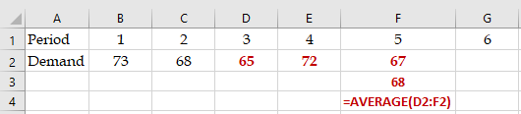
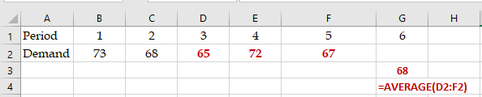
Problems 1
Given the following data,
a) Compute 3-period moving average for period 5?
Period 1 2 3 4 5
Demand 73 68 65 72 67
b) Compute 3-period moving average forecast for period 6?

Slide 3
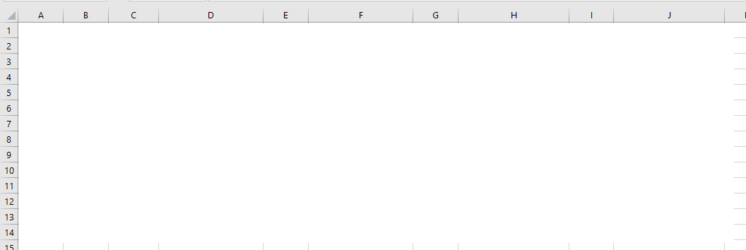
Problems 2-3
(a) Compute 2-period moving average in period (month) 5 and 9-period moving average in month 10.
(b) Compute 2-period moving average forecast in month 6 and 9-period moving average forecast in month 11.
(c) Compute 4-period moving average for all months.
(d) Compute 4-period moving average forecast for all months including the next month.
In order to increase the responsiveness of a forecast (i.e., respond quickly to the data changes) made using the moving average technique, the number of periods in the average should be:
  A) decreased
  B) increased
  C) multiplied by a larger alpha
  D) multiplied by a smaller alpha
  none of the above

Slide 4
Problems 4-5
Compute MAD and TS at the end of period 4 for the following data, .
Sum |A-F| = 15
MAD = Sum |A-F| /n
=15/4 = 3.75
Sum (A-F) = 9
TS = Sum(A-F)/MAD
TS = 9/3.75 = 2.4
The sum of the forecast errors (SFE) and the mean absolute deviation (MAD) are calculated in each period. The values of SFE and MAD in the last period to be 46 and 21, respectively. Which of the following is the value of tracking signal in the last period?
TS= SFE/MAD ➔ TS= 46/21= 2.2

Slide 5
Problems 6-7
Compute the age of data in 4 period moving average forecasts.
In a 3 period moving average forecast, the most recent piece of data belongs to the previous period. It is 1 period old. The second piece is 2 periods and the oldest piece is 3 periods old.
Average Age of Data = (1+2+3)/3 = 2.
However when we have a linear trend, we can average the first and the last pieces of data
Average Age of Data = (1+3)/2 = 2.
Compute the age of data in 7 period moving average forecasts.
Average Age of Data = (1+7)/2 = 4.

Slide 6
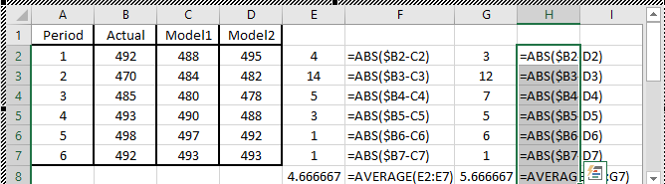
Problems 8-9
You must choose between two alternative forecasting models. Both models have been used to prepare forecasts for a six-month period. Compute mean absolute deviation (MAD) for the forecasting model 2.
Which forecasting model would you recommend? What is the MAD for the recommended forecasting model?
  A) Model 1 with MAD of 4.67
  B) Model 2 with MAD of 0.33
  C) Model 1 with MAD of 3.39
  D) Model 2 with MAD of 2.0
  E) none of the above

Slide 7
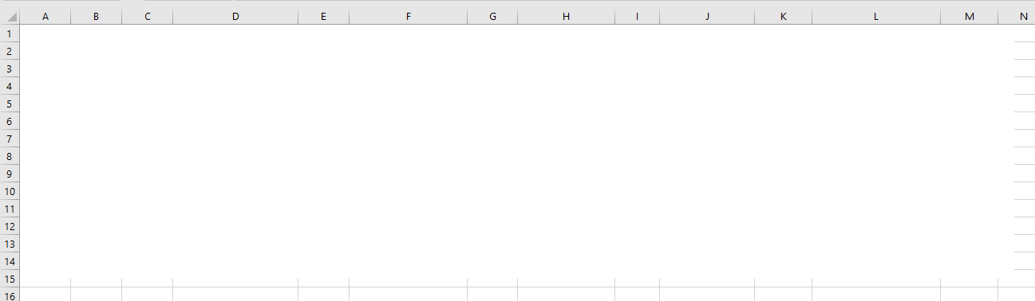
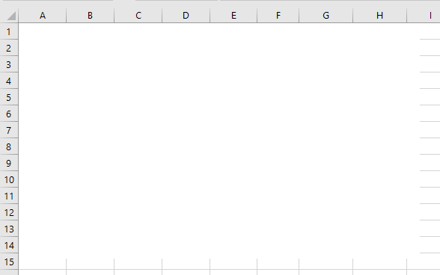
Problems 10-11
(a) Compute 2-period and 6-period moving average for all months including the next month.
(b) Compute Absolute Deviation (Error) for all months.
(c) Compute MAD for all months.
(a) Compute 2-period and 6-period moving averages. (b) Chose the preferred method. (c) Forecast using the preferred method. (d) Compute the standard deviation of the forecast.

Slide 8
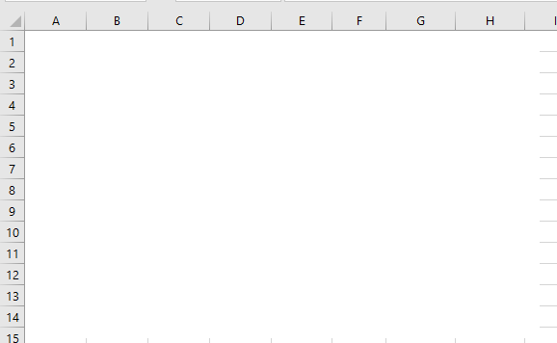
Problem 12
(a) Compute average and standard deviation of the forecast for the next period using 5-period moving averages. (b) Compute the Tracking Signal (TS) for all periods.

Slide 9
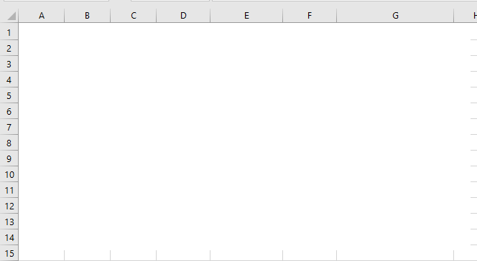
Problem 13
(a) Compute forecast for next period using 3-period moving average. (b) Compute the standard deviation of the forecast using MSE.

Slide 10
Problem 14
I- to select the best forecasting technique
II- to estimate the standard deviation of the forecast.
III- to see if the forecast is within control limits
IV- to see if the forecast does not show any specific pattern.
  A) the main two applications of MAD are I and II. The main two applications of Tracking Signal are III and IV.
  B) the main two applications of MAD are I and III. The main two applications of Tracking Signal are II and IV.
  C) the main two applications of MAD are I and IV. The main two applications of Tracking Signal are II and III.
  D) the main two applications of MAD are II and III. The main two applications of Tracking Signal are I and IV.
  E) none of the above

Slide 11
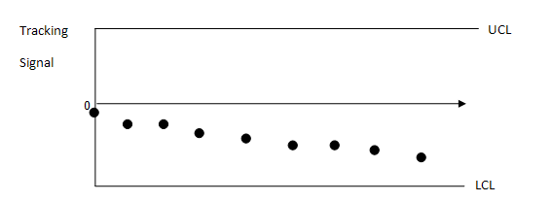
Problem 15
Given the following tracking signal graph
  A) the forecasting method overestimates the demand
  B) the forecasting method underestimates the demand
  C) the demand is very seasonal
  D) the forecasting method is moving average
  E) the forecasting method is exponential smoothing

Slide 12
Problem 16
The 5-period moving average in month 6 was 150 units. Actual demand in month 7 is 180 units. What is 6 period moving average in month 7?
MA⁵₆ = (A6+A5+A4+A3+A2)/5
MA⁶₇ = (A7+A6+A5+A4+A3+A2)/6
MA⁵₆ = (A6+A5+A4+A3+A2)/5 = 150
A6+A5+A4+A3+A2 = 750
A7 = 180
MA⁶₇ = (A7+A6+A5+A4+A3+A2)/6
MA⁶₇ = (180+750)/6 = 155

Slide 13
Problem 16- Alternative Solution
The 5-period moving average in month 6 was 150 units. Actual demand in month 7 is 180 units. What is 6 period moving average in month 7?
We may assume that 5-period moving average was
MA⁵₆=(150+150+150+150+150)/5 = 150.
Now we have
MA⁶₇=(180+150+150+150+150+150)/6 = 155.
We could have also said suppose A7= 150+30.
If A7 was 150, then
MA⁶₇ = 150, since all the actual values are 150.
But the reality is the most current value is 30 units more than 150.
In 6 period moving average there are 6 numbers: 30/6=5.
MA⁶₇ = 150+5 =155

Slide 14
Problem 17
Actual demand in month 8 is 160 units. The 4-period moving average in month 7 was 110 units. What is 5-period moving average in month 8?
  A) 100
  B) 110
  C) 120
  D) 140
  E) 150
MA⁴₇ = (A7+A6+A5+A4)/4 = 110
A7+A6+A5+A4 = 440
A8 = 160
MA⁵₈ = (A8+ A7+A6+A5+A4)/5
MA⁵₈ = (160+440)/5 = 120
Alternatively, if A7 was 110, then MA⁵₈ = 110.
But A7=110+50
We need divide 50 by 5, that is 10. MA⁵₈ =110+10 = 120

Slide 15
Problem 18
Suppose the 5-period moving average in period 20 is equal to 800. Suppose period 16 demand is 850. Also suppose the demand for period 21 is 900. Compute 5-period moving average for period 21.
= (
+A16)/5
MA⁵₂₀ = (A20+A19+A18+A17+A16)/5
MA⁵₂₀ = (A20+A19+A18+A17+A16)/5 =800
= (
➔
+850)/5 =800
+850 =4000
➔
=3150
MA⁵₂₁ = (A21+A20+A19+A18+A17)/5
MA⁵₂₁ = (A21+A20+A19+A18+A17)/5 =???
= (
+A21)/5
= (
+900)/5
=
(3150+900)/5 =810
MA⁵₂₁ = MA⁵₂₀ +(A21- A16)/5
MA⁵₂₁ = 800 +(900- 850) /5=810

Slide 16
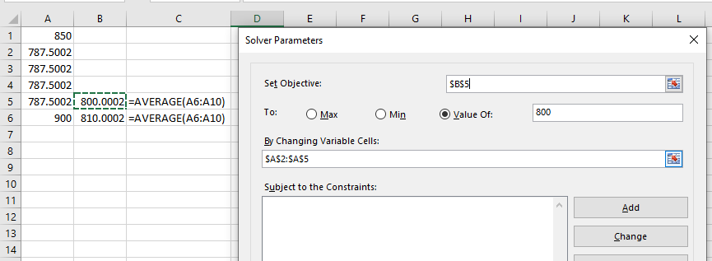
Problem 18
Suppose the 5-period moving average in period 20 is equal to 800. Suppose period 16 demand is 850. Also suppose the demand for period 21 is 900. Compute 5-period moving average for period 21.
MA⁵₂₀ = (A20+A19+A18+A17+A16)/5 =800
MA⁵₂₁ = (A21+A20+A19+A18+A17)/5 =???
We drop 850/5 and we add 900/5
We drop -850/5 and we add +900/5
MA⁵₂₀ = 800 -850/5 +900/5
MA⁵₂₀ = 800 +10 =810
Alternatively
Solver

Slide 17
Problem 19
Which one is a better forecasting technique?
2-period moving average.
4-period moving average.
8-period moving average.
12-period moving average.
The one with minimal MAD

