Slide 1
More on Throughput & Capacity
https://youtu.be/EkwteDoj6Rg
Based on the book: Managing Business Process Flows.

Slide 2
Forecasting
Forecast: a prediction of the future value of a variable of interest, such as demand.
Marketing, finance, and operations are the three key building blocks of manufacturing and service organizations.
They all need forecasting for planning, organizing, and budgeting.

Slide 3
Types of Forecasting
Qualitative Techniques
  Delphi
Quantitative Techniques
  Time Series Analysis - Analyzing data by time periods to determine if trends or patterns exist.
    Moving Average and Weighted Moving Average
    Exponential Smoothing
  Regression Analysis - Relating a dependent variable (demand) to other independent variables (price, income, etc.)
    Linear - Single and Multi Variables
    Nonlinear - Single and Multi Variables
Measures of Accuracy
  Mean Absolute Deviation, Mean Squared error, Mean Absolute Percentage Error, Tracking Signal

Slide 4
Four Characteristics of All Forecasting Tecniques
Forecasts are almost always inaccurate- Differ from actual.
Forecasts should be accompanied by a measure of forecast error- such as standard deviation or coefficient of variatione.
Forecasts for aggregate items are more accurate than individual forecasts. Aggregate forecasts reduce the amount of variability – relative to the aggregate mean demand. Standard deviation of sum of two variables is less than sum of the standard deviation of the two variables.
Long-range forecasts are less accurate than short-range forecasts. Forecasts further into the future tends to be less accurate than those of more imminent events. As time passes, we get better information, and make better prediction.

Slide 5
World Conteinerized Cargo-2016
More than 50% of containers coming to US pass through LA/LB ports. More than 1/3 of the containerized product consumed in all other states pass through SPB ports. The total value of trade using the SoCal trade infrastructure network is $300 billion, creating $30 billion in state and local taxes and around 3 million jobs or full time equivalents.

Slide 6
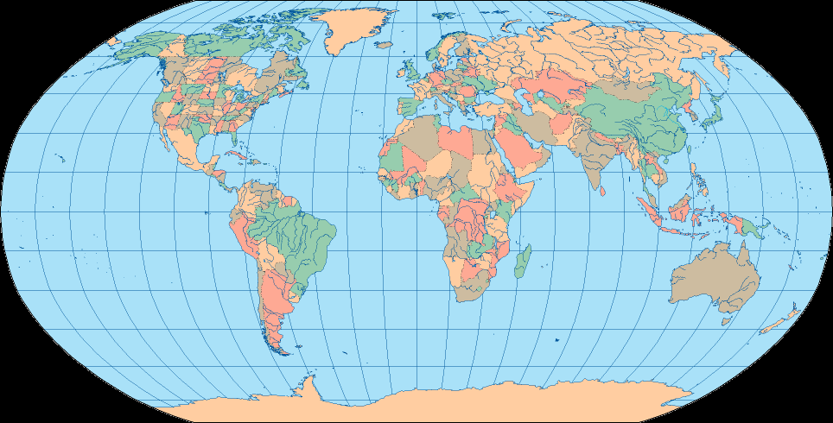
US-China Alternative Routes
Narvik, Norway
Prince Rupert, Canada
Vostochny, Russia
New York
Rotterdam, Netherlands
New York
Norfolk
Los Angeles
Norfolk
Savannah
Hong Kong, China
Savannah
Ensenada, Mexico
Colima, Mexico
Singapore

Slide 7
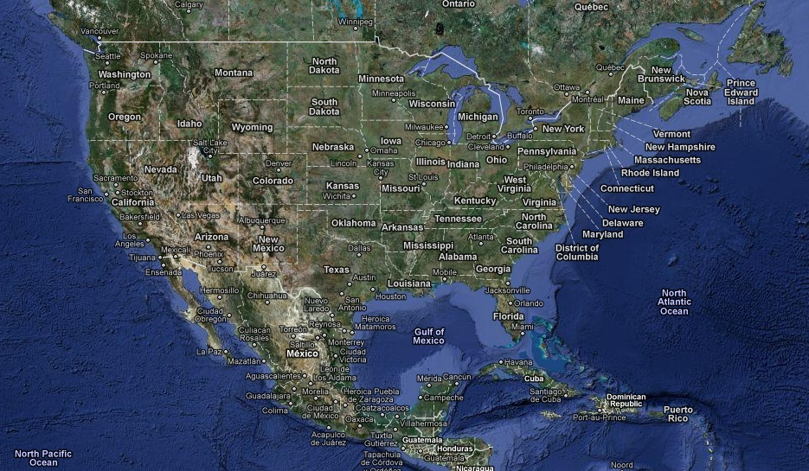
Strategic Positioning and Smooth Flow
4 Weeks
2 Weeks
3 Weeks

Slide 8
Strategic Positioning and Smooth Flow
2-3 days
3-4 days
14 days

Slide 9
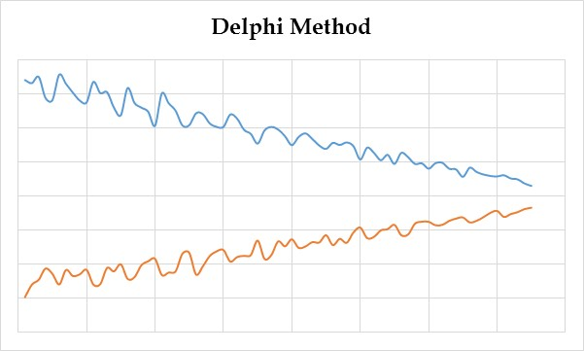
Qualitative Methods - Delphi
Non-quantitative forecasting techniques based on expert opinions and intuition. Typically used when there are no data available.
Delphi Method
Subjective, judgmental
Based on intuition, estimates, and opinions
  Expert Opinions
  Market Research
  Historical Analogies

Slide 10
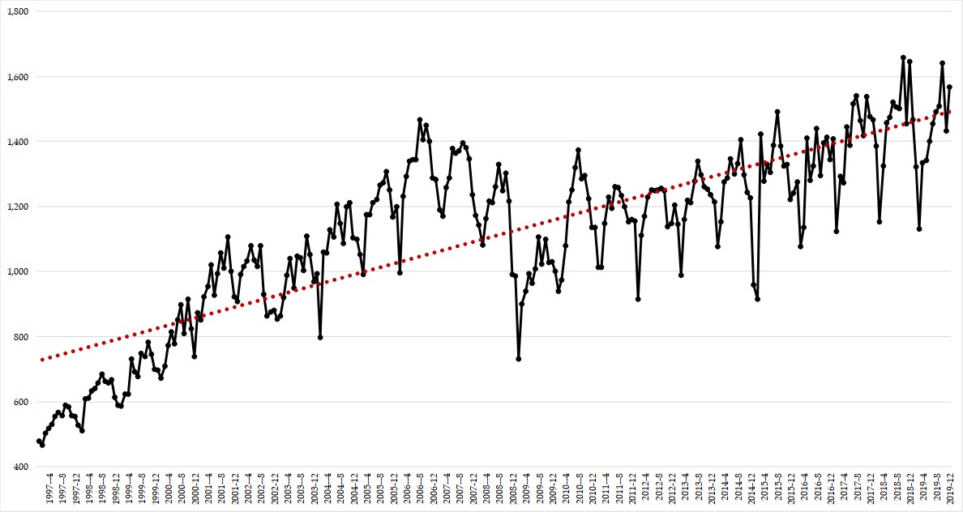
Time Series Analysis- Systematic & Random
Time Series. A relationship between the variable of interest – demand in our case - and time.
Observed variable (O) = Systematic component (S) + Random component (R)
Level (current deseasonalized )
Trend (growth or decline)
Seasonality (predictable seasonal fluctuation)
Cycles (every several years- boom or recession)
Systematic component: Expected value of the variable
Random component: The part of the forecast that deviates from the systematic component
Forecast error: difference between forecast and actual demand

Slide 11
LA/LB (SPB) Ports 23 Years Monthly Activity (TEUs)
Trend
Level
Cycles
Seasonality

Slide 12
Moving Average
3 period moving average in period 5: MA(5,3)
3 period moving average forecast in period 5: FMA(5,3)
n period moving average forecast in period t: FMA(t,n)
n period moving average : MA(t,n)
n period moving average forecast : Ft(Pn)
Naïve Forecast: Forecast for next period = Actual for this period. ➔ F(t+1) = At
3-period moving average in month t
  Ft(3p) = Average (At+A(t-1)+A(t-2))
8-period moving average
  Ft(8p) = Average (At+A(t-1)+A(t-2)+A(t-3)+A(t-4)+A(t-5)+A(t-6)A(t-7))
8-period moving average
  Ft(8p) = Average (At+A(t-1)+A(t-2)+A(t-3)+A(t-4)+A(t-5)+A(t-6)A(t-7))

Slide 13
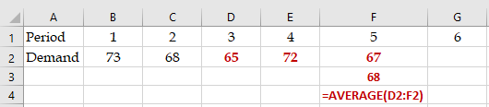
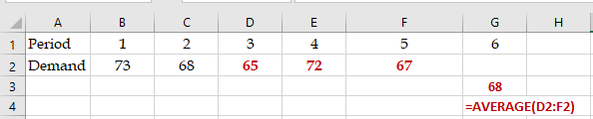
Problem
Given the following data,
a) Compute 3-period moving average for period 5?
Period 1 2 3 4 5
Demand 73 68 65 72 67
b) Compute 3-period moving average forecast for period 6?

Slide 14
Moving Average
MA(5,3): 3-period Moving Average in month 5.
MA(t,n): n-period Moving Average in month t.
Ft(P3): 3-period moving average forecast in period t
Ft(Pn): n-period moving average forecast in period t
Ft(Pn)= MA((t-1),n)

Slide 15
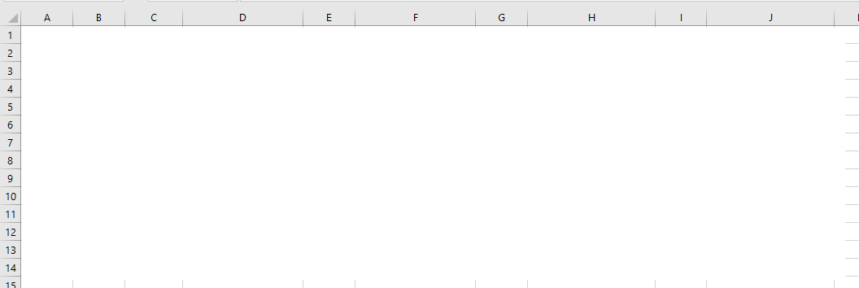
Problems
(a) Compute 2-period moving average in period (month) 5 and 9-period moving average in month 10.
(b) Compute 2-period moving average forecast in month 6 and 9-period moving average forecast in month 11.
(c) Compute 4-period moving average for all months.
(d) Compute 4-period moving average forecast for all months including the next month.
In order to increase the responsiveness of a forecast (i.e., respond quickly to the data changes) made using the moving average technique, the number of periods in the average should be:
  A) decreased
  B) increased
  C) multiplied by a larger alpha
  D) multiplied by a smaller alpha
  none of the above

Slide 16
Forecasting Error
Error = Deviation =Et= At-Ft
Absolute Deviation = Absolute Error = abs(E) = |E|
  = MAD = AVERAGE(|E|) over the available periods.
Forecast for next period: F(t+1) = MA(t,n)
Standard Deviation of Demand = 1.25MAD
  What MAD? MAD(t)
Tracking Signal = TS= SUM(E)/MAD
Squared Error = E² = E^2
Mean Squared Error (MSE) = AVERAGE(E^2) over the available periods.
Forecast for next period: F(t+1) = MA(t,n)
Standard Deviation of Demand = SQRT(MSE)

Slide 17
How do we measure errors?
Error = At - Ft
Standard Deviation of Error = 1.25MAD
Error is assumed to be normally distributed
  A MEAN (AVERAGE) = 0
  STANDARD DEVIATION = 1.25MAD
Therefore, our forecast is also normally distributed
  A MEAN (AVERAGE) = Ft
  STANDARD DEVIATION = 1.25MAD

Slide 18
MAD for One Method
But. Compare two or more forecasting techniques only over a period when data is available for all techniques.

Slide 19
Compare Two Methods

Slide 20
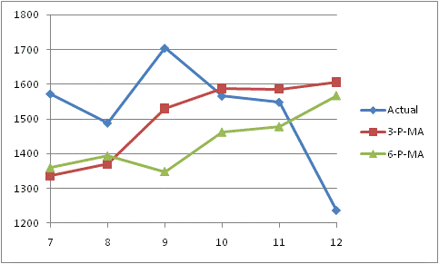
Moving Average Comparison
How many periods should we use for forecasting?
  6-week forecast is 1519 and MAD is 195
  3-week forecast is 1450 and MAD is almost 160
  3-week MAD is lower than 6-week MAD
Seems we prefer 3-week to 6-week.
So … should we use as many periods as possible?

Slide 21
Check a Second Example

Slide 22
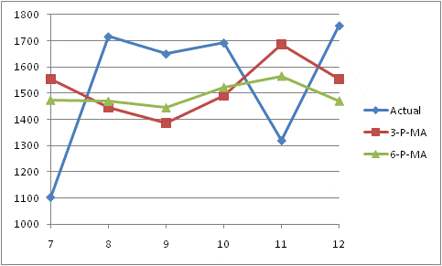
MA comparison
Note that MAD is now lower for the 6-week than for the 3-week MA.
  3-week MAD is 293
  6-week MAD is almost 254
What is going on?

Slide 23
Moving Average: Observations
A large number of periods will cause the moving average to respond slowly to changes. A smooth curve.
A small number of periods will be more reactive. Response to the most current changes.
Long term investors stay with larger number of periods. Day-trades, with smaller number of periods.
Try many different time window sizes, and choose the one with the lowest MAD.

Slide 24
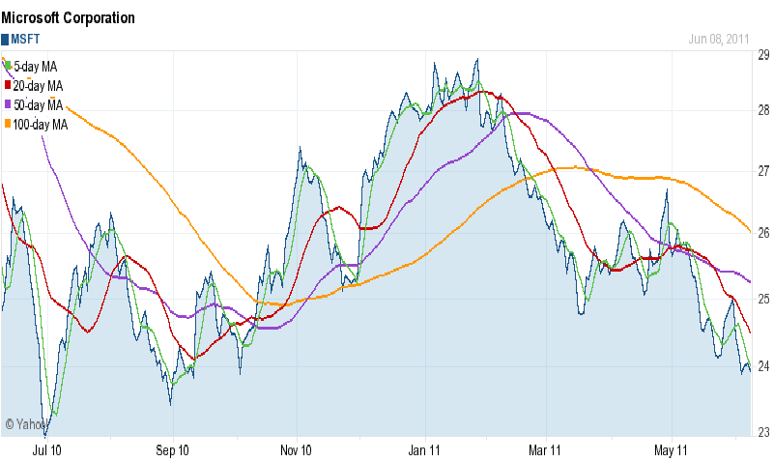
Moving Average: Microsoft

Slide 25
Tracking Signal

Slide 26
Tracking Signal
Are our observations within UCL and LCL?
Is there any systematic error?
Tracking Signal
UCL
Time
LCL

Slide 27
Tracking Signal
Tracking Signal
UCL
Time
LCL

Slide 28
Tracking Signal
Tracking Signal
UCL
Time
LCL

Slide 29
Basic Applications of MAD and TS
MAD
  To select the most appropriate forecasting method among two or more candidate methods
  To estimate the Standard Deviation of forecast
TS
  To check if TS is between ULC and LCL
  To check if TS does not show any systematic pattern
In practice UCL=5, LCL = -5

Slide 30
Chapter 7
Demand Forecasting in a Supply Chain
Predictions are usually difficult, especially about the future.
Yogi Berra
The former New York Yankees Catcher

