Slide 1
Chapter 7
Demand Forecasting in a Supply Chain
Forecasting -1
Moving Average
Ardavan Asef-Vaziri
Based on
Operations management: Stevenson
Operations Management: Jacobs, Chase, and Aquilano
Supply Chain Management: Chopra and Meindl
USC Marshall School of Business Lecture Notes
“Those who do not remember the past are condemned to repeat it”
George Santayana Spanish philosopher, essayist, poet and novelist (1863-1952)

Slide 2

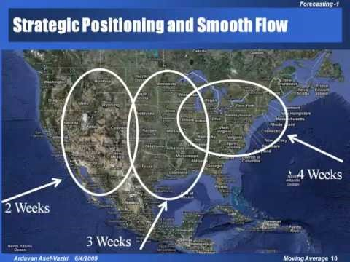
Recoded Lecture on Moving Average Slides
https://www.youtube.com/watch?v=gt-YOLxJqBk&t=8s

Slide 3
Uses of Forecasts
Forecast: a prediction of the future value of a variable of interest, such as demand.
Accounting | Cost/Profit Estimates
Finance | Cash Flow and Funding
Human Resources | Hiring/Recruiting/Training
Marketing | Pricing, Promotion
MIS | IT/IS Systems, Services
Operations | Production Planning, MRP
Product/Service Design | New Products and Services

Slide 4
Types of Forecasting
Qualitative Techniques
  Delphi
Quantitative Techniques
  Time Series Analysis - Analyzing data by time periods to determine if trends or patterns exist.
    Moving Average
    Exponential Smoothing
  Causal Relationship Forecasting - Relating demand to an underlying factor other than time.
    Linear - Single and Multi Variables
    Nonlinear - Single and Multi Variables
Measures of Accuracy
  Mean Absolute Deviation, Tracking Signal

Slide 5
Four Characteristics of Forecasts
Forecasts are usually (always) inaccurate (wrong).
Forecasts should be accompanied by a measure of forecast error.
Forecasts for aggregate items are more accurate than individual forecasts. Aggregate forecasts reduce the amount of variability – relative to the aggregate mean demand. Standard Deviation of sum of two variables is less than sum of the Standard Deviation of the two variables.
Long-range forecasts are less accurate than short-range forecasts. Forecasts further into the future tends to be less accurate than those of more imminent events. As time passes, we get better information, and make better prediction.

Slide 6
Container Handling 2007: World Total 450 MTEUs

Slide 7
San Pedro Bay (SPB) Ports- Portsts of LA/LB
More than 50% of containers coming to US pass through SPB ports. More than 1/3 of the containerized product consumed in all other states pass through SPB ports.
The total value of trade using the southern California trade infrastructure network is around $300 billion, creating around $30 billion in state and local taxes and around 3 million jobs or full time equivalents.
SPB ports need to retain their competing edges.

Slide 8
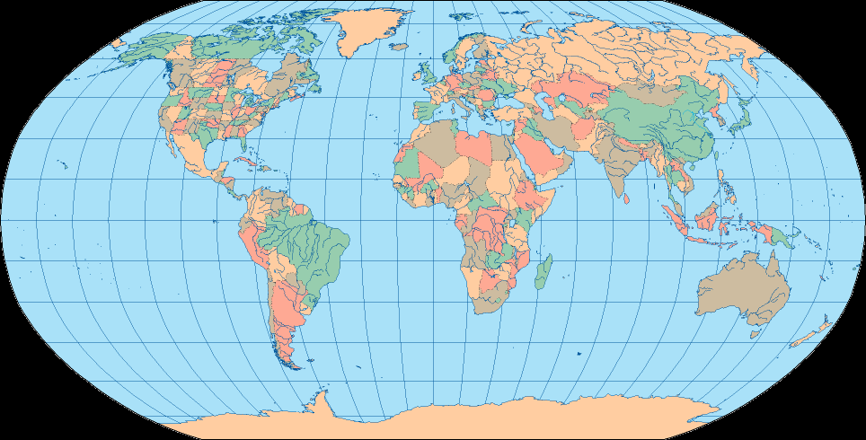
US-China Alternative Routes
Narvik, Norway
Prince Rupert, Canada
Vostochny, Russia
New York
Rotterdam, Netherlands
Norfolk
New York
Savannah
Los Angeles
Norfolk
Hong Kong, China
Savannah
Ensenada, Mexico
Colima, Mexico
Singapore

Slide 9
Competing Edges of SPB Ports
Deep-water facilities for 8,000+ container ships.
State-of-the-art on-dock facilities between ship and train.
Intermodal transfer – Ship-train-truck.
Consolidation and distribution facilities for trans-loading- from 20’ and 40’ to 56’.
The last two Characteristics of all Forecasting Techniques

Slide 10
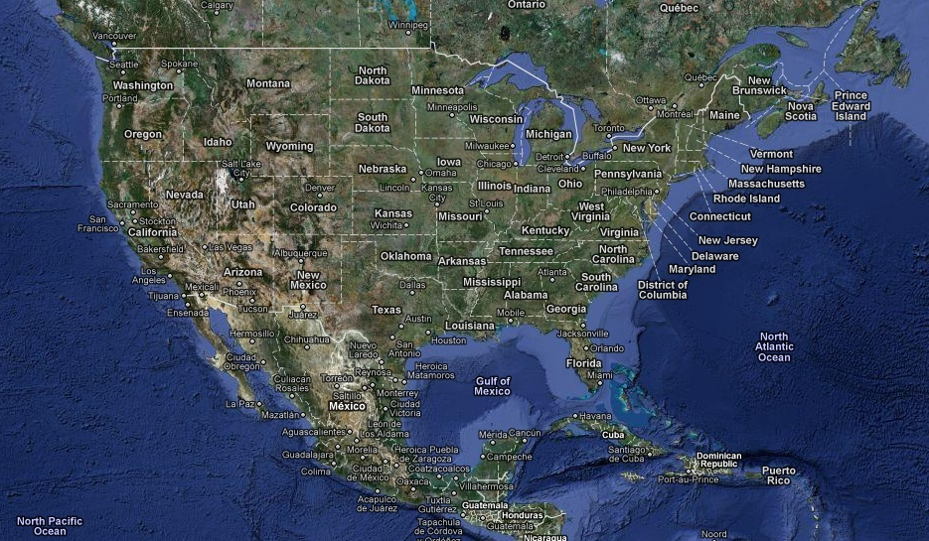
Strategic Positioning and Smooth Flow
4 Weeks
2 Weeks
3 Weeks

Slide 11
Strategic Positioning and Smooth Flow
2-3 days
3-4 days
14 days

Slide 12
Qualitative Methods - Delphi
Non-quantitative forecasting techniques based on expert opinions and intuition. Typically used when there are no data available.
Delphi Method
Subjective, judgmental
Based on intuition, estimates, and opinions
  Expert Opinions
  Market Research
  Historical Analogies

Slide 13
Time Series Forecasts
Find a relationship between demand and time.
Demand
Time

Slide 14
Components of an Observation
Observed variable (O) =
Systematic component (S) + Random component (R)
Level (current deseasonalized )
Trend (growth or decline)
Seasonality (predictable seasonal fluctuation)
Systematic component: Expected value of the variable
Random component: The part of the forecast that deviates from the systematic component
Forecast error: difference between forecast and actual demand

Slide 15
Time Series Techniques
Naive Forecast
Moving Average
Exponential Smoothing

Slide 16
Naive Forecast
We sold 250 wheels last week....
Now, next week we should sell.…
250 wheels
F_{(t+1)} = A_{t}
A_{t} : Actual demand in period t
F_{(t+1)} : Forecast of demand for period t+1
The naive forecast can also serve as an
accuracy standard for other techniques.

Slide 17
Moving Average
Three period moving average in period 7 is the average of:
MA₇³ = (A₇+ A₆+ A₅ )/3
Three period moving average in period t is the average of:
MA_{t}³ = (A_{t}+ A_{t-1}+ A_{t-2} )/3
Ten period moving average in period t is the average of:
MA_{t}¹⁰ = (A_{t}+ A_{t-1}+ A_{t-2} +A_{t-3}+ ….+ A_{t-9} )/10

Slide 18
Forecast Using Moving Average
n period moving average in period t is the average of:
MA_{t}^{n} = (A_{t}+ A_{t-1}+ A_{t-2} +A_{t-3}+ ….+ A_{t-n+1} )/n
Forecast for period t+1 is equal to moving average for period t
F_{t+1} =MA_{t}^{n}
F_{t+1} =MA_{t}^{n} = (A_{t}+ A_{t-1}+ A_{t-2} +A_{t-3}+ ….+ A_{t-n+1} )/n

Slide 19
An example for comparison of two Moving Averages
Let’s develop 3-week and 6-week moving average forecasts for demand in week 13.

Slide 20
3-Period and 6-Period Moving Average
(1300+1356+1442)/3
(1300+1356+1442+1576+1716+1832)/6

Slide 21
MAD to Compare Two or More Methods

Slide 22
How do we measure errors?
Error = At - Ft
Standard Deviation of Error = 1.25MAD
Error is assumed to be normally distributed
  A MEAN (AVERAGE) = 0
  STANDARD DEVIATION = 1.25MAD
Therefore, our forecast is also normally distributed
  A MEAN (AVERAGE) = Ft
  STANDARD DEVIATION = 1.25MAD

Slide 23
MAD for One Method
But. Compare two or more forecasting techniques only over a period when data is available for all techniques.

Slide 24
Compare Two Methods

Slide 25
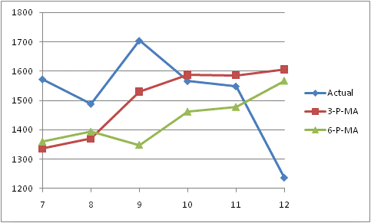
Moving Average Comparison
How many periods should we use for forecasting?
  6-week forecast is 1519 and MAD is 195
  3-week forecast is 1450 and MAD is almost 160
  3-week MAD is lower than 6-week MAD
Seems we prefer 3-week to 6-week.
So … should we use as many periods as possible?

Slide 26
Check a Second Example

Slide 27
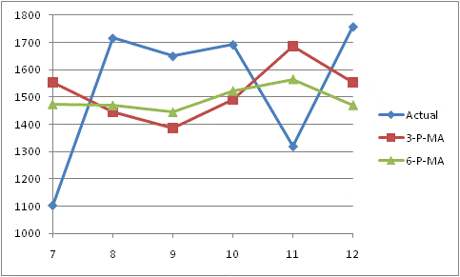
MA comparison
Note that MAD is now lower for the 6-week than for the 3-week MA.
  3-week MAD is 293
  6-week MAD is almost 254
What is going on?

Slide 28
Moving Average: Observations
A large number of periods will cause the moving average to respond slowly to changes. A smooth curve.
A small number of periods will be more reactive. Response to the most current changes.
Long term investors stay with larger number of periods. Day-trades, with smaller number of periods.
Try many different time window sizes, and choose the one with the lowest MAD.

Slide 29
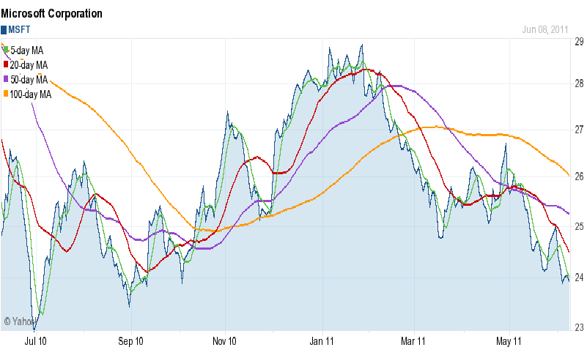
Moving Average: Microsoft

Slide 30
Tracking Signal

Slide 31
Tracking Signal
Are our observations within UCL and LCL?
Is there any systematic error?
Tracking Signal
UCL
Time
LCL

Slide 32
Tracking Signal
Tracking Signal
UCL
Time
LCL

Slide 33
Tracking Signal
Tracking Signal
UCL
Time
LCL

Slide 34
Basic Applications of MAD and TS
MAD
  To select the most appropriate forecasting method among two or more candidate methods
  To estimate the Standard Deviation of forecast
TS
  To check if TS is between ULC and LCL
  To check if TS does not show any systematic pattern
In practice UCL=5, LCL = -5

Slide 35
Chapter 7
Demand Forecasting in a Supply Chain
Predictions are usually difficult, especially about the future.
Yogi Berra
The former New York Yankees Catcher

