Slide 1
Basic Predictive Analysis
Basics of Time Series Analysis
Introduction to Forecasting & Time Series
Those who do not remember the past are condemned to repeat it
George Santayana Spanish philosopher, poet and novelist(1863-1952)

Slide 2
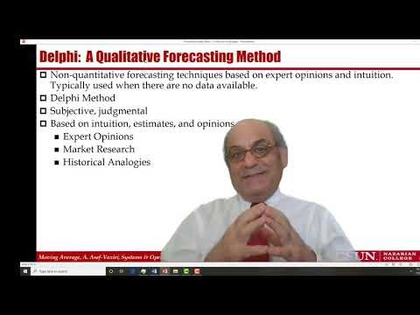

Introduction to Forecasting and Time Series

Slide 3
All Business Processes & Functions Need Forecasting
Forecast: a prediction of the future value of a variable of interest, such as demand.
Marketing, finance, and operations are the three key building blocks of manufacturing and service organizations.
They all need forecasting for planning, organizing, and budgeting.

Slide 4
Four Characteristics of All Forecasting Techniques
Forecasts are almost always inaccurate- Differ from actual.
Forecasts should be accompanied by a measure of forecast error- such as standard deviation or coefficient of variation.
Forecasts for aggregate items are more accurate than individual forecasts. Aggregate forecasts reduce the amount of variability – relative to the aggregate mean demand. Standard deviation of sum of two variables is less than sum of the standard deviation of the two variables.
Long-range forecasts are less accurate than short-range forecasts. Forecasts further into the future tends to be less accurate than those of more imminent events. As time passes, we get better information, and make better prediction.

Slide 5
World Containerized Cargo-2016

Slide 6
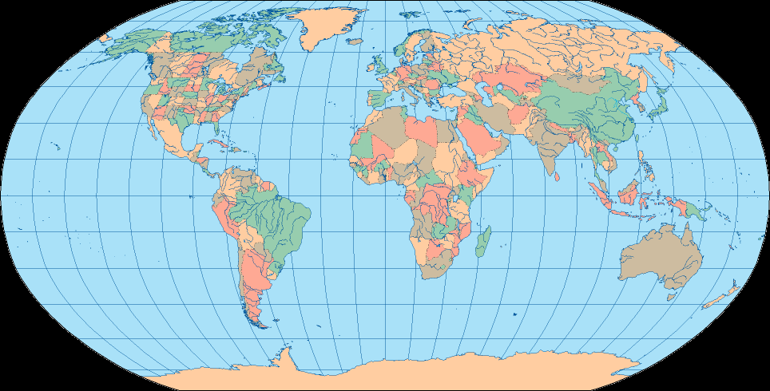
US-China Alternative Routes
Narvik, Norway
Prince Rupert, Canada
New York
Vostochny, Russia
Norfolk
Rotterdam, Netherlands
New York
Norfolk
Savannah
Los Angeles
Hong Kong, China
Savannah
Ensenada, Mexico
Colima, Mexico
Singapore

Slide 7
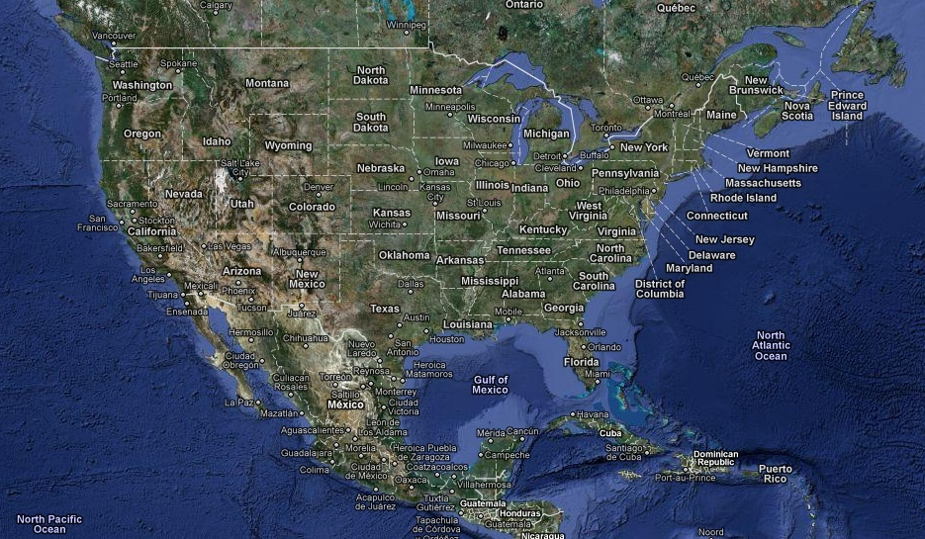
Aggregate Forecasts Are More Accurate
4 Weeks
2 Weeks
3 Weeks

Slide 8
Forecasts More into Future Are Less Accurate
2-3 days
3-4 days
14 days

Slide 9
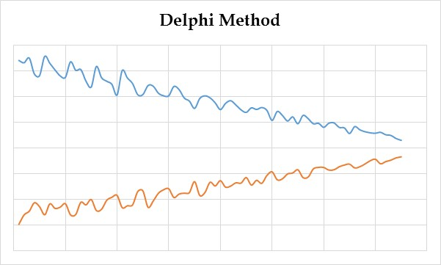
Delphi: A Qualitative Forecasting Method
Non-quantitative forecasting techniques based on expert opinions and intuition. Typically used when there are no data available.
Delphi Method
Subjective, judgmental
Based on intuition, estimates, and opinions
  Expert Opinions
  Market Research
  Historical Analogies

Slide 10
Types of Forecasting- Time Series
Quantitative Techniques
  Time Series Analysis - Analyzing the data on a variable of interest (such as sales, demand, etc.) measured at successive time periods.
    Moving Average
    Weighted Moving Average
    Exponential Smoothing
  Regression Analysis - Relating a dependent variable (demand) to other independent variables (time, price, income, etc.)
    Linear – Single-Variable or Multi-Variables
    Nonlinear - Single-Variable or Multi-Variables
    Time Series or Causal
Measures of Accuracy
  Mean Absolute Deviation (MAD)
  Mean Squared Error (MSE)
  Mean Absolute Relative Deviation (MARD) [Mean Absolute Percentage Error (MAPE)]
  Tracking Signal (TS)

Slide 11
Systematic & Random Variations - LA/LB Ports 23 Years TEUs
Time Series. A relationship between the variable of interest – demand - and time.
Systematic Components (Expected)
  Level (current deseasonalized
  Trend (growth or decline)
  Seasonality (less than one year)
  Cycles (every several years)
Random Components (Not Predictable)
Cycles
1,200
1,000
Trend
800
Seasonality
Level
600
400

