Slide 1
Descriptive Statistics
Ardavan Asef-Vaziri

Slide 2
Random Variables- Numerical, Categorical
A random Variable is an outcome of an experience!
  The number of students entering a campus coffee shop in a two minutes time interval.
  The grade of a student in a course.
Random Variables
  Numerical
  Categorical
Numerical Random Variables
  The number of students attending a specific class in a specific day.
  Number of Roast-Beef sandwiches sold in an Arby’s on Reseda.
Categorical Random Variables
  Major of a student- FIN, MKT, MGT, ACCT, SOM, etc.
  Type of a residence- APT., CONDO, TH-A, TH-D, SF, MH, etc.

Slide 3
Random Variables
A random Variable is an outcome of an experience!
  The number of students entering a campus coffee shop in a two minutes time interval.
  The grade of a student in a course.
Random Variables
  Numerical
  Categorical
Numerical Random Variables
  The number of students attending a specific class in a specific day.
  Number of Roast-Beef sandwiches sold in an Arby’s on Reseda.
Categorical Random Variables
  Major of a student- FIN, MKT, MGT, ACCT, SOM, etc.
  Type of a residence- APT., CONDO, TH-A, TH-D, SF, MH, etc.

Slide 4
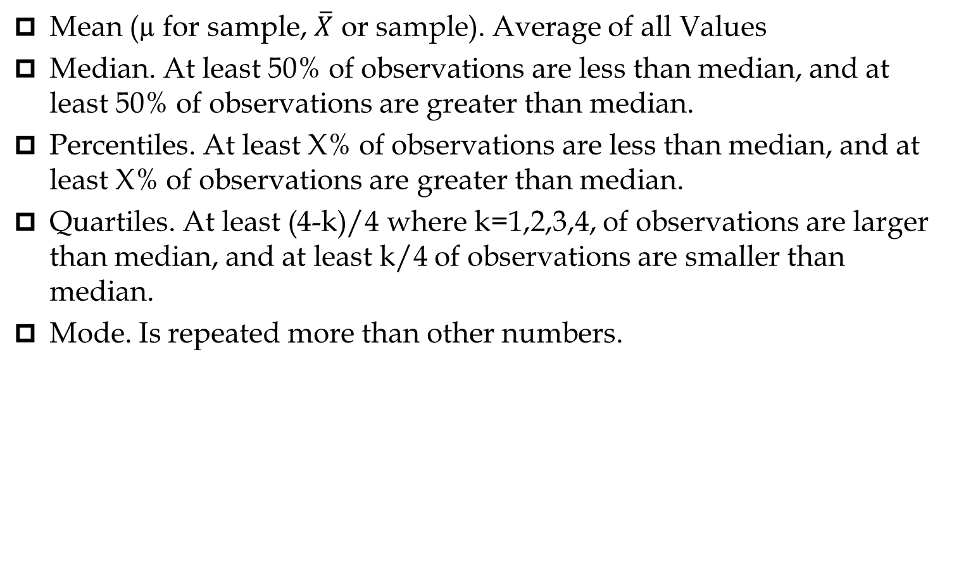
Measures of Centralization- Location
Mean (µ for sample, $\overline{X}$ or sample). Average of all Values
Median. At least 50% of observations are less than median, and at least 50% of observations are greater than median.
Percentiles. At least X% of observations are less than median, and at least X% of observations are greater than median.
Quartiles. At least (4-k)/4 where k=1,2,3,4, of observations are larger than median, and at least k/4 of observations are smaller than median.
Mode. Is repeated more than other numbers.

Slide 5
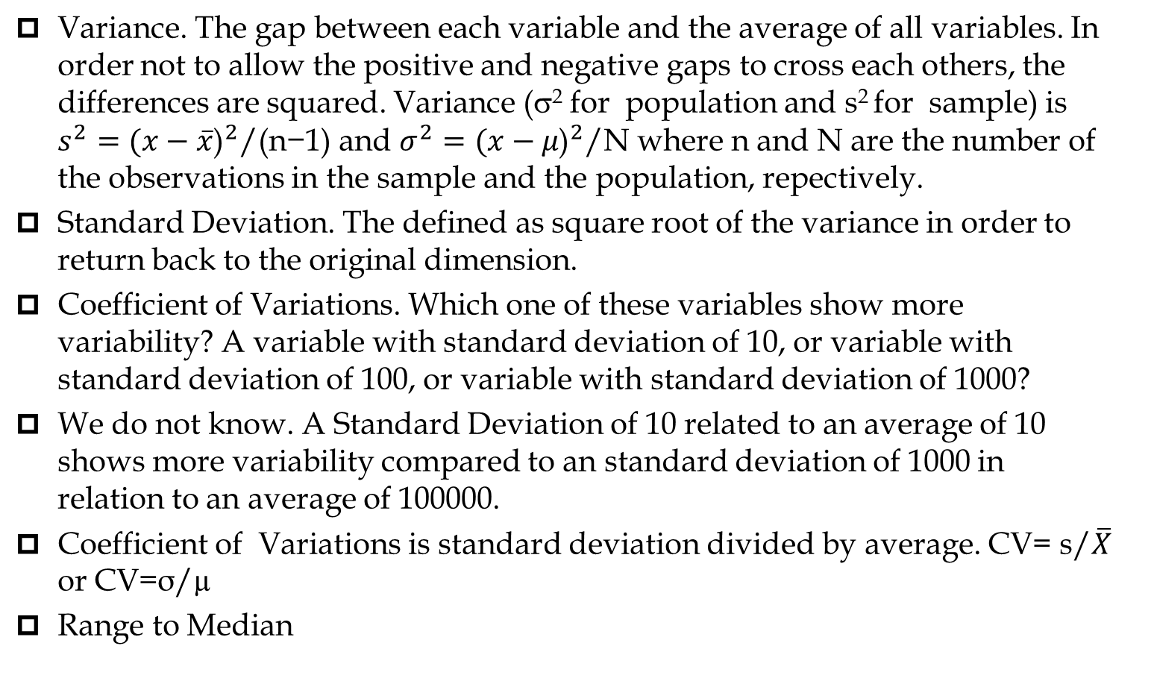
Measures of Dispersion- Variability
Variance. The gap between each variable and the average of all variables. In order not to allow the positive and negative gaps to cross each others, the differences are squared. Variance (σ² for population and s² for sample) is $s^{2}={(x−\overline{x}\text{)}}^{2}\text{/(}\text{n}\text{−1)}$ and $σ^{2}={(x−μ\text{)}}^{2}\text{/}\text{N}$ where n and N are the number of the observations in the sample and the population, repectively.
  Standard Deviation. The defined as square root of the variance in order to return back to the original dimension.
  Coefficient of Variations. Which one of these variables show more variability? A variable with standard deviation of 10, or variable with standard deviation of 100, or variable with standard deviation of 1000?
We do not know. A Standard Deviation of 10 related to an average of 10 shows more variability compared to an standard deviation of 1000 in relation to an average of 100000.
Coefficient of Variations is standard deviation divided by average. CV= s/$\overline{X}$ or CV=σ/µ
Range to Median

Slide 6
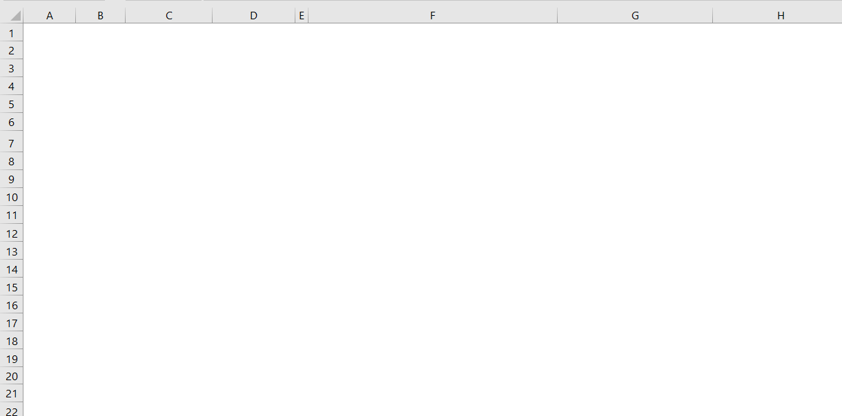
Mean and Variance

Slide 7
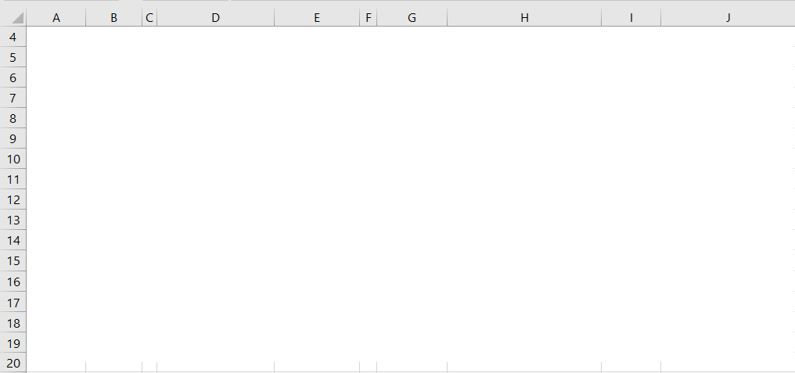
Descriptive Statistics

