Slide 1
Basic Predictive Analysis
Basics of Time Series Analysis
Measures of Forecasting Error
MAD, TS, MSE, MARD (MAPE), StdDev Forecast Problems
Predictions are usually difficult, especially about the future.
Yogi Berra The former New York Yankees Catcher

Slide 2

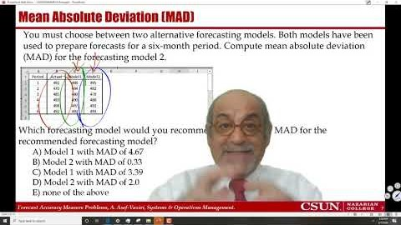
Recorded Lecture
https://youtu.be/2NJcpIBSUmc
You may put it on double speed. Slide 20 is important.

Slide 3
Bring Your Qs to Class
Please go through these slides. If you have question bring it to our class.
All the excel-sheets are active. You can double-click on them, and they get open.
You can also right click on them and open the file.
In all cases, I recommend to select all, and then paste it into a new work-sheet.
This is especially important if intend to use SOLVER.

Slide 4
Forecasting Error
Error = Deviation =Et= At-Ft ➔ E=A-F.
Absolute Deviation = Absolute Error = ABS(E) = |E|.
Mean Absolute Deviation (MAD) = AVERAGE(|E|) over the available periods.
Forecast for next period: F(t+1) = MA(t,n).
Standard Deviation of Demand = 1.25MAD ➔ What MAD? MAD(t).
Tracking Signal (TS) = SUM(E)/MAD.
Squared Error = E² = E^2.
Mean Squared Error (MSE) = AVERAGE(E^2) over the available periods.
Forecast for next period: F(t+1) = MA(t,n).
Standard Deviation of Demand = SQRT(MSE) ➔ What MSE? MSE(t).
MARD = MAPE = AVERAGE(|E|/A).
Forecast for next period: F(t+1) = MA(t,n).
CV of (|E|/A) = 1.25MAPE ➔ StdDev Forecast = 1.25MAPE*F(t+1)

Slide 5
Mean Absolute Deviation- Measure of Forecast Accuracy
MAD = Average(|A-F|)
3000
2500
2000
1500
1000
500
0
1
3
5
7
9
11

Slide 6
Mean Absolute Deviation & Tracking Signal
Compute MAD and TS at the end of period 4 for the following data,
Sum |A-F| = 15
MAD = Sum |A-F| /n =15/4 = 3.75
Sum (A-F) = 9
TS = Sum(A-F)/MAD
TS = 9/3.75 = 2.4
The sum of the forecast errors (SFE) and the mean absolute deviation (MAD) are calculated in each period. The values of SFE and MAD in the last period to be 46 and 21, respectively. Compute the tracking signal in the last period?
TS= SFE/MAD ➔ TS= 46/21= 2.2

Slide 7
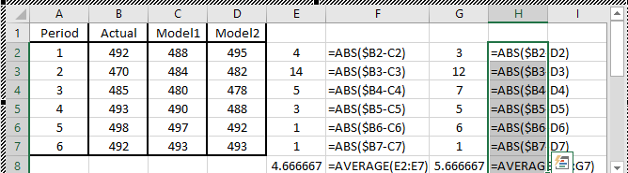
Mean Absolute Deviation (MAD)
You must choose between two alternative forecasting models. Both models have been used to prepare forecasts for a six-month period. Compute mean absolute deviation (MAD) for the forecasting model 2.
Which forecasting model would you recommend? What is the MAD for the recommended forecasting model?
  Model 1 with MAD of 4.67
  Model 2 with MAD of 0.33
  C) Model 1 with MAD of 3.39
  D) Model 2 with MAD of 2.0
  E) None of the above

Slide 8
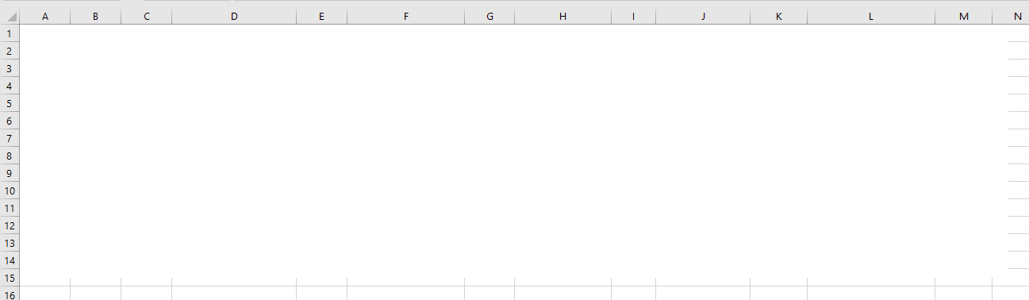
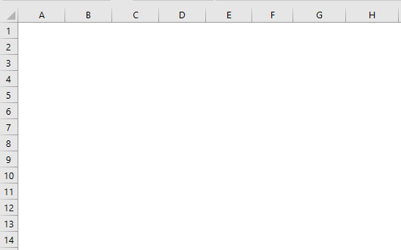
MAD & Standard Deviation of Forecast
(a) Compute 2-period and 6-period moving average forecast for all months including the next month.
(b) Compute Absolute Deviation (Error) for all months.
(c) Compute MAD for all months.
(d) Compute 2-period and 6-period moving averages. (e) Chose the preferred method. (f) Forecast using the preferred method. (g) Compute the standard deviation of the forecast using MAD.

Slide 9
Compare Two Methods- Based on MAD
Which one is a better forecasting technique?
2-period MA.
4-period MA.
8-period MA.
12-period MA.
The one with minimal MAD

Slide 10
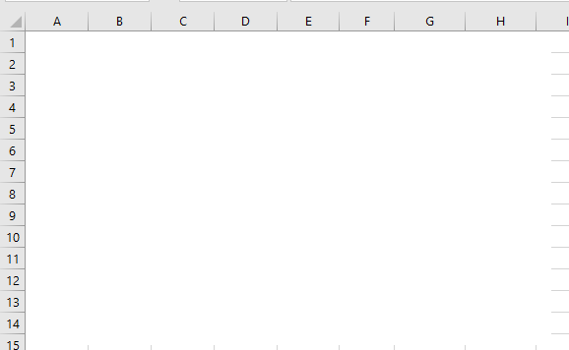
Tracking Signal
(a) Compute average and standard deviation of the forecast for the next period using 5-period moving average and MAD.
(b) Compute the Tracking Signal (TS) for all periods. TS=SUM(A-F)/MAD

Slide 11
Mean Absolute Deviation- Measure of Forecast Accuracy
MAD = Average(|A-F|)
3000
2500
2000
1500
1000
500
0
1
3
5
7
9
11

Slide 12
Mean Absolute Deviation- Measure of Forecast Accuracy
MSE = Average(A-F)²
3000
2500
2000
1500
1000
500
0
1
3
5
7
9
11

Slide 13
Mean Absolute Deviation- Measure of Forecast Accuracy
MAD vs. MES
3000
2500
2000
1500
1000
500
0
1
3
5
7
9
11

Slide 14
Mean Absolute Deviation- Measure of Forecast Accuracy
MAD vs. MES
3000
2500
2000
1500
1000
500
0
1
3
5
7
9
11

Slide 15
Mean Squared Error- Measure of Forecast Accuracy
MSE = Average((A-F)²)
2500
2000
1500
1000
500
0
1
3
5
7
9
11

Slide 16
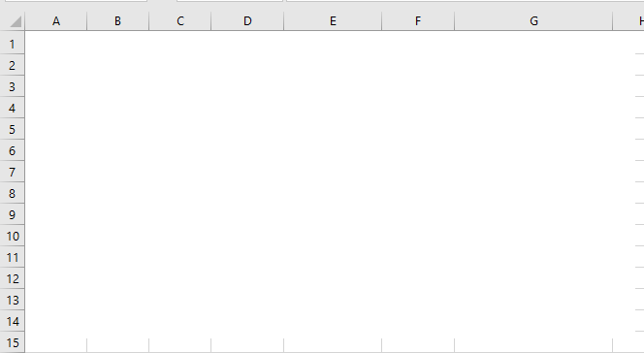
Mean Squared Error
Compute forecast for next period using 3-period moving average.
Compute the standard deviation of the forecast using MSE.

Slide 17
Mean Absolute Relative Deviation- Measure of Forecast Accuracy
MARD = Average(|A-F|/A)
3000
2500
2000
1500
1000
500
0
1
3
5
7
9
11

Slide 18
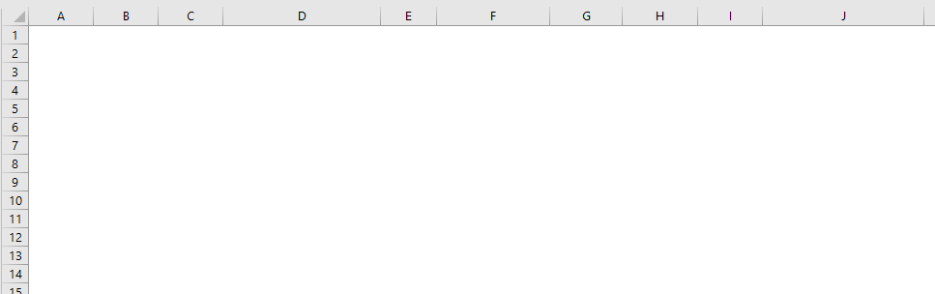
Mean Relative Absolute Deviation- MARD- MAPE
|E|= |A-E|
MAD = AVERAGE (|E|)
MARD= AVERAGE(|E|/A)
StdDev= Relative Error =1.25 MARD
Forecast for next period = ?
Standard Deviation of Forecast for next period = ?

Slide 19
Main Applications of MAD, MSE, MARD
To select the best forecasting technique based on minimal MAD, MSE, MARD.
To estimate the standard deviation of the forecast and minimize it.
If our current period is period t, our next period is period t+1. Our forecast for the next period if F(t+1). But F(t+1) is the average of demand for the next period.
Demand for the next period has Normal Distribution with the average of F(t+1) and a Standard Deviation which is computed based on MAD, MSE, or MARD in period t.
Standard Deviation of demand for t+1 is computed based on MAD, MSE, MARD in period t.
Current Period: t
Forecast for the next period: F(t+1).
Standard deviation of the forecast in period t+1:
  1.25 MAD or SQRT(MSE), or 1.25MARD*Ft in period t
  These three numbers are not equal

Slide 20
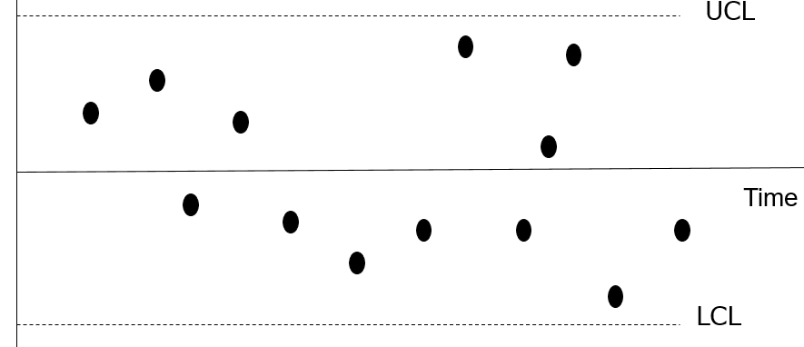
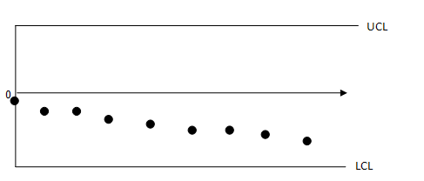
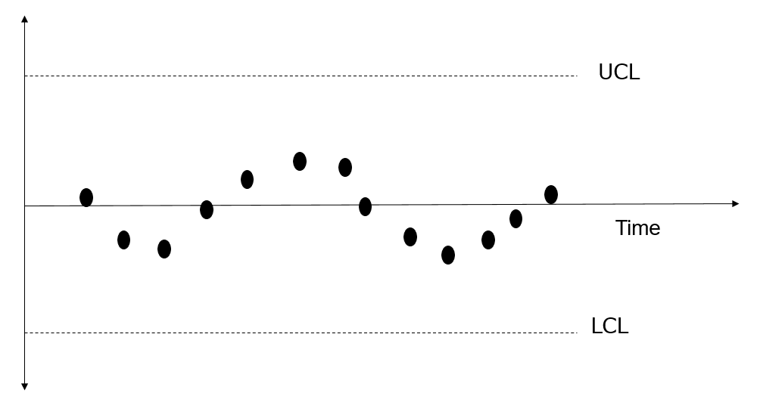
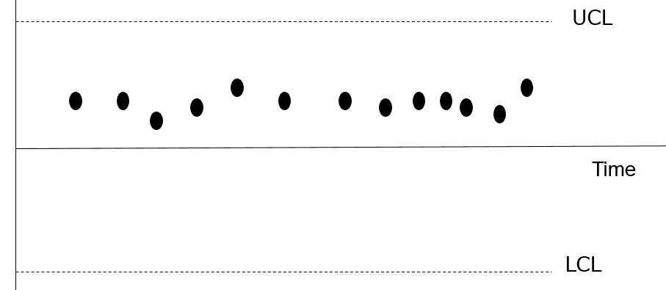
Main Applications of TS
TS = SUM(A-F)/MAD. TS has the SUM of the errors in its numerator. Therefore, we expect it to be zero or close to zero. TS needs to remain within reasonable control limits
TS should not show a pattern. If there is a pattern, that means there was a systematic component f the data, but our forecasting technique failed to recognize it.

Slide 21
MAD vs MSE: Another Example

Slide 22

Graph Showing Absolute Error – A Visualization Practice

