Slide 1
Moving Average Problems
Basic Insights

Slide 2



Slide 3
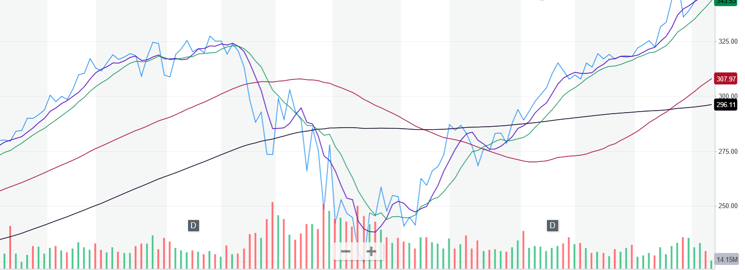
n-period - Large vs. Small
To increase the responsiveness of a forecast (i.e., respond quickly to the data changes) made using the moving average technique, should we increase or decrease the the number of periods included in the moving average?
5, 10, 50, 100 period

Slide 4
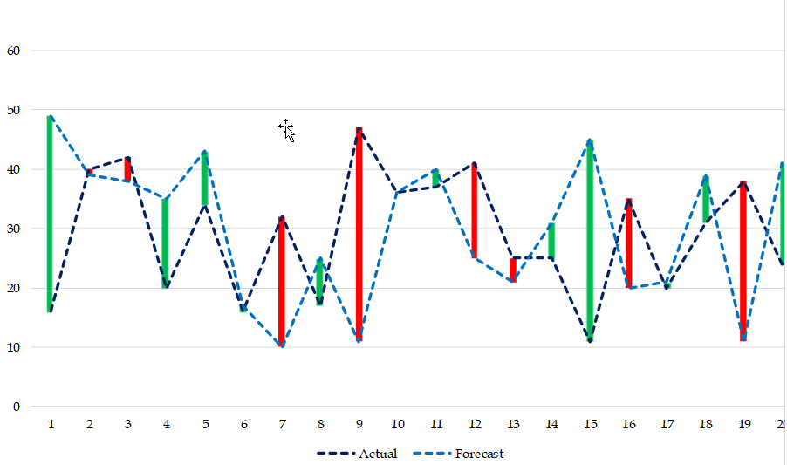
Mean Absolute Deviation- Measure of Forecast Accuracy
Dark Blue: Actual.
Light Blue: Forecast.
Vertical Gap: Error
Red: A>F
Green: F>A
In MAD we weight Red and Green equally.
But since Red means we have lost potential sales, we may assign higher weight to Red.
We treat Red and Green equally.

Slide 5


Compare Two Methods- Based on MAD
Which one is a better forecasting technique? 2-period MA, 3-period MA, 6-period MA, 12-period MA?
The one with minimal MAD.

Slide 6
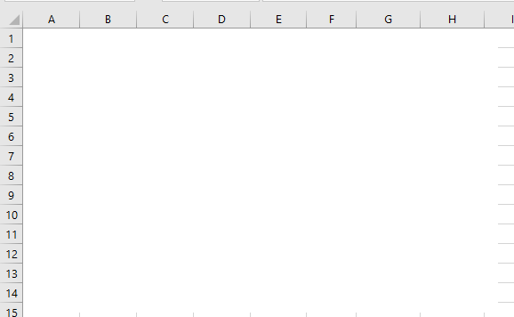
Tracking Signal
(a) Compute average and standard deviation of the forecast for the next period using 5-period moving average and MAD.
(b) Compute the Tracking Signal (TS) for all periods. TS=SUM(A-F)/MAD

Slide 7
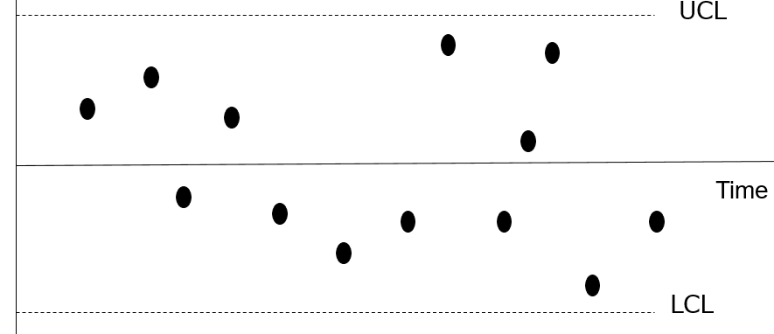
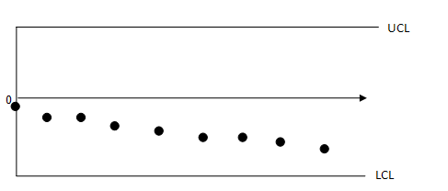
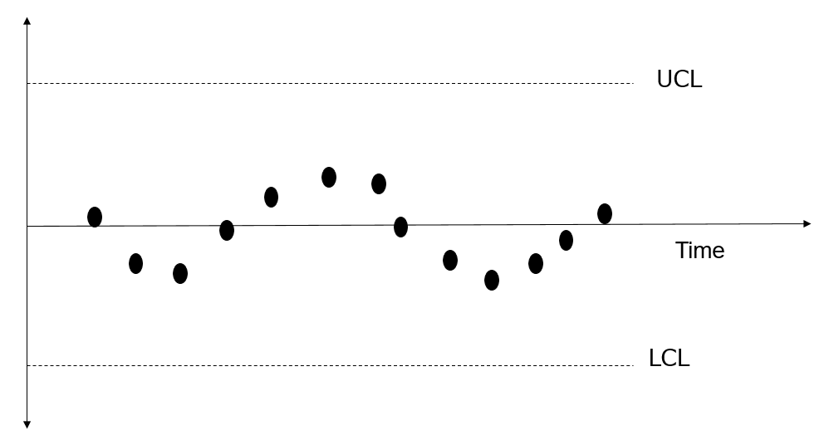
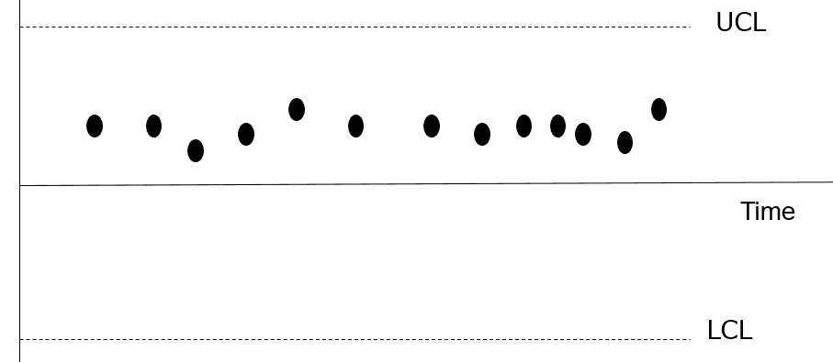
Main Applications of TS
TS = SUM(A-F)/MAD. TS has the SUM of the errors in its numerator. Therefore, we expect it to be zero or close to zero. TS needs to remain within reasonable control limits
TS should not show a pattern. If there is a pattern, that means there was a systematic component f the data, but our forecasting technique failed to recognize it.

Slide 8
Mean Absolute Deviation- Measure of Forecast Accuracy

Slide 9
Mean Squared Error Measure of Forecast Accuracy

Slide 10
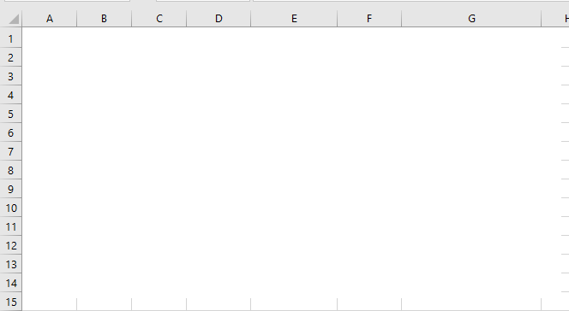
Mean Squared Error Using MSE
Compute forecast for next period using 3-period moving average.
Compute the standard deviation of the forecast using MSE.

Slide 11
Mean Absolute Relative Deviation- Measure of Forecast Accuracy
MARD = Average(|A-F|/A)
3000
2500
2000
1500
1000
500
0
1
3
5
7
9
11

Slide 12
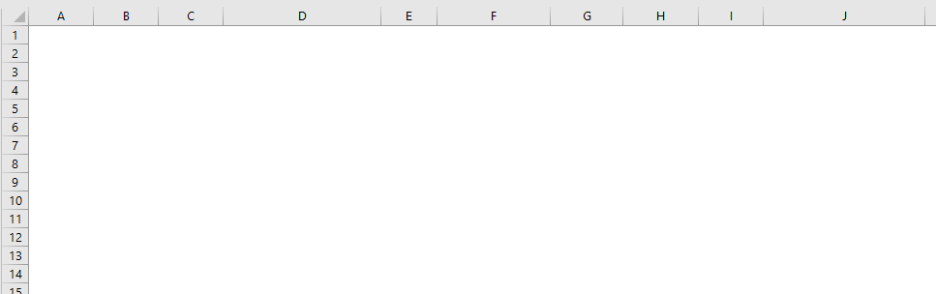
Mean Relative Absolute Deviation- MAPE
|E|= |A-E|
MAD = AVERAGE (|E|)
MAPE = AVERAGE(|E|/A)
StdDev= Relative Error =1.25 MARD
Forecast for next period = ?
Standard Deviation of Forecast for next period = ?

Slide 13
Main Applications of MAD, MSE, MARD
To select the best forecasting technique based on minimal MAD, MSE, MARD.
To estimate the standard deviation of the forecast and minimize it.
If our current period is period t, our next period is period t+1. Our forecast for the next period if F(t+1). But F(t+1) is the average of demand for the next period.
Demand for the next period has Normal Distribution with the average of F(t+1) and a Standard Deviation which is computed based on MAD, MSE, or MARD in period t.
Standard Deviation of demand for t+1 is computed based on MAD, MSE, MARD in period t.
Current Period: t
Forecast for the next period: F(t+1).
Standard deviation of the forecast in period t+1:
  1.25 MAD or SQRT(MSE), or 1.25MARD*Fnext-period
  These three numbers are not equal

Slide 14
N-Period MA to (n+1)-Period MA
The 5-period moving average in month 6 was 200 units. Actual data in month 7 is 170 units. Compute the 6 period moving average in month 7.
We could have also said
5-period moving average in month 6 is 200.
If the actual data in month 6 was 200, then 6-period moving average in month 7 was also 200.
But the actual data in month 7 is 170 which is -30 units away from 200.
The -30 unit should be broken down on 6 periods. That is -30/6 = -5
MA⁶₇ = 200 - 5 = 195
MA⁵₆ = (A6+A5+A4+A3+A2)/5
MA⁶₇ = (A7+A6+A5+A4+A3+A2)/6
MA⁵₆ = (A6+A5+A4+A3+A2)/5 = 200
A6+A5+A4+A3+A2 = 1000
A7 = 170
MA⁶₇ = (A7+A6+A5+A4+A3+A2)/6
MA⁶₇ = (170+1000)/6 = 195

Slide 15
Practice- N-Period MA to (n+1)-Period MA
The 6-period moving average in month 8 was 160 units. Actual data in month 9 is 195 units. What is 7 period moving average in month 9?
MA⁶₈=(A8+A7+A6+A5+A4+A3)/6 = 160.
A8+A7+A6+A5+A4+A3 = 6(160) = 960
MA⁷₉=(A9+A8+A7+A6+A5+A4+A3)/7 = (195+960)/7 = 1155/7 = 165.
Alternatively, we could have also said if A9 was 160, then MA⁷₉ = 160, because we can assume all the other values are 150 since their average is 150.
But the demand in month 9 is 195 units; +35 units away from 160.
In 6 period moving average this +35 difference is broken down over 7 numbers.
That is 35/7 = 5.
MA⁷₉ = 160+5 =165

Slide 16
n-period to n-period From Month t to t+1
Suppose the 5-period demand moving average in period 10 is equal to 800. The demand in period 6 is 750, and in 11 is 850. Compute 5-period moving average in period 11.
= (
+A6)/5
MA⁵₁₀ = (A10+A9+A8+A7+A6)/5 =800
MA⁵₁₀ = (A10+A9+A8+A7+A6)/5
= (
➔
+750)/5 =800
+750 =4000
➔
=3250
= (
A11+ )/5
MA⁵₁₁ = (A11+A10+A9+A8+A7)/5
MA⁵₁₁ = (A11+A10+A9+A8+A7)/5 =???
= (
850+ )/5
=
(850+3250)/5 =820
MA⁵₁₁ = (A11+A10+A9+A8+A7)/5
MA⁵₁₀ = (A10+A9+A8+A7+A6)/5 =800
MA⁵₁₁ = MA⁵₁₀ +(A11- A6)/5
MA⁵₁₁ = 800 +(850- 750) /5=820

Slide 17
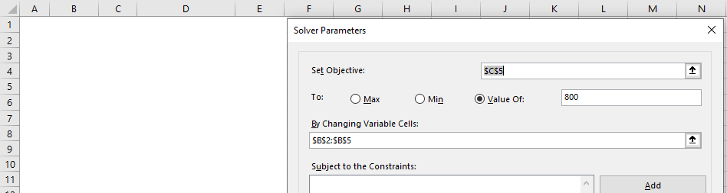
Alternative Solution
Suppose the 5-period moving average in period 10 is equal to 850. Suppose period 6 demand is 900. Also suppose the demand for period 11 is 820. Compute 5-period moving average for period 11.
If 820 was 900 then MA⁵₁₁ = MA⁵₁₀
But I is no 900, it is -80 away from 900.
That -80 is divided between 5 periods ➔ -80/5 = -16
MA⁵₁₁ = MA⁵₁₀ -16 = 850-16 = 834
Alternatively; Solver

Slide 18
Age of Data
Compute the age of data in 4-period moving average forecasts.
In a 3-period moving average forecast, the most recent piece of data belongs to the previous period. It is 1 period old. The second piece is 2 periods old, and the oldest piece is 3 periods old.
Average Age of Data = (1+2+3+4)/4 = 2.5.
However, when we have a linear trend, we can average the first and the last pieces of data.
Average Age of Data = (1+4)/2 = 2.5
We can also do the same for non-linear patterns, but the answer will be approximate (not exact).
Compute the age of data in 9-period moving average forecasts.
Average Age of Data = (1+9)/2 = 5.

Slide 19

Graph Showing Absolute Error – A Visualization Practice

Slide 20
Graph Showing Absolute Error – A Visualization Practice

Slide 21
MAD vs MSE: Another Example

