Slide 1


Basic Predictive Analysis
Basics of Time Series Analysis
Moving Average Problems
The first 11:40 mins – the first 6 slides- is on Moving Average basics.
If you have already learned the basics of Moving Average from my previous lectures, then ignore them and ONLY watch Slides 7-13 starting from minute 11:40 to the END.
That is a total of about 20 minutes.
If you need practice on basics, then you may watch from the beginning.
Those who do not remember the past are condemned to repeat it
George Santayana Spanish philosopher, poet and novelist (1863-1952)

Slide 2
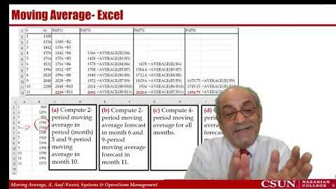

The Lecture https://youtu.be/g_lg0F_7Hmc
If You Know the Basics Start From Minute 11:40

Slide 3
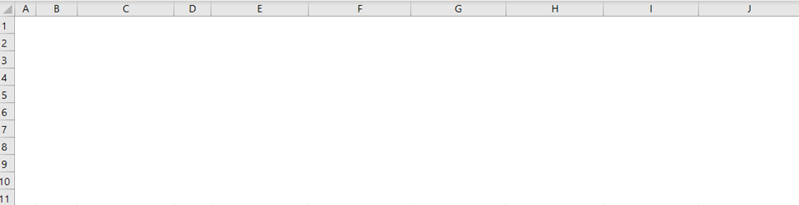
Moving Average: n-periods
The moving averages forecasting methods use the average of a set of most recent data as the forecast for the next period.
The moving averages forecasting methods are not usually used in the presence of considerable trend and seasonal patterns.
We have data for 8 periods. What is your forecast for the next period (period 9).
We can compute (i) the average all data, (ii) last period demand, the average of the (iii) last 2-periods, (vi) last 3-periods, (v) last n-periods.

Slide 4
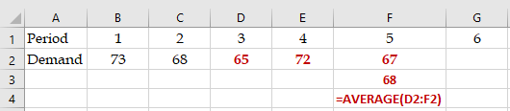
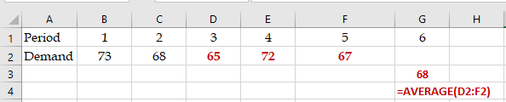
Moving Average vs. Moving Average Forecast
Given the following data,
a) Compute 3-period moving average for period 5?
Period 1 2 3 4 5
Demand 73 68 65 72 67
b) Compute 3-period moving average forecast for period 6?

Slide 5
Notations
3 period moving average in period 5: MA(5,3)
3 period moving average forecast in period 5: FMA(5,3)
n period moving average forecast in period t: FMA(t,n)
n period moving average : MA(t,n)
n period moving average forecast : Ft(np)
Naïve Forecast: Forecast for next period = Actual for this period. F(t+1) = At
3-period moving average in month t
  Ft(3p) = Average (At+A(t-1)+A(t-2))
5-period moving average
  Ft(5p) = Average (At+A(t-1)+A(t-2)+A(t-3)+A(t-4))
8-period moving average
  Ft(8p) = Average (At+A(t-1)+A(t-2)+A(t-3)+A(t-4)+A(t-5)+A(t-6)A(t-7))
For Simplicity, in many cases, we simply use At and Ft for actual and forecast values.

Slide 6
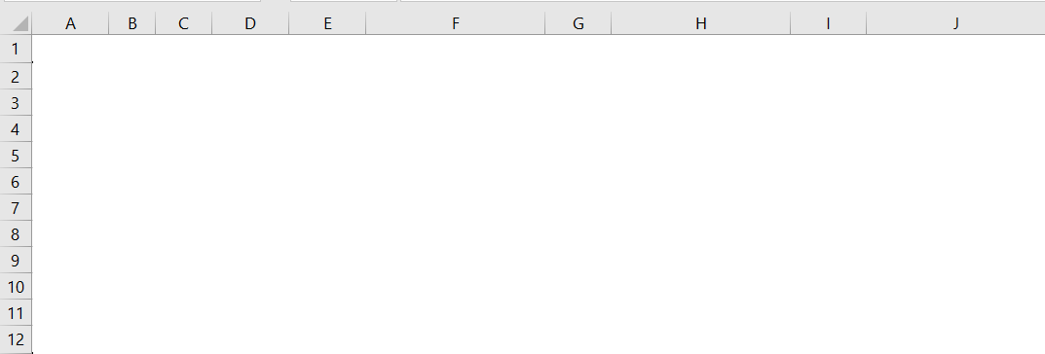
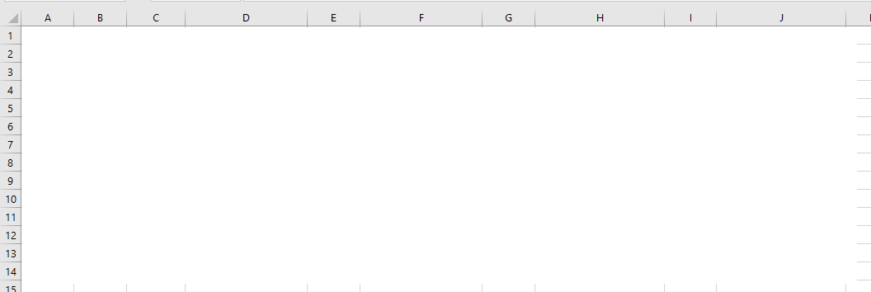
Moving Average- Excel
(a) Compute 2-period moving average in period (month) 5 and 9-period moving average in month 10.
(b) Compute 2-period moving average forecast in month 6 and 9-period moving average forecast in month 11.
(c) Compute 4-period moving average for all months.
(d) Compute 4-period moving average forecast for all months including the next month.

Slide 7
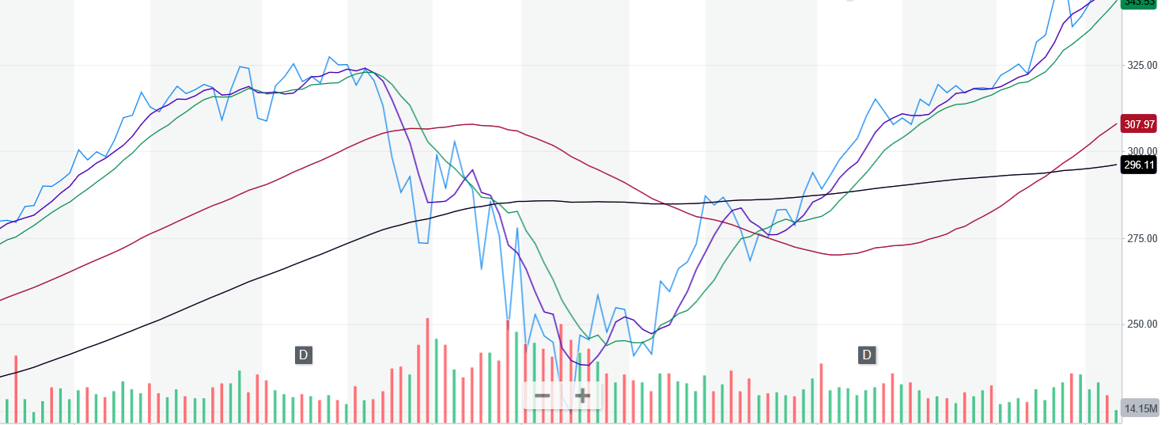
n-period - Large vs. Small
In order to increase the responsiveness of a forecast (i.e., respond quickly to the data changes) made using the moving average technique, the number of periods in the average should be:
  A) decreased
  B) increased
  C) multiplied by a larger alpha
  D) multiplied by a smaller alpha
  none of the above
AAPL: 5, 10, 50, 100

Slide 8
Age of Data
Compute the age of data in 3-period moving average forecasts.
In a 3-period moving average forecast, the most recent piece of data belongs to the previous period. It is 1 period old. The second piece is 2 periods, and the oldest piece is 3 periods old.
Average Age of Data = (1+2+3)/3 = 2.
However, when we have a linear trend, we can average the first and the last pieces of data
Average Age of Data = (1+3)/2 = 2.
We can do the same even for non-linear patterns, but the answer will be an approximate (not exact).
Compute the age of data in 7-period moving average forecasts.
Average Age of Data = (1+7)/2 = 4.

Slide 9
N-Period MA to (n+1)-Period MA
The 5-period moving average in month 6 was 150 units. Actual demand in month 7 is 180 units. What is 6 period moving average in month 7?
MA⁵₆ = (A6+A5+A4+A3+A2)/5
MA⁶₇ = (A7+A6+A5+A4+A3+A2)/6
MA⁵₆ = (A6+A5+A4+A3+A2)/5 = 150
A6+A5+A4+A3+A2 = 750
A7 = 180
MA⁶₇ = (A7+A6+A5+A4+A3+A2)/6
MA⁶₇ = (180+750)/6 = 155

Slide 10
Alternative Solution
The 5-period moving average in month 6 was 150 units. Actual demand in month 7 is 180 units. What is 6 period moving average in month 7?
We may assume that 5-period moving average was
MA⁵₆=(150+150+150+150+150)/5 = 150.
Now we have
MA⁶₇=(180+150+150+150+150+150)/6 = 155.
We could have also said suppose A7= 150+30.
If A7 was 150, then
MA⁶₇ = 150, since all the actual values are 150.
But the reality is the most current value is 30 units more than 150.
In 6 period moving average there are 6 numbers: 30/6=5.
MA⁶₇ = 150+5 =155

Slide 11
Another Example- n-period MA to (n+1)-period MA
Actual demand in month 8 is 160 units. The 4-period moving average in month 7 was 110 units. What is 5-period moving average in month 8?
  A) 100
  B) 110
  C) 120
  D) 140
  E) 150
MA⁴₇ = (A7+A6+A5+A4)/4 = 110
A7+A6+A5+A4 = 440
A8 = 160
MA⁵₈ = (A8+ A7+A6+A5+A4)/5
MA⁵₈ = (160+440)/5 = 120
Alternatively, if A7 was 110, then MA⁵₈ = 110.
But A7=110+50
We need divide 50 by 5, that is 10. MA⁵₈ =110+10 = 120

Slide 12
n-period to n-period From Month t to t+1
Suppose the 5-period moving average in period 20 is equal to 800. Suppose period 16 demand is 850. Also suppose the demand for period 21 is 900. Compute 5-period moving average for period 21.
= (
+A16)/5
MA⁵₂₀ = (A20+A19+A18+A17+A16)/5
MA⁵₂₀ = (A20+A19+A18+A17+A16)/5 =800
= (
➔
+850)/5 =800
+850 =4000
➔
=3150
MA⁵₂₁ = (A21+A20+A19+A18+A17)/5
MA⁵₂₁ = (A21+A20+A19+A18+A17)/5 =???
= (
+A21)/5
= (
+900)/5
=
(3150+900)/5 =810
MA⁵₂₁ = MA⁵₂₀ +(A21- A16)/5
MA⁵₂₁ = 800 +(900- 850) /5=810

Slide 13
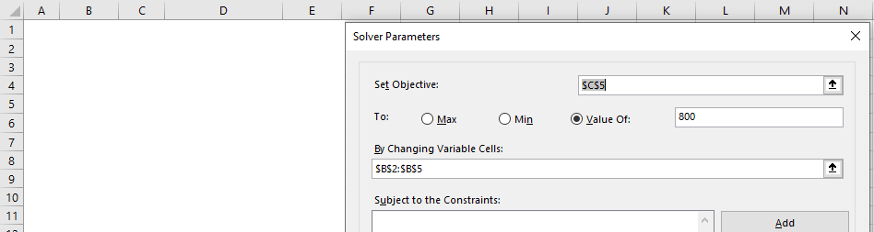
Alternative Solution
Suppose the 5-period moving average in period 20 is equal to 800. Suppose period 16 demand is 850. Also suppose the demand for period 21 is 900. Compute 5-period moving average for period 21.
MA⁵₂₀ = (A20+A19+A18+A17+A16)/5 =800
MA⁵₂₁ = (A21+A20+A19+A18+A17)/5 =???
We drop 850/5 and we add 900/5
We drop -850/5 and we add +900/5
MA⁵₂₀ = 800 -850/5 +900/5
MA⁵₂₀ = 800 +10 =810
Alternatively; Solver

