Slide 1
Waited Moving Average

Slide 2

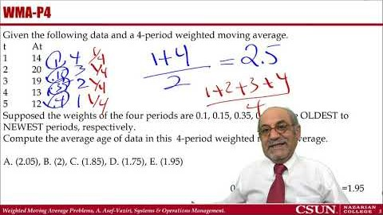
Recorded Lecture
https://youtu.be/TtS_QkhwXhs

Slide 3
WMA-1
Given the following data and a 4-period weighted moving average.
T At
1 14
2 20
3 19
4 13
5 12
Supposed the weights of the four periods are 0.1, 0.15, 0.35, 0.4 for the OLDEST to NEWEST periods, respectively.
Compute the 4-period weighted moving average in period 5
A. (15.8), B. (13.2), C. (14.2), D. (16.4), E. (16.2)
0.4*12+0.35*13+0.15*19+0.1*20

Slide 4
WMA-2
Given the following data and a 4-period weighted moving average.
T At
1 14
2 20
3 19
4 13
5 12
Supposed the weights of the four periods are 0.1, 0.15, 0.35, 0.4 for the OLDEST to NEWEST periods, respectively.
Compute the 4-period weighted moving average forecast in period 6.
A. (15.8), B. (13.2), C. (14.2), D. (16.4), E. (16.2)
0.4*12+0.35*13+0.15*19+0.1*20

Slide 5
WMA-3
Given the following data and a 4-period weighted moving average.
t At
1 14
2 20
19
13
12
Supposed the weights of the four periods are 2, 4, 6, 7 for the OLDEST to NEWEST periods, respectively.
Compute the 4-period weighted moving average in period 5.
A. (16.47), B. (16.05), C. (14.63), D. (12.95), E. (14.39)
(7/19)*12+ (6/19)* 13+ (4/19)* 19+ (2/19)* 20

Slide 6
WMA-4
Given the following data and a 4-period weighted moving average.
t At
1 14
2 20
19
13
12
Supposed the weights of the four periods are 0.1, 0.15, 0.35, 0.4 for the OLDEST to NEWEST periods, respectively.
Compute the average age of data in this 4-period weighted moving average.
A. (2.05), B. (2), C. (1.85), D. (1.75), E. (1.95)
0.4*1+0.35*2+0.15*3+0.1*4

Slide 7
WMA-5
The age of data in which of the following techniques is younger
Four period moving average
Age of data = (1+4)/2 = 2.5
B. Exponential Smoothing with alpha = 0.25
Age of data = 1/alpha = 1/0.25 = 4 periods
D. Five period weighted moving average with weights of 0.1, 0.1, 0.2, 0.2, and 0.40 for the OLDEST to NEWEST periods, respectively.
E. Five period weighted moving average with weights of 0.2, 0.2, 0.2, 0.2, and 0.2 for the OLDEST to NEWEST periods, respectively.

