Slide 1
Chapter 7
Demand Forecasting in a Supply Chain
Forecasting - 4
Trend Adjusted Exponential Smoothing
Ardavan Asef-Vaziri
References:
Supply Chain Management; Chopra and Meindl
USC Marshall School of Business Lecture Notes

Slide 2
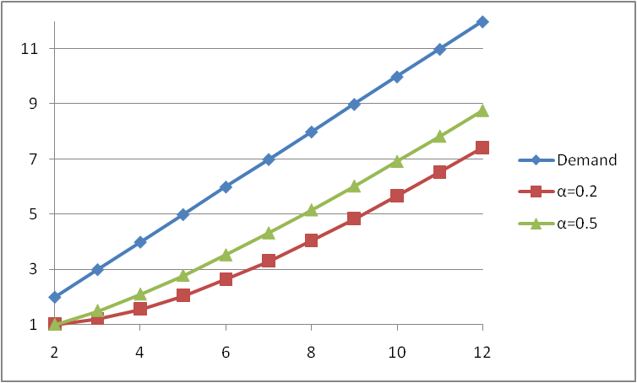
Data With Trend
Problem: Exponential smoothing (and also moving average) lags the trend.
Solution: We need a trend included forecasting method.
  Linear Regression
  Trend Adjusted (Double) exponential smoothing

Slide 3
Trend Adjusted Exponential Smoothing: Holt’s Model
Appropriate when there is a trend in the systematic component of demand.
F_{t+1} = ( L_{t} + T_{t} ) = forecast for period t+1 in period t
F_{t+l} = ( L_{t} + lT_{t} ) = forecast for period t+l in period t
L_{t} = Estimate of level at the end of period t
T_{t} = Estimate of trend at the end of period t
F_{t} = Forecast of demand for period t
A_{t} = Actual demand observed in period t

Slide 4
General Steps in adaptive Forecasting
0- Initialize: Compute initial estimates of level, L₀, trend ,T₀ using linear regression on the original set of data; L₀= b₀ , T₀ = b₁. No need to remove seasonality, because there is no seasonality.
1- Forecast: Forecast demand for period t+1 using the general equation, F_{t+1} = L_{t}+T_{t} .
2- Modify estimates: Modify the estimates of level, L_{t+1} and trend, T_{t+1}.
Repeat steps 1, 2, and 3 for each subsequent period.

Slide 5
Trend-Corrected Exponential Smoothing (Holt’s Model)
In period t, the forecast for future periods is expressed as follows
F_{t+1} = L_{t} + T_{t}
F_{t+l} = L_{t} + lT_{t}
F₁ = L₀ + T₀
What about F₂ ?
L_{t} = α A_{t} + (1-α) F_{t}
T_{t} = β ( L_{t} – L_{t-1} ) + (1-β) T_{t-1}
α = smoothing constant for level
β = smoothing constant for trend

Slide 6
Example : L0 = 100, T0 = 10, α = 0.2 and β = 0.3
L₀ = 100, T₀ = 10
F₁ = L₀ + T₀ = 100 +10 =110
A₁ =115
L_{t} = α A_{t} + (1-α) F_{t}
L₁ = 0.2 A₁ + 0.8 F₁
L₁ = 0.2 (115) + 0.8 (110) = 111
T_{t} = β ( L_{t} – L_{t-1} ) + (1-β) T_{t-1}
T₁ = 0.3( L₁ – L₀ ) + 0.7 T₀
T₁ = 0.3( 111-100 ) + 0.7 (10) = 10.3

Slide 7
Example : L0 = 100, T0 = 10, α = 0.2 and β = 0.3
L₁ = 111, T₁ = 10.3 ➔ F₂ = L₁ + T₁ = 111 +10.3 =121.3
A₂ =125
L_{t} = α A_{t} + (1-α) F_{t}
L₂ = 0.2 A₂ + 0.8 F₂
L₂ = 0.2 (125) + 0.8 (121.3) = 122
T_{t} = β ( L_{t} – L_{t-1} ) + (1-β) T_{t-1}
T₂ = 0.3( L₂ – L₁ ) + 0.7 T₁
T₂ = 0.3( 122-111 ) + 0.7(10.3) = 10.5
F₃ = L₂ + T₂ = 122 +10.5 =132.5

Slide 8
Holt’s Model Example 2
Tahoe Salt demand data. Forecast demand for period 1 using Holt’s model (trend adjusted exponential smoothing). Assume α = 0.1, β = 0.2.
Using linear regression on the original set of data,
L₀ = 12015 (linear intercept)
T₀ = 1549 (linear slope)

Slide 9
Holt’s Model Example (continued)
Forecast for period 1:
F1 = L0 + T0 = 12015 + 1549 = 13564
A1 = 8000
L1 = αA1 + (1-α)F1 = (0.1)(8000) + (0.9)(13564) = 13008
T1 = β(L1 - L0) + (1-β)T0 = (0.2)(13008 - 12015) + (0.8)(1549)
= 1438
F2 = L1 + T1 = 13008 + 1438 = 14446
A2 = 13000
L2 = αA2 + (1−α)F2 = (0.1)(13000) + (0.9)(14446) = 14301
T2 = β(L2 – L1) + (1-β)T1 = (0.2)(14301 - 13008) + (0.8)(1438)
= 1409
F3 = L2 + T2 = 14301+ 1409 = 15710

Slide 10
Holt’s Model Example (continued)
F13 = L12 + T12 = 30445 + 1542 = 31987
F18 = L12 + 5T12 = 30445 + 7710 = 38155

Slide 11
Varying Trend Example

Slide 12
Varying Trend Example

Slide 13
Double Exponential Smoothing
It is similar to single exponential smoothing.
Basic idea - introduce a trend estimator that changes over time.
If the underlying trend changes, over-shoots may happen.
Issues to choose two smoothing rates, a and β.
  β close to 1 means quicker responses to trend changes, but may over-respond to random fluctuations.
  α close to 1 means quicker responses to level changes, but again may over-respond to random fluctuations.

