Slide 1
Chapter 7
Demand Forecasting in a Supply Chain
Forecasting -2
Exponential Smoothing
Ardavan Asef-Vaziri
Based on
Operations management: Stevenson
Operations Management: Jacobs and Chase
Supply Chain Management: Chopra and Meindl
The lecurte on YouTube https://youtu.be/A1nCIgYSuw4

Slide 2
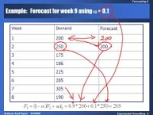

Chapter 7
Demand Forecasting in a Supply Chain
https://www.youtube.com/watch?v=A1nCIgYSuw4&t=0s

Slide 3
Time Series Methods
Moving Average
  Discard old records
  Assign same weight for recent records
Assign different weights
  Weighted moving average
Exponential Smoothing

Slide 4
Exponential Smoothing

Slide 5
Exponential Smoothing
t
At
Ft
1
100
100
2
100
3
110
α=0.2
150
Since I have no information for F1, I just enter A1 which is 100. Alternatively we may assume the average of all available data as our forecast for period 1.
A1 ⬅ F2
F3 =(1-α)F2 + α A2
F3 =0.8(100) + 0.2(150)
F3 =80 + 30 = 110
F3 =(1-α)F2 + α A2
F2 & A2 ⬅ F3
A1 ⬅ F2
A1 & A2 ⬅ F3

Slide 6
Exponential Smoothing
α=0.2
t
At
Ft
1
100
100
2
150
100
3
110
4
112
120
F4 =(1-α)F3 + α A3
F4 =0.8(110) + 0.2(120)
F4 =88 + 24 = 112
F4 =(1-α)F3 + α A3
A3 & F3 ⬅ F4
A1 & A2 ⬅ F3
A1& A2 & A3 ⬅ F4

Slide 7
Example: Forecast for week 9 using α = 0.1
Week | Demand | Forecast
1 | 200
2 | 250 | 200
3 | 175
4 | 186
5 | 225
6 | 285
7 | 305
8 | 190

Slide 8
Week 4
Week | Demand | Forecast
1 | 200
2 | 250 | 200
3 | 175 | 205
4 | 186
5 | 225
6 | 285
7 | 305
8 | 190

Slide 9
Exponential Smoothing
Week | Demand | Forecast
1 | 200
2 | 250 | 200
3 | 175 | 205
4 | 186 | 202
5 | 225 | 200
6 | 285 | 203
7 | 305 | 211
8 | 190 | 220

Slide 10
Two important questions
How to choose α? Large α or Small α
  When does it work?
  When does it not?
What is better exponential smoothing
OR moving average?

Slide 11
The Same Example: α = 0.4
Week | Demand | Forecast
1 | 200
2 | 250 | 200
3 | 175 | 220
4 | 186 | 202
5 | 225 | 196
6 | 285 | 207
7 | 305 | 238
8 | 190 | 265

Slide 12
Comparison

Slide 13
Comparison
As α becomes larger, the predicted values exhibit more variation, because they are more responsive to the demand in the previous period.
  A large α seems to track the series better.
  Value of stability
This parallels our observation regarding MA: there is a trade-off between responsiveness and smoothing out demand fluctuations.

Slide 14
Comparison
Week | Demand | Forecast for 0.1 alpha | AD | Forecast for 0.4 alpha | AD
1 | 200
2 | 250 | 200.00 | 50.00 | 200.00 | 50.00
3 | 175 | 205.00 | 30.00 | 220.00 | 45.00
4 | 186 | 202.00 | 16.00 | 202.00 | 16.00
5 | 225 | 200.40 | 24.60 | 195.60 | 29.40
6 | 285 | 202.86 | 82.14 | 207.36 | 77.64
7 | 305 | 211.07 | 93.93 | 238.42 | 66.58
8 | 190 | 220.47 | 30.47 | 265.05 | 75.05
 |  |  | 46.73 |  | 51.38
Choose the forecast with lower MAD.

Slide 15
Which α to choose?
In general want to calculate MAD for many different values of α and choose the one with the lowest MAD.
Same idea to determine if Exponential Smoothing or Moving Average is preferred.
Note that one advantage of exponential smoothing requires less data storage to implement.

Slide 16
All Pieces of Data are Taken into Account in ES
F_{t} = a A_{t–1} + (1 – a) F_{t–1}
F_{t–1} = a A_{t–2} + (1 – a) F_{t–2}
F_{t} = aA_{t–1}+(1–a)aA_{t–2}+(1–a)²F_{t–2}
F_{t–2} = a A_{t–3} + (1 – a) F_{t–3}
F_{t} = aA_{t–1}+(1–a)aA_{t–2}+(1–a)²a A_{t–3} + (1 – a) ³ F_{t–3}
= aA_{t–1}+(1–a)aA_{t–2}+(1–a)²aA_{t–3} +(1–a)³aA_{t–4}
+(1–a)⁴aA_{t–5}+(1–a)⁵aA_{t–6} +(1–a)⁶aA_{t–7}+…
A large number of data are taken into account– All data are taken into account in ES.

Slide 17
What is better? Exponential Smoothing or Moving Average
Age of data in moving average is (1+ n)/2 .
Age of data in exponential smoothing is about 1/ α.
(1+n)/2 = 1/ α ⎝ α = 2/(n+1)
If we set α = 2/(n +1) , then moving average and exponential smoothing are approximately equivalent.
  It does not mean that the two models have the same forecasts.
  The variances of the errors are identical.

Slide 18
Compute MAD & TS

Slide 19
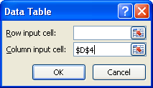
Data Table Excel
Data, what if, Data table
This is a one variable Data Table
Min, conditional formatting

Slide 20
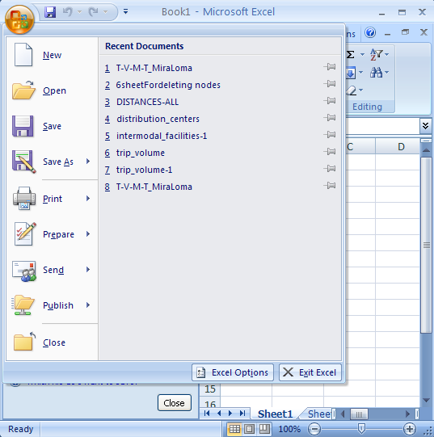
Office Button

Slide 21
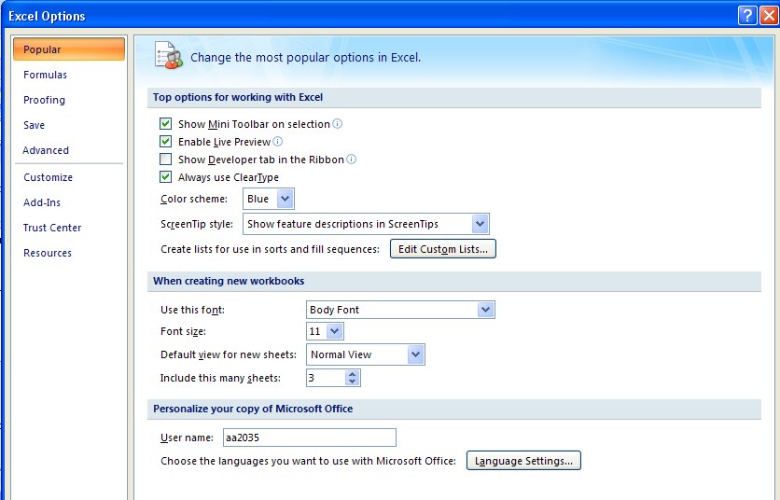
Add-Inns

Slide 22
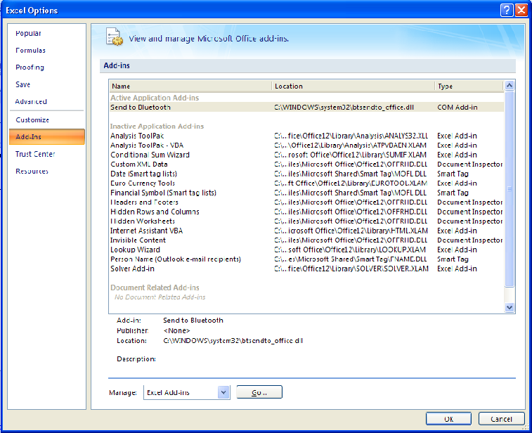
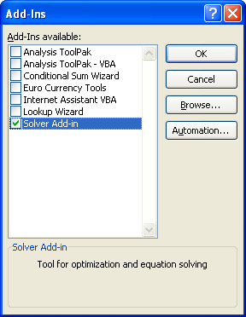
Not OK, but GO, then Check Mark Solver

Slide 23
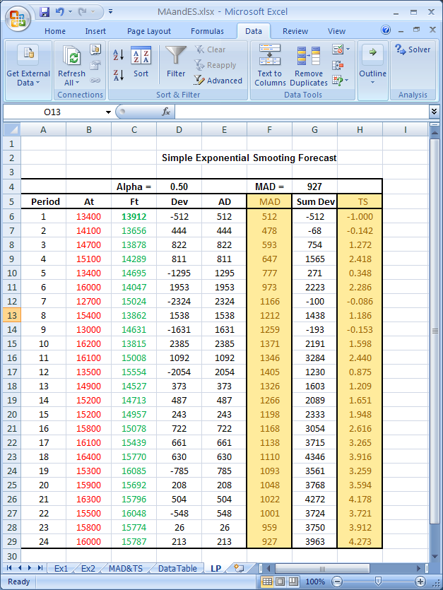
Data Tab/ Solver

Slide 24
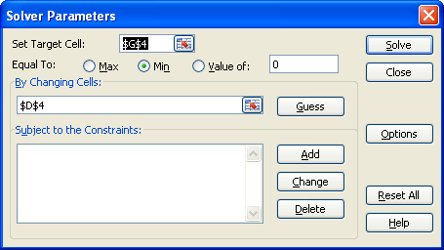
Target Cell/Changing Cells

Slide 25

Optimal α Minimal MAD

Slide 26
NOTE – The following pages are not recorded
Note: The following discussion – from the next page up to the end of this set of slides – are not recorded.

Slide 27
Measures of Forecast Error; Additional Indices
Error: difference between predicted value and actual value (E)
Mean Absolute Deviation (MAD)
Tracking Signal (TS)
Mean Square Error (MSE)
Mean Absolute Percentage Error (MAPE)

Slide 28
Measures of Forecast Error

