Slide 1


Basic Predictive Analysis
Basics of Time Series Analysis
Exponential Smoothing Problems
The first 11 mins – the first 6 slides- is on Exponential Smoothing basics.
If you have already learned the basics of Exponential Smoothing from my previous lectures, then ignore them and ONLY watch Slides 7-11 from minute 11 to the END.
If you need practice on basics, then you may watch from the beginning.
If you can look into the seeds of time, and say which grain will grow and which will not
speak then unto me.
William Shakespeare, 1564-1616.

Slide 2


The Lecture https://youtu.be/1J6ysRf75K0
The Lecture https://youtu.be/g_lg0F_7Hmc

Slide 3
Exponential Smoothing- Two Formulas That are the same

Slide 4
From This Period to the Next Period
1. Given an actual demand of 60 for a period when forecast of 70 was anticipated, and an alpha of 0.3, what would the forecast for the next period be using simple exponential smoothing?
F = (1-0.3)(70)+0.3(60) = 67
2. You have been asked to forecast demand for a product using an exponential smoothing. The actual demand and forecast for year 2019 where 850 and 910, respectively. Compute the demand forecast for 2020 using a smoothing constant of 0.3.
  F = (1-0.3)(910)+0.3(850) = 892
3. Given the following demand. What is your forecast for period 4 using exponential smoothing and α=0.5? 1:(300), 2:(500), 3:(600).
F_{t+1} = (1-α)F_{t}+ α(A_{t})
F_{t+1} = (1-0.5)F_{t}+ 0.5(A_{t})
F_{t+1} = (1/2) F_{t}+ (1/2) (A_{t})
F_{t+1} = (F_{t}+A_{t})/2
F₃ = (F₂+A₂)/2
F₃ = (300+500)/2= 400
F₄ = (F₃+A₃)/2 = (400+600)/2 = 500

Slide 5
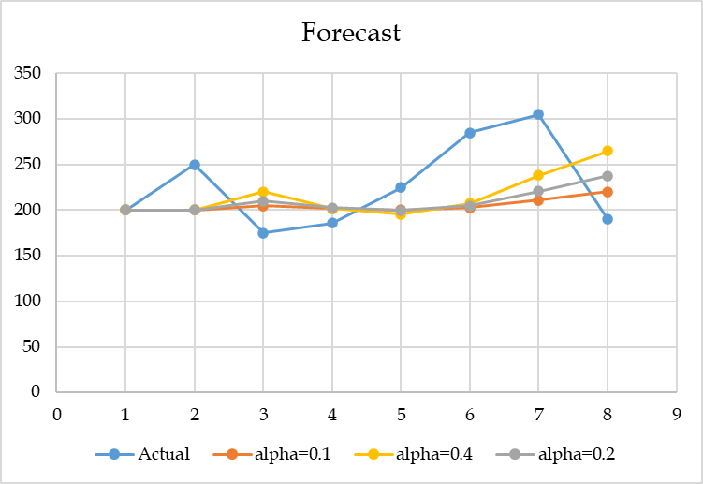

α: Large or Small, 0.1, 0.2, 0.4
4. Is large α better or small α?
We do not know. It depends on data.
The best α is the one that minimizes our metric which may be MAD or MSE or MARD.

Slide 6

MAD in Excel
5. The president of State University wants to forecast student enrollments for the next academic year based on the following historical data for the past 5 years. What is your forecast for next year using exponential smoothing with α = 0.4?

Slide 7
Role of α
6. A forecast based on the previous forecast plus a percentage of the forecast error is:
  A) a naive forecast
  B) a simple moving average forecast
  C) a centered moving average forecast
  D) an exponentially smoothed forecast
  E) an associative forecast
7. In exponential smoothing forecasting, using large values of the smoothing coefficient α generates forecasts that are more:
  A) accurate
  B) responsive
  C) random
  D) stable
  E) level
F_{t+1} = (1-α)F_{t}+ α(A_{t})
F_{t+1} = F_{t}+ α(A_{t}-F_{t} )
F_{t+1} = (1-α)F_{t}+ α(A_{t})

Slide 8
Meaning of α - From Naïve to No Change
8. For what value of α, exponential smoothing becomes naïve method (F_{t+1} = A_{t})?
  A) α =0
  B) α =0.25
  C) α =0.5
  D) α =0.75
  E) α =1
9. For what value of α, exponential smoothing becomes a straight line?
  A) α =0
  B) α =0.25
  C) α =0.5
  D) α =0.75
  E) α =1
F_{t+1} = (1-α)F_{t}+ α(A_{t})
F_{t+1} = (A_{t})
F_{t+1} = (1-1)F_{t}+ 1(A_{t})
F_{t+1} = (1-α)F_{t}+ α(A_{t})
F_{t+1} = F_{t}
F_{t+1} = (1-0)F_{t}+ 0(A_{t})

Slide 9
Change Alpha Value from 1 to 0 by 0.1 steps

Slide 10
Finding α
10. Exponential smoothing is being used to forecast demand. The current forecast of 66 was 5 units larger than actual demand. The next forecast is 65. Compute α?
F_{(t+1)} = F_{t} + α (A_{t}-F_{t})
65
66
+5
- 5
65 = 66 + α (-5)
5 α = 1
α = 0.2
11. It can be mathematically proved that the Age of data in exponential smoothing is 1/α . The larger the α, the larger the number of periods in the moving average. True or false? Why?
False
α = 0.5 ➔ age of data is 2 periods.
α = 0.2 ➔ age of data is 5 periods.
α = 0.1 ➔ age of data is 10 periods.

Slide 11
Age of Data
12. Given a forecast using a 6-period moving average. What is the average age of data?
The last piece (newest piece) of data is only 1 period old.
The first piece (oldest piece) of data in a 6-period moving average is 6 periods old.
The average age of data is (1+6)/2 = 3.5
13. If the age of data in exponential smoothing is 1/ α, for what value of α, exponential smoothing performs close to a 6-period moving average?
The age of data in a 6-period moving average is 3.5.
The age of data in exponential smoothing is 1/ α.
1/ α = 3.5
α = 1/3.5
α = 0.29

