Slide 1
SOLVER and Data Analysis Add-Ins

Slide 2
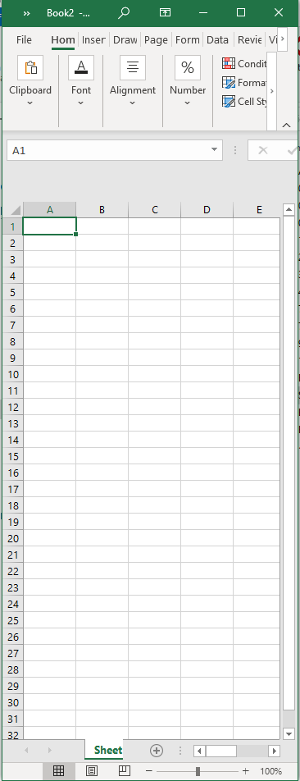
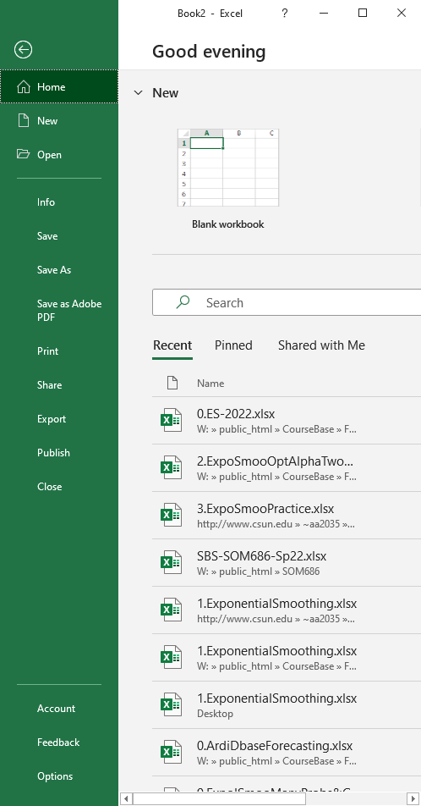
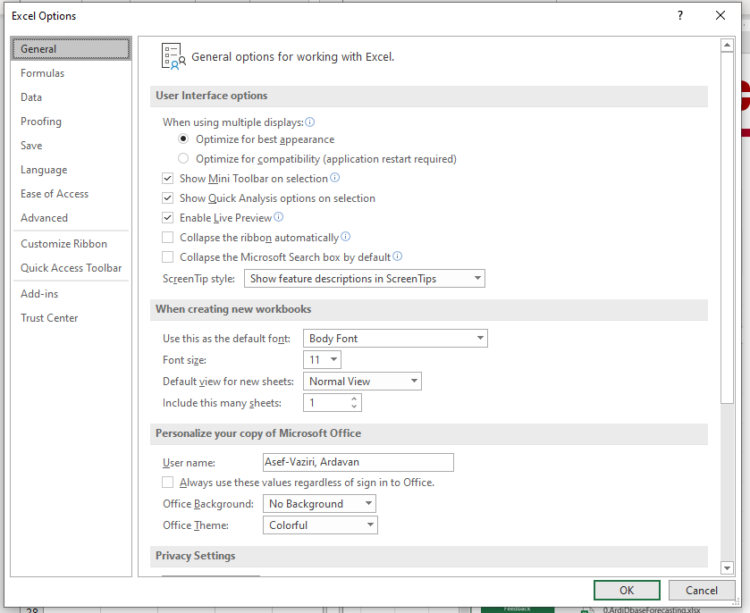
Not OK, but GO, then Check Mark Solver
File
Options

Slide 3
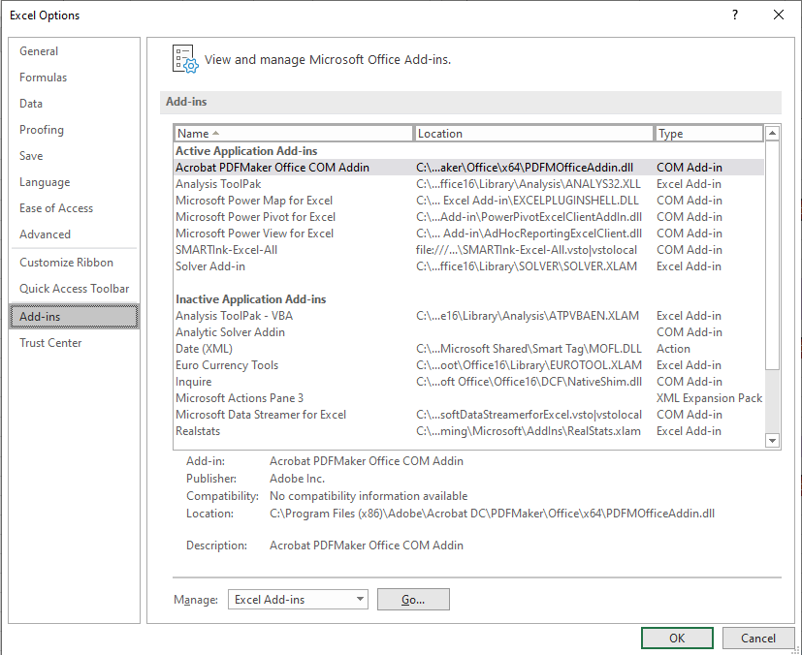
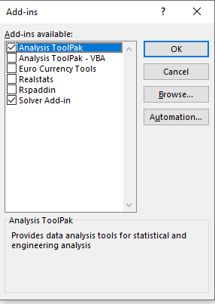
Not OK, but GO, then Check Mark Solver
For Mac. Go to the Tools menu, select "Add-ins"
Check "Solver Add-in" and "Analysis ToolPak" then click OK

